Slide 1

CPSC 871
John D. McGregor
Module 6 Session 3
System of Systems

Slide 2
Definition
System of Systems (SoS): any system that is a relatively large and complex, dynamically evolving, and physically distributed system of pre-existing, heterogeneous, autonomous, and independently governed systems, whereby the system of systems exhibits significant amounts of unexpected emergent behavior and characteristics
A system of systems is owned and evolved by different organizations.
Constituents of a system of systems are at different points in their life cycles.

Slide 3
Examples
Phone system
Electric grid
Automobile
Airport

Slide 4
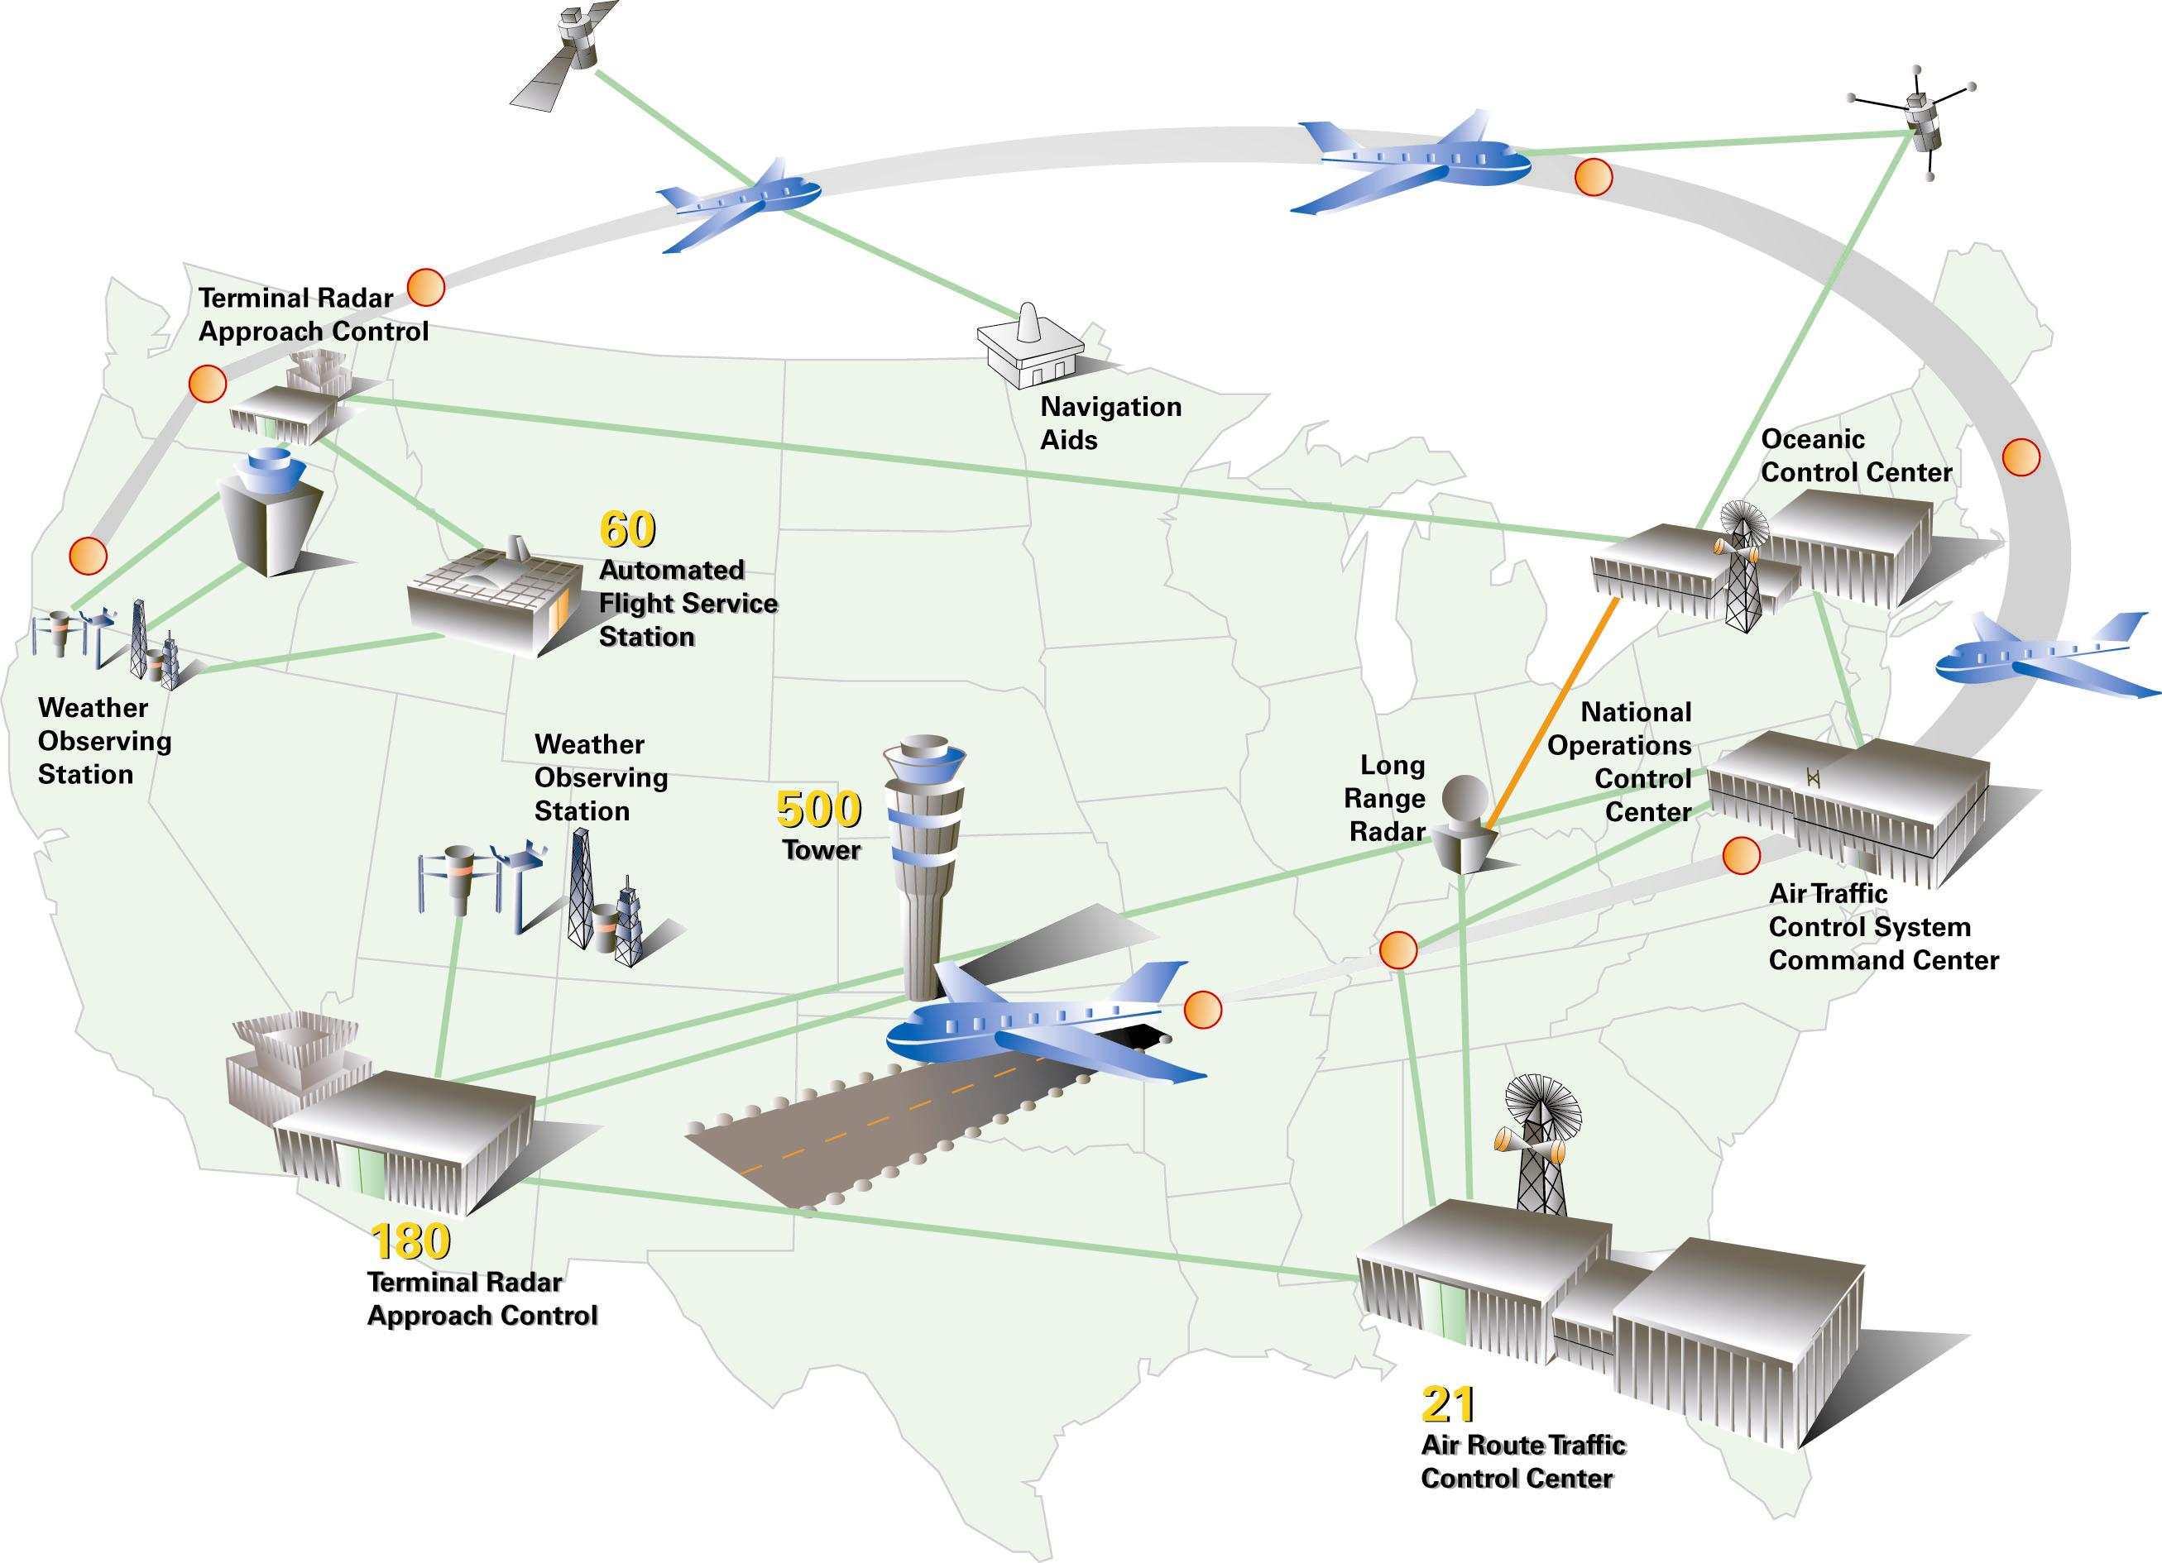
Airspace

Slide 5
Characteristics
Operational Independence of Elements
Managerial Independence of Elements
Evolutionary Development
Emergent Behavior
Geographical Distribution of Elements
Inter-disciplinary Study
Heterogeneity of Systems
Networks of Systems

Slide 6
Characteristics
scale—increases the flexibility required of system-of-systems constituents while increasing the constraints imposed on the engineered solution
multi-domain—constituents from different domains may belong to different domains and a capability may be used in different domains
varied operational context—users operating with different workflows and under different business processes may use the same capability
decentralized control—a system of systems has more than one decision-making authority
rapidly evolving contexts—changes in technology, unpredictable user demands, and other modifications ripple through a system of systems
continuous and often disconnected execution of multiple life-cycle phases—constituents often are in different phases of their life cycles and those life cycles may differ from one another
opportunistic needs to collaborate and integrate—new demands create new opportunities that require more adaptation by constituents and the system of systems

Slide 7
What makes a SoS different
operational independence of the systems - Each system within a system of systems has a “life of its own” and can function acceptably and provide useful service without necessarily interacting with other systems.
managerial independence of the systems - The individual systems within a system of systems are under different authorities. For exam-ple, within the U.S. Department of Defense (DoD) different service branches will own different systems in the context of a system of systems.
evolutionary development - The different systems within the system of systems are developed and upgraded on uncoordinated schedules. While current policies can coordinate the schedules for a relatively limited number of systems within a system of systems, it is unlikely that such a policy can scale to a size of the Global Information Grid (GIG).

Slide 8
Types of SoS
Virtual. Virtual SoS lack a central management authority and a centrally agreed upon purpose for the system-of-systems. Large-scale behavior emerges—and may be desirable—but this type of SoS must rely upon relatively invisible mechanisms to maintain it.
Collaborative. In collaborative SoS the component systems interact more or less voluntarily to fulfill agreed upon central purposes. The Internet is a collaborative system. The Internet Engineering Task Force works out standards but has no power to enforce them. The central players collectively decide how to provide or deny service, thereby providing some means of enforcing and maintaining standards.
Acknowledged. Acknowledged SoS have recognized objectives, a designated manager, and resources for the SoS; however, the constituent systems retain their independent ownership, objectives, funding, and development and sustainment approaches. Changes in the systems are based on collaboration between the SoS and the system.
Directed. Directed SoS are those in which the integrated system-of-systems is built and managed to fulfill specific purposes. It is centrally managed during long-term operation to continue to fulfill those purposes as well as any new ones the system owners might wish to address. The component systems maintain an ability to operate independently, but their normal operational mode is subordinated to the central managed purpose.

Slide 9
Compared to an SOA
collaboration and authority
motivation and accountability
multiple models
expectation of evolution
highly fluid processes
minimal centrality

Slide 10
The U.S. Department of Defense (DoD) System Engineering Guide for System-of-Systems Engineering (Version 1, August 2008) defines four types of systems of systems, directed, acknowledged, collaborative, and virtual.*

Slide 11
Evolution
Two forms of evolution must be considered within a system of systems:
  (1) evolution of the components and
  (2) evolution of the system of systems itself.
At a minimum, governance for evolution should include rules and guidelines for
  informing other components systems (when known) of the changes in the interfaces to and functionality of one system
  coordinating schedules with other component systems so that those that have to change can do so together (when backward compatibility of interfaces cannot be maintained)
  maintaining multiple versions of the system when schedules cannot be coordinated
  developing each system to insulate it from changes in other component systems
  minimizing the perturbations to interfaces when changing a system

Slide 12
DoD SE Guide
“The SoS architecture provides an integrated view of the ensemble of systems within the SoS. The development of the architecture of an SoS is an important core element for SoS SE because it frames and supports design changes to the SoS over time.”

Slide 13
SoS systems engineers must be able to function in an environment where the SoS manager does not control all of the systems that impact the SoS capabilities and stakeholders have interests beyond the SoS objectives.
SoS SE must balance SoS needs with individual system needs.
SoS SE planning and implementation must consider and leverage the development plans of the individual systems.
SoS SE must address the end-to-end behavior of the ensemble of systems, addressing the key issues which affect that behavior.

Slide 14
Core Elements of SoS SE
Translating SoS Capability Objectives into High-Level SoS Requirements over Time
Understanding the Constituent Systems and Their Relationships over Time
Assessing Extent to Which SoS Performance Meets Capability Objectives over Time
Developing, Evolving and Maintaining an Architecture for the SoS2
Monitoring and Assessing Potential Impacts of Changes on SoS Performance
Addressing SoS Requirements and Solution Options
Orchestrating Upgrades to SoS

Slide 15
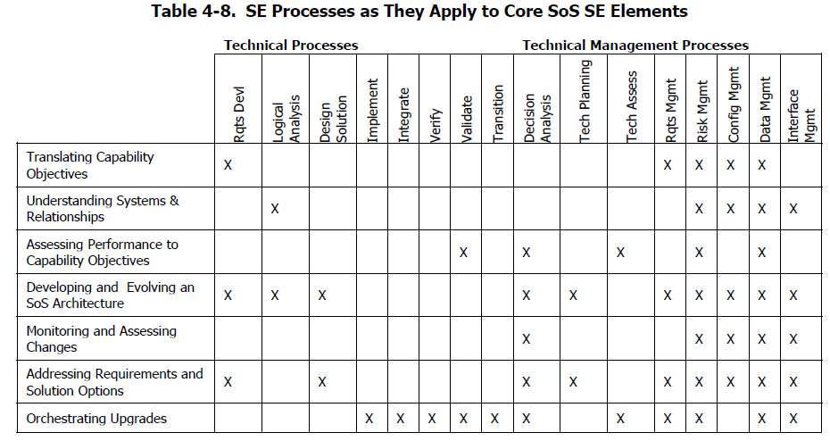
SoS SE Elements

Slide 16
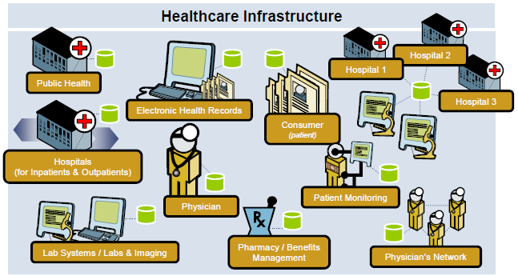
Ultra-Large Scale Systems
http://www.sei.cmu.edu/library/abstracts/presentations/icgse06.cfm

Slide 17
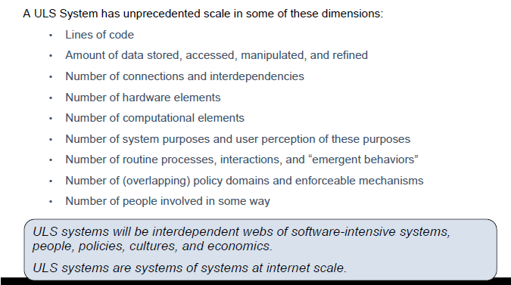
Ultra-Large Scale Systems
http://www.sei.cmu.edu/uls/

Slide 18
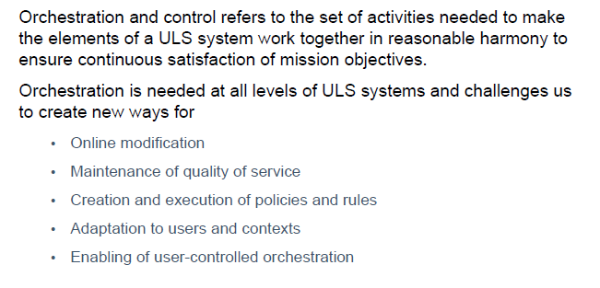
Ultra-large Scale Systems
The SE plays a central role in orchestration and control

Slide 19
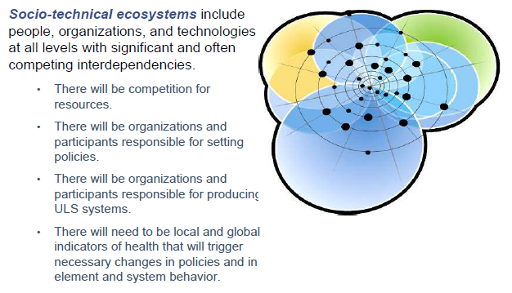
Ecosystems
http://www.sei.cmu.edu/library/assets/ICGSE06.pdf

Slide 20
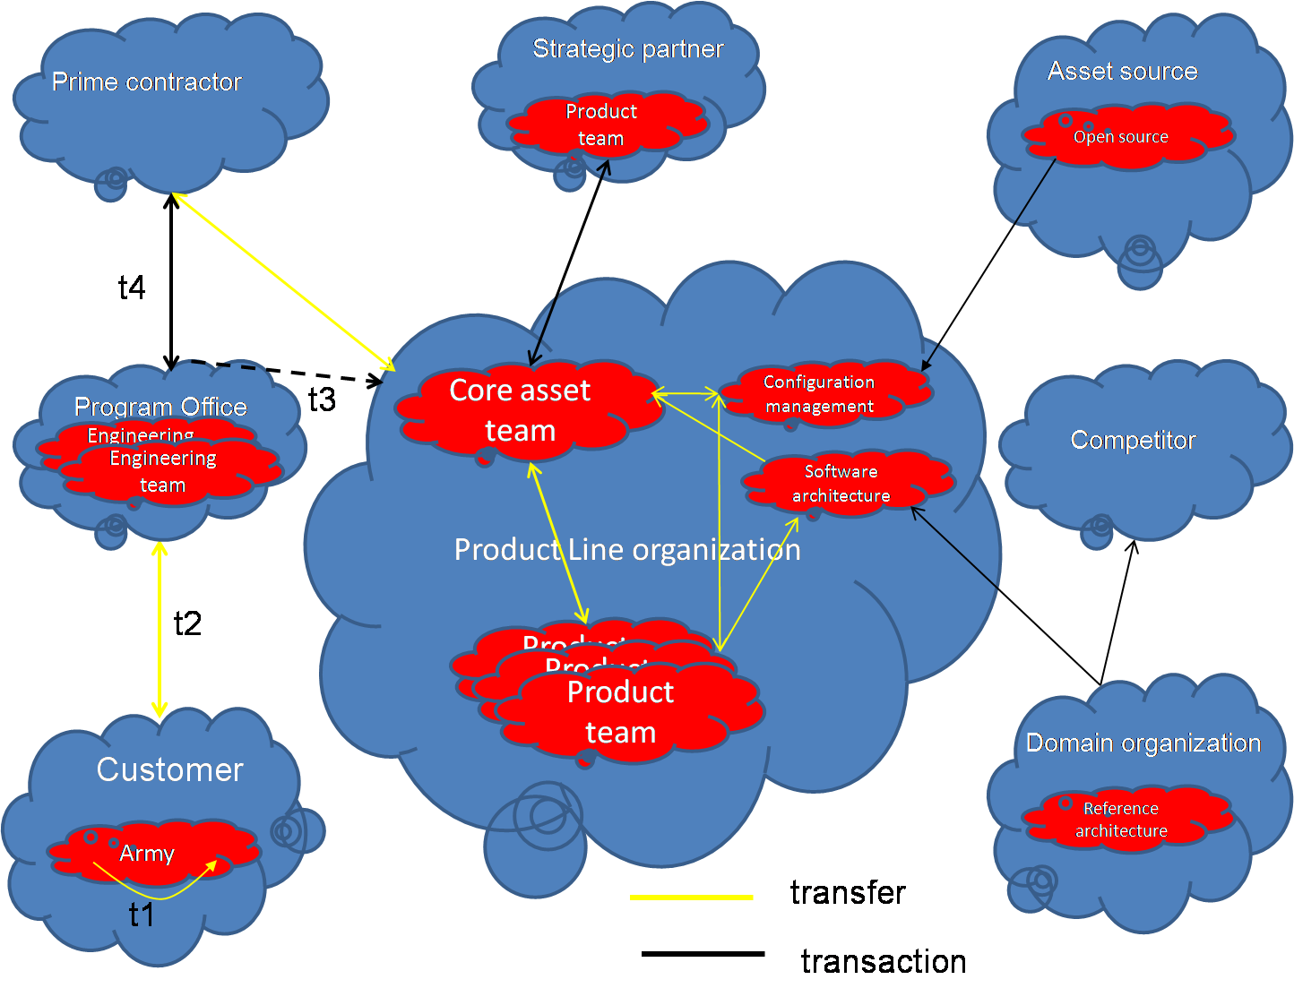
Ecosystems
A software product line organization is a focal point in its own ecosystem.
This is some of my research into strategic software engineering

Slide 21
Here’s what you are going to do
Add to your initial EPF model. Add the activities, techniques, etc. that we have covered since your last submission.
Due: zip the produced web site and email to me by 11:59 PM October 14th.

