Slide 1

CPSC 871
John D. McGregor
Module 7 Session 1
More UML

Slide 2
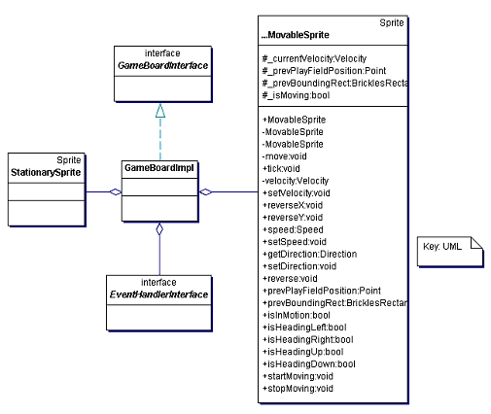
Types of association
GameBoardImpl is an implementation of the interface GameBoardInterface. The line marked (2) indicates “realization” of an interface. An interface is a specification of behavior but it does not provide any implementation like a class would.
GameBoardImpl provides behavior (code) for each method in the interface.
The clear diamonds indicate aggregation (1)
Instances of these classes are contained in the GameBoardImpl
(2)
(1)
(1)
(1)

Slide 3
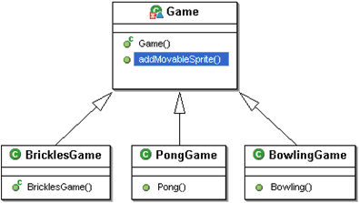
Generalization
Generalization takes three classes as seen below and creates a more abstract class
Each of the special (generalized) classes has the same specification as the generalization but with some variation maybe in behavior or maybe just in how the behavior is implemented.

Slide 4
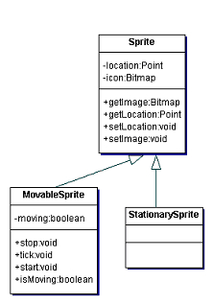
Generalization/inheritance
A classification scheme using an inheritance hierarchy
The subclasses are special cases of the base class
Enables substitution

Slide 5
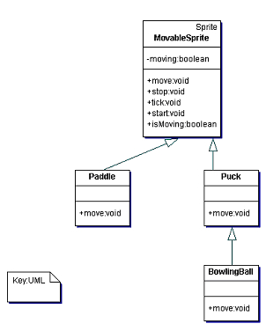
Generalization/inheritance
MovableSprite gives the main behaviors of the moving sprites
An alternative would be to have a Movability class, an instance of which that is aggregated into those Sprites that must move.

Slide 6
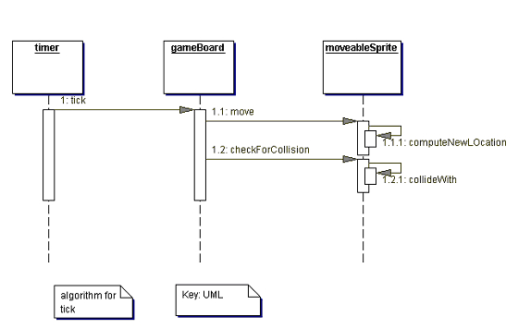
Sequence diagram
A single thread of control
An alternative would be to make each MoveableSprite have its own thread

Slide 7
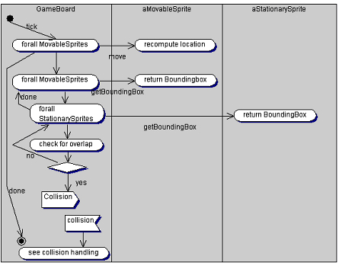
Activity diagram
This is the main animation loop.
Each rectangle represents an object from a class. Much like
the sequence
diagram but more
complex behavior
is represented.

Slide 8
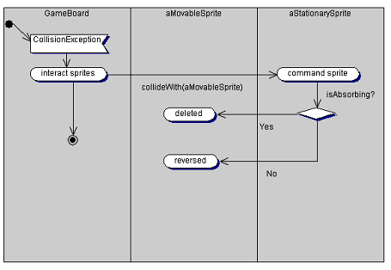
Activity diagram for exception
Handling a collision can be an exceptional event since it happens a very small percentage of the time.

Slide 9
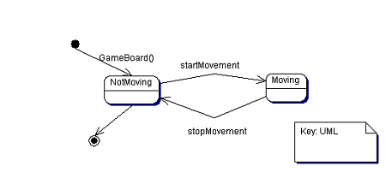
State machine
A state is a configuration of data.
A transition is a change in some data values that are sufficiently different that the program changes behavior

Slide 10
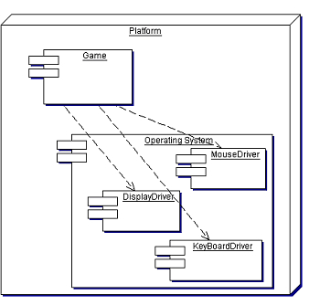
UML – deployment diagram
This diagram shows two components on one computing box. One of those components aggregates 3 other components.

Slide 11
Java2UML
UML gives a higher level view of a program
To understand a Java program the Java2UML function automatically creates a UML class diagram

Slide 12
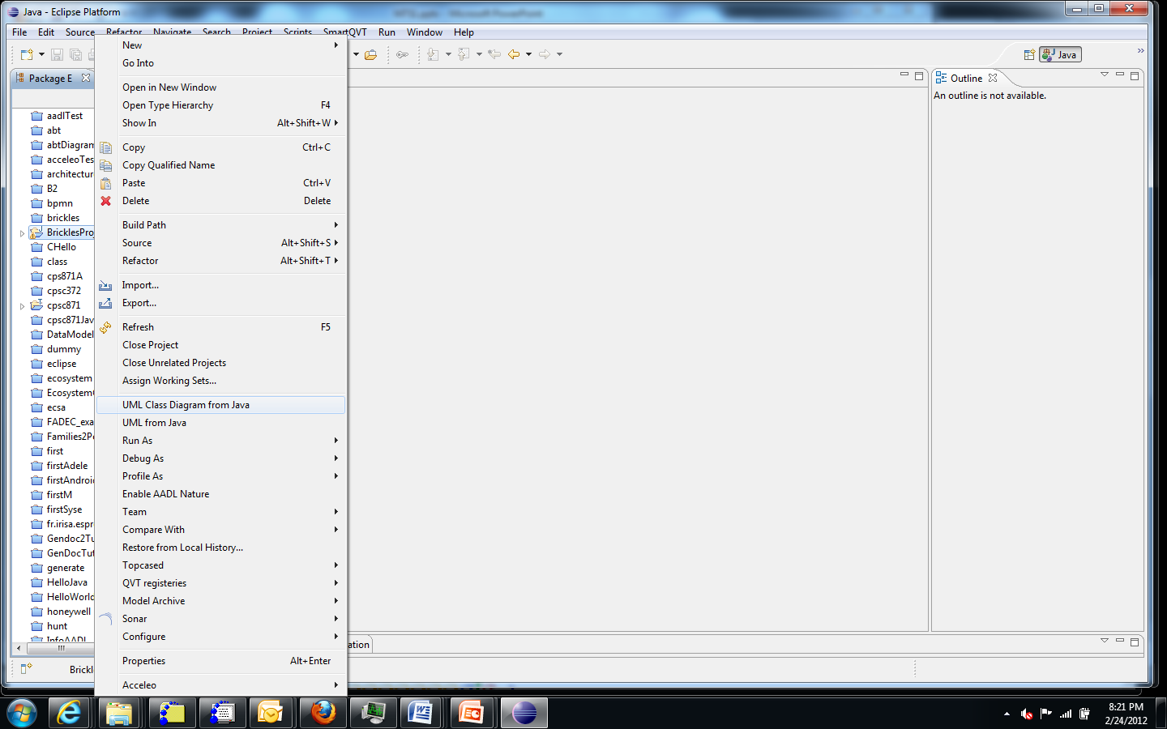
Click on project, then click on UML Class Diagram from Java

Slide 13
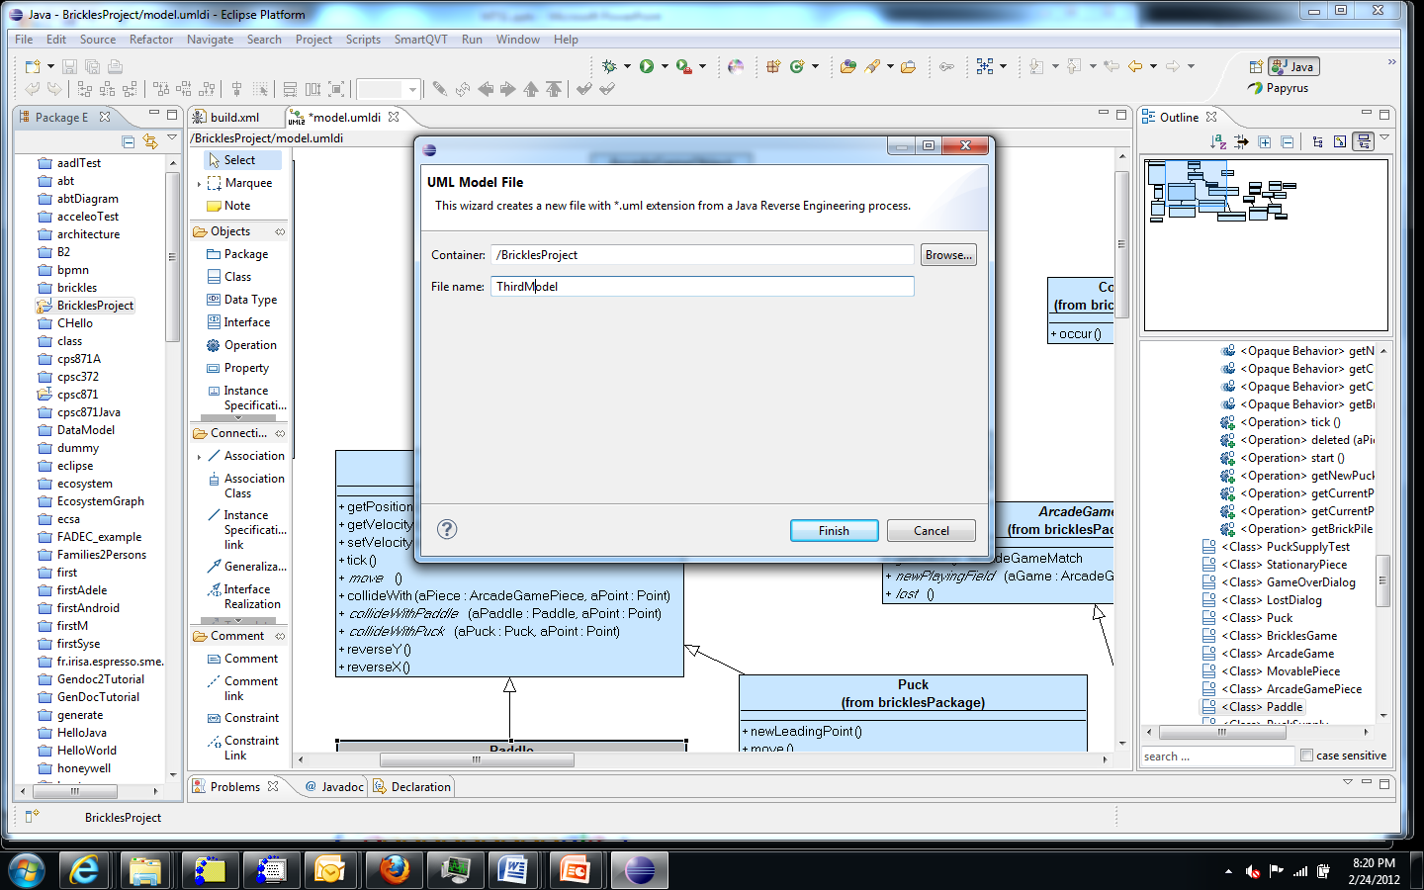
Give name to the model

Slide 14
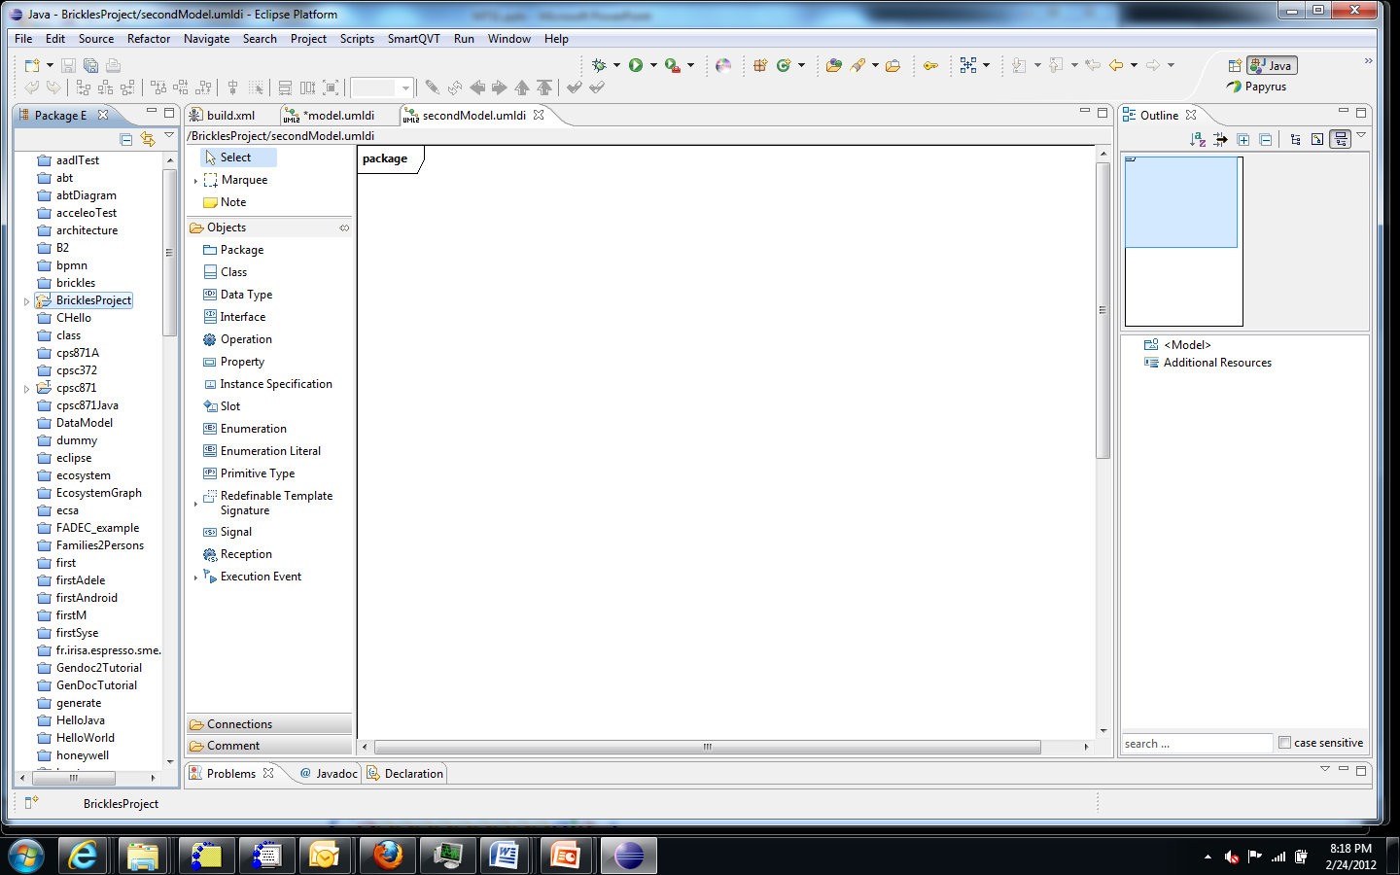
The class diagram primitives are in the outline view

Slide 15
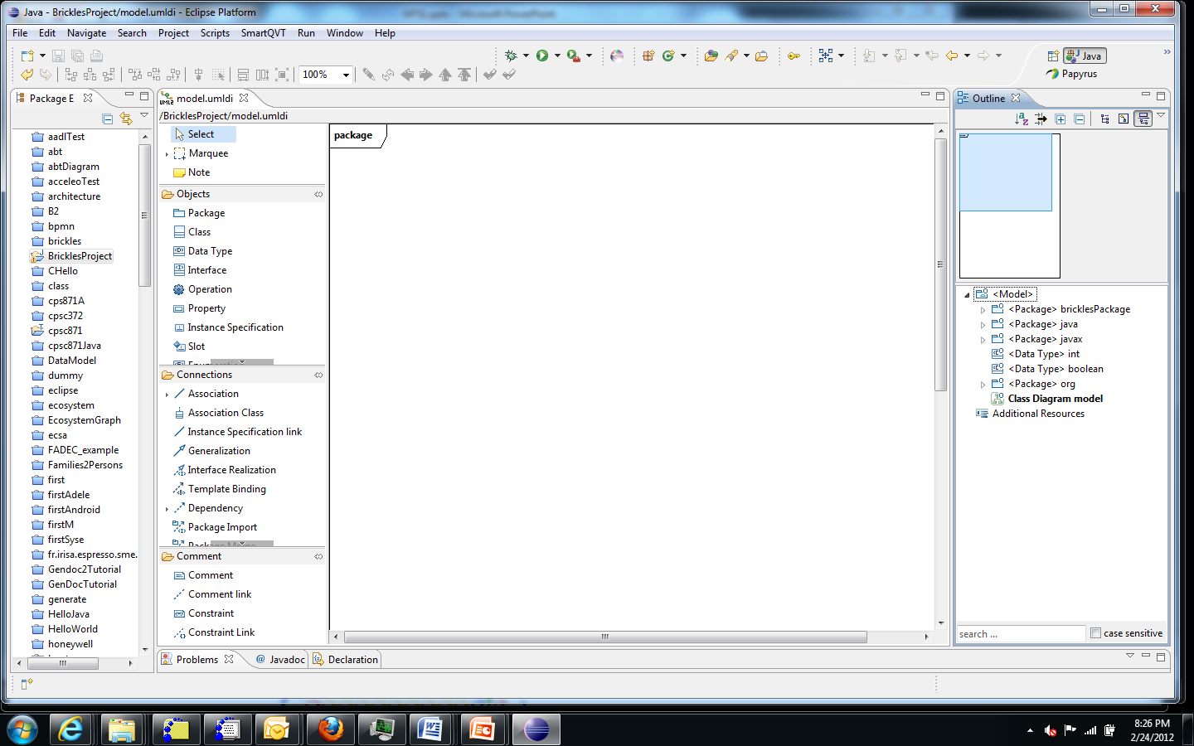
Expand the elements in the outline

Slide 16
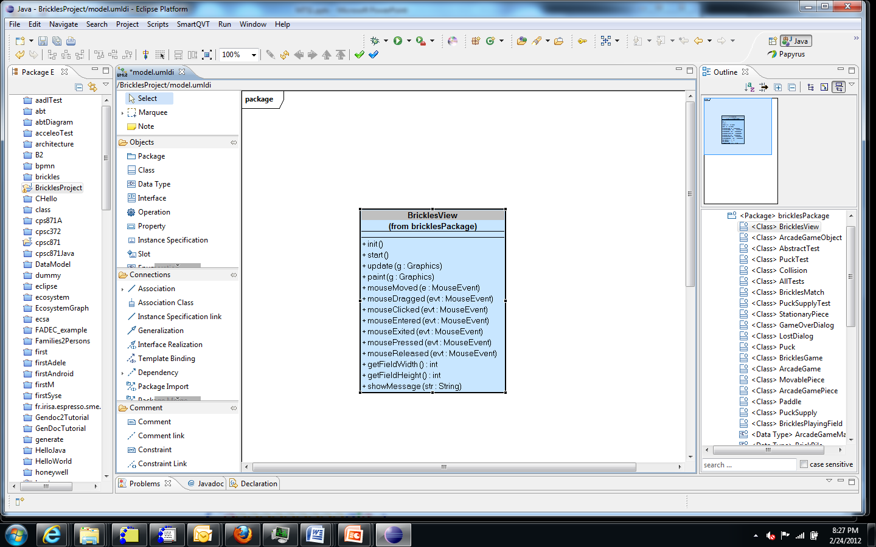
Drag and drop the first entry in the outline

Slide 17
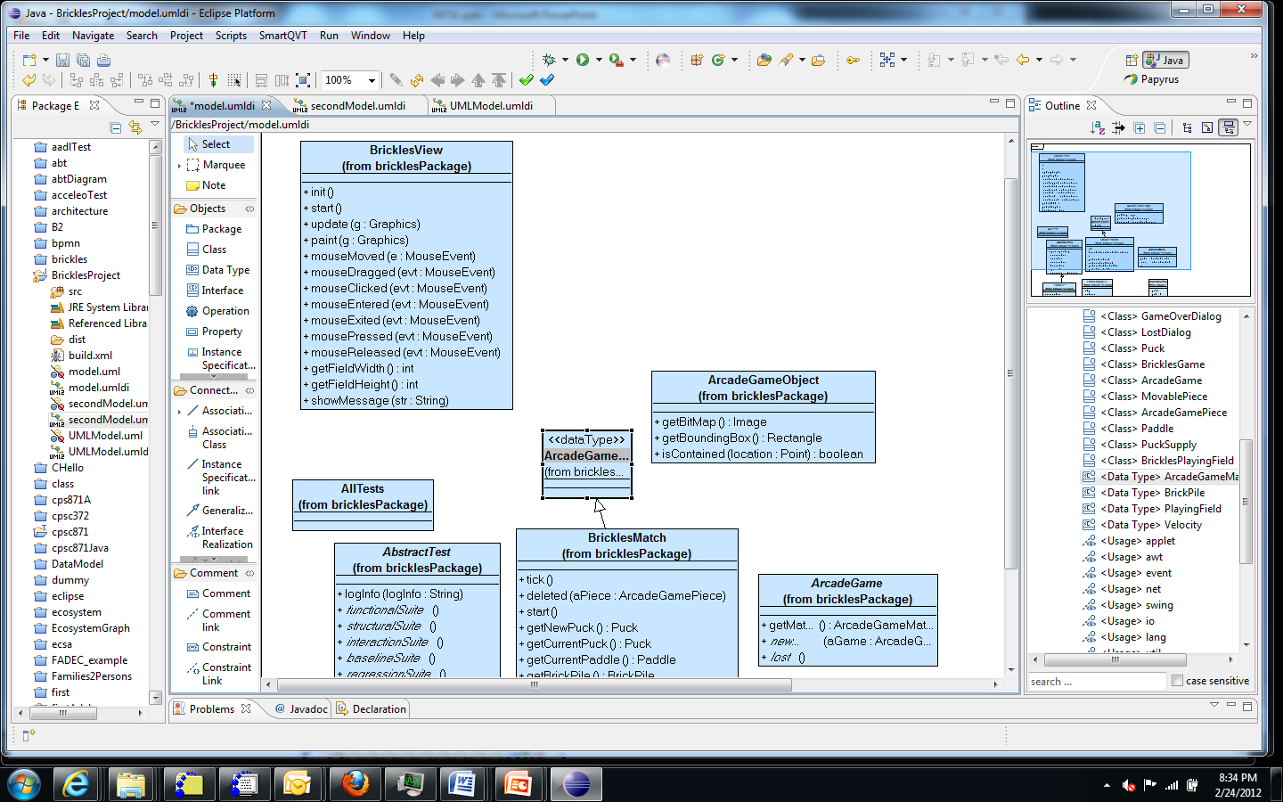
Drag ‘n drop each element in the outline

Slide 18
Round trip engineering
A UML model is created including several diagrams.
Code is generated from the model with some custom programming
Java2UML will take code to uml
UML model is reviewed and modified
Repeat

Slide 19
Here’s what you are going to do
Follow along and create the class diagram as I did.
In the third session of this module you will use the debugger to track down a defect in the Brickles code.
As a starting point to understanding that code create two sequence diagrams from the code.
Use the Papyrus UML to draw these. Take screen shots and submit.

