Slide 1

CPSC 871
John D. McGregor
Module 7 Session 2
Agile Software Development

Slide 2
A bit of history
Kent Beck introduced Extreme Programming in 1999
This was during the dot com bubble when web was the focus
Programming was rapid and, for many developers, it was very lightweight
Agile methods were intended for rapid development of prototypes that evolved into final products through constant interaction with customers
We spoke about this in an earlier module. This time there is a different, more narrowly focused emphasis.

Slide 3
Agile methods
There are several different agile methods
Pair-wise programming –two people share a computer – one programs, one reviews/directs
Test-driven development – the developer of a unit first creates a set of tests and then writes the code that must pass those tests
Their idea was to “not do any unnecessary work” – but what they judge as unnecessary and what others judge as unnecessary can be very different.

Slide 4
Caveat
To the pointy-headed manager “agile” just has the right feel.
To the engineer “agile” is a trade-off disaster waiting to happen.
Agile works under certain conditions
Beware of the person who tells you any technique works in all cases

Slide 5
Agile processes
“Scrum” is one agile method in which the development work is divided into sprints. Each sprint is an iteration over a “chunk” of behavior in the program. It maybe be stated in terms of implementing a certain set of use cases.
In Scrum, a stand-up meeting is held every day to check on progress and to plan the next 24 hours. (Like in rugby)
Other techniques are used to structure the other development activities.
In the last unit we looked at Sonar as a way of getting “continuous” feedback on numerous metrics.
Also the main work of the individual developer can be accomplished using test-driven (or test first) techniques.

Slide 6
Test first programming
In this agile method the sequence of requirements, design, implementation, and test is replaced by write a test, implement code that will pass the test, run the test to verify.
Writing a test is considered creating the requirement. That means the test writer must be a domain knowledgeable person.

Slide 7
Test first programming – 2
The result is a set of tests that the program passes and a set of code that satisfies the tests plus the customer.
There are several challenges with this approach:
How to coordinate among multiple test writers?
How to ensure that the product is complete?
We will look at this in greater detail in the next Module.

Slide 8
Continuous integration
The Eclipse environment has many tools and can connect with other tools to facilitate agile development.
Continuous integration servers support a particular approach to product development – “always running software”
That is, we begin with a skeleton program that is almost a prototype of the architecture and we elaborate it into the completed product in increments.

Slide 9
Continuous integration - 2
Every time a developer checks-in their module the continuous integration server kicks off a series of automated actions that include building the product, running a battery of tests, and generating the Sonar metrics.
We know very quickly if there are problems with the new material and its integration with existing code.

Slide 10
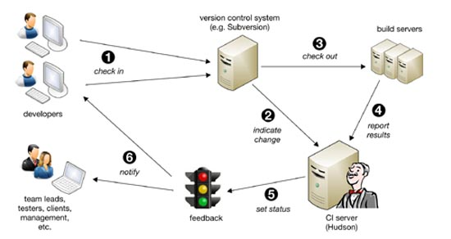
Continuous integration - 3
Hudson is an open source tool that facilitates continuous integration
Figure from: http://www.methodsandtools.com/tools/tools.php?hudson

Slide 11
Continuous integration - 4
This approach can work with large or small projects.
Progress is always forward with only small steps back to correct errors introduced in the newest code.
We are getting quite a load of tools for our developer machine. But also a lot of capability. More in the next module.

Slide 12
Here is what you are going to do
Find an agile development method, not mentioned in the notes, in the literature.
Compare it to the ones discussed here.
Write a brief summary and comparison and submit.

