Slide 1

CPSC 871
John D. McGregor
Module 7 Session 3
Debugging

Slide 2
A bit of history
The act of tracking down the source of a failure is referred to as “debugging”
This comes from one of the first computers which, when it was acting incorrectly, was found to have an insect underneath one of the vacuum tubes.

Slide 3
Eclipse
Eclipse, the structure underlying OSATE, is the best Java development environment.
It has a set of tools that makes a developer very productive.
Here is a link to a small set of tutorials for beginners at java programming
  http://sourceforge.net/projects/eclipsetutorial/files/1.%20Total%20Beginners/
You don’t have to become a programmer just get the main idea from the tutorial.

Slide 4
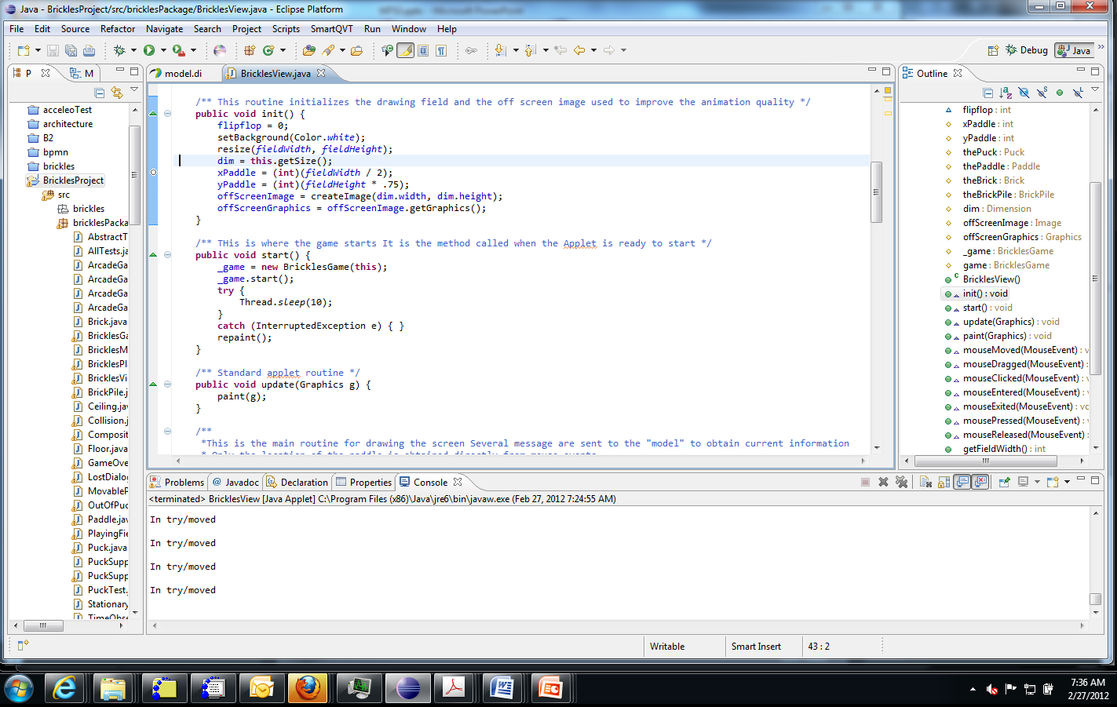
Java Perspective

Slide 5
Debugging method
Assuming the program has been executed for some data set and incorrect results have been found.
If we are not familiar with the program then the first step in debugging is to scan either a cartoon of the architecture or a package diagram for the code to get a very high-level picture of the program structure.

Slide 6
Debugging method - 2
To debug a program we typically make hypotheses about the cause of a failure based on the available evidence. “I see that this value is incorrect and it is computed in this module so somewhere in there is the defect.”
We then design experiments to confirm or refute our hypotheses. “If I set a breakpoint just before control passes into this module all variables should have correct values”

Slide 7
Debugging strategies
We then use strategies to guide our search:
Pincher move – start at points you believe are far from the point of trouble and before and after it in the program. Run the program and observe the results. At the first breakpoint everything should be correct and at the second breakpoint there should be evidence of a failure (incorrect values, program halts before it reaches the point). Now move the two breakpoints closer to each other. Continue until there is a single statement between or the error occurs before the first breakpoint or after the second.
One step at a time – Use the step over debugger control and step through the program checking data values that initially signaled the failure. Continue until a value is incorrect.

Slide 8
Debugging strategies - 2
Use pincher when you are unsure exactly where the failure occurs.
Use the step over method when you are more certain.

Slide 9
Debugging – happy ending
Our search finds the fault, it is corrected, and the program now executes correctly.
Using the Eclipse debugger is a fast, efficient way to test many different values over a varying range of program statements.
Don’t forget to try more than one data set before declaring victory.

Slide 10
Debugging sequence
Go to www.cs.clemson.edu/~johnmc/courses/cpsc871/resources/debug.zip
This is a wink tutorial on using the Eclipse debugger.
Now use that on the BricklesProject
If you move the paddle so that a puck hits it and bounces off and hits the brick wall, the game terminates abnormally.
Use the debugger to find the problem.
You do not need to fix the problem but form an hypothesis about what is wrong and write that up
Do a couple of screen shots to show what you do. Submit the hypothesis and the screen shots.
Submit by 11:59pm Oct 26th

