Slide 1

CPSC 871
John D. McGregor
Module 9 Session 1
Engineering Management/Measurement

Slide 2
Personal Software Process (PSP)
SEI-developed
Industry validated
The main part of lecture for this unit is for you to read these technical reports:
http://www.sei.cmu.edu/library/abstracts/reports/00tr022.cfm?DCSext.abstractsource=SearchResults
http://www.sei.cmu.edu/library/abstracts/reports/09sr018.cfm

Slide 3
Underlying assumptions about development
You will likely spend your time this week the same way you did last week
You have to track the way you spend time to allow for planning
You must compare your time estimates and plans to what you actually did
You need to determine where your previous plans were in error and correct future planning
To mange your time, you need to make a plan and follow your plan

Slide 4
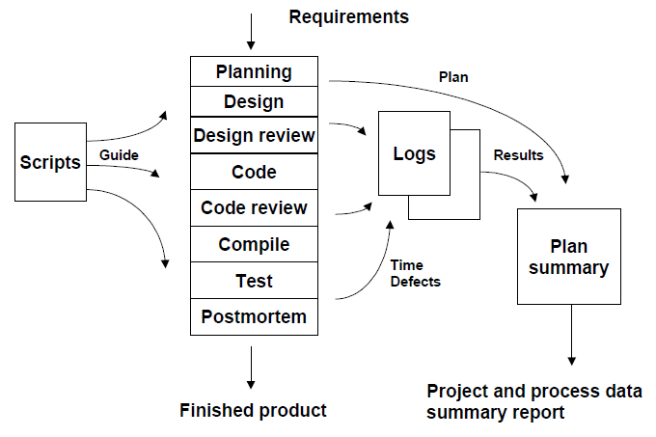
PSP Process

Slide 5
PSP Principles
The PSP design is based on the following planning and quality principles:
• Every engineer is different; to be most effective, engineers must plan their work and they must base their plans on their own personal data.
• To consistently improve their performance, engineers must personally use well-defined and measured processes.
• To produce quality products, engineers must feel personally responsible for the quality of their products. Superior products are not produced by mistake; engineers must strive to do quality work.
• It costs less to find and fix defects earlier in a process than later.
• It is more efficient to prevent defects than to find and fix them.
• The right way is always the fastest and cheapest way to do a job.

Slide 6
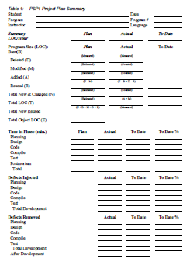
Page 22 PSP report

Slide 7
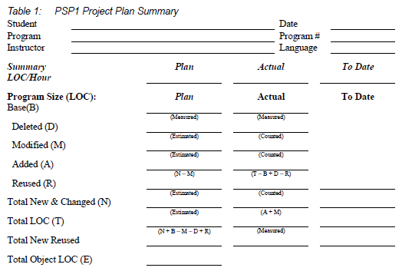

Slide 8
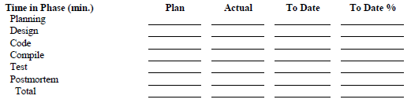

Slide 9
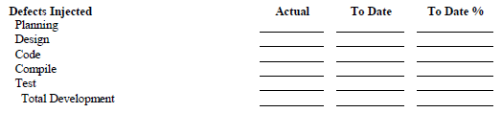

Slide 10
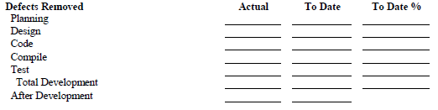

Slide 11
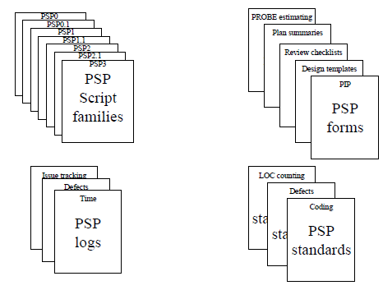
PSP stuff

Slide 12
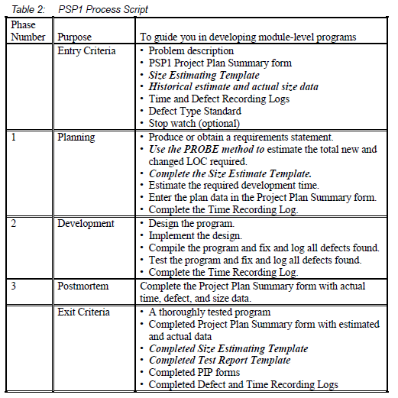
PSP Script

Slide 13
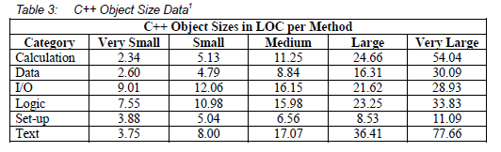

Slide 14
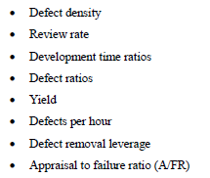
Quality Measures

Slide 15
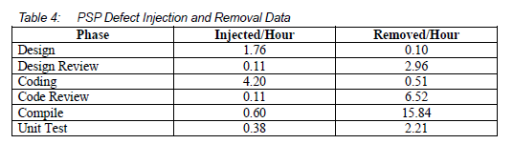
Defects

Slide 16
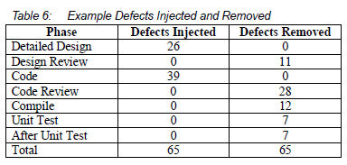

Slide 17
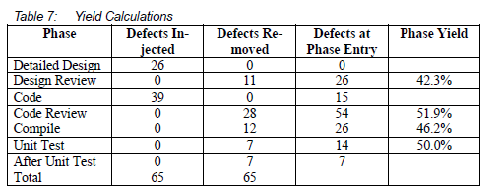

Slide 18
Team Software Process (TSP)
There is also a team software process which in many ways has been more successful than PSP
Should you be interested here is the URL for the TSP Book of Knowledge (BoK)
http://www.sei.cmu.edu/library/abstracts/reports/10tr020.cfm?DCSext.abstractsource=SearchResults

