Slide 1

CPSC 871
John D. McGregor
MMS1
Maintenance & a new trend

Slide 2
Lehman’s Laws on Evolution
(1974) Continuing Change — E-type systems must be continually adapted or they become progressively less satisfactory.[3]
(1974) Increasing Complexity — As an E-type system evolves its complexity increases unless work is done to maintain or reduce it.[3]
(1974) Self Regulation — E-type system evolution process is self-regulating with distribution of product and process measures close to normal.[3]
(1978) Conservation of Organisational Stability (invariant work rate) - The average effective global activity rate in an evolving E-type system is invariant over product lifetime.[3]
(1978) Conservation of Familiarity — As an E-type system evolves all associated with it, developers, sales personnel, users, for example, must maintain mastery of its content and behaviour to achieve satisfactory evolution. Excessive growth diminishes that mastery. Hence the average incremental growth remains invariant as the system evolves.[3]
(1991) Continuing Growth — The functional content of E-type systems must be continually increased to maintain user satisfaction over their lifetime.
(1996) Declining Quality — The quality of E-type systems will appear to be declining unless they are rigorously maintained and adapted to operational environment changes.
(1996) Feedback System (first stated 1974, formalised as law 1996) — E-type evolution processes constitute multi-level, multi-loop, multi-agent feedback systems and must be treated as such to achieve significant improvement over any reasonable base.

Slide 3
Maintenance
Adaptive – modifying the system to cope with changes in the software environment (DBMS, OS)
Perfective – implementing new or changed user requirements which concern functional enhancements to the software
Corrective – diagnosing and fixing errors, possibly ones found by users
Preventive – increasing software maintainability or reliability to prevent problems in the future

Slide 4
DSM
Design Structure Matrix
SONAR
OSATE
Modularity

Slide 5
Inside maintenance
Recurses til there is an atomic component to be changed
Defines, modifies, and uses locations in the code
Between maintenance
Between modules the question is conformance to interface specs

Slide 6
Evolution, blending, and specialization
Systems engineering
Software engineering
Software systems engineering
Requirements/Architecture
DevOps

Slide 7
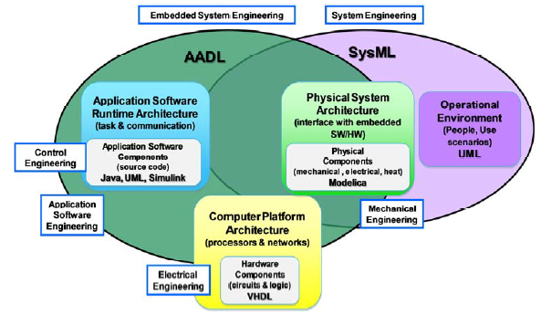
Phases blend

Slide 8
Mapping

Slide 9
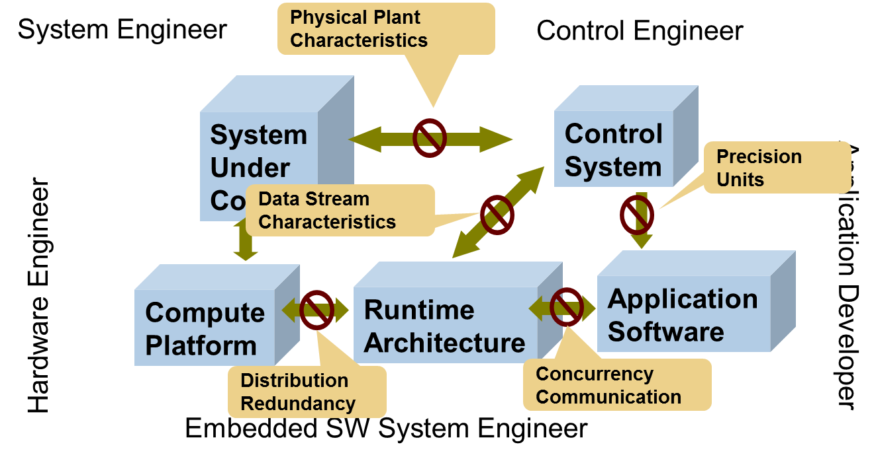
Competencies blend

Slide 11
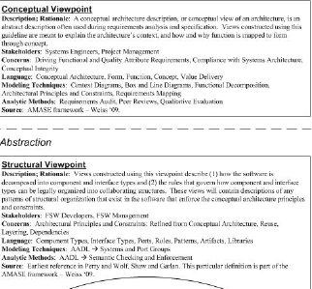
http://trs-new.jpl.nasa.gov/dspace/bitstream/2014/43120/1/12-4068.pdf

Slide 12
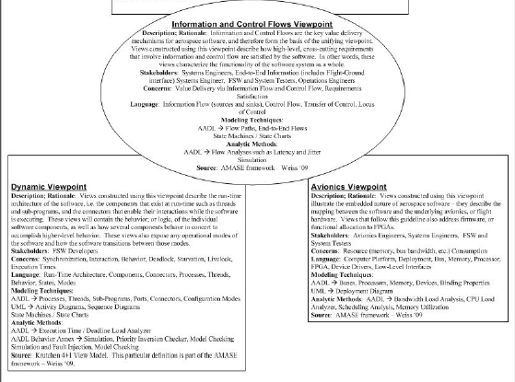

Slide 13
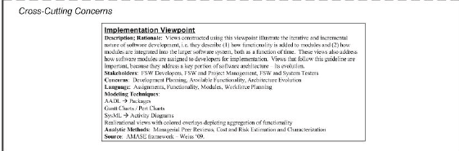

Slide 14
Model repository

Slide 15
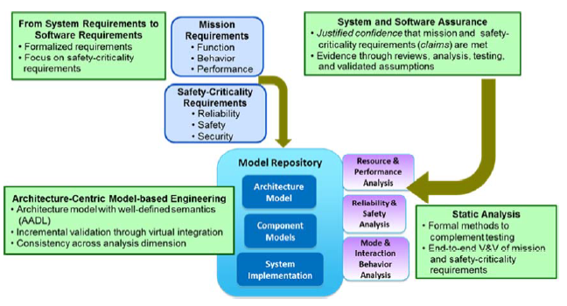
Model repository

Slide 16
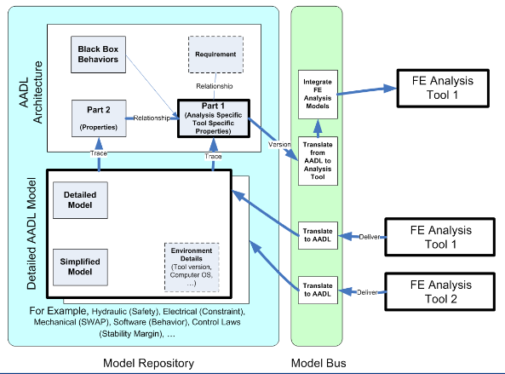
Model repository

Slide 17
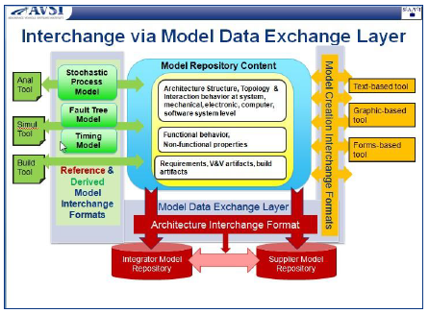
Interchange among suppliers

Slide 18
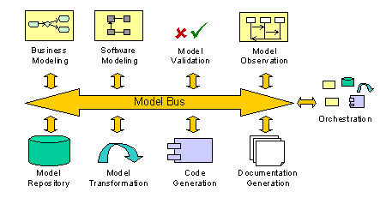
Model bus

Slide 19
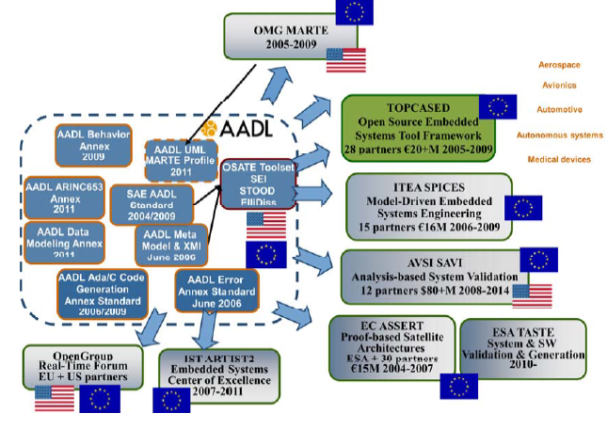

Slide 20
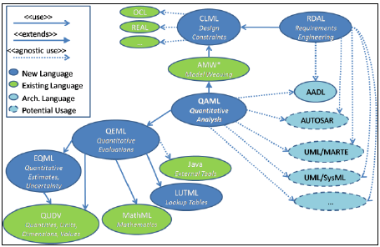
QAML

Slide 21
RDAL
https://wiki.sei.cmu.edu/aadl/images/9/93/Requirements_annex_tutorial_07022013.pdf

Slide 22
Here’s what you are going to do…
Read pages 1 – 66 from http://www.sei.cmu.edu/reports/12sr013.pdf
Define/Refine a process for developing apps that specialize in system analysis/design
Use EPF
Due Nov. 27, 2013 at 11:59pm
Be prepared to demo app in class Dec 3, 5

Slide 23
https://www.signup4.net/Upload/BOOZ14A/SAFE23E/Modified%20FEMplugin%20Show-and-tell.pdf
http://www.erts2012.org/Site/0P2RUC89/5B-3.pdf
https://wiki.sei.cmu.edu/aadl/images/9/93/Requirements_annex_tutorial_07022013.pdf
http://trs-new.jpl.nasa.gov/dspace/bitstream/2014/43120/1/12-4068.pdf

