Slide 1

CPSC 871
John D. McGregor
MSumS2
Summary – technical issues in software engineering

Slide 2
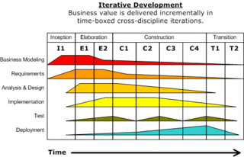
Rational Unified Process

Slide 3
Process models
Different “shapes” to the schedules and work decomposition
Waterfall – one pass; all requirements
Spiral – multiple passes; all requirements but prioritized
Iterative – multiple passes; a set of requirements
Incremental – a subset of requirements

Slide 4
Processes
Most of the models don’t have names
Agile methods have names because they get publicity
Extreme Programming
Test-driven development
Scrum
…
Planned vs agile

Slide 5
Processes
My organization uses an iterative, incremental approach
A two week cycle time is as fast as we can move and maintain forward progress

Slide 6
Tools
Tool captures human thoughts and actions
Uses a specific notation – UML, SySML, AADL
Most notations provide a means of making notes outside of the notation
Used to communicate with humans or other tools

Slide 7
Tools - 2
A workflow is a series of transformations formed by the output of one tool being the input to another tool
Used to automate processes
Example: Using Ant to build a product the source code might first go to an analyzer to check coding standards and then if OK on to the compiler and then on to …

Slide 8
Tools - 3
Topcased
OSATE
Eclipse
EPF
ASCE
SONAR
Emulators

Slide 9
Comments on tools?
Not enough documentation

Slide 10
Practice areas
Rather than try to tie down exactly when requirements will be done it is more effective to layout a rough sequence but let the pros go where they need to when they need to
A practice area is broader than just a few specific actions

Slide 11
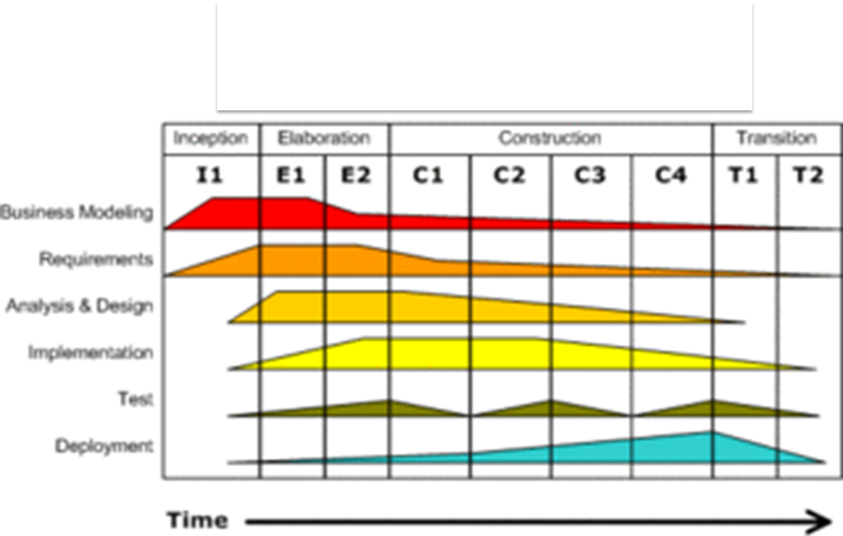
RUP practices

Slide 12
Business modeling
We did not spend much time here
Domain modeling using UML class diagrams and sequence diagrams or DSLs to describe business rules
Entities and relationships
Captures business objects and business rules

Slide 13
Requirements
Functional – what the system does
Non-functional (aka quality attributes) – properties of the system such as reliability
Because some non-functional requirements negate others we use a priority scheme to determine which are most important
Requirements come from customers, regulatory agencies, ecosystem partners, competitors, our imagination
Some requirements are derived from others – usually design requirements

Slide 14
Requirements - 2
Representations
Statements – human language (English, …) statements of what is expected from the system
Use cases – actor/system dialogue shows inputs and processing of those inputs
Feature models – describes high-level features and their interactions with other features
Tools
Topcased

Slide 15
Requirements – 3
Requirements are evaluated in several ways
Reviews and inspections
By development staff
Customers/domain experts
Consistency checks across
the requirements model
the architecture model
comparison with test cases

Slide 16
Analysis and Design
Requirements are analyzed to group them and to begin to relate them to a design
Often there is a need for more detail
The use cases may be elaborated using sequence diagrams

Slide 17
Analysis and Design - 2
The architecture is created by paying close attention to the non-functional requirements as the groups of functional requirements are allocated to specific machines or processes
There is a body of architecture patterns that have been found to enhance particular qualities
The architecture team begins with that and with architectures used in similar systems to select a basic “style”

Slide 18
Analysis and Design - 3
The architecture details the structure of the program, behavior of the program and the error propagations through the program.
AADL provides ways of expressing both of these
Systems represent modules; ports represent inputs and outputs; connections wire outputs to inputs
Annexes are small independent languages

Slide 19
Analysis and Design - 4
Usually there will be a designated architect on a project who has architecting and domain experience
This person will participate in all phases of the project with emphasis on architecture

Slide 20
Analysis and Design - 5
Model checking is used during this phase to validate the architecture for such issues as deadlock
Using advanced algorithms the model checker explores every path in the architecture to verify the truth of claims such as “deadlock free”
Model checking can also be used to check code.

Slide 21
Analysis and Design - 6
Resolute – a language for writing constraints for an AADL model
check_position (app : component, actuator : component) <=
** "(R2.3) The app (component " app ") and the actuator (component " actuator ") have the same value for the position" **
true

Slide 22
Implementation
This activity is receding in importance as more of the code is auto-generated
But much is still hand-written
Choose languages that fit the job
Use DSLs to get domain experts to write some of the code

Slide 23
Test
Testing is gaining in importance as programs become more mission and life critical
Reviews and inspections can be structured as tests by providing specific questions that the reviewers have to ask
AADL and related tools provide means of simulating program execution so the architecture can be tested

Slide 24
Test - 2
The program code is usually tested in three phases
Unit testing – developer of a module also develops tests (maybe before the module) and tests the module in isolation
Integration testing – a developer who is using the work of several teams creates tests that examine the interactions among the units
System testing – the requirements are used to create tests

Slide 25
Test - 3
System testing takes a different perspective
Unit testing determines whether a unit does correctly what it does
System testing determines whether a program does what it is required to do
Some customers will also test a newly acquired product to assure themselves that the product does what they need done.

Slide 26
Deployment
A product is delivered to where it will be used in a variety of ways
A deployment package includes the required programs; resources such as pictures, different language files; licenses for included products; installation guides
An installer may be used to encapsulate all of the above or a simple zip file

Slide 27
Deployment - 2
The software may be shrink wrapped and sold in a store or downloaded from web

Slide 28
Technical management
Practices that are not mentioned in the basic RUP diagram include
Configuration management which usually includes version control
Build management
Test data management
License management

Slide 29
Comments?

Slide 30
Conclusion
Software engineering involves a wide range of activities in several disciplines
Business, psychology, economics, …
Small specific languages are key
I hope you have been able to make connections between topics beyond just what we talk about in class and understand now why certain things are the way they are
I hope that you have a deeper appreciation for the variety as well as being able to actually perform some of those activities

Slide 31
Here is what you are going to do
Expand the scenario you started in class on Tuesday
Address each of the major areas we discussed Tues/Thur with respect to your app
Submit this along with the final release of your app by 11:59 pm, Dec 4th

