Slide 1

Supporting Strategic Software Engineering Decision Making through Ecosystems
John D. McGregor
johnmc@clemson.edu

Slide 2
Outline
Basics
Example
STREAM
Business view
Software view
Innovation view
Ecosystems Analyses
General
Specific
Ecosystem Development Plan
Conclusion

Slide 3
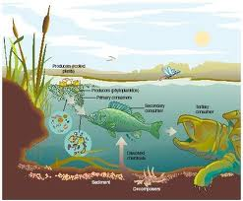
Real world ecosystems
In a real world ecosystem there are predators and prey.
There are competitors for scarce resources.
There are collaborators who help one another survive and thrive.
http://canarygeog.canaryzoo.com/Ecosystems%20Ecosystems.htm

Slide 4
basics

Slide 5
Software ecosystem
David Messerschmitt and Clemens Szyperski have defined a software ecosystem as:
“A set of businesses functioning as a unit and interacting with a shared market for software and services, together with relationships among them. These relationships are frequently underpinned by a common technological platform and operate through the exchange of information, resources, and artifacts.”
David G. Messerschmitt and Clemens Szyperski (2003). Software Ecosystem: Understanding an Indispensable Technology and Industry. Cambridge, MA, USA: MIT Press.

Slide 6
But there is more than that…
Often the questions that clients want answered are not business questions directly
They also address some aspect of the software, such as its quality, and/or
They include some innovation that is a combination of business model and software products, such as Eclipse’s approach using a plug-in architecture and flexible licensing.

Slide 7
Microsoft Ecosystem(s?)
Microsoft operates inside an ecosystem that encompasses an array of partners, complementors, and competitors around their various Windows platforms.
They explicitly support the ecosystem by giving “partners” discounts, early access to information, and conferences where they can present and network across the ecosystem.
Microsoft opens (publishes) certain APIs.
Companies create products using those APIs to integrate with Microsoft products, which brings the integrator direct revenue and brings Microsoft more business as well.

Slide 8
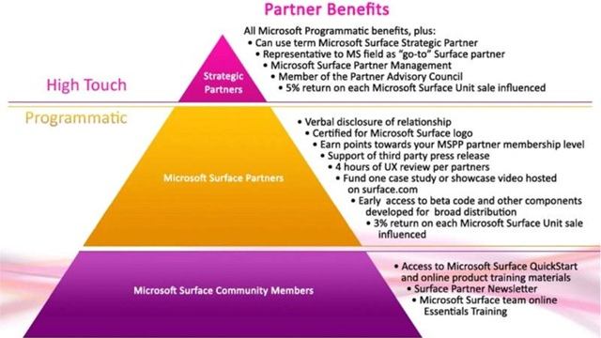
Microsoft has numerous Partner programs
http://www.neowin.net/news/microsoft-partners-now-offered-microsoft-surface-sdk

Slide 9
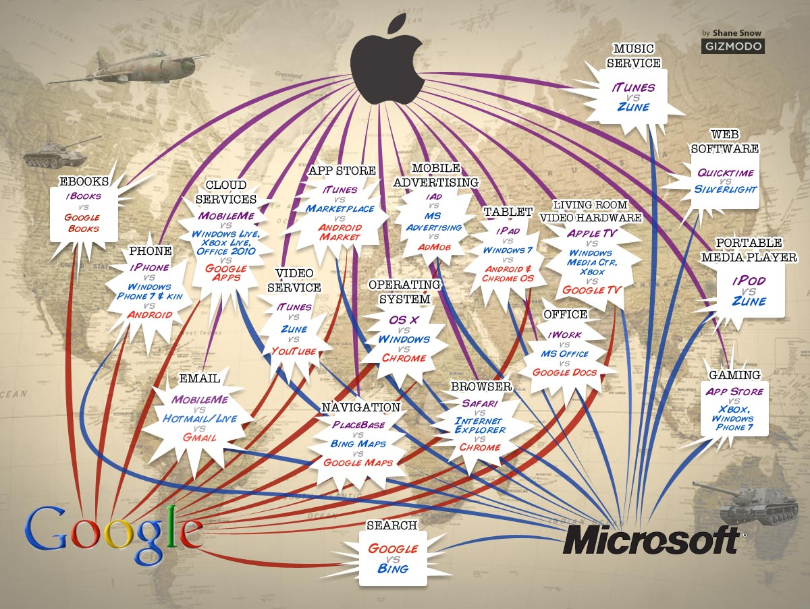
Competitive view of the ecosystem
http://www.hzahed.com/blog/post/2012/05/05/Microsoft-vs-Google-vs-Apple.aspx

Slide 10

“magnetism”
A vibrant ecosystem attracts new members.
The magnetic pull of an ecosystem is proportional to the number of adoptions and members.
The openArchitectureware project responsible for Xtext, Xtend, … was independent but became part of the Eclipse Foundation’s ecosystem.

Slide 11
“magnetism” - 2
Magnetism is a good term because it includes the concept of repulsion.
Recently a change in license caused projects and/or developers to leave some large ecosystems¹.
¹http://www.redmonk.com/jgovernor/2011/05/09/on-changing-horses-open-
source-licenses-foundations-and-the-software-freedom-conservancy/

Slide 12
Definitions
Keystone – the supplier of an important resource that shapes a market. This is often a software or hardware platform but could even be an international standard.
Niche player – users of the resources supplied by the keystone

Slide 13
Definitions - Roles
Hub – may provide a platform but may simply be the focus of the model – Eclipse Foundation
Broker – may provide a façade for a set of entities to an outside entity – a standards body like OMG
Bridge – provides flow through from one entity to another – a media organization that gathers technical news and publishes it
Cluster – a set of nodes in the network with a high degree of coupling – The members of the Eclipse Foundation
http://www.chrisbirke.com/whitepapers/2002%20-%20Managing%20in%20a%20Small%20World%20Ecosystem.pdf

Slide 14
Ecosystem as a business strategy
A strategy that emphasizes collaboration where possible and competition where advantageous
Considers all elements of a market including predators and prey
Open source foundations have played an important role by providing a place where organizations can come together to establish and share commoditized knowledge
Takes advantage of the fact that software is a non-rival good

Slide 15
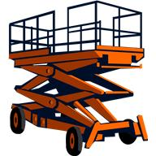
Platform Definition
A platform is a set of resources that give users of the platform a head start toward a completed product.
The resources usually include an architecture for some class of products including constraints and patterns, code assets, tools, and other items.

Slide 16
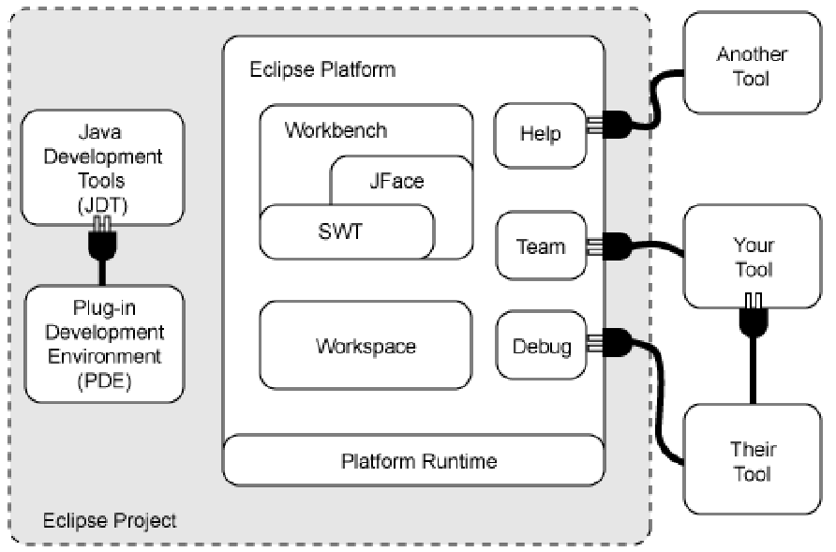
Eclipse Platform
The platform is a “hub” around which collaborators gather.
Apps may interact through the services provided by the platform

Slide 17
The ecosystem around an SPL
A SPL organization, whose asset base is a platform, needs to take intentional, strategic actions based on complete, correct, and consistent data in areas including:
building a business case
make/buy/mine/commission/adopt
CONOPS
Later …
commonality/variability analysis
scoping
production planning

Slide 18
Building a business case
Obviously a variety of business models can be used
Eclipse – open
Apple - proprietary
Included in this practice area is a SWOT analysis
Strengths – relationships with entities that have useful expertise, access to markets, etc are strengths
Weaknesses – relationships with entities that require too much support can be a weakness
Opportunities – missing relationships can be opportunities to add strength to the organization
Threats - rival organizations with existing products that can be substituted for the products of the hub or that are considering such products are threats
The ecosystem includes all of the forces that influence the business case.
Both collaborate with many others

Slide 19
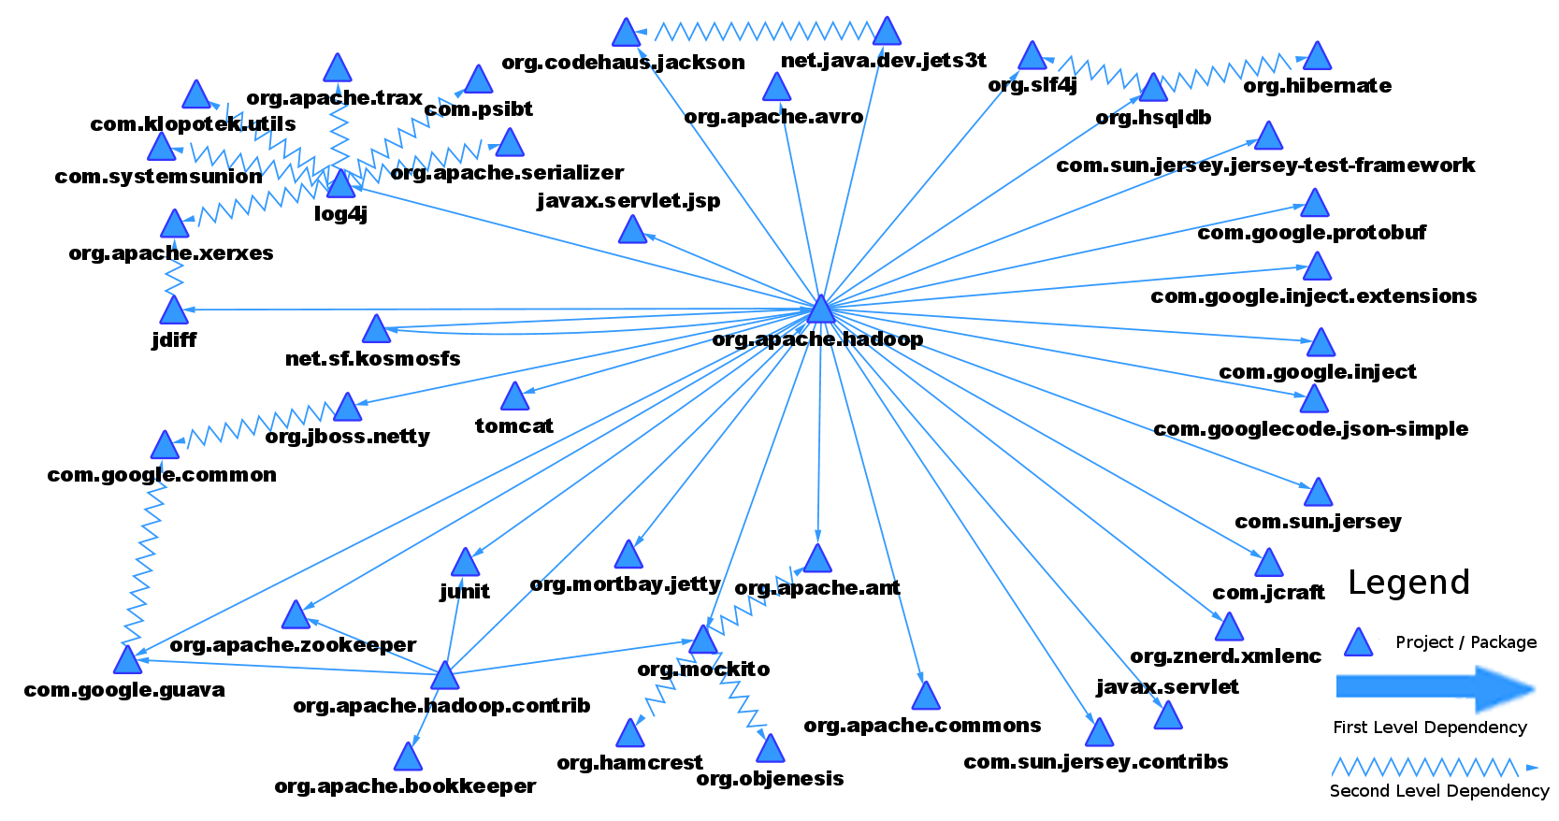
Make/buy/mine/commission/adopt
This practice area is about acquiring assets
The ecosystem includes suppliers; having identified them early facilitates making new agreements more appropriate to the purpose
Or existing members may be competitors with new members introduced into the ecosystem

Slide 20
CONOPS
The CONOPS for the product line should address all direct connections between the hub and other entities.
It answers questions such as:
How are partners included in decision making?
What interactions occur with 3rd party product builders?
Who else are our suppliers supplying?
The CONOPS will be more complete if its construction is guided by an ecosystem model.

Slide 21
Example

Slide 22

Eclipse Foundation
The foundation and the open source development platform are equally of interest.
Their software is in the supply chains of a great many products.
The foundation is the hub of a cluster of member organizations.
Consulting companies, training companies, book authors, commercial plug-in vendors all participate in the Eclipse ecosystem as do all of the member organizations of the foundation.
Decisions made by the foundation ripple far afield.
Eclipse has some product line characteristics.
I will use this as an example throughout because everyone is familiar with it. I will also use other examples.
Clemson University is an academic
member of the Eclipse Foundation

Slide 23
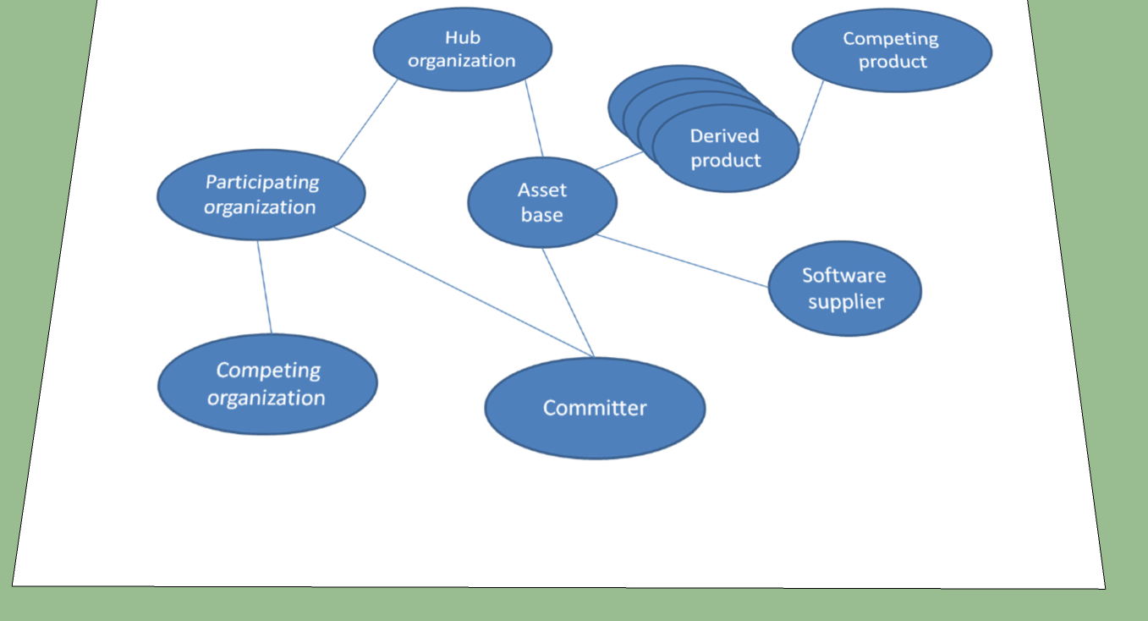
Notional Eclipse Ecosystem model

Slide 24
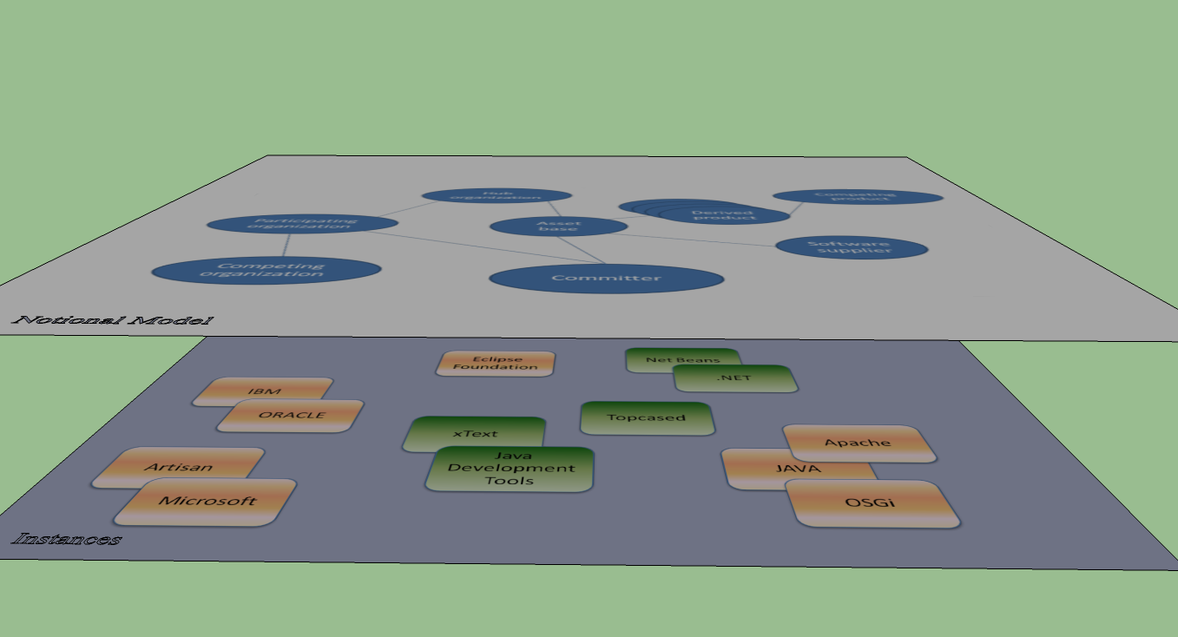
Instances –usually impossible to list them all

Slide 25

Questions??

Slide 26
Stream – Our modeling method

Slide 27
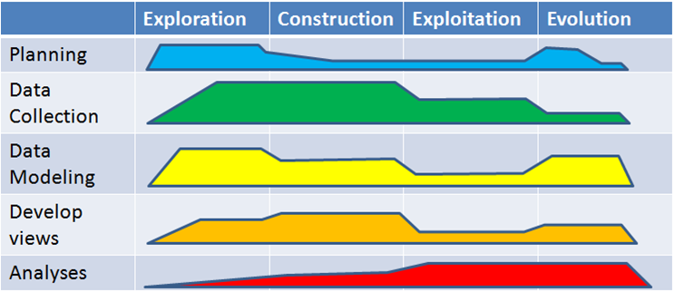
STREAM
STRategic Ecosystem Analysis Method
Exploration | of how the information in the ecosystem should be classified, represented, and analyzed
Construction | of data representations and relationships
Exploitation | uses the relationships defined in the model to trace impacts and to predict the reactions to specific decisions
Evolution | of existing information and new information being added.

Slide 28
Actions
 | Exploration | Construction | Exploitation | Evolution
Planning | Define questions |  |  | Expand on objectives
Data Collection | Determine data sources | Gather data |  | Gather additional data
Data Modeling | Determine data representation | Create data model |  | Update views
Develop views | Determine relevant stakeholders | Identify views |  | Add views as needed
Analyses |  | Setup algorithms | Examine, compute, report | Guide changes with data

Slide 29

Complete life cycle

Slide 30
Definitions - Viewpoints
Viewpoint - The standard definition of each type of view is captured as a viewpoint (similar to a type in a programming language) that allows views (instances of the viewpoint) to be routinely defined.
View - A view is an instance of a view point. It presents a subset of the information from a model.
In STREAM each viewpoint uses a recognized model as the basic representation. For example, we use Porter’s 5 Forces model in the business viewpoint. Views are instances of a viewpoint.

Slide 31
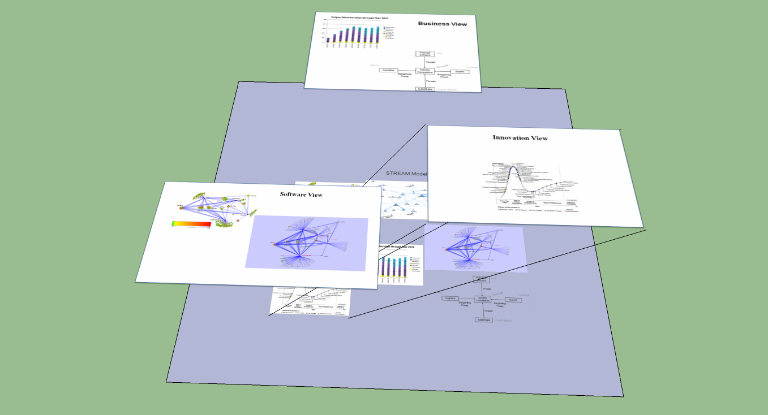
Viewpoints – filter information

Slide 32
Views
Viewpoint – business
B2B connection views
Supply chain views
Viewpoint – software
Dependencies among products views
Software architecture view
Viewpoint – innovation
New feature proposal views
New business model views

Slide 33
Business viewpoint

Slide 34
Business viewpoint
We include all organizations in the business view whether they are commercial, governmental, or not-for-profit.
We include individual people when that person has a unique role.
Businesses are linked to other businesses through several relationships such as “collaborates”, “competes with”, and others.
For example, in the Eclipse ecosystem the members of the Foundation would be linked to the foundation.

Slide 35
Business aspect of strategy
Joining an ecosystem raises your switching costs.
Get stuff for free
Limitations on architecture
http://www.forbes.com/sites/jump/2012/11/12/take-a-lesson-from-apple-a-strategy-to-keep-customers-in-your-ecosystem/
The ecosystem needs to be modular so that there is the option to lots of little experiments, throw away the losers.

Slide 36
Porter’s Five Forces Model
Potential Entrants
Threats
Suppliers
Industry Competitors
Buyers
Bargaining Power
Bargaining Power
Threats
Substitutes
Substitutes | Organizations that currently have products or services that could be used in place of yours
Potential Entrants | Organizations that have products or services that might become available to be used in place of yours
Buyers | Organizations who are currently purchasing your products or services
Suppliers | Organizations that provide some portion of the content of your products or services
Competitors | Organizations that are addressing the same market need or mission as yours

Slide 37


Business/Software Ecosystems
Transaction – an exchange that has an associated cost – license the use of a library
Transfer – an exchange for which there is no cost – initial adoption of an open source software product

Slide 38
Transactions/Transfers
I contribute a new feature to an open source project – I transfer copyright to the project, the project transfers to me committer status
I become a partner with a commercial organization – I pay on a sliding scale and receive in return a varying amount of (1) early access to information; and (2) products.
I extend a platform with a plugin – To do this I obtain information and software and engage in transactions with customers

Slide 39
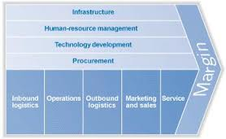
Porter’s Value Chain
The elements of the 5 Forces model contribute to the value chain
Foundation gives team an infrastructure.
Member organizations handle personnel
issues and the projects handle merit recognition.
Project teams are company lines and handle
requirements and implementation.
Contributions
checked for IP
Purity.
Councils handle
Development.
Foundation
manages the IP.

Slide 40
Value chain
A supply network delivers needed supplies to the hub,
when we analyze the steps the organization goes through to transform supplies into products we focus on the value added at each step.
Typically we model at the supply chain level but not down to the value chain level unless the analysis is limited to the business units inside a company which is seldom the case in an ecosystem.

Slide 41
Supply chain
One type of transaction is to purchase materials
The links from supplier to supplied organization form the supply chain and what I sometimes refer to as the quality chain. The quality is not built into a product late. It has to start early at the sources of materials.
Part of the specification between supplier and supplied has to be the levels of quality attributes required.

Slide 42
Supply Chain - 2
Is an open source supply chain safe? What if someone buys the copyright (sometimes held by a foundation)?
“Martin personally owns the copyright to Moodle code.”¹
You can still use the code already developed but future versions might be proprietary.
¹ http://mfeldstein.com/the-blackboard-announcements-part-2-can-open-source-be-bought/

Slide 43

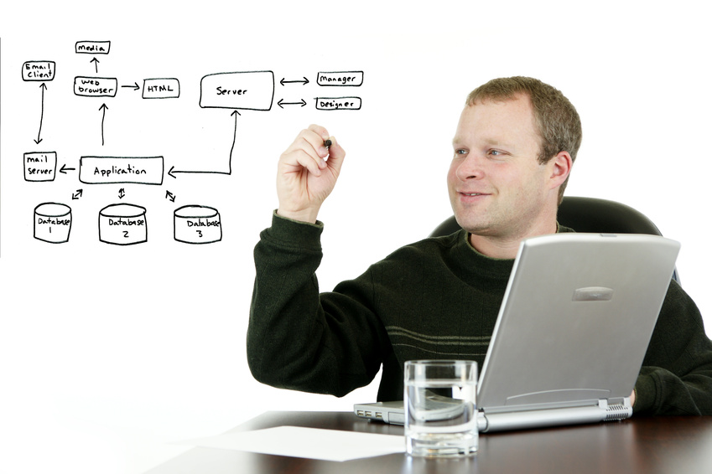


Supply chain - 3
The software supply chain is really …

Slide 44
Supply chain - 4
a supply network.
The software supply chain is different from a standard supply chain because of licensing. Seldom is a software product sold. We pay a license fee to use the product.

Slide 45
Supply Chain 1
TD₂ + αTD₁
TD₁
TD_{HUB} + β(TD₂ + αTD₁₎
TD_{HUB} + β(TD₂ + αTD₁₎
The Hub in the ecosystem maintains the core asset base and acquires assets from suppliers.
Some of the product development projects use the software assets as is and some build on it to provide something bigger.
As the technical debt incurred in Supplier₁ flows to Supplier₂ and on does the impact of that debt change? Does it diminish as the asset from Supplier₁ gets more deeply encapsulated?

Slide 46
Supply Chain 2
TD₄ + αTD₁
TD₃+ βTD₁+λTD₂
TD₁
TD₁
TD₂
In this case there is a common supplier to two other suppliers.
Does the core asset base in the Hub reflect the debt from Supplier₁ along both supply chains?

Slide 47
Hadoop Supply Chain

Slide 48

Risks and Threats
Risks – The risks in the business viewpoint are risks to the health of the businesses. In particular will the market for this group of companies cease to exist?
Threats – The competitors, substitutes, and potential entrants from the Porter analysis are all threats to each other.

Slide 49
Eclipse example
Eclipse has a shrinking number of competitors and a growing number of users. Some suppliers are being subsumed while others are emerging through new projects.
The Eclipse Foundation was formed to provide IP ownership and administrative support to a set of projects related to IDEs.
There are many supply chains tied to the various projects in Eclipse.

Slide 50
Eclipse example
Potential Entrants
Visu
Threats
Apache
Microsoft
Topcased
Suppliers
Industry Competitors
Buyers
Bargaining Power
Bargaining Power
Threats
Substitutes
Visual Studio

Slide 51
Software viewpoint

Slide 52
Software viewpoint
We include all software whether sold or simply used.
We include any size unit of software that is exchanged with another entity.
We link two software entities when one entity is associated with the other in any one of several traditional ways. The most usual of which is “uses”.
For example, in the Eclipse ecosystem plug-ins have “requires” dependencies on other plug-ins.
We also link software to the organization that produces it, that owns it, and/or that licenses it.

Slide 53
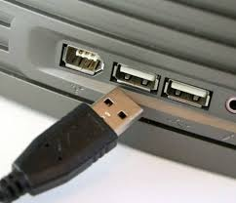
Extensibility
How easy is it to change the feature set to include new features
USB allows many different types of devices to connect
De facto/international standards

Slide 54
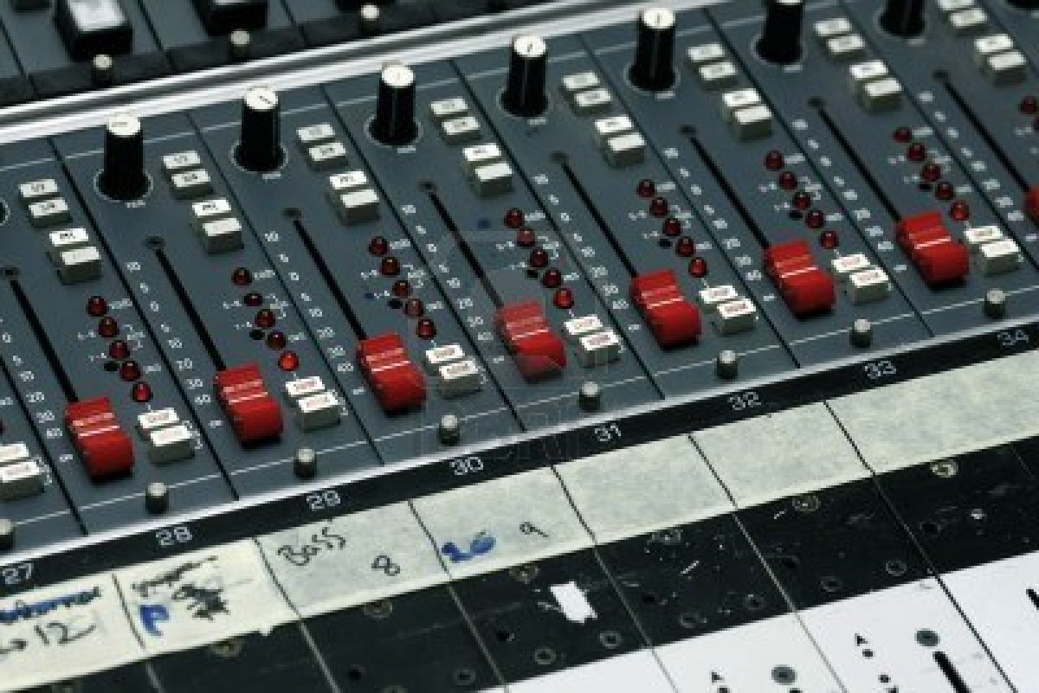
Flexibility
How easy is it to adapt to new features without changing code
For example, a port that has “Object” as its type specification will handle a wider range of data than a port specified to be a double
Changing the value of a
configuration item rather than
adding a new configuration
item

Slide 55
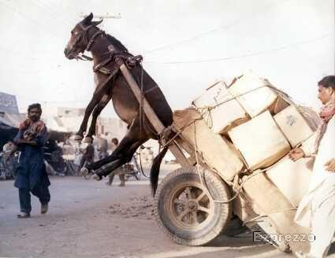
Scalability
50 petabytes of data stored in Hadoop and Teradata, 400 million items for sale, 250 million queries a day, 100,000 pages served per second, 112 million active users, $75 billions sold in 2012 - eBay
Bing found that every 100ms faster
they deliver search result pages
yields 0.6% more in revenue.
Highscalability.com

Slide 56
Variability and Scoping
Scoping a product line constrains the amount of variability needed.
The same is true for an ecosystem but it is harder to bound the ecosystem.
The feature tree for the platform provides the common portion and determines some constraints on the variability.
The extensibility prevents as definitive a scope as a product line.

Slide 57
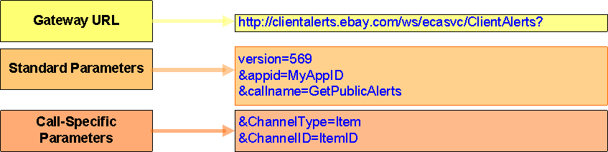
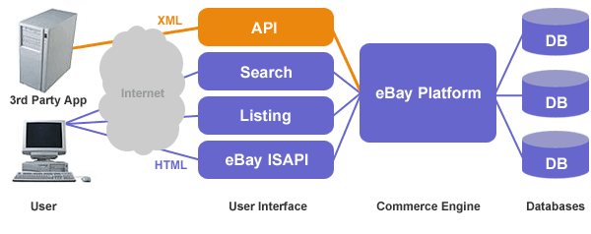
APIs
eBay’s Client Alerts API

Slide 58
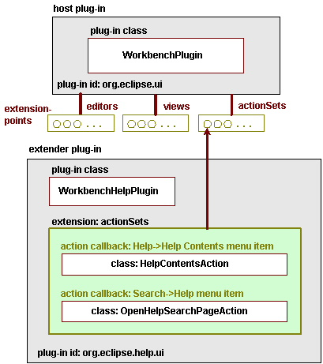
Eclipse plugin architecture

Slide 59
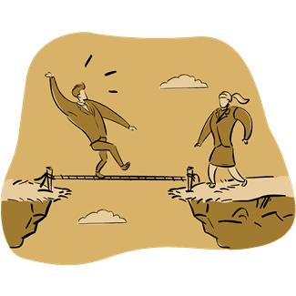
Risks and Threats
Risks – The biggest risk is that the business plans of individual companies will lead to an incoherent set of software offerings which are not mutually supportive. A second risk is a major change in a supplier.
Threats – poor quality, incompatibility among components

Slide 60
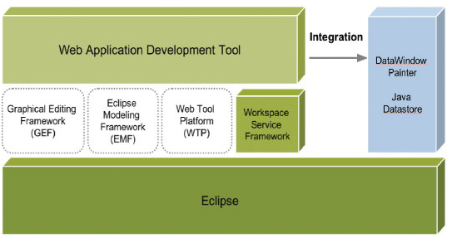
Eclipse Example

Slide 61
Innovation viewpoint

Slide 62

Innovation Ecosystem
One software product line organization defined a unique business model to fund their core asset base. The license for use of their assets required that any new assets the product builders produced became part of the core asset base.
This innovative license distributed the cost of extending the core asset base, beyond the basic assets, to those who reap the greatest benefits.
The innovation is connected to the organization(s) that created it and when appropriate to the software that implements it.

Slide 63
The latest
The chief competitor to Apple’s iPad isn’t a hardware company like Samsung it is Amazon’s Kindle Fire
Innovation crosses traditional boundaries
Tablets now out sell PCs
Turns out the majority of people don’t need the power of a desktop at home

Slide 64
Innovation Viewpoint
This viewpoint is harder to categorize than others because you don’t know it til you see it.
The classes of innovation defined by Businessweek include:
Product - tablet
Process – continuous integration
Customer Experience – customize products
Business Model - coopetition

Slide 65

Risks and Threats
Risks
The biggest risk is that the market will not be ready for a particular innovation. Early in the innovation process we should trace an ecosystem thread to determine the members of the ecosystem that must be “ready” for our innovation. Imagine releasing your latest record on CD before CD players are cheap enough so that many people own them.
Threats
The biggest threat is the pressure to remain on schedule while innovating. By its nature innovation is more difficult to predict. Giving in to schedule pressure will often kill the most risky, but most promising , project.

Slide 66
Eclipse Example
Product - The Eclipse architecture uses several innovative features: plug-ins and dependency injection which support a number of powerful design patterns. The ability for a developer to choose the tools they want to work with and then integrate them into an environment has been a powerful selling point.
Process - The extensive review process before release, the synchronizing of sub-projects before release, the intellectual property reviews before contributions are accepted, and the project maturation process are examples of innovative processes for an open source organization.
Customer Experience - The business model for Eclipse results in a more complete, more professional package for customers, where a customer is another developer who is reusing plug-ins to build new plug-ins or is an end user of an Eclipse-based RCP application in any one of hundreds of topics.
Business Model - The Eclipse Foundation has a business model that may be unique in its totality. It is an open source project, which is hardly innovative, but it was one of the first to use such a high percentage of paid contributors.

Slide 67

That is a tour of the three viewpoints
Now we turn to techniques for creating useful information about the ecosystem from the large quantities of data typically available
But before we go on, questions??

Slide 68
Ecosystem Analyses and uses

Slide 69
Model
We built the model to help with decision making
Before we began modeling we identified the questions the model had to help answer in order to include the correct information
Now we extract data from the model
Sometimes just seeing the contents of the ecosystem is useful
Network metrics
Paths through model

Slide 70
Model - 2
We want to look for “features” in the ecosystem
Clusters are working groups that are productive and a prime source of innovation as inputs from members of the cluster are integrated. The Hub of the analysis usually is also the center of a cluster, but other clusters may indicate potential competitors or at least organizations that may force a different trajectory. These clusters may be hubs of their own ecosystem
Bridges bring groups together – groups of businesses or groups of software products; two clusters
Brokers represent a group to the rest of the ecosystem; such as a cluster

Slide 71
Looking for basics
Hub – look for emergence of competing hubs
Broker – look for entities going around the broker to establish direct connections
Bridge – look for changes in throughput of the bridge
Cluster – look for fewer participants in the cluster

Slide 72
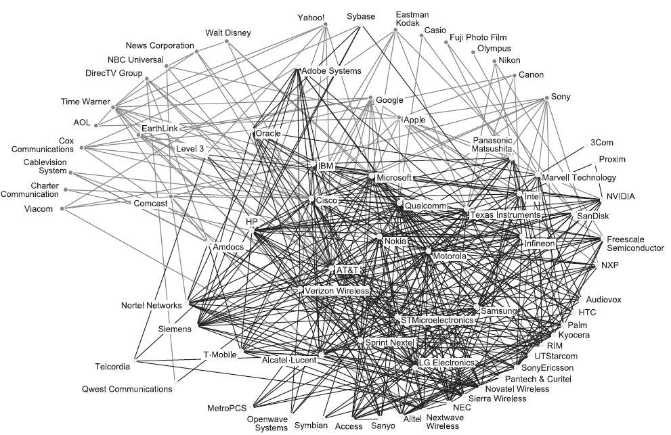
R.C. Basole, Visualization of interfirm relations in a converging mobile ecosystem,
in Journal of Information Technology, 24, pp. 144 – 159.

Slide 73
Network metrics
average in-degree of nodes - number of in links an entity has at a given point in time – how important is this node to the operation of the ecosystem
average out-degree of nodes - number of out links (dependencies) an entity has at a given point in time – how complex or difficult to maintain
average degree of partners - average number of links that an entity’s partners have – defines the extent of the supply chain
path length - the number of steps to reach a specific entity in the network –

Slide 74
Network metrics - 2
clustering coefficient - the degree to which a firm’s partners are also partners which each other – identifies voting blocks in a consortium
network density - the ratio of links that exist in the network to the number of potential links that could be if all possible pairs of nodes were directly connected – modularity of the software or business relationships

Slide 75
eBay’s technical ecosystem dashboard
The server farm is a significant expense for a software ecosystem.
http://www.datafinancenews.com/news/ebay-releases-new-metric-giving-holistic-view-of-a-companys-technical-ecosystem-dse-fine-tunes-datacentre-infrastructure/
By using the DSE dashboard, eBay software engineers have already allowed the company to avoid a $2million server refresh by removing 400 servers from a server pool by slightly decreasing the memory allocated for an application in the pool. 1MW of power consumption was also eliminated. - See more at: http://www.datafinancenews.com/news/ebay-releases-new-metric-giving-holistic-view-of-a-companys-technical-ecosystem-dse-fine-tunes-datacentre-infrastructure/#sthash.bek1Jkxd.dpuf

Slide 76
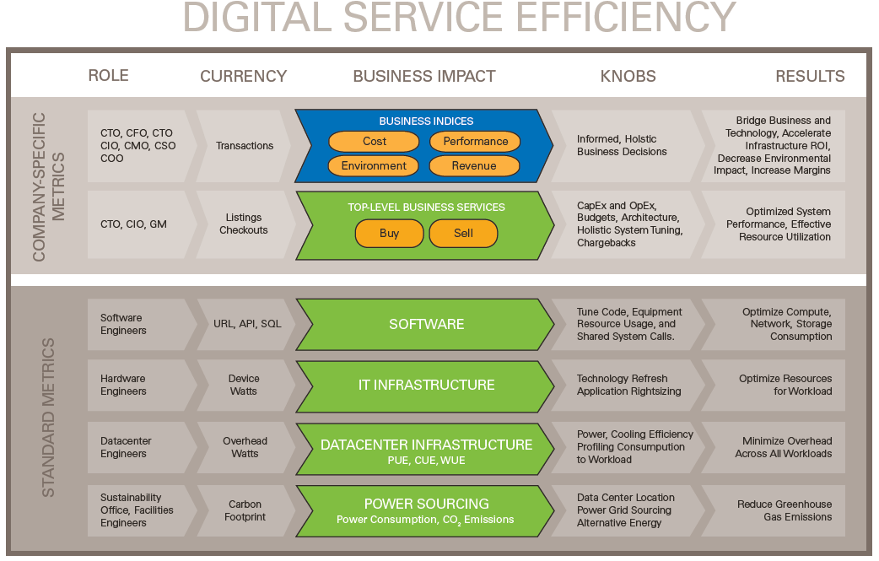
eBay’s dashboard

Slide 77
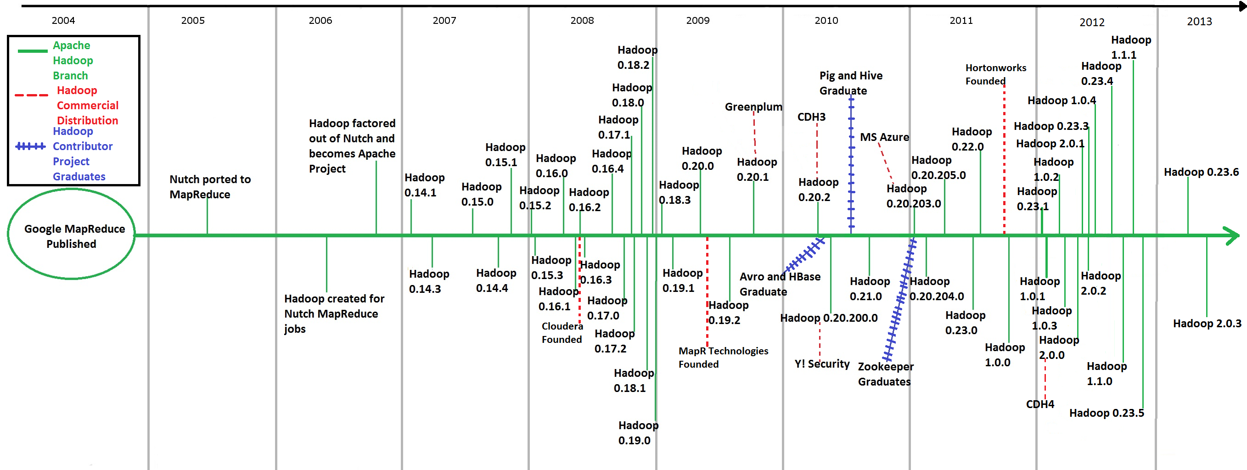
Timelines put things in perspective

Slide 78
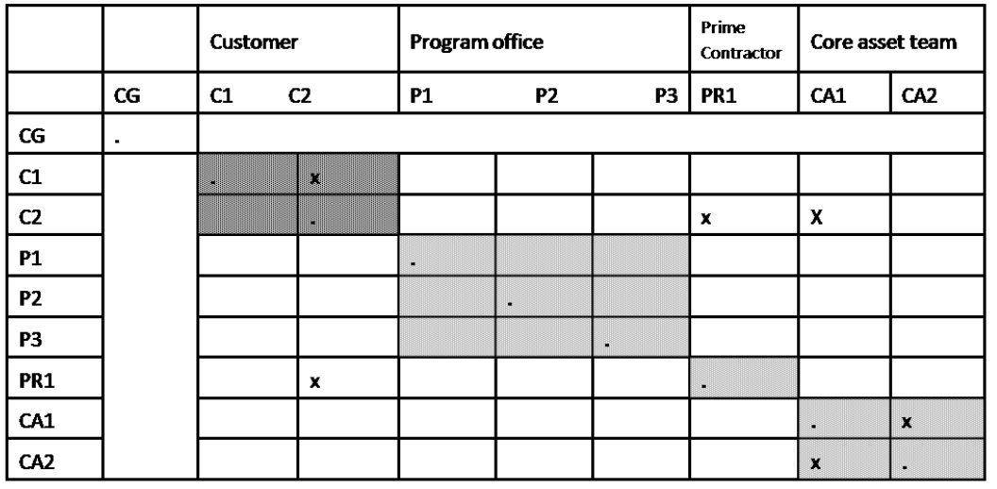
Task Dependency Matrix
Same as the Design Structure Matrix (DSM) but use business relationship
We strive for the same modularity and independence we look for in software.

Slide 79

Issues that could potentially be examined at an ecosystem level
Sustainability
Security
Pollutants in the supply chain
Technical debt
Completeness

Slide 80
Strengthening the ecosystem
Usually only hubs are big enough to afford activities that sustain the ecosystem
Hold conferences such as EclipseCon
Publish material about the activities or maintain a web portal with forums, etc
Market the ecosystem to targeted organizations
Set requirements such as yearly contribution of publications that mention the ecosystem

Slide 81
Assessment
The success criteria for the client must be in balance with its ecosystem. Productivity, stability, and robustness are possible criteria.
What explicit activities does the ecosystem do to build a sense of community?
What is the platform strategy? Is there a roadmap that meets the needs of the community? Is it flexible enough to support niche players?

Slide 82
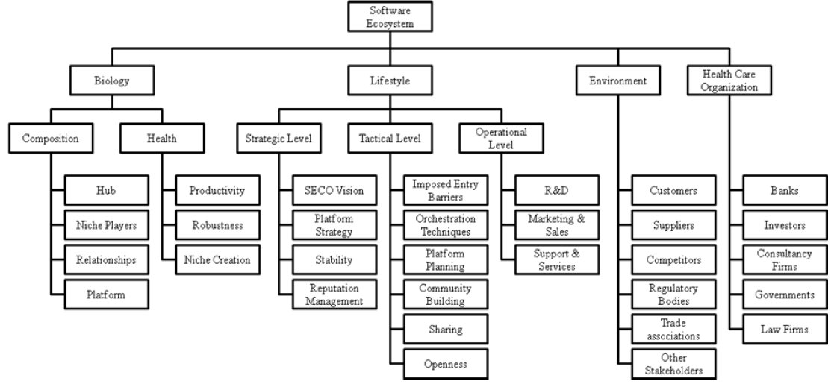
Ecosystem Assessment
A number of attributes of the ecosystem can be the basis for analysis, manipulation, and evaluation.

Slide 83
Analysis - Health
Measures of ecosystem health
Productivity – how easy is it to build products
Robustness – adapting to changes in the domain
Niche Creation – evolution of the scope and core asset base

Slide 84
Productivity of Hadoop Ecosystem

Slide 85
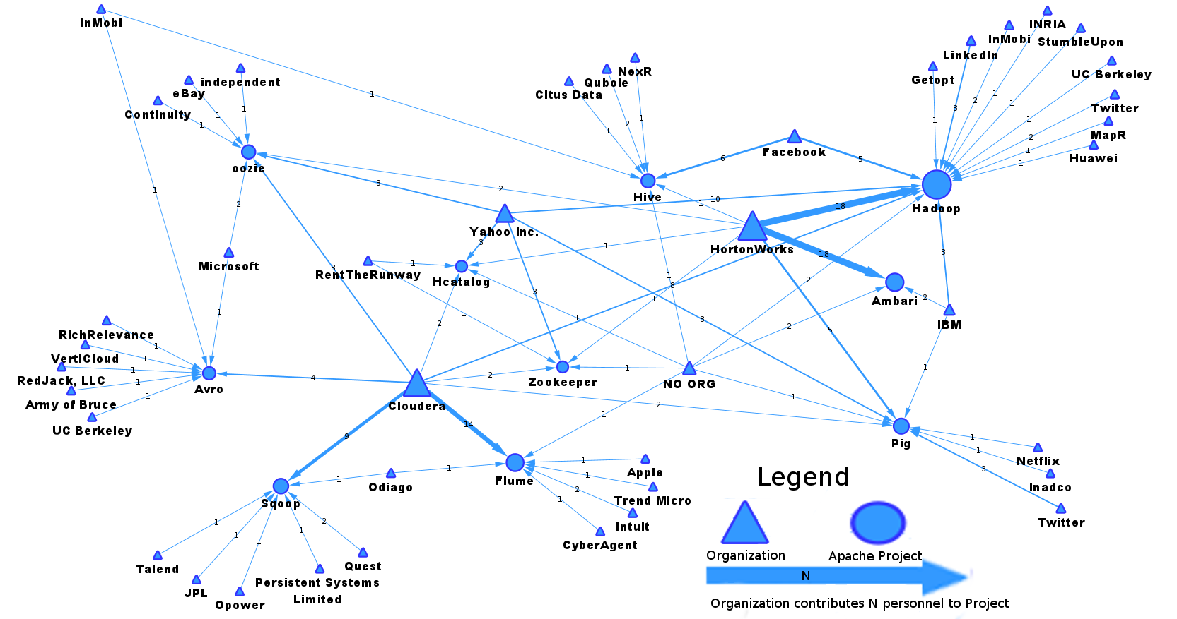
Robustness of Hadoop Ecosystem
Robustness – There is a very diverse group of companies involved in Hadoop.

Slide 86
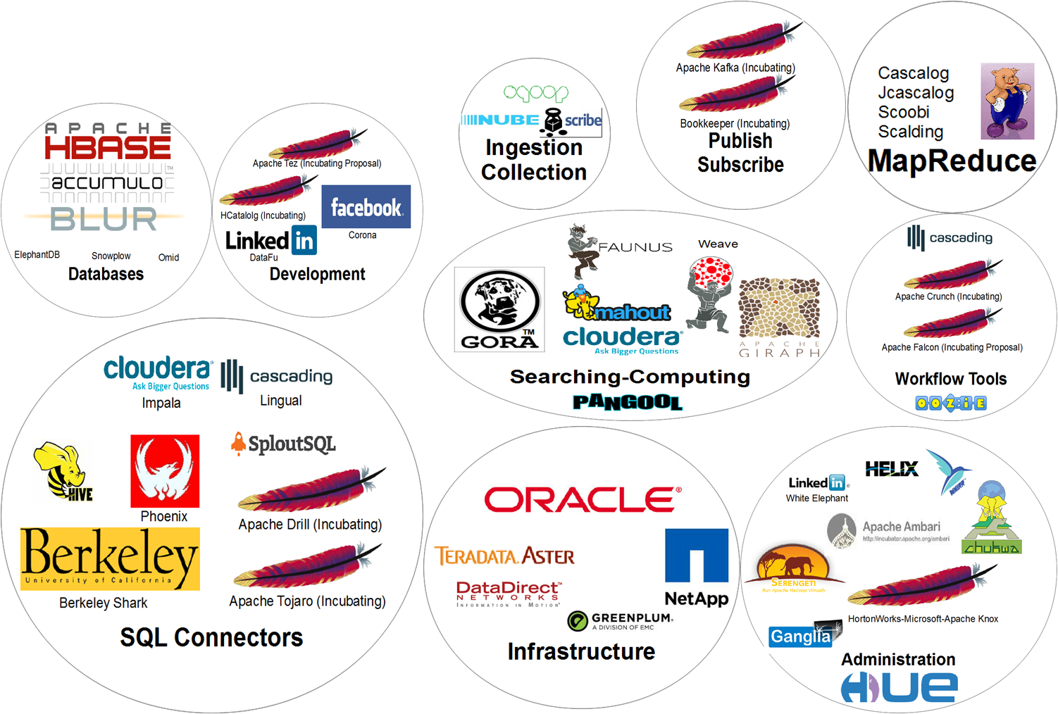
Niche Creation in Hadoop Ecosystem

Slide 87
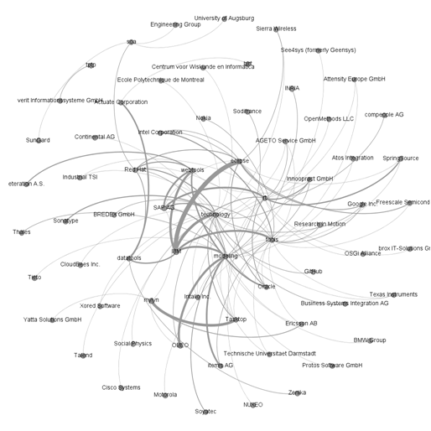
Using Ecosystem Data to make Decisions
Which members of the ecosystem are important?
Which members will be affected by a specific decision?
Some of the paths through this model represent standard strategic structures such as the value chains for an organization.
A strategic modeling tool will allow us to capture relevant information about each member of the ecosystem.
The tool also allows us to filter the representation to show only members that meet a criterion.
Mission threads can be mapped onto the ecosystem model

Slide 88
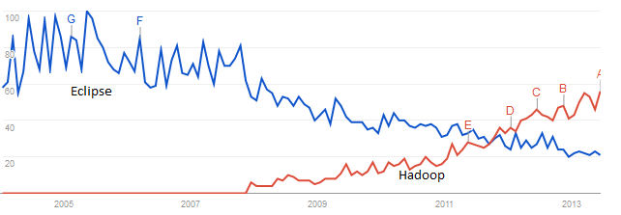
Google Trends gives a rough comparison or gauge of popularity

Slide 89
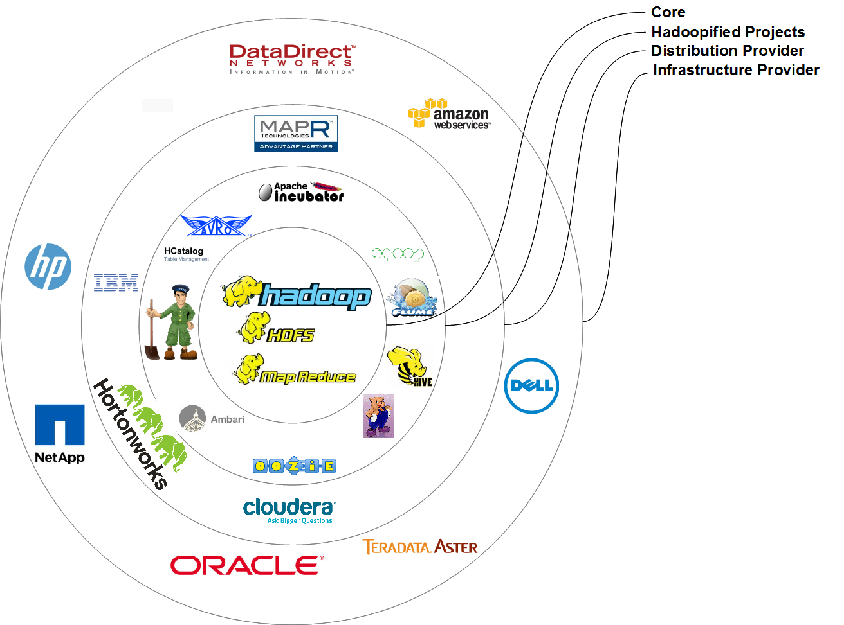
Evolutionary Forces

Slide 90
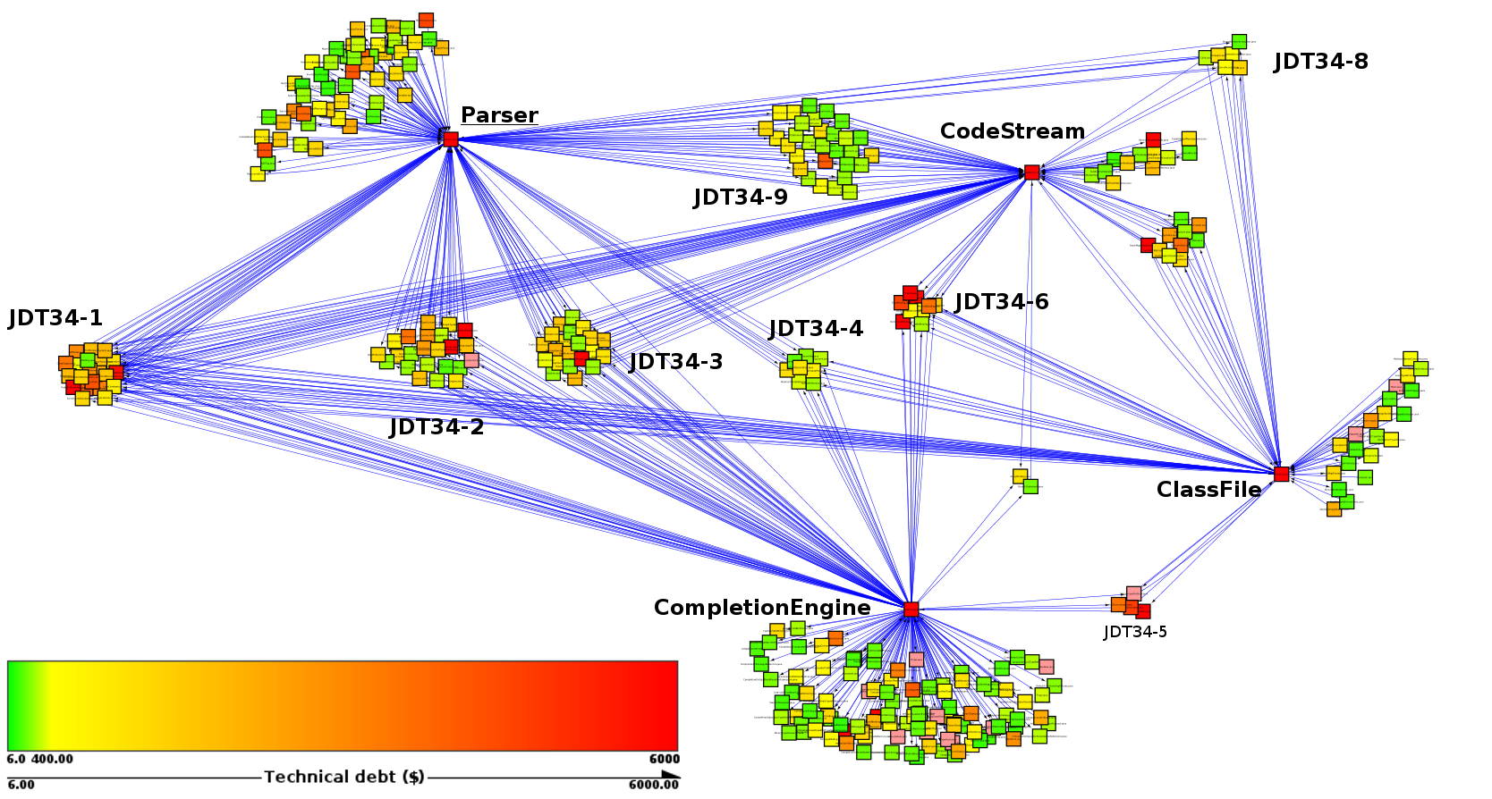
Eclipse – JDT 3.4

Slide 91
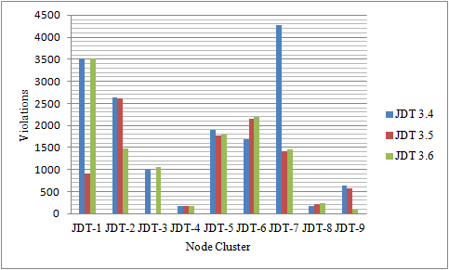
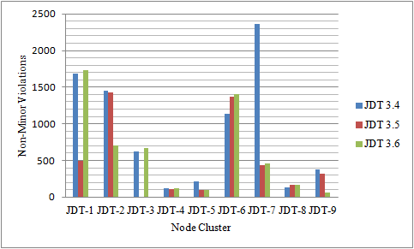
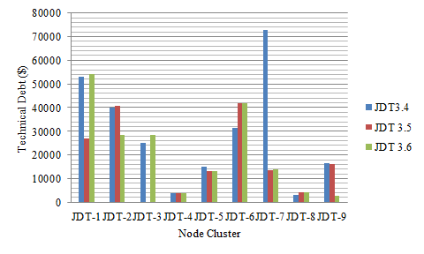
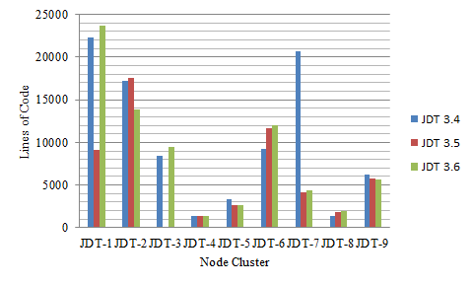
Coding standard violations

Slide 92
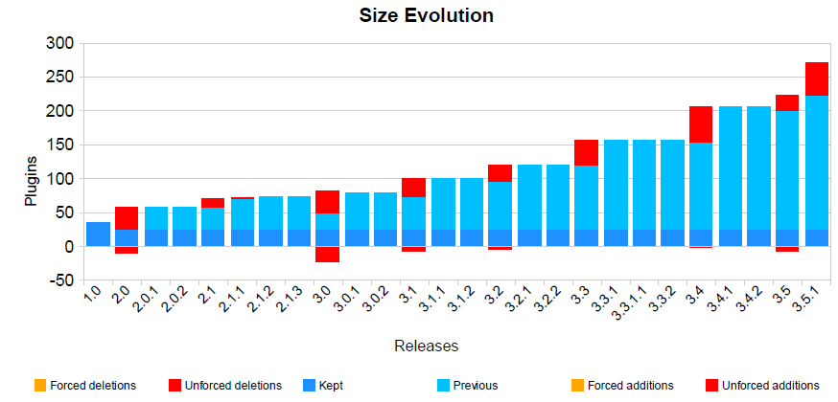
Ecosystem metrics
The software architecture promotes productivity as measured by the number of extensions, number of downloads, or number of developers creating extensions, e.g. plug-ins. Looking for trends.

Slide 93
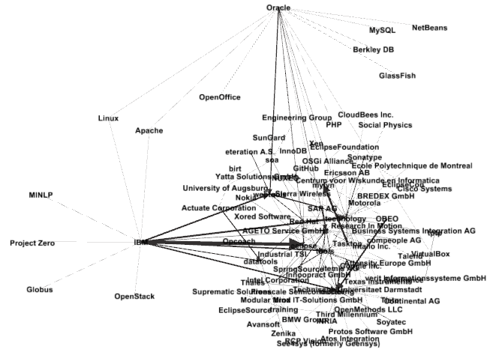
Relationships among organizations
Different sized lines indicate different numbers of out degree.
You can see the interplay between IBM and Oracle in this ecosystem

Slide 94
Transaction Threads
Following a mission thread and identifying the transactions and transfers allows us to track boundaries of organizations, communities or other collectives.
Tools such as Cytoscape make this
easy by highlighting selected
elements that follow a path.

Slide 95
Ecosystem development plan

Slide 96
Ecosystem Development Plan
An ecosystem exists in a complex environment of interacting ecosystems and competing markets.
The best way to build the ecosystem is to have explicit, attractive value propositions for each type of stakeholder.
Set up activities that promote membership interaction – conferences, forums for more than technical questions.

Slide 97
Ecosystem Development Plan - 2
What is the value proposition for every stakeholder you want involved?
Do mini-experiments to give stakeholders exactly what they want.
What groups related to those in the ecosystem are underrepresented or not represented at all?

Slide 98
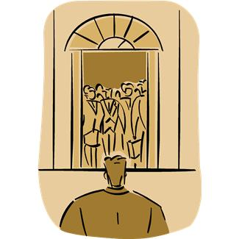
Ecosystem Development Plan - 3
How easy is it for a new entrant to determine how to get involved?
How do each of these contribute to innovation?
How do you plan to increase involvement at each level?

Slide 99
conclusion

Slide 100
Results to date
Strategic managers like and use the results.
Non-strategic managers don’t see the point.
Ecosystem is rapidly growing in popularity as a business model and ecosystem modeling is a successful strategic management tool.
It is a different mindset since some control is given over to the community.

Slide 101
Results, cont’d
Organizations can take explicit steps to strengthen the ecosystem(s) in which they reside.
Our method of three viewpoints reduces complexity for the managers making the model useful rather than simply beautiful.

Slide 102


Slide 103
References
Bosch, J. Software Product Lines to Software Ecosystems. SPLC 2009: 111-119.
John D. McGregor: A method for analyzing software product line ecosystems. ECSA Companion Volume 2010: 73-80.
Philippe Kruchten. The Rational Unified Process: An Introduction (2nd Edition), Addison-Wesley, 2000.
Victor R. Basili and Gianluigi Caldiera and H. Dieter Rombach. The Goal Question Metric Approach, Encyclopedia of Software Engineering,Wiley, 1994.
Gephi, Gephi.org (visited 2/11/2012).
Ron Adner. Match Your Innovation Strategy to Your Innovation Ecosystem, Harvard Business Review, 2006.
Marco Iansiti and Roy Levien. Strategy as Ecology, Harvard Business Review, March 2004.
Martti Viljainen and Marjo Kauppinen. Software Ecosystems: A Set of Management Practices for Platform Integrators in the Telecom Industry, Lecture Notes in Business Information Processing Volume 80, 2011, pp 32-43
Baldwin, Carliss Y. "Where Do Transactions Come From? Modularity, Transactions, and the Boundaries of Firms." Industrial and Corporate Change 17, no. 1 (February 2008): 155-195.
Michael E. Porter. How Competitive Forces Shape Strategy, Harvard Business Review, 1979.

