Slide 1

CPSC 871
John D. McGregor
Model-driven Software Engineering
Module 0 Session 2

Slide 2
Models
A model is an abstraction from reality.
We omit certain details when we create the model.
Any “real” entity can be modeled in multiple ways depending upon which details are suppressed and which are visible in the model.

Slide 3
Models - 2
To be useful a model has to be amenable to analysis.
A standard notation with standard semantics supports tools that can compute measures based on the structures.
Software engineers have defined many modeling languages that support analysis.
We will look at a few this semester.

Slide 4
Abstraction
Languages such as FORTRAN have used abstraction as a means to hide the complexity of the basic machine.
Improvements in the ability to handle complexity are eventually overcome by increases in scale and additional complexity until new abstractions are defined.
Model-driven techniques appear to be the next technology to hide complexity.

Slide 5
Tower of abstraction
M3: Meta- Object Facility
M2: Process Metamodel
M1: Process Model
abstraction
M0: Enacted
Process
# of elements

Slide 6
Model-driven
Model-driven refers to the use of models as the primary means of abstraction.
There are numerous modeling notations.
A primary source has been the Object Management Group (OMG) which has produced:
  The Unified Modeling Language (UML)
  The System Modeling Language (SysML)
The Society for Automotive Engineering (SAE) has produced the Architecture Analysis and Design Language (AADL)
These will be the languages we use this semester.

Slide 7
Modeling
Modeling begins in the problem space and then moves to the solution space.
The notation used in the problem space must make it easy to represent the types of problems to be solved. And likewise the solution space notation must have a natural mapping to the underlying machine upon which the solution must execute.
The UML notation encompasses 8 different diagrams that represent different perspectives of the problem and the solution.

Slide 8
UML Diagrams
Use Case Diagram
Class Diagram
Sequence Diagram
Collaboration Diagram
State Diagram
Activity Diagram
Component Diagram
Deployment Diagram

Slide 9
SySML
SySML is a “profile” of UML. That is SySML is defined by extending UML.
4 diagrams are added
  Requirements diagram
  Parametric diagram
  Block definition diagram
  Internal block diagram
And the activity diagram is modified from UML

Slide 10
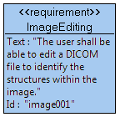
For example:
The requirements for a product can be represented using the SysML language which has a “requirement” construct.
In these modeling languages there are graphical and xml-based representations.
Here is the SysML requirement construct.

Slide 11
Modeling tools
The modeling tool we will use is Topcased, which can be found at www.topcased.org.
It is an open-source tool that is built on top of the Eclipse platform.
We will use the tool to capture the problem and our solution to the problem.
The advantage of this approach is a repeatable process for capturing, analyzing, and transforming information about the problem.

Slide 12
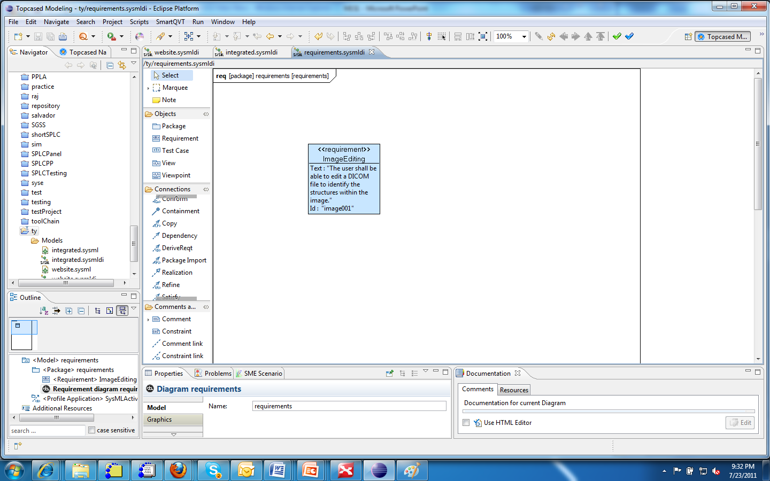
Screen shot of Topcased
6
1
2
4
3
5

Slide 13
Topcased GUI regions
1 – This is the list of projects in the current workspace.
2 – The pallet of icons that are legal elements of diagram type being edited.
3 – This is a decomposition of the current model and its constituent diagrams.
4 – Modeling canvas where elements are laid out.
5 – These tabs contain various editors and displays.
6 – Menu bar with quick access to functions.

Slide 14
What’s next?
Install Topcased 5.0 from www.topcased.org.
Go to www.topcased.org and select documentation. You will find a list of tutorials.
Begin learning how to use the tool by producing a requirements diagram for our problem.
View the wink tutorial from the module page

