Slide 1

CPSC 871
John D. McGregor
Module 1 Session 2
Requirements Elicitation/analysis

Slide 2
Reference
Work through chapter 2 of the SWEBoK
http://www.computer.org/portal/web/swebok/html/contentsch2#ch2

Slide 3
Defining the problem
The first task is to understand the problem.
A systems engineer may analyze the system to be built and develop a set of requirements and “allocate” some of those requirements to be handled by the software portion of the system.
Or we may need to interact directly with potential users of the product.

Slide 4
A digression about systems engineering
A systems engineer is trained to analyze complex situations and to break a needed system down into constituent parts where each part is either hardware-based or software-based.
For example, a cell phone has a radio, a keypad, and a body that opens and closes. The phone also has an address book, web browser, etc. The first are in hardware and the last in software.

Slide 5
Systems engineering
The systems engineer works with experts in the domain of the system, e.g. telephony.
The “features” of the system are defined at a high-level
The systems engineer then takes each feature and creates a more detailed and complete definition. They add attributes that characterize the operation of the product.
The engineer determines which features are to be handled by hardware and by software. This starts the software requirements process.

Slide 6
Software only
For products that do not involve hardware within the definition of the product a software engineer will initiate the requirements process.
The engineer “elicits” requirements from stakeholders of the product. That is, the engineer uses techniques to get the stakeholder to express ideas about the product.
A “stakeholder” is anyone with an interest in a product. It might be a user, the person purchasing the product, the people who will build it and the list goes on.
Some requirements are obvious, the product has to provide the functions necessary to control a piece of hardware such as an automobile but often we need additional techiques.

Slide 7
Use cases
A use case is a description of how the product will be used. The idea is that it is easier to get a stakeholder to tell how they would interact with the product than to give some abstract statement of requirement.
The “actor” in a use case is the entity outside the system who stimulates the product.
The “use” is a structured scenario that describes how the product is used.

Slide 8
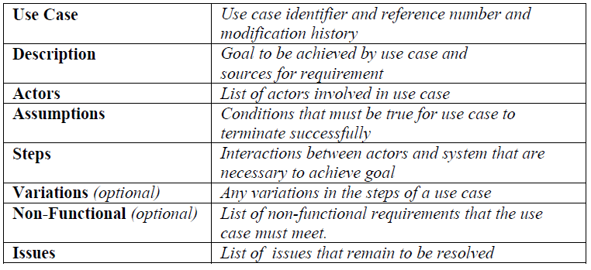
Template
Here is one template for a use case:
Topcased also has a structure for a use case.

Slide 9
Scenario
The use case scenario may be structured like a dialogue between the actor and the system:
A “rainy” day scenario would be one in which the actor enters an invalid password.
The actor … | The system responds by:
Enters a valid user name | Checking the name and then displays the password entry
Enters a valid password | Checking the password and displaying the initial level menu

Slide 10
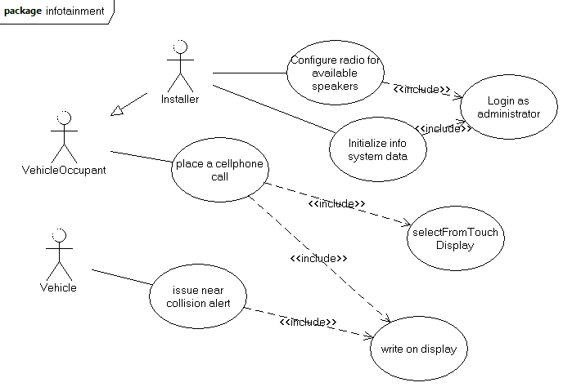
UML use case diagram

Slide 11
Topcased
Create a Topcased project
Create a SysML use case diagram
Create a few use cases about the target system
Fill in the information in various editors for each use case.

Slide 12
Stakeholder interviews
To get the information needed to complete the use cases the stakeholders are interviewed
Each stakeholder lists all of the outside stimuli they can think of
Engineers take one stimulus at a time, associate it with an actor, and ask for a detailed description
The more items in the model, the more it stimulates the stakeholders to think of other things.

Slide 13
Requirements
Once a set of use cases has been developed one of a couple of things can happen
Some teams use the use cases as the requirements and they move on to design
Other teams create a set of requirements
These are explicit statements of the form:
  The system shall…
  The system should…

Slide 14
Requirements - 2
Functional requirements define WHAT the product must do.
  Compute an image
  Make a long-distance phone call
Non-functional requirements define HOW the product must perform.
  Performance
  Reliability
  Availability

Slide 15
Requirements - 3
Priority
  Life-critical
  Mission-critical
  Strategic
  Tactical
The priority determines how much testing, how much analysis and design, etc.
Requirements may be volatile or stable, which affects the level of formality.

Slide 16
Requirements analysis
Once an initial round of elicitation is completed, the requirements model is analyzed.
Analysis is a systematic examination that applies a set of rules and assumptions to the requirements model.
Object-oriented analysis and structured analysis are two examples of widely-used analysis techniques.

Slide 17
Object-oriented analysis
Object-oriented analysis uses a set of representations to represent the domain knowledge and requirements.
This representation is intended to provide a bridge between a set of problem-space concepts and a set of solution space concepts.
The idea being that a solution should embed the problem within itself. Then as the problem changes, changes to the solution are a natural consequence.

Slide 18
Object-oriented analysis - 2
We will use the Unified Modeling Language (UML) and the Architecture Analysis and Design Language (AADL) as the representations.
Both of these languages allow us to create models that support various automated analyses.
Topcased supports both of these languages.
In fact the use case diagram is a part of UML.

Slide 19
Domain analysis
Usually a company does not solve one problem and then move on to a completely unrelated new problem.
They develop expertise in one domain (body of knowledge).
Domain analysis captures that body of knowledge.

Slide 20

Domain analysis - 2
Concepts, such as device, radio, and television, are represented as “entities” using the UML class diagram. Each concept is represented in a three part box that includes the name of the concept, data that characterizes the concept, and behaviors related to the concept.
The class definition “encapsulates,” i.e. groups together the elements that are used together.

Slide 21
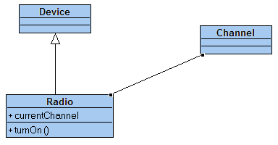
Domain analysis - 3
Concepts are related to one another.
“Device” is a concept that is more general than “Radio.”
“Channel” is a property of a “Radio”.

Slide 22
Domain analysis - 3
In domain analysis we capture “what is” the actual structure of the domain we are analyzing.
We will see later that in design we elaborate on that to get a design of what we need to solve the problem.
“What is” includes concepts but also algorithms, the deployment of software to hardware, and the stateful behavior of the entities in the domain.

Slide 23
Stateful behavior
Lets consider the Radio as a stateful entity in our domain.
What significantly different modes of operation does it have?
It can be turned on or off. Its sound can be muted or not.
It can be on one of three bands: AM, FM-1, and FM-2.

Slide 24
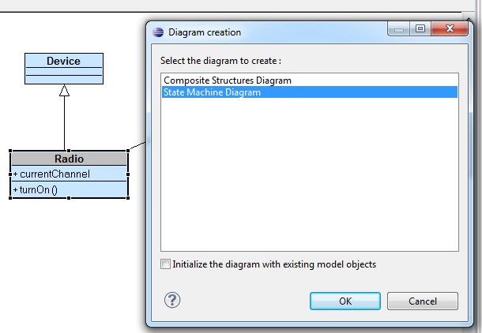
Embedded state machine
Double click on Radio and the dialog looks like below. Select State
Machine Diagram.

Slide 25
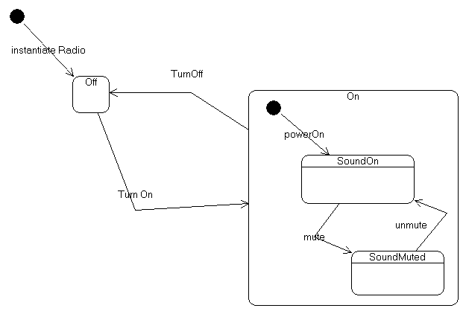
Radio
The state machine for the mute button is nested inside the state machine for the radio.
This is in the domain analysis part of our work because we are capturing how the underlying hardware works.

Slide 26
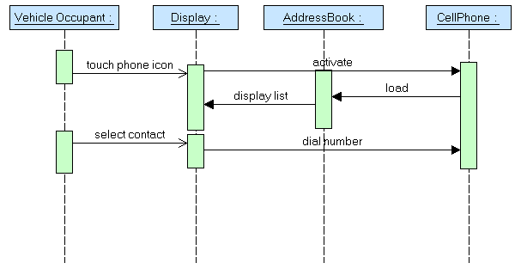
Algorithms
The sequence diagram allows us to capture common sequences of operations.
Here we capture how to make a phone call.
This is domain information because it is how most cell phones work so it is basic information.

Slide 27
The complete model
The complete model involves numerous diagrams of several diagram types.
Remember that UML stands for the Unified Modeling LANGUAGE. Think of the modeling of a domain as telling a story written in this language. Think of the diagrams as communication with others.
The domain information is used in conjunction with the requirements model to be certain that the requirements are understood in the context of the domain.

