Slide 1

CPSC 871
John D. McGregor
Module 2 Session 1
Project Management

Slide 2
Objective
In this module we will explore some supporting areas including project management and change management.
Read http://www.computer.org/portal/web/swebok/html/contentsch8#ch8

Slide 3
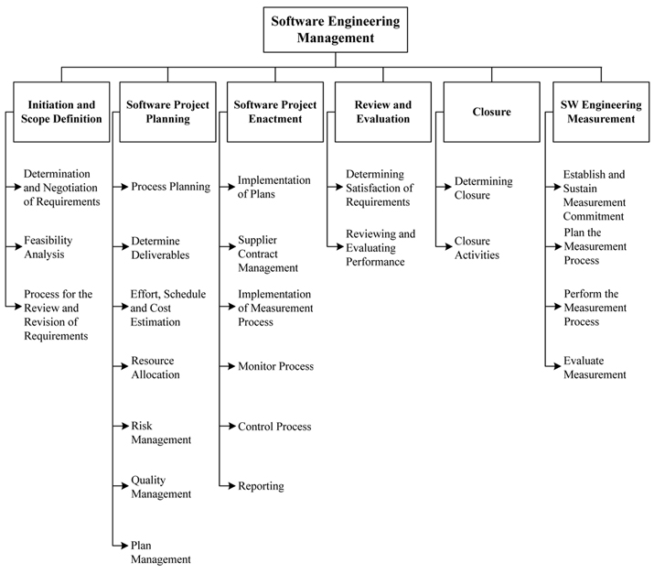
Management topics

Slide 4
Project Planning
The Project Planning tasks ensure that various elements of the Project are coordinated and therefore guide the project execution
Canonical saying: If you fail to plan, you plan to fail.

Slide 5
Planning includes
1) Project Scope Definition and Scope Planning 2) Project Activity Definition and Activity Sequencing 3) Time, Effort and Resource Estimation 4) Risk Factors Identification 5) Cost Estimation and Budgeting 6) Organizational and Resource Planning 7) Schedule Development 8) Quality Planning 9) Risk Management Planning 10) Project Plan Development and Execution 11) Performance Reporting 12) Planning Change Management 13) Project Rollout Planning

Slide 6
SWOT – know the organization
Strengths
reputation
Weaknesses
No new products
Opportunities
Innovation will cut prices in half
Threats
Others are licensing the same technology

Slide 7
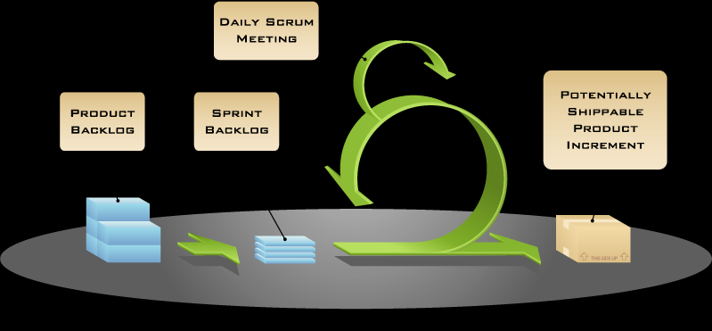
Agile

Slide 8
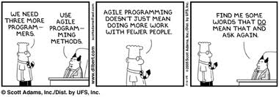
Effort estimation
Process steps => who will carry them out => what is the productivity of those people?
Personal software process (PSP) tracks time to do a job as well as # of errors to get productivity.
Most projects require decomposition.

Slide 9
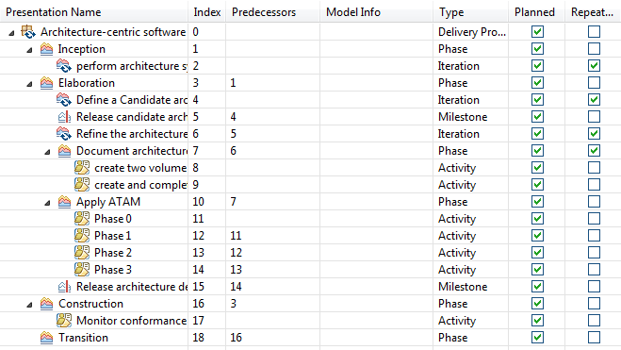
Work Breakdown Structure (WBS)

Slide 10
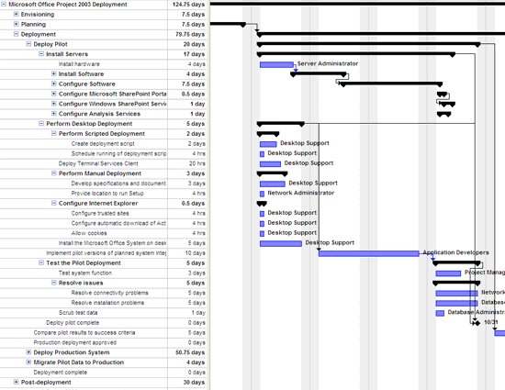
Microsoft project

Slide 11
Cost Estimation
COnstructive COst MOdel II (COCOMO™ II)
Read http://csse.usc.edu/csse/research/COCOMOII/cocomo_main.html

Slide 12
Object points
Object points (alternatively named application points) are an alternative function-related measure to function points when 4Gls or similar languages are used for development.
Object points are NOT the same as object classes.
The number of object points in a program is a weighted estimate of
The number of separate screens that are displayed;
The number of reports that are produced by the system;
The number of program modules that must be developed to supplement the database code;

Slide 13
Object point estimation
Object points are easier to estimate from a specification than function points as they are simply concerned with screens, reports and programming language modules.
They can therefore be estimated at a fairly early point in the development process.
At this stage, it is very difficult to estimate the number of lines of code in a system.

Slide 14
Algorithmic cost modelling
Cost is estimated as a mathematical function of product, project and process attributes whose values are estimated by project managers:
Effort = A × Size^{B} × M
A is an organisation-dependent constant, B reflects the disproportionate effort for large projects and M is a multiplier reflecting product, process and people attributes.
The most commonly used product attribute for cost estimation is code size.
Most models are similar but they use different values for A, B and M.

Slide 15
Productivity estimates
Real-time embedded systems, 40-160 LOC/P-month.
Systems programs , 150-400 LOC/P-month.
Commercial applications, 200-900 LOC/P-month.
In object points, productivity has been measured between 4 and 50 object points/month depending on tool support and developer capability.

Slide 16
COCOMO 2 models
COCOMO 2 incorporates a range of sub-models that produce increasingly detailed software estimates.
The sub-models in COCOMO 2 are:
Application composition model. Used when software is composed from existing parts.
Early design model. Used when requirements are available but design has not yet started.
Reuse model. Used to compute the effort of integrating reusable components.
Post-architecture model. Used once the system architecture has been designed and more information about the system is available.

Slide 17
Use of COCOMO 2 models

Slide 18
Risk management
The purpose of Risk Management (RSKM) is to identify potential problems before they occur so that risk-handling activities can be planned and invoked as needed across the life of the product or project to mitigate adverse impacts on achieving objectives.
Potential problem – failure to complete on time
Probability of occurrence – 50%
Consequences – loss of initial sales surge for an innovation

Slide 19
Risk management - 2
How do we “manage” risk?
Define a risk management strategy
Identify and analyze risks
Handle risks by mitigating
Continuous risk management strategy
Identify risks EVERYWHERE
List risks, prioritize risks, and plan mitigations
Monitor, revise, and react

Slide 20
Risk management - 3
For our continuing problem
Risk – The product may not be simple enough for the audience.
Probability – Most software engineers these days do not have a strong math background.
Consequences – won’t use the product
Mitigation – iterations of GUI design and usability testing

Slide 21
Software Quality Assurance (SQA)
Includes reviews/inspections, coding standards, testing, and other activities
In life critical systems software safety engineering is one of the high-priority activities
The software quality engineer watches over everything from a quality perspective.
Witnesses every important test.

Slide 22
SQA Plan outline
3.1 Task: Review Software Products 3-4
3.2 Task: Evaluate Software Tools 3-4
3.3 Task: Evaluate Facilities 3-4
3.4 Task: Evaluate Software Products Review Process 3-4
3.5 Task: Evaluate Project Planning, Tracking and Oversight Processes 3-4
3.6 Task: Evaluate System Requirements Analysis Process 3-4
3.7 Task: Evaluate System Design Process 3-4
3.8 Task: Evaluate Software Requirements Analysis Process 3-4
3.9 Task: Evaluate Software Design Process 3-4
3.10 Task: Evaluate Software Implementation and Unit Testing Process 3-4
3.11 Task: Evaluate Unit Integration and Testing, CI Qualification Testing, CI/HWCI Integration and Testing, and System Qualification Testing Processes 3-4
3.12 Task: Evaluate End-item delivery Process 3-4

Slide 23
SQA Plan outline - 2
3.13 Task: Evaluate the Corrective Action Process 3-4
3.14 Task: Media Certification 3-4
3.15 Task: Non-Deliverable Software Certification 3-4
3.16 Task: Evaluate Storage and Handling Process 3-4
3.17 Task: Evaluate Subcontractor Control 3-4
3.18 Task: Evaluate Deviations and Waivers 3-4
3.19 Task: Evaluate Configuration Management Process 3-4
3.20 Task: Evaluate Software Development Library Control Process 3-4
3.21 Task: Evaluate Non-Developmental Software 3-4
3.22 Task: Verify Project Reviews and Audits 3-4
3.22.1 Task: Verify Technical Reviews 3-4
3.22.2 Task: Verify Management Reviews 3-4
3.22.3 Task: Conduct Process Audits 3-4
3.22.4 Task: Conduct Configuration Audits 3-4
3.23 Task: Verify Software Quality Assurance 3-4
3.24 Responsibilities 3-4
3.25 Schedule 3-4

Slide 24
Quality Management
“quality” is actually a multi-part idea
All those non-functional requirements set goals for the quality attributes of a system
ISO 9126
Functionality: are the required functions available, including interoperabilithy and security
Reliability: maturity, fault tolerance and recoverability
Usability: how easy it is to understand, learn, operate the software system
Efficiency: performance and resource behaviour
Maintainability: how easy is it to modify the software
Portability: can the software easily be transfered to another environment, including installability

Slide 25
Runtime Qualities
Functionality Definition: the ability of the system to do the work for which it was intended. Performance Definition: the response time, utilization, and throughput behavior of the system. Not to be confused with human performance or system delivery time. Security Definition: a measure of system’s ability to resist unauthorized attempts at usage or behavior modification, while still providing service to legitimate users. Availability (Reliability quality attributes falls under this category) Definition: the measure of time that the system is up and running correctly; the length of time between failures and the length of time needed to resume operation after a failure. Usability Definition: the ease of use and of training the end users of the system. Sub qualities: learnability, efficiency, affect, helpfulness, control. Interoperability Definition: the ability of two or more systems to cooperate at runtime

Slide 26
Non-runtime Qualities
Modifiability Definition: the ease with which a software system can accommodate changes to its software Portability Definition: the ability of a system to run under different computing environments. The environment types can be either hardware or software, but is usually a combination of the two. Reusability Definition: the degree to which existing applications can be reused in new applications. Integrability Definition: the ability to make the separately developed components of the system work correctly together. Testability Definition: the ease with which software can be made to demonstrate its faults

Slide 27
Quality Management - 2
http://software-quality.blogspot.com/2005/08/iso9126-software-quality-attributes.html

Slide 28
Framework
Guiding Vision – Establish a guiding vision for the project and continuously reinforce it through words and actions.
Teamwork & Collaboration – Facilitate collaboration and teamwork through relationships and community.
Simple Rules – Establish and support the team’s set of guiding practices.
Open Information – Provide open access to information.
Light Touch – Apply just enough control to foster emergent order.
Agile Vigilance – Constantly monitor and adjust.

Slide 29
Milestones
Feature freeze - The date when all required features are known and the detailed design has uncovered no more. No more features are inserted into the product.
Code freeze - Implementation of the design has stopped. Some testing of the features has occurred.
System test freeze - Integration testing is complete. Code freeze for system test to start.
Beta ship - The date the Beta software ships to Beta customers
Product ship - The date the product ships to the general customer base

Slide 30
Measurement
To make decisions we need data
Measurements of the products provides some of that:
Size – often given in lines of code
Complexity – program is viewed as a graph and the number of paths through the graph is one way of measuring complexity
Testability – how easy it is to make the product fail if it has faults – determines how long in testing
Property-based Software Engineering Measurement CS-TR-3368 – 1 University of Maryland

Slide 31
Measurement - 2
Goal-Question-Metric is a method for determining which measure to use
Goal – what you are trying to achieve
Question – What questions can you ask to determine if you are achieving the goal.
Metric – What measures can you collect that will answer the questions that will tell whether you are achieving the goal or not.

Slide 32
Measurement - 3
Goal: Ship defect free software-intensive products.
Question:
What is the defect density of the code being produced by the current process?
What is the testability of the code?
Metric:
Measure the complexity of the code.
Domain/range ratio

Slide 33
Domain/range ratio
If a function takes 3 parameters and returns a single value, the ration is 3/1
If a function takes 1 parameter and returns one value the ratio is 1 and we should be able to very easily trace the logic.
We can determine the D/R ratio for a class as a container of functions.

Slide 34
McCabe’s Cyclomatic Complexity
measures the number of linearly independent paths through the flowgraph
v(F) = e − n + 2, F the flowgraph of the code, n the number of vertices, e the number of edges
Intuition — the larger the CCN the “more complex” the code
Various sources recommend a CCN of no more than 10-15
For examples: http://www.cs.auckland.ac.nz/compsci702s1c/lectures/ewan/cs702-notes-lec05-ccn.pdf

Slide 35
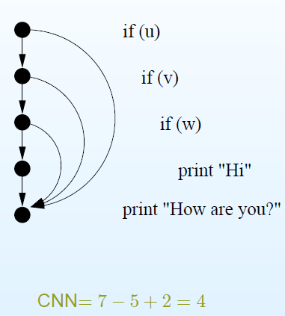
McCabe’s Cyclomatic Complexity - 2

Slide 36
Monitoring
Planning at the beginning and Measuring at the end is not sufficient.
Monitoring includes measuring as work proceeds, evaluation of the measurements, and re-planning based on the evaluation.
Productivity, scrap and rework, defects injected, and defects detected are some of the measurements.
The more automated the development process the more automated the measurement process can be.
The Scrum evaluates progress daily, iterative time-boxed project do so at the end of each time-box.

Slide 37
PMBOK
Cost Management
Risk Management
Scope Management
Resource Management
Communications Management
Quality Management
Time Management
Procurement Management
Integration Management

Slide 38
10 tips
1. Understand the user’s needs, write the specs before coding and keep them up to date. Develop the User Interface with the specs and flush out design issues.
2. Break projects into modules of 1 week or shorter.
3. Implement risky modules early.
4. Create validation milestones, every 3 to 4 weeks.
5. Provide the necessary resources.
6. Get developer buy-in for features, timelines and milestones.
7. Keep people accountable to their commitments.
8. Resist “feature creep” during implementation and testing.
9. Use automated functional testing tools and do stress testing.
10. Under-promise, over-deliver and plan a pleasant surprise at the end.

