Slide 1

CPSC 871
John D. McGregor
Module 2 Session 2
Fault Analysis

Slide 2
Fault/Failure
A fault is a defect in a workproduct
A failure is a discrepancy from the expected behavior at runtime.
Explicitly identifying what can go wrong and designing for it is an important part of safety design.

Slide 3
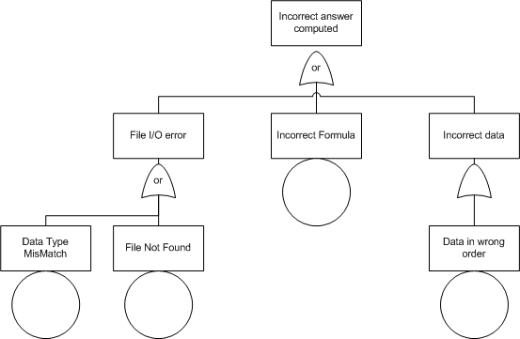
Fault Tree Analysis

Slide 4
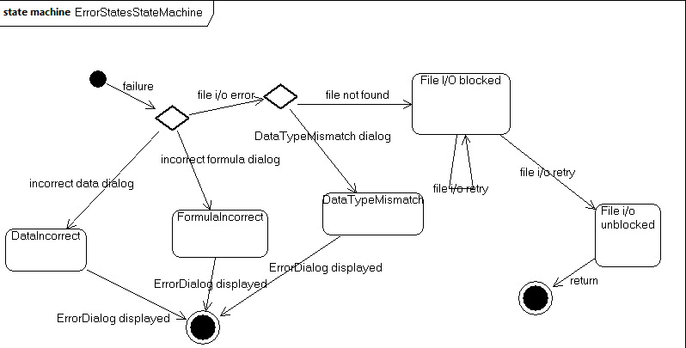
State machine for FHA

