Slide 1

CPSC 871
John D. McGregor
Module 3 Session 1
Architecture

Slide 2
Session Objectives
Give an overview of software architecture principles

Slide 3
Software architecture
The software architecture of a program or computing system is the structure or structures of the system, which comprise software elements, the externally visible properties of those elements, and the relationships among them.
Software Architecture in Practice (2nd edition), Bass, Clements, Kazman; Addison-Wesley 2003

Slide 4
Warning!!
The following single pictures are NOT architectures but simplified architecture cartoons.

Slide 5
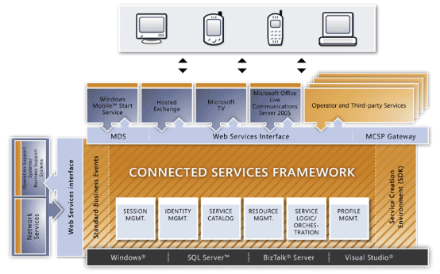
Connected Services
http://msdn.microsoft.com/en-us/library/aa306115.aspx

Slide 6
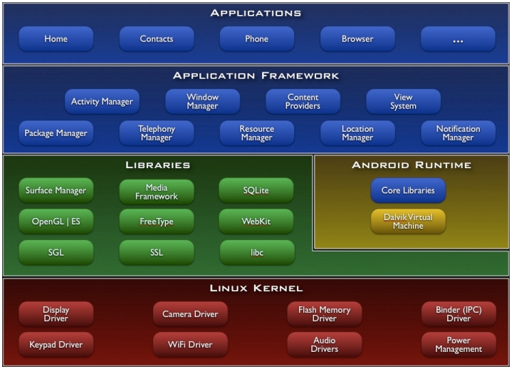
Android open architecture

Slide 7
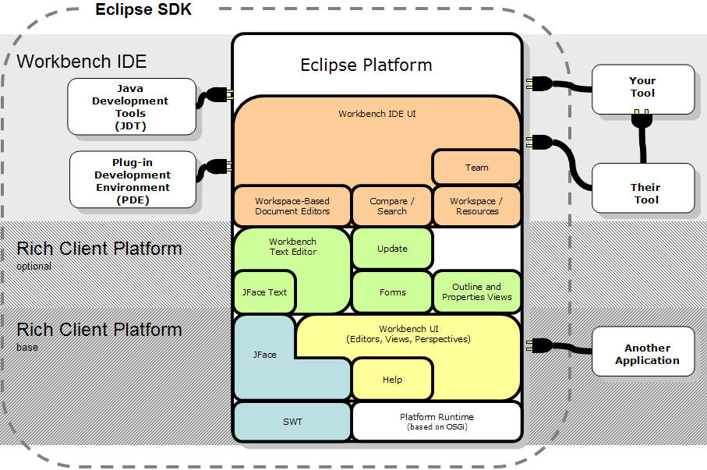
Eclipse architecture

Slide 8
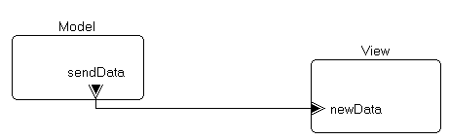
Essential elements
Components - a unit in which some program logic resides – should be a single concept
Connectors – joins two components via some relationship – data or control or both flow over the connector from one component to the other
Ports – a device on a component that allows data/control to flow into or out of the component
Illustrated using the AADL

Slide 9
Architecture actions
The architect forms concepts that are contained in components and connects components that
  Need data from the other component
  Is the next piece of work to be done
  Will refine what has already been done
  And many other things
Components often are formed to satisfy a functional requirement

Slide 10
Quality attributes
How the components are formed and how they are connected affects the quality attributes
The larger a component, the more complex it is
The more public its internals are the more testable it is
The more connectors there are the less maintainable the system is

Slide 11
Flows
The architect does not do detailed design within a certain level of component so the architecture simply shows a flow through from an in port to an out port
A
System implementation S1.impl
ADL
Process P2
C1
flow path F5
C3
C5
Process P1
flow path F7

Slide 12
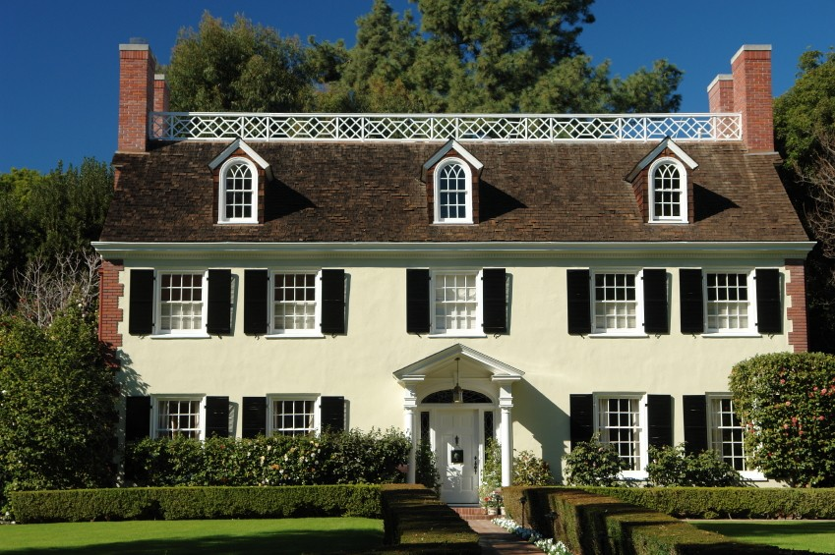
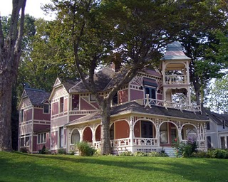
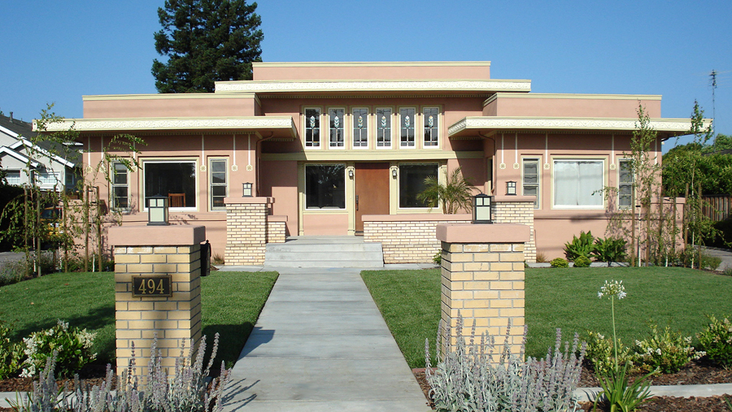
Styles
An architecture style is a pattern that is repeated from one system to another because it solves a standard problem.
A style is like a design pattern but on a higher, more abstract level.

Slide 13
Example - Layered
Many systems use the “layered” pattern as an underlying structure. The architecture for my infotainment example begins as a layered system.
“Layered” requires that an element in one layer only communicate with elements in an adjacent layer. All relations either go up or down but not a mixture.
This improves several attributes including maintainability, testability, and portability.
The figure on the next page shows a layered architecture in which “uses” is the relationship.
A component can use what is below it in the figure but can not use what is above it.

Slide 14
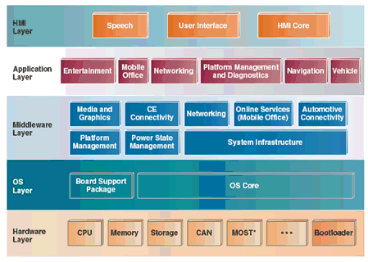
Infotainment Architecture
http://www.drdobbs.com/embedded-systems/222600438;jsessionid=2CWUXIXKB5KHRQE1GHRSKH4ATMY32JVN

Slide 15
Interactive systems
Many of the software systems we develop are interactive or reactive.
An action is taken that modifies the state of the system and the new state is reflected in what the user sees on the screen.
Menus change, graphics change, text changes.
There are usually multiple windows and changes may be made in several of these.
A popular architecture for this is Model/View/Controller

Slide 16
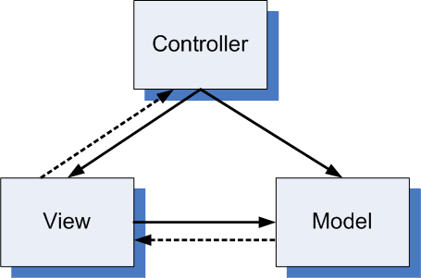
MVC
Model encapsulates all data
View shows some of the data; may have several views at the same time
Controller responds to external events such as mouse clicks
Enhances modularity, modifiability, portability but not performance

Slide 17
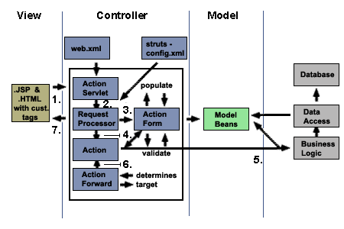
Java Beans Application

Slide 18
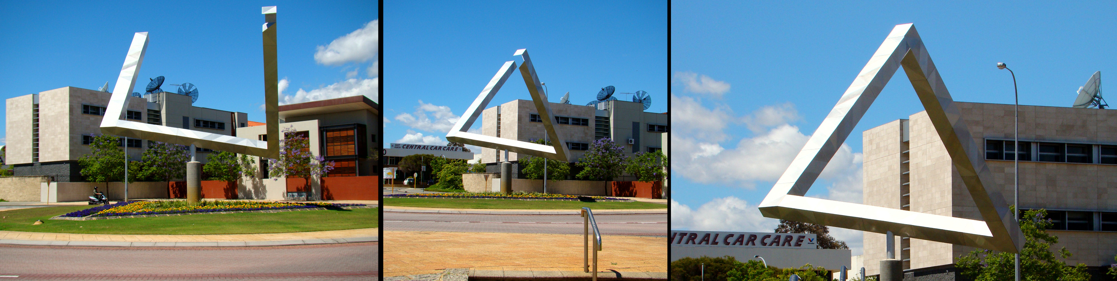
Views and Viewpoints
One entity, three views, three different impressions
This is why we call the single picture of an architecture a cartoon
We needs as many different views as are necessary to communicate the complete picture

Slide 19
Views and Viewpoints - 2
A view is a representation of one or more structural aspects of an architecture that illustrates how the architecture addresses one or more concerns held by one or more of its stakeholders. [IEEE 1471]
A viewpoint is a collection of patterns, templates, and conventions for constructing one type of view. It defines the stakeholders whose concerns are reflected in the viewpoint and the guidelines, principles, and template models for constructing its views. [IEEE 1471]
The multiple pages in a building’s blueprint are different views from different viewpoints.

Slide 20
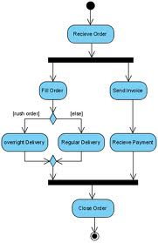
Standard Viewpoints
Functional – what does the system do – The use case diagrams give one view
Information – what does the system do it to – class diagram gives data structures – sequence diagrams give flow of data
Concurrency – how is work on the data sequenced – sequence and activity diagrams

Slide 21
Architecture process
Input => functional and non-functional requirements
Generate quality attribute scenarios
Have stakeholders prioritize them
Choose high level style
Begin a recursive decent of decomposition
When appropriate level of detail is reached evaluate the architecture against the scenarios

Slide 22
Structure of scenario
Source of stimulus (e.g., human, computer system, etc.)
Stimulus – a condition that needs to be considered
Environment - what are the conditions when the stimulus occurs?
Artifact – what elements of the system are stimulated.
Response – the activity undertaken after arrival of the stimulus
Response measure – when the response occurs it should be measurable so that the requirement can be tested.

Slide 23
Performance scenario
Source of stimulus – typically an actor – Any user
Stimulus – clicks on save button
Environment – data has been entered into a matrix editor
Artifact – data matrix
Response – the data is written to the current file
Response measure – takes less than 2 seconds to write
What other attributes for our problem?

Slide 24
Decomposition
Our value computation is an interactive system. So we can start with MVC and decompose from there.
Controller
Controller
Controller
Controller
View
Model
Data Editor
Model
System menu
Properties editor
Controller
Controller
Controller
Controller
Data Editor
System Model
System menu
Editor Model
Properties editor

Slide 25
Extension
Controller
Controller
Controller
Controller
Data Editor
System Model
System menu
Editor Model
Properties editor
Controller
Controller
Controller
Controller
Data Editor
System Model
DataBase
System menu
Editor Model
Properties editor

Slide 26
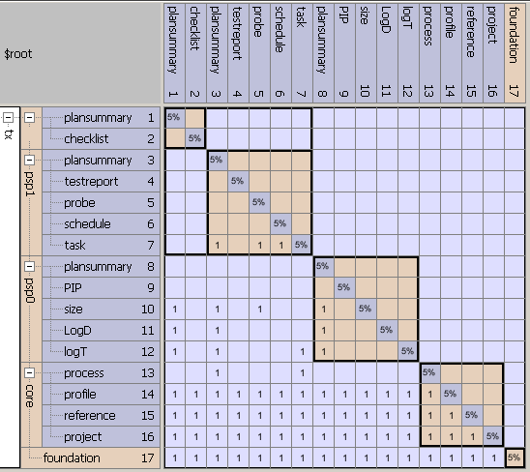
Design Structure Matrix

Slide 27
DSM
 | model | view | controller
model | x
view | 1 | x
controller | 1 | 1 | x
Controller
View
Model

Slide 28
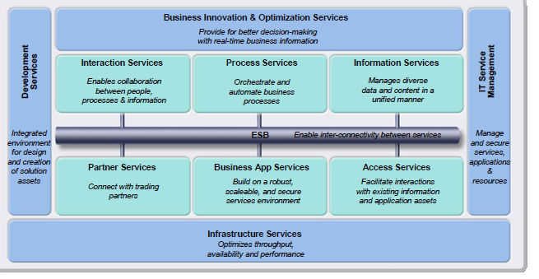
Reference architecture

