Slide 1

CPSC 871
John D. McGregor
Module 4 Session 3
Architecture Evaluation

Slide 2
Architecture adds value
Value is a synonym for desirableness
If the value of something increases it is because it has become more desirable for some reason
A “value chain” represents a sequence of stages, each of which makes the “thing”, for which this is the value chain, more desirable.
The value chain for a software product is the series of activities that craft a solution.

Slide 3
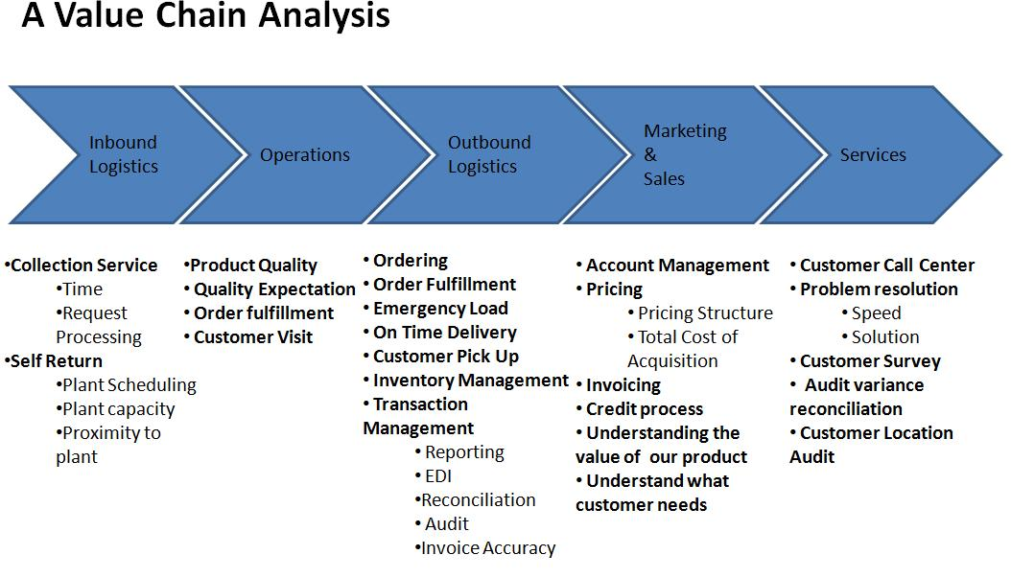
Porter’s Value Chain

Slide 4
Adding value
How does architecture add value? (How does it make the product more desirable?)
Increased probability that customers like the product
Increased probability of highly reliable operation
Increased probability that the product will have the qualities desired
Increased predictability of implementation

Slide 5
Adding value - 2
Even architecture evaluation adds value
It removes defects making the architecture more desirable as a basis for building a product
Question: How do we measure these increases in value?

Slide 6
http://www.vico.org/pages/PatronsDisseny/Pattern%20Presentation%20Abstra/
http://www.dossier-andreas.net/software_architecture/pac.html
http://www.innovatingtomorrow.net/2008/04/04/pac-software-architecture

Slide 7
Architecture TradeOff Analysis Method (ATAM)
The purpose of the ATAM is to assess the consequences of architectural decisions in light of quality attribute requirements.
http://www.sei.cmu.edu/reports/00tr004.pdf

Slide 8
Conceptual Flow of ATAM
Business
Drivers
Quality
Attributes
Scenarios
Analysis
Software
Architecture
Architectural
Approaches
Architectural
Decisions
Tradeoffs
impacts
Sensitivity Points
distilled
into
Non-Risks
Risk Themes
Risks

Slide 9
Phase 0
Partnership and preparation
Phase 1
Evaluation
Phase 2
Evaluation continued
Phase 3
Follow-up

Slide 10
Phase 0
Logistics are agreed to
Meeting dates
Who must attend
Team membership
Agenda is agreed to
Collect initial information

Slide 11
Overview of Phase 1
Step 1
Present the ATAM
Step 2
Present business drivers
Step 3
Present architecture
Step 4
Identify architectural approaches
Step 5
Generate quality attribute utility tree
Step 6
Analyse architectural approaches

Slide 12
Present Business Drivers
Describe
The system’s most important functions
Any relevant technical, managerial, economic, or political constraints
The business goals and context as they relate to the project
The major stakeholders
The architectural drivers (the major quality attribute goals)

Slide 13
Present Architecture
Driving architectural requirements, measurable quantities associated with these, standards/models/approaches for meeting these
Important architectural information
Context diagram
Module or layer view
Component and connector view
Deployment view

Slide 14
Present Architecture - 2
Architectural approaches, patterns, tactics employed, what quality attributes they address and how they address those attributes
Use of COTS and their integration
Most important use case scenarios
Most important change scenarios
Issues/risk w.r.t. meeting the diving requirements

Slide 15
Step 4: identify architectural approaches
Catalog the evident patterns and approaches
Based on step 3
Serves as the basis for later analysis

Slide 16
Quality Attribute Scenario
Stimulus
Stimulus source
Environment
Artifact
Response
Response measure

Slide 17
Quality Attribute Scenario
Stimulus – requests computation of a data set
Stimulus source – software architect
Environment – desktop machine with 4 G memory and dual core processor
Artifact – data for a set of products
Response – the vector of values is created
Response measure – the vector is calculated in less than 30 milliseconds per value

Slide 18
Step 5: Generate quality attribute utility tree
Utility tree
Present the quality attribute goals in detail
Quality attribute goals are
Identified, prioritised, refined
Expressed as scenarios
Utility is an expression of the overall goodness of the system
Quality attributes form the second level being components of utility

Slide 19
Step 5: Generate quality attribute utility tree con’t
Scenarios are prioritised
Depending on how important they are and
Depending on how difficult it will be for the architecture to satisfy a scenario

Slide 20
Step 6: Analyse architectural approaches
Examine the highest ranked scenarios
The goal is for the evaluation team to be convinced that the approach is appropriate for meeting the attribute-specific requirements
Scenario walkthroughs
Identify and record a set of sensitivity points and tradeoff points, risks and non-risks
Sensitivity and tradeoff points are candidate risks

Slide 21
Phase 2
Step 7
Brainstorm and prioritise scenarios
Step 8
Analyse architectural approaches
Step 9
Present results

Slide 22
Step 7: Brainstorm and prioritise scenarios
Utility tree shows architects view on the quality attributes
Here the focus is on the other stakeholders view on the quality attributes and scenarios based on these
Which are the mot meaningful and important scenarios w.r.t. users etc.

Slide 23
Step 8: Analyse architectural approaches
Highest ranked scenarios from step 7 are presented to the architect
Explain how relevant architectural decisions contribute to realising each one

Slide 24
Step 9: Present results
Outputs:
The architectural approaches documented
The set of scenarios and their prioritisation from the brainstorming
The utility tree
The risks discovered
The non-risks documented
The sensitivity points and tradeoff points found

Slide 25
Conceptual Flow of ATAM
Business
Drivers
Quality
Attributes
Scenarios
Analysis
Software
Architecture
Architectural
Approaches
Architectural
Decisions
Tradeoffs
impacts
Sensitivity Points
distilled
into
Non-Risks
Risk Themes
Risks

