Slide 1

CPSC 871
John D. McGregor
Module 6 Session 2
Validation and Verification

Slide 2
Definitions
Integration is the assembling of pieces into a whole
  Subsystems into a system or systems into a system of systems
Verification is determining that an element performs its functions without fault
Validation is determining that what the element does is what it should do.

Slide 3
Relationship
verification
element
element
Integrated system
element
verification
element
element
element
validation
Integrated system
verification
element
element
element
element
verification
element
element
Verification techniques are applied before an element is released. When
a specific set of elements has been verified they are integrated into a larger
element. The functionality of the integrated system is validated before the system
is made available for use.

Slide 4
The “V-model”
System
Requirements
review
Analysis
Guided
Inspection
Architectural Design
Detailed Design
Integration
Coding
Unit

Slide 5
Parallel model
Use cases
review
Requirements
Analysis
models
Guided
Inspection
Analysis
Architectural Design
Architecture
description
ATAM
Guided
Inspection
Design
models
Detailed Design
Unit
Integration
Implementation
Coding
System
Development
Testing

Slide 6
Testing artifacts
Plans
  Usual levels – unit, etc
  How test is coordinated between core assets and products
Test cases
  <pre-conditions, inputs, expected results>
  Data sets
Infrastructure
  Must be able to execute the software in a controlled environment so that the outputs can be observed and compared to the expected results.

Slide 7
IEEE Test Plan - 1
    Introduction
    Test Items
    Tested Features
    Features Not Tested (per cycle)
    Testing Strategy and Approach
      Syntax
      Description of Functionality
      Arguments for tests
      Expected Output
      Specific Exclusions
      Dependencies
      Test Case Success/Failure Criteria

Slide 8
IEEE Test Plan - 2
    Pass/Fail Criteria for the Complete Test Cycle
    Entrance Criteria/Exit Criteria
    Test Suspension Criteria and Resumption Requirements
    Test Deliverables/Status Communications Vehicles
    Testing Tasks
    Hardware and Software Requirements
    Problem Determination and Correction Responsibilities
    Staffing and Training Needs/Assignments
    Test Schedules
    Risks and Contingencies
    Approvals

Slide 9
Coverage
A measure that can be used to compare validation (and verification) techniques.
An item is “covered” when it has been touched by at least one test case.
An inspection technique that uses a scenario as a test case will touch several artifacts including interfaces and implementation designs. Then the next scenario should be selected to touch other artifacts. The more disjoint the sets of “touched artifacts” are, the better the coverage per set of scenarios.

Slide 10
Coverage - 2
The domain determines how much coverage is sufficient.
Airworthy systems need a much more complete coverage than a business system where faults can be recovered from.
But coverage is not the whole story…

Slide 11
Designing for testability - 1
The ease with which a piece of software gives up its faults
Observability
  Special interfaces
  Meta-level access to state
Controllability
  Methods that can set state
  Meta-level access to these state changing methods
Product line
  Separate test interface which can be compiled into a test version but eliminated from the production version

Slide 12
Designing for testability - 2
Strategy must be based on language
  Java – can use reflection
  C++ - must have more static design
Separate the interfaces for observing (get methods) and controlling (set methods)
Compose component based on purpose; only add those interfaces needed for the purpose
Couple the composition of tests with the composition of components

Slide 13
Using testability
You have just tested your 1000 line program and found 27 defects.
How do you feel?
Have you finished?

Slide 14
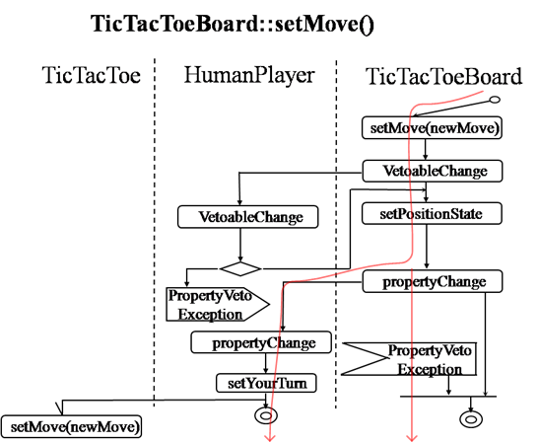
Mapping from scenario to design

Slide 15
Architecture Tradeoff Analysis Method (ATAM)
“Test” the architecture
Use scenarios from the use cases
Test for architectural qualities such as
  extensibility
  maintainability

Slide 16
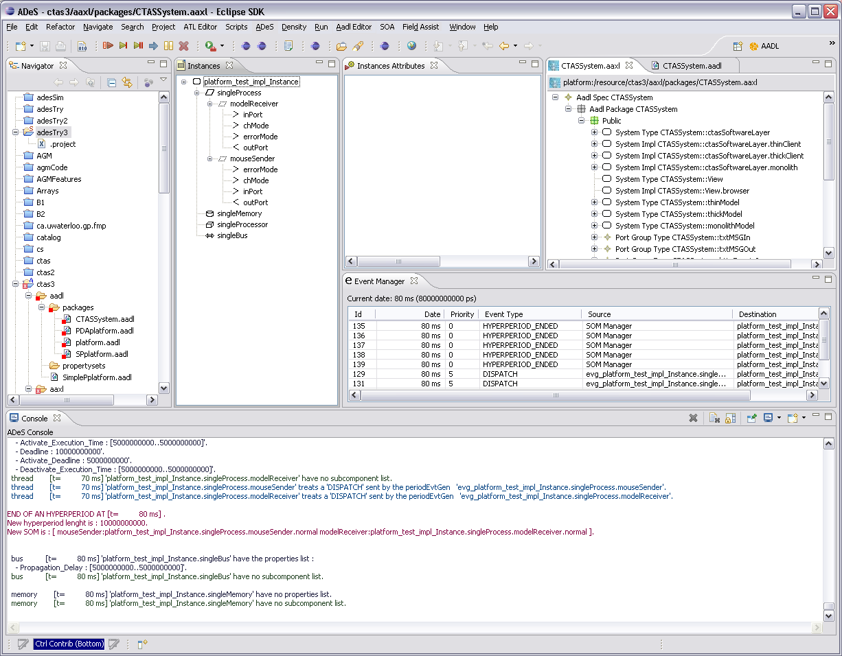
ADeS architecture simulation

Slide 17
Operational profiles
.1
.8
.2
.1
.6
.2
.4
.03
.04
.03

Slide 18
Variation representation

Slide 19
System tests
Test sample applications
  Combinations of choices at variation points
  Full scale integration tests
  Limited to what can be built at the moment
  Involve product builders early
Test specific application
  Tests a specific product prior to deployment
  Rerun some of the selected products’ test cases
  Feedback results to core asset builders

Slide 20
Combinatorial testing – Specific technique
Pair-wise testing – OATS
Multi-way test coverage – more than pair-wise, less than all possible
Minimum test sets -

Slide 21
Orthogonal Array Testing System (OATS)
Factor | Level | Constraint
VP1 | VP1.1
 | VP1.2
 | Both
VP2 | None
 | VP2.1
 | VP2.2
VP3 | VP3.1 | Requires VP1.2
 | VP3.2 | Requires VP4
 | Both
VP4 | VP4.1
 | VP4.2
VP5 | VP5.1
 | VP5.2
Orthogonal Array Testing System (OATS)
One factor for each variation point
One level for each variant within a factor
“All combinations” is usually impossible but pair-wise usually is manageable.
Constraints identify test cases that are invalid

Slide 22
Example test matrix
1 | 2 | 3 | 4 | 5 | 6 | 7
0 | 0 | 0 | 0 | 0 | 0 | 0
1 | 1 | 1 | 1 | 1 | 1 | 0
2 | 2 | 2 | 2 | 2 | 2 | 0
0 | 0 | 1 | 2 | 1 | 2 | 0
1 | 1 | 2 | 0 | 2 | 0 | 0
2 | 2 | 0 | 1 | 0 | 1 | 0
0 | 1 | 0 | 2 | 2 | 1 | 1
1 | 2 | 1 | 0 | 0 | 2 | 1
2 | 0 | 2 | 1 | 1 | 0 | 1
0 | 2 | 2 | 0 | 1 | 1 | 1
1 | 0 | 0 | 1 | 2 | 2 | 1
2 | 1 | 1 | 2 | 0 | 0 | 1
0 | 1 | 2 | 1 | 0 | 2 | 2
1 | 2 | 0 | 2 | 1 | 0 | 2
2 | 0 | 1 | 0 | 2 | 1 | 2
0 | 2 | 1 | 1 | 2 | 0 | 2
1 | 0 | 2 | 2 | 0 | 1 | 2
2 | 1 | 0 | 0 | 1 | 2 | 2
factor
Use standard pre-defined arrays
This one is larger than needed but that will work
Each of the factors has values 0,1,2
Defined to include all pair-wise combinations
level

Slide 23
Mapping
1 | 2 | 3 | 4 | 5 | 6 | 7
0 | 0 | 0 | 0 | 0 | 0 | 0
1 | 1 | 1 | 1 | 1 | 1 | 0
2 | 2 | 2 | 2 | 2 | 2 | 0
0 | 0 | 1 | 2 | 1 | 2 | 0
1 | 1 | 2 | 0 | 2 | 0 | 0
2 | 2 | 0 | 1 | 0 | 1 | 0
0 | 1 | 0 | 2 | 2 | 1 | 1
1 | 2 | 1 | 0 | 0 | 2 | 1
2 | 0 | 2 | 1 | 1 | 0 | 1
0 | 2 | 2 | 0 | 1 | 1 | 1
1 | 0 | 0 | 1 | 2 | 2 | 1
2 | 1 | 1 | 2 | 0 | 0 | 1
0 | 1 | 2 | 1 | 0 | 2 | 2
1 | 2 | 0 | 2 | 1 | 0 | 2
2 | 0 | 1 | 0 | 2 | 1 | 2
0 | 2 | 1 | 1 | 2 | 0 | 2
1 | 0 | 2 | 2 | 0 | 1 | 2
2 | 1 | 0 | 0 | 1 | 2 | 2
Factor | Level | Constraint
VP1 | VP1.1
 | VP1.2
 | Both
VP2 | None
 | VP2.1
 | VP2.2
VP3 | VP3.1 | Requires VP1.2
 | VP3.2 | Requires VP4
 | Both
VP4 | VP4.1
 | VP4.2
VP5 | VP5.1
 | VP5.2
map

Slide 24
Mapped array
VP1 | VP2 | VP3 | VP4 | VP5
VP1.1 | None | VP3.1 | VP4.1 | VP5.1 | c
VP1.2 | VP2.1 | VP3.2 | VP4.2 | VP5.2
Both | VP2.2 | Both | 2 | 2 | x
VP1.1 | None | VP3.2 | 2 | VP5.2 | x
VP1.2 | VP2.1 | Both | VP4.1 | 2 | x
Both | VP2.2 | VP3.1 | VP4.2 | VP5.1
VP1.1 | VP2.1 | VP3.1 | 2 | 2 | x,c
VP1.2 | VP2.2 | VP3.2 | VP4.1 | VP5.1
Both | None | Both | VP4.2 | VP5.2
VP1.1 | VP2.2 | Both | VP4.1 | VP5.2
VP1.2 | None | VP3.1 | VP4.2 | 2 | x
Both | VP2.1 | VP3.2 | 2 | VP5.1 | x
VP1.1 | VP2.1 | Both | VP4.2 | VP5.1
VP1.2 | VP2.2 | VP3.1 | 2 | VP5.2 | x
Both | None | VP3.2 | VP4.1 | 2 | x
VP1.1 | VP2.2 | VP3.2 | VP4.2 | 2 | x
VP1.2 | None | Both | 2 | VP5.1 | x
Both | VP2.1 | VP3.1 | VP4.1 | VP5.2
Every row is a system under test.
17 test products vs 72 possible combinations
Columns 4 and 5 have more levels than are needed. Columns 6 and 7 are not needed at all.
Where a “2” is in the column, this indicates the tester could repeat a value (one of the variants).
Legend: c = constraint; x = any choice for constant will work

Slide 25
Validation
Validation takes on the customer’s perspective as the basis for examining the product.
Validation goes back to the CONOPS.
The system threads should be consistent with the CONOPS and are a rich source of test cases.

Slide 26
Validation
Validation continues into the client side by having the customer perform acceptance tests.
These are defined as part of the contract.
Planning for system validation should closely reflect the context of the acceptance tests.

