Slide 1

CPSC 371
John D. McGregor
Session 22
Metrics

Slide 2
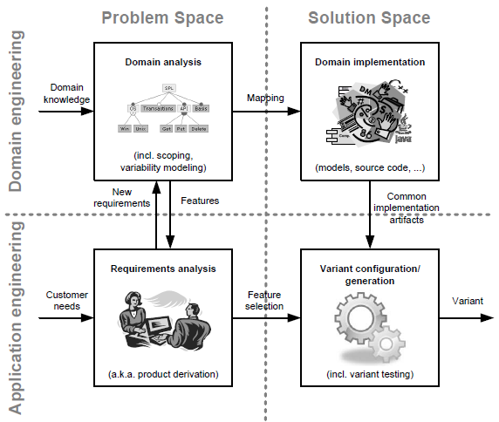

Slide 3
Specification and design
specification
problem
specification
solution
implementation

