Slide 1

CPSC 872
John D. McGregor
Session 10
Interface Design, cont’d

Slide 2
External system interfaces
From vehicle

Slide 3

Internal interfaces
From vehicle

Slide 4
A complete interface
The single most frequent mistake with interface definition is to omit error semantics.
AADL has a comprehensive error modeling syntax.
I want to digress into that area for a few slides with the view of what should be behind the interface and then what is made visible.

Slide 5
Error models
A fault is a root cause for an error, e.g. a burned-out transistor in a memory cell in a memory chip.
An error is a persistent undesired or erroneous state or condition in a component, e.g. an incorrect word retrieved from a memory with a bad cell.
A failure occurs when a component is no longer able to satisfy its nominal specification, e.g. an incorrect word retrieved from a faulty memory cannot be corrected by the provided EDAC.

Slide 6
Error models - 2
An error model type may declare Error states, which may be used to model e.g.
• Hazards identified during a hazard analysis
• Failure Modes identified during a FMEA
(There must be a distinguished initial error state.)
Error events, which may be used to model e.g.
• Internal faults
• Internal repairs
(These are made visible to permit external property associations.)
Error propagations, which may be used to model e.g.
• Failure effects

Slide 7
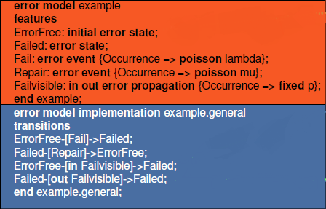
Error models - 3
Error model in AADL
Parallel structure to other AADL elements
Defined separately and then instantiated in a “system”

Slide 8
Dependability
The error models are an integral part of designing dependable systems.
Please read beginning with section 4.3 and through section 5 in this tech report:
http://www.dtic.mil/cgi-bin/GetTRDoc?AD=ADA472582&Location=U2&doc=GetTRDoc.pdf

Slide 9
AADL Error Annex
annex error {**
Model => My_Models::Example.Notional;
Model_Hierarchy => Error_Free when 2 ormore (S1[Error_Free],
S2[Error_Free],
S3[Error_Free],
S4[Error_Free])
and 1 orless (S1[Fail_Unknown],
S2[Fail_Unknown],
S3[Fail_Unknown],
S4[Fail_Unknown]),
Fail_Unknown when others;
Fail_1.Vote_Transition =>
S2.A_Failure_Detected[Error_Free,Bad_Data]
and S3.A_Failure_Detected[Error_Free,Bad_Data];
Fail_2.Vote_Transition =>
S1.A_Failure_Detected[Error_Free,Bad_Data]
and S3.B_Failure_Detected[Error_Free,Bad_Data];
Fail_3.Vote_Transition =>
S1.B_Failure_Detected[Error_Free,Bad_Data]
and S2.B_Failure_Detected[Error_Free,Bad_Data];
Report => Error_Free;
**};

Slide 10
Error model syntax
In AADL annexes represent additions to the basic standard
annex error model {** -- this opens use of an annex
error model SensorErrorModel – name of model
initial error state – “error” is a modifier for state
out error propagation – an out port for error returns
{Occurrence => poisson 1E-3} – poisson is a statistical distribution defining frequency of occurrence
Full model starts on next slide=>

Slide 11
Error model
package FireAlarmErrorLib
public
annex error model {**
error model SensorErrorModel
features
error free: initial error state;
unavailable, babbling: error state;
smoke detected omission: out error propagation
{Occurrence => fixed 1};
smoke detected commission: out error propagation
{Occurrence => poisson 1E-3};
fail stop, fail babble: error event;
end SensorErrorModel;

Slide 12
Error model - 2
error model implementation SensorErrorModel.Standard
transitions
error free -[fail stop]-> unavailable;
error free -[fail babble]-> babbling;
unavailable -[out smoke detected omission]->unavailable;
babbling -[out smoke detected commission]-> babbling;
end SensorErrorModel.Standard;
. . .
**};
end FireAlarmErrorLib;

Slide 13
Extended example
http://comjnl.oxfordjournals.org/content/early/2010/03/17/comjnl.bxq024.full.pdf+html

Slide 14
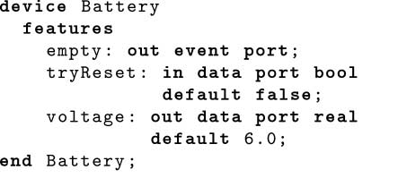
Extended example - 2

Slide 15
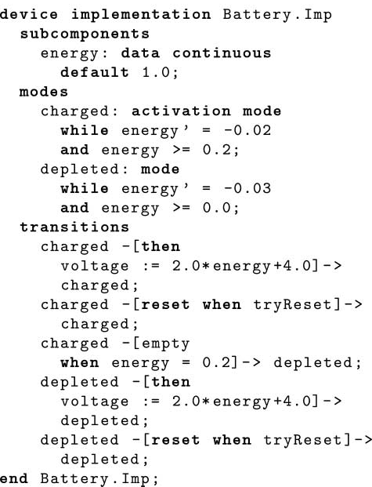
Extended example - 3

Slide 16
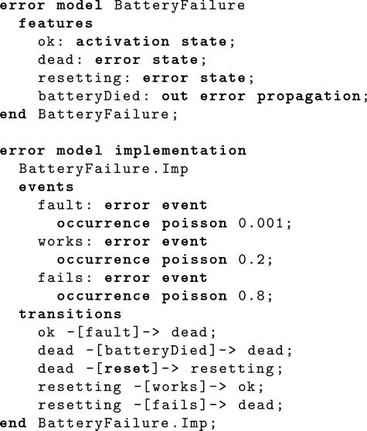
Extended example - 4

Slide 17
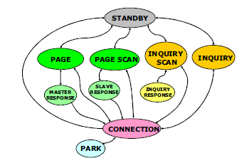
Interface description
Pre/post-conditions on each function
State model that relates the functions
Error model that adds the error behavior
https://developer.bluetooth.org/DevelopmentResources/Pages/Bluetooth-Smart-Optimizations.aspx

Slide 18
Object Constraint Language
http://st.inf.tu-dresden.de/files/general/OCLByExampleLecture.pdf
http://modeling-languages.com/wp-content/uploads/2012/03/OCLChapter.pdf

Slide 19
Summary
An interface is a specification
Atomic pieces of programs - The pre/post-conditions and function signature define what is required and what is provided
Plugable pieces of programs - The state models that are part of the interface definition add constraints to the order in which functions can be used.

Slide 20
“Complete” Programs
Individual functions call other functions
This leads to a sequence of function calls which leads to a sequence (or path) of instructions being executed
This may be fixed at compile time but obscured by the huge number of paths OR
The links may be changed dynamically at runtime

Slide 21
safety
Eliminate the possibility of dynamic changes to the set of possible sequences
The state model for the system defines a high level set of sequences
Whether human choice is involved in which path to take or not is irrelevant
We want to be certain that the set of sequences contains all we need and nothing we do not want

Slide 22
“Batch” systems
Flow of control is determined completely by the input data

Slide 23
Reactive systems
The program is driven by external events such as menu selections
Each action is a state change action
S₁
Guard (pre-condition)/Action (function)
S₂

Slide 24
Linear Temporal Logic
http://web.iitd.ac.in/~sumeet/slide3.pdf
http://www.cs.cmu.edu/~emc/15817-f09/lecture2.pdf

Slide 25
Assignment
Select one of the interfaces in our system:
OBD to cell phone
Cell phone to cloud
Build a description of the interface using English or AADL
Due Sept 24 by 11:59pm

