Slide 1

CPSC 872
John D. McGregor
Session 16
Design operators

Slide 2
Specification and design
specification
problem
specification
solution
implementation

Slide 3
Software design is about micro structures
Software architecture is about macro structures
http://msdn.microsoft.com/en-us/library/ee658124.aspx

Slide 4
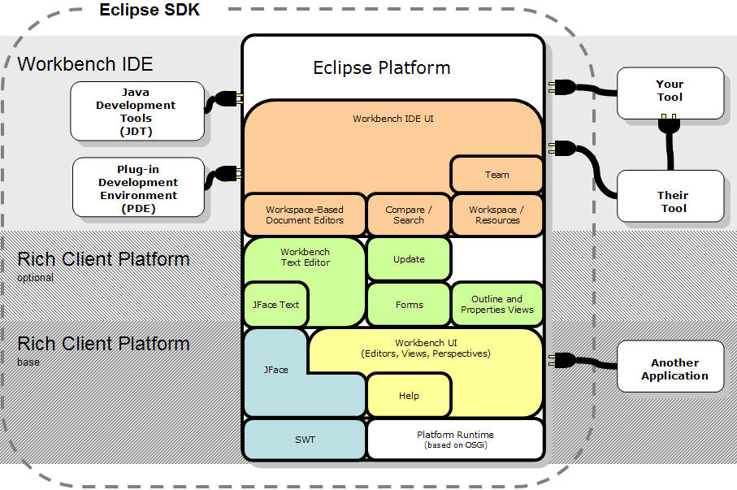
Eclipse architecture cartoon

Slide 5
Pieces
Modules, subsystems, …
These are pieces of a system and entities with which the architect works.
Determining what a particular module does is the job of the architect
How a particular module does its assigned job is a detailed design issue not an architecture issue
Architectural issues cross module boundaries

Slide 6
Orchestration/choreography
The architect creates pieces for certain reasons
And connects certain pieces to achieve specific objectives.
The architect orchestrates the interactions of the pieces of the system but leaves the details to the engineers.

Slide 7
System/software
A system is the complete package needed to solve a problem. It will usually include:
  Hardware – stand-alone computer; an electronic controller embedded in an assembly such as a brake assembly; an integrated multi-function device such as a cell-phone
  Software – an operating system or an end-user application
Some people even include the users and other non-computing elements as part of the system

Slide 8
Stakeholders
A stakeholder is any person with an interest in the system.
We will listen harder to some stakeholders than others.
In our techniques often we will give stakeholders differing numbers of votes based on their priority.
The architect is a diplomat but also a dictator.

Slide 9
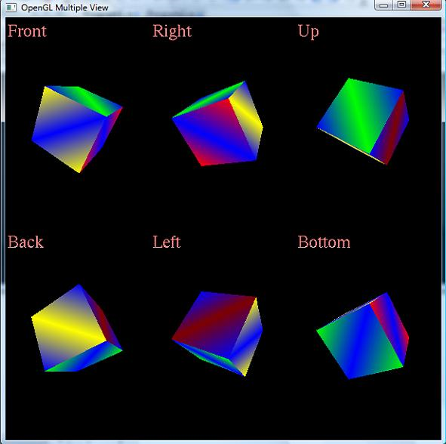
Views
Different ways of looking at the same thing.

Slide 10
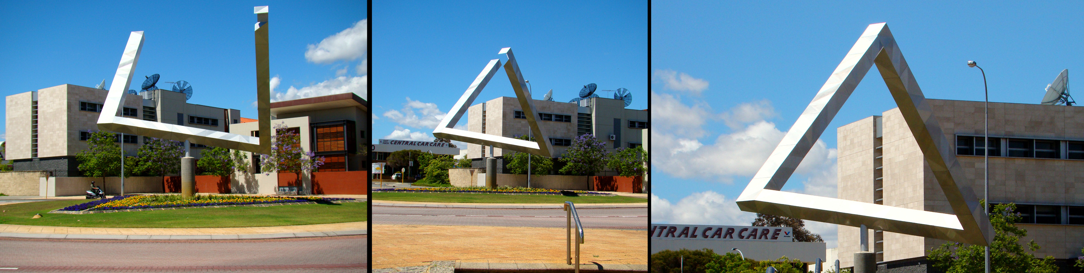
One entity, 3 views

Slide 11
Concepts
Styles and patterns
  layered
Principles
  Separation of concerns
Operators
  decompose

Slide 12
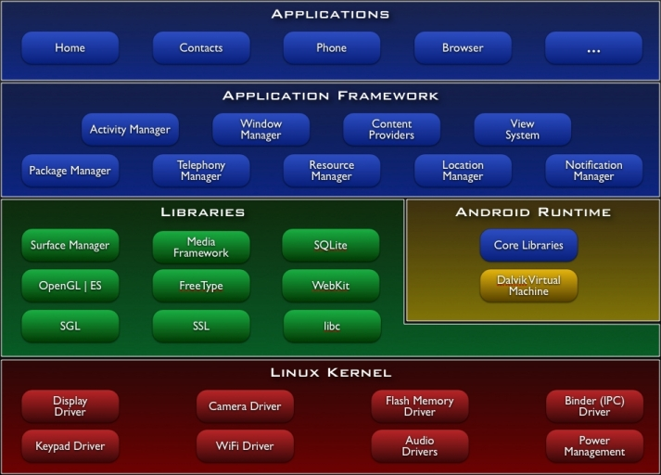
Example architecture – Android device
The primary structure here is “layer.”
Code in a layer may only “know about” code in “lower” layers.
Why?

Slide 14
Design Principle
Separation of concerns

Slide 15
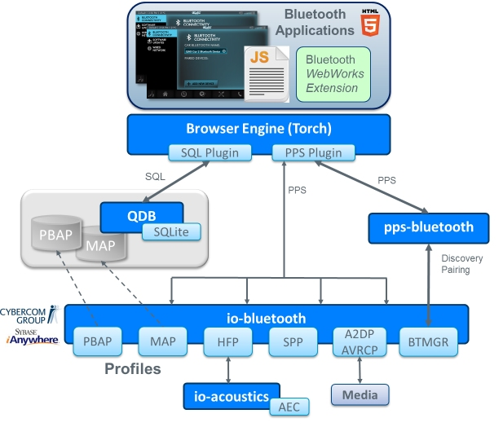
Bluetooth top to bottom
http://www.qnx.com/developers
/docs/qnxcar2/index.jsp?topic=
%2Fcom.qnx.doc.qnxcar2.system
_architecture%2Ftopic%2FMDG
_bluetooth.html

Slide 16
Ubiquitous architecture styles
Client/Server
client
server
request
DB
return

Slide 17
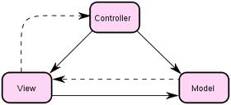
Model-View-Controller
http://developer.apple.com/library/mac/#documentation/General/Conceptual/DevPedia-CocoaCore/MVC.html
http://www.dossier-andreas.net/software_architecture/mvc.html
As anti-pattern
  http://broadcast.oreilly.com/2008/10/mvc-as-anti-pattern.html

Slide 18
Decomposition
Our value computation is an interactive system. So we can start with MVC from slide 16 and decompose from there.
Controller
Controller
Controller
Controller
View
Model
Data Editor
Model
System menu
Properties editor
Controller
Controller
Controller
Controller
Data Editor
System Model
System menu
Editor Model
Properties editor

Slide 19
Extension
Controller
Controller
Controller
Controller
Data Editor
System Model
System menu
Editor Model
Properties editor
Controller
Controller
Controller
Controller
Data Editor
System Model
DataBase
System menu
Editor Model
Properties editor

Slide 20
Baldwin’s Modularity Operators
Modularity reduces complexity and enhances maintainability
Baldwin and Clark define 6 operators
Any system
  Splitting
  Substitution
Assumes a modular system
  Augmenting
  Excluding
  Inversion
  Porting

Slide 21
  Splitting
AKA decomposition
A monolithic system or a module is divided into two or more modules
Client/server is a split that enhances value by allowing multiple clients to access a single server – the assumption being that not all clients want to access the server at the same time

Slide 22
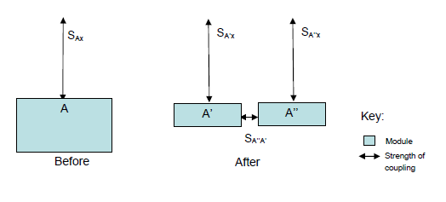
Splitting
Reducing cost of modifying a single responsibility

Slide 23
  Substitution
AKA plug compatible
One module is replaced by another with equivalent behavior but presumably a different implementation
A desktop, laptop, and mobile device all have a bluetooth connection that obeys the bluetooth protocol but each has a different implementation; substituting will allow one system to be used on all three platforms but with a different driver

Slide 24
  Augmenting
An additional module is added to the system
Perhaps a new type of communication connection such as USB is added to the system

Slide 25
  Excluding
A module is removed from the system.
A generic software system may be tailored for a specific installation. The standard stereo module is excluded and the system is augmented with a surround sound module

Slide 26
Inversion
Two or more modules are modified
The result is a third module that captures the commonality among the initial modules
A stereo sound system module and a surround sound module are analyzed and their common behavior made into a sound system module which is then related to the reduced stereo and surround sound modules
Enhances the maintainability and extensibility

Slide 27
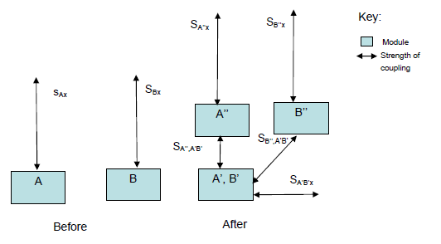
Inversion
Increases cohesion

Slide 28
Porting
A module is divided into a module that is more tightly coupled to the system under design and a module that is free from the single system
Making a system easily used by multiple OSs is a typical example.
Some new module may be needed in between the tightly coupled module and the free one

