Slide 1

CPSC 872
John D. McGregor
Session 22
Architecture Design, cont’d

Slide 2
Specification and design
specification
problem
specification
solution
implementation

Slide 3
AADL – client/server style
system client
features
requestService:out event data port;
receiveResults: in event data port;
end client;
system implementation client.basic
end client.basic;
system serverType
features
receiveRequest:in event data port;
returnResults: out event data port;
end serverType;
system implementation serverType.impl
end serverType.impl;

Slide 4
AADL – driver program
system DemoCS
end DemoCS;
system implementation DemoCS.basic
subcomponents
c: system client;
s: system serverType;
connections
conn1: port c.requestService -> s.receiveRequest;
conn2: port s.returnResults -> c.receiveResults;
end DemoCS.basic;

Slide 5
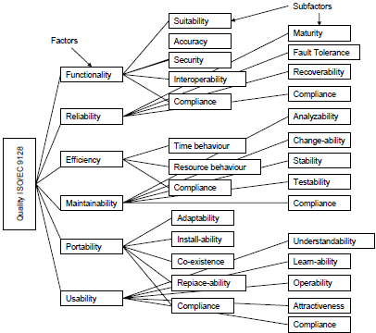
Quality attributes ISO-9126

Slide 6
Adding value
How does architecture add value? (How does it make the product more desirable?)
Increased probability that customers like the product
Increased probability of highly reliable operation
Increased probability that the product will have the qualities desired
Increased predictability of implementation

Slide 7
Adding value - 2
Even architecture evaluation adds value
It removes defects making the architecture more desirable as a basis for building a product
Question: How do we measure these increases in value?

Slide 8
Architecture TradeOff Analysis Method (ATAM)
The purpose of the ATAM is to assess the consequences of architectural decisions in light of quality attribute requirements.
http://www.sei.cmu.edu/reports/00tr004.pdf

Slide 9
Phase 0
Partnership and preparation
Phase 1
Evaluation
Phase 2
Evaluation continued
Phase 3
Follow-up

Slide 10
Overview of Phase 1
Step 1
Present the ATAM
Step 2
Present business drivers
Step 3
Present architecture
Step 4
Identify architectural approaches
Step 5
Generate quality attribute utility tree
Step 6
Analyse architectural approaches

Slide 11
Quality attribute scenarios
A quality attribute scenario is directly derived from a non-functional requirement and consists of the following parts:
source of stimulus, which is the entity that generated the stimulus;
stimulus, which is the condition that needs to be considered when it arrives at a system;
environment, which determines under which conditions the stimulus occurs;
artifact, is the element that receives the stimulus;
response, which is the activity undertaken after the arrival of the stimulus;
response measure, which represents the way a response is measured when it occurs.

Slide 12
Scenario
Source of stimulus: cell phone
Stimulus: begin reading from bus
Environment: OBD dongle is plugged in and car is on
Artifact: data stream
Response: Data begins to be transferred to cloud
Response measure: data transferred at a rate equal to the read rate

Slide 13
Source of stimulus:
Stimulus:
Environment:
Artifact:
Response:
Response measure:

Slide 14
Step 5 – Lets draw the tree
(H,M)
Repair in 3 days
Maintainability
(M,L)
Modifiability
Replace function
In 2 days
Extensibility
Utility

Slide 15
Conceptual Flow of ATAM
Business
Drivers
Quality
Attributes
Scenarios
Analysis
Software
Architecture
Architectural
Approaches
Architectural
Decisions
Tradeoffs
impacts
Sensitivity Points
distilled
into
Non-Risks
Risk Themes
Risks

Slide 17
A cloud infrastructure
http://fi-ware.org/
What’s interesting about its design?
What would you look for?
How do we evaluate it?

Slide 18
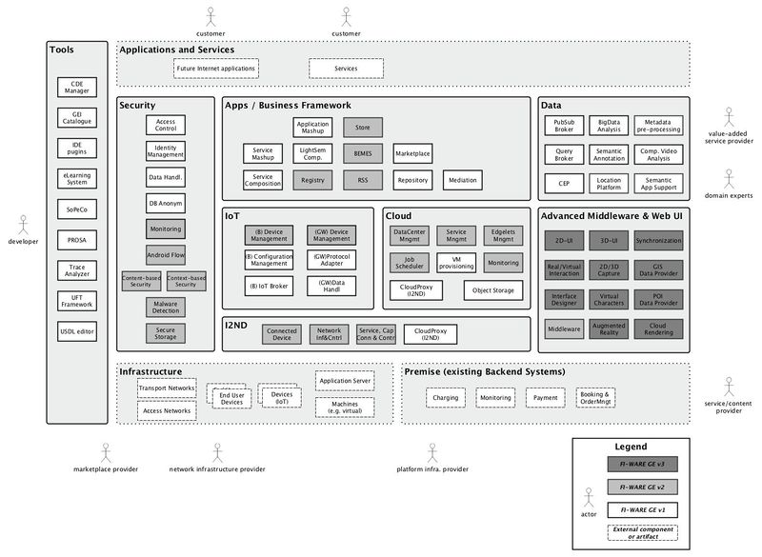

Slide 19
links
http://catalogue.fi-ware.org/enablers/complex-event-processing-cep-ibm-proactive-technology-online
http://catalogue.fi-ware.org/enablers/bigdata-analysis-cosmos
http://catalogue.fi-ware.org/enablers/configuration-manager-iot-discovery
http://catalogue.fi-ware.org/enablers/configuration-manager-orion-context-broker
http://catalogue.fi-ware.org/enablers/gateway-data-handling-ge-espr4fastdata
http://catalogue.fi-ware.org/enablers/gis-data-provider-geoserver3d
http://catalogue.fi-ware.org/enablers/interface-designer
http://catalogue.fi-ware.org/enablers/network-information-and-control-ofnic-uniroma

Slide 20
Assignment
Create 2 quality attribute scenarios that include the cloud part of our product.
Trace those through the architecture (you will have to make assumptions about exactly what happens)
Build the AADL definitions needed to represent these scenarios
Report on any problems you find with the architecture
Due Oct 29th by 11:59PM via email

