Slide 1

CPSC 872
John D. McGregor
Session 26
Full development process

Slide 2
Context
specification
problem
specification
solution
implementation

Slide 3
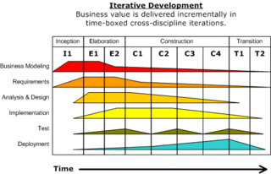
Rational Unified Process (RUP)

Slide 4
Business modeling
Specifications
Interfaces
Domain-specific standards
Process modeling

Slide 5
Requirements
Use cases
Feature models
Specifications/ no implementation
Separation of concerns
Definition of interfaces

Slide 6
Analysis and Design
Design by contract
Architectural design
Styles
Trade-offs among quality attributes
Detailed design
Design patterns
Trade-offs among quality attributes
AADL and other tools
Architecture-centric development
Simulation of product

Slide 7
Car
OBD
Phone
Cloud

