Slide 1

CPSC 872
John D. McGregor
Session 30
ULS and Complex Adaptive Systems, cont’d

Slide 2
Context
specification
problem
specification
solution
implementation

Slide 3
Software and systems
A system is a set of connected things working together.
A software-intensive system includes software things and hardware things.

Slide 4
Types of systems
1. Structures (Bridges)
2. Clock works (Solar system)
3. Controls (Thermostat)
4. Open (Biological cells)
5. Lower organisms (Plants)
6. Animals (Birds)
7. Man (Humans)
8. Social (Families)
9. Transcendental (God)

Slide 5
System of systems
A collaboration of independent systems that have lives of their own but are brought together to serve a purpose.
they have five common characteristics: operational independence of the individual systems, managerial independence of the systems, geographical distribution, emergent behavior and evolutionary development

Slide 6
Automobile
Can be viewed as a system of systems
Basic vehicle +
Plugin GPS +
Tablet connected via bluetooth +
Plugin video player +
…

Slide 7
Complex Adaptive Systems
http://www3.nd.edu/~gmadey/Activities/CAS-Briefing.pdf
http://sdsi.asu.edu/wp-content/uploads/2013/01/Dahm-AIAA-2013-AIAA-Aerospace-Sciences-Keynote.pdf

Slide 8
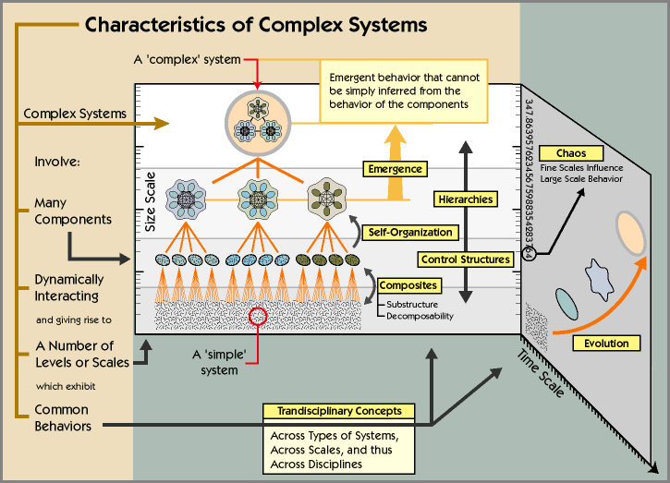
Complex adaptive systems
"a system that emerges over time into a coherent form, and adapts and organizes itself without any singular entity deliberately managing or controlling it" [Holland, 1995]
Emergence
Dynamism
Edge of chaos
Non-linear change
Notes:
http://www.necsi.edu/projects/mclemens/cs_char.gif

Slide 9

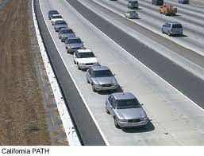
Designing Complex Adaptive Systems
Is platooning like “flock behavior”?
Flock behavior involves a few simple rules
Separation - avoid crowding neighbors (short range repulsion)
Alignment - steer towards average heading of neighbors
Cohesion - steer towards average position of neighbors (long range attraction)
We are interested in finding the simple
rules for platoons of vehicles in order to
simplify autonomy for vehicles.

Slide 10
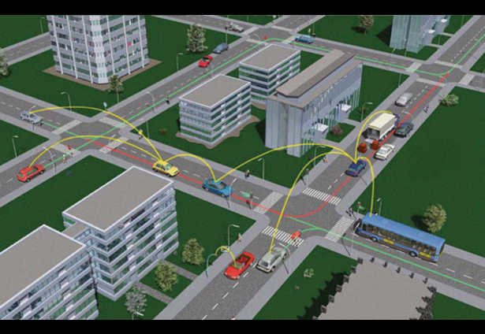
Ultra-large scale systems
"interdependent webs of software-reliant systems, people, policies, cultures, and economics" [Northrop, 2006]
Unprecedented scale in terms of:
number of routine processes, interactions, and “emergent behaviors”
lines of code
number of jurisdictions
number of people
number of policies

Slide 11
Consequences of ultra-large scale systems
Consequences of being ULS
Decentralized
Conflicting, diverse, unknowable requirements
Continuous evolution
Heterogeneous elements
Erosion of the people/system boundary
Failure as the norm
New paradigms for policy and control

Slide 12
Cyber-Physical systems
https://www.google.com/url?sa=t&rct=j&q=&esrc=s&source=web&cd=6&ved=0CEQQFjAF&url=https%3A%2F%2Fece.uwaterloo.ca%2F~rpellizz%2Fcourses%2FIntro720T5.pptx&ei=yAtuVLamA42IgwSPoYIY&usg=AFQjCNF2dcGidLKHeTczI9qvnIx1bnCEpw&bvm=bv.80120444,d.eXY&cad=rja
http://www.ee.washington.edu/research/nsl/aar-cps/winterrev4.pdf

Slide 13
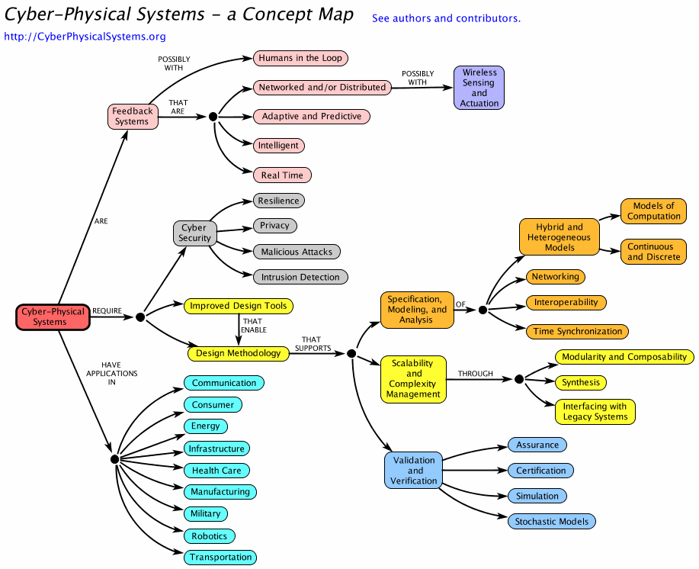

Slide 14
Implications for design
Uncertainty
Non-linear
Emergent behavior
Cause and effect do not appear to be related
Specify for an envelope of behavior rather than specific values
Accept results that are within the boundary
Raise errors at the boundary

Slide 15
Design for testability
Fault -> error -> failure
Reachability
Infection
Propagation
Controllability
Observability

Slide 16
Design for testability
Controllability
Need routines that allow setting values in memory
Observability
Assertions
Testability ports (this is what the hardware people do))

Slide 17
Policies
http://www.innovation.cc/scholarly-style/desouza_lin_policy_informatics_v16i1a7.pdf

Slide 18
Design
Our usual design process assumes a mechanistic, linear world
We seek optimization
With complex adaptive systems non-linear responses make that impossible

Slide 19
Socio-technical ecosystem
socio
technical
Management
interactions
architects
interactions
architecture
design session
Architecture/impl
session

