Slide 1

CPSC 872
John D. McGregor
Session 31
This is it.

Slide 2
Context
specification
problem
specification
solution
implementation

Slide 3
Car
OBD
Phone
Cloud

Slide 4
Perspectives
Tool
Architectural
Usability
Media
Importance of context
Seeking diverse opinions

Slide 5
Perspective description
Users
Artifacts
Context
Activities
Central relations
Communication
Perspective-Implied Use Qualities
Described by

Slide 6
Constraints
Helps establish the context
Legal
Industry/ad hoc standards
Government regulations & law
Societal issues - privacy

Slide 7
Interfaces
Interface vs specification
An interface may be described by a state machine
Ports
Error models
Pre/post-conditions on each function
State model that relates the functions
Error model that adds the error behavior

Slide 8
Traceability
Follow a requirement into the actual system
Improves maintenance by making it easier to know all program elements that have to change given a change in requirements

Slide 9
Process
All the tasks that have to be carried out to produce a product can be examined, optimized and monitored
Process models such as iterative, incremental achieve specific business and technical goals
Tools such as EPF facilitate this

Slide 10
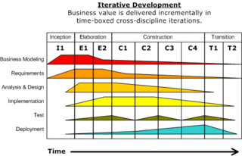

Slide 11
Design
Static/dynamic
When can change happen
  Idea time
  Compile time/interpret time
  Link time
  Deploy time
  Configure time
  Runtime

Slide 12
Design concepts
Styles and patterns
  layered
Principles
  Separation of concerns
Operators
  decompose

Slide 13
Modularity operators
Modularity reduces complexity and enhances maintainability
Baldwin and Clark define 6 operators
Any system
  Splitting
  Substitution
Assumes a modular system
  Augmenting
  Excluding
  Inversion
  Porting

Slide 14
Pattern elements
Pattern Name (Scope, Purpose)
Intent
Also Known As
Motivation
Applicability
Structure
Participants
Collaborations
Consequences
Implementation
An implementation
Sample Code and Usage
Program Listing
Known Uses
Examples of the pattern found in real systems.
Related Patterns

Slide 15
Patterns
Singleton
Observer
Visitor
…

Slide 16
Quality attributes
Quality attribute vs non-functional requirements
Scenario
  Source of stimulus:
  Stimulus:
  Environment:
  Artifact:
  Response:
  Response measure:

Slide 17
ATAM
Business
Drivers
Quality
Attributes
Scenarios
Analysis
Software
Architecture
Architectural
Approaches
Architectural
Decisions
Tradeoffs
impacts
Sensitivity Points
distilled
into
Non-Risks
Risk Themes
Risks

Slide 18
Modules
Module specification
module
Module specification
Module implementation
Module implementation

Slide 19
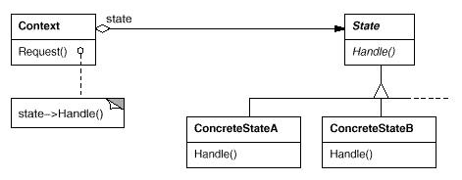
State

Slide 20
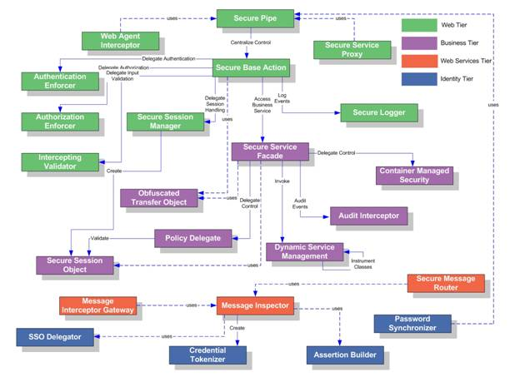
Pattern Language

Slide 21
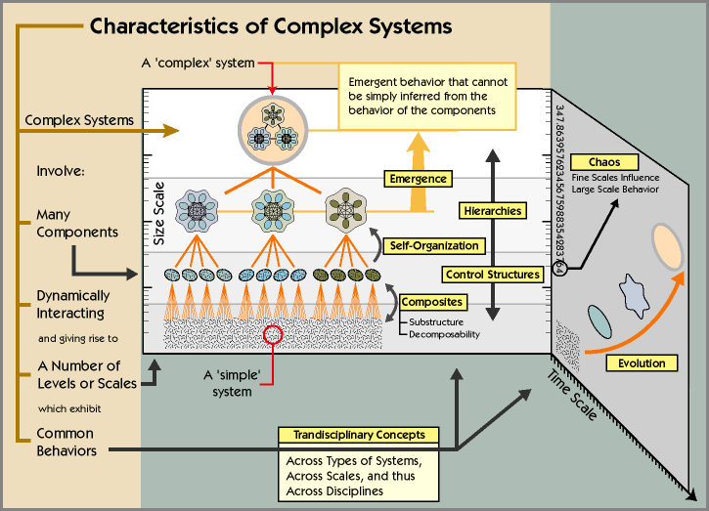
Complex adaptive systems

Slide 22
Design for testability
Controllability
  Need routines that allow setting values in memory
Observability
  Assertions
  Testability ports (this is what the hardware people do))

