Slide 1

CpSc 872
John D. McGregor
Class 4
Design concepts

Slide 2


Slide 3


Slide 4

An example of poor design

Slide 5
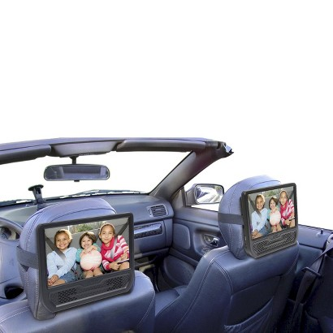
Product in use

Slide 6
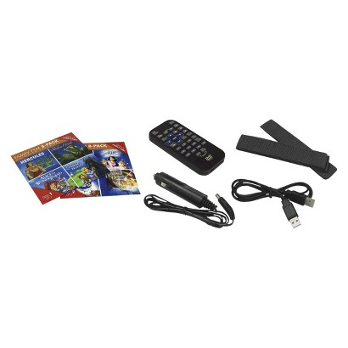
Parts of the product

Slide 7
Plugs and wires
One unit is VCR
Other dumb terminal
Plug to vehicle power
Location of plugs on side

Slide 8
2nd screen

Slide 9
Strap around headrest
Velcro attaches to seat and hair

Slide 10
Car
OBD
Phone
Cloud

Slide 11
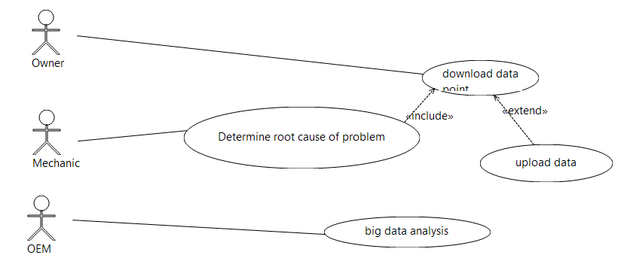
Use cases

Slide 12
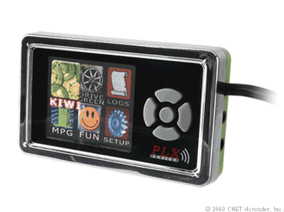
OBD products
http://www.devtoaster.com/products/rev/
http://www.obdkey.com/wifi/index.asp
http://www.cnet.com/products/plx-kiwi-bluetooth/

Slide 13
Rev Features
Vehicle Speed
RPM
Fuel Consumption*
Engine Coolant Temp
Fuel Pressure
Calculated Engine Load
Throttle Position
Intake Manifold Pressure
Air Intake Temp
Timing Advance
Mass Air Flow
Fuel Level
Barometric Pressure
EVAP System Vapor Pressure
Fuel Trim
Boost**

Slide 14
Design perspectives
Reading assignment: http://www.ida.liu.se/~jonlu/fulltext/hult-HCI21.pdf
Design elements :
  user
  artifact
  context
  activities

Slide 15
Divergent ideas
Need multiple ideas to get a well-rounded concept
OBD I
laptop
OBD II
wireless
wifi
bluetooth
Cell phone
Insurance rating system
Context diagram

Slide 16
Relationships among design components

Slide 17
Perspectives
Tool
Architectural
Usability
Media

Slide 18
Assignment
Read the reading assignment
Focus on the perspectives in section 3
We will use them in class on Thursday

