Slide 1

CPSC 872
John D. McGregor
Session 7
Interface Design

Slide 2
External system interfaces
From vehicle

Slide 3

Internal interfaces
From vehicle

Slide 4
Interfaces
An interface is “a thin layer or boundary between two different substances or entities.”
At interfaces things change, the possibilities of inconsistencies arise, information can leak.
Hardware, software components, and humans come together at interfaces.
But more generally …

Slide 5

Waves on a beach
In deep water the speed (or velocity) of a water wave depends only on its wave length. Specifically, the speed is proportional to the square root of the wavelength. Thus, the longer the wave length, the faster the wave, or vice versa. The speed of a single wave is called the phase speed. Amazingly, the speed of a packet of waves (the group speed) is often not the same.
The speed of waves of different wave lengths in deep water. "Deep" in this context is not an absolute value, but is relative to wave length. The simple relationship starts to to breakdown when the depth of the water is less than 1/4 th the wave length. At that depth the bottom exerts sufficient drag on the wave to slow its motion and thus decrease the wavelength.
Decreasing speed of waves as water becomes shallow has dramatic consequences on the beach. As the waves slow, their profile is laterally compressed and since each wave must carry the same energy it becomes higher. As the wave approaches shore this process continues until the height exceeds 1/7 th the wave length and the wave becomes unstable. Then the wave breaks.
http://www.owrc.com/waves/waves.html

Slide 6
Reflections
When waves approach a shore with a gradual depth profile, e.g. a beach, most of the wave energy is absorbed by the breaking of waves.
When waves approach a hard vertical surface, e.g. a concrete wall or a dock, most of the energy is converted into waves moving in the opposite direction, a reflection. Of course the reflected waves are superimposed onto the original waves, and the two sets of wave moving in opposite directions can create a real mess.

Slide 7
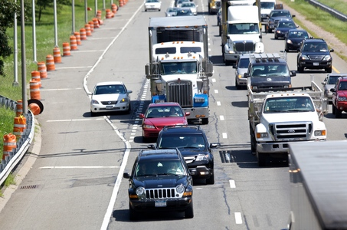
Merging traffic
Traffic signals, road signs, and lane markings are the interface between drivers

Slide 8


Between people with different languages
Translators and translation form the interface between people with different languages

Slide 9
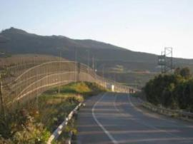

International boundaries
The interface between countries may be simple or complex

Slide 10

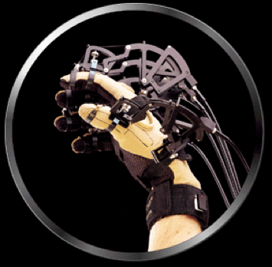
Human-Computer interfaces
Between the human and the machine
Mismatch in speed
Analogies to the real world

Slide 11
Interface terminology
By ‘interface terminology’, we refer to a
set of terms resulting from the interconnection of disciplines which are not normally perceived as contiguous

Slide 12
Interface terminology - 2
As sciences are evolving at a rapid pace, the need for interface terminology will be felt more and more acutely by the specialists and users concerned. As regards environmental economics, interface terminology cannot be viewed as a no man’s land between the two disciplines (Figure 2a); actually, it refers to a common ground which has become part of each of the original disciplines, enriching it by broadening its scope, as illustrated in Figure 2b:
Let us be clear about the notion of common ground: it remains to be seen
whether ‘common’ is to be taken as an indication that the interface terminology will be exactly the same in all situations. This question will be examined later; for the moment, we shall assume that ‘common’ designates an existing link between the two disciplines. Both economics and environmental studies include an additional field which allows them to consider present-day problems from a new angle.

Slide 13
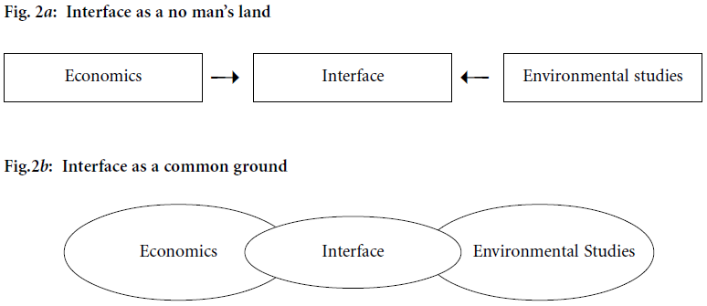
Interface terminology - 3
One way to think of an interface is as not belonging to either element being
composed.
Another way to think of it is as uniting the two elements and overlapping
them both.

Slide 14
Interface terminology - 4
The specifications and the state machine that describes their interaction are the interface.
implementation
implementation
specification
specification

Slide 15
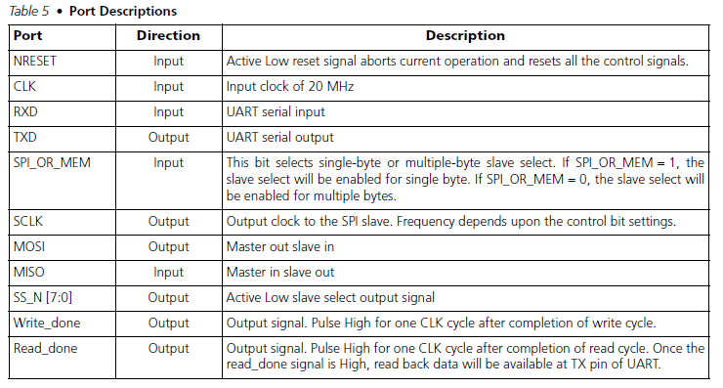
UART to SPI interface
The concept of a “port” is used to separate the interface from an implementation.

Slide 16
API
Application Programmer Interface (or programming or …)
This is the term for the interfaces that are visible to developers who are writing software that will integrate with the software behind the interface.
Part of product planning is determining how others will be allowed to integrate and then defining the interface.

Slide 17
Components and Interfaces
This is one place where hardware people and software people may be further apart than in other topics we have considered.
A component in the Unified Modeling Language "represents a modular part of a system, that encapsulates its content and whose manifestation is replaceable within its environment. A component defines its behavior in terms of provided and required interfaces". OMG (2008).
An interface is a thin layer or boundary between two different substances or entities.
http://mtc.epfl.ch/~tah/Publications/interface_theories_for_component-based_design.pdf

Slide 18
Components and Interfaces -2
A component description communicates what the component can do.
An interface description communicates how the component can be used.
The terms interface and specification are sometimes confused.
AADL model elements provide this separation.

Slide 19
Components and Interfaces -3
Components describe behavior independent of the environment in which it is deployed.
Interfaces constrain the environment so that specific components can work correctly.
The interface defines the input requirements and the output guarantees.

Slide 20
Interface Design
Often this defaults to user interface design, but we will focus on component interfaces.
At the component level interfaces are defined during the architecture design process.
Abstraction – An interface abstracts away how the behavior is provided. It declares what the component provides.
Information hiding – Prevents external access to the implementation of those abstractions.

Slide 21
I/O Interfaces
Ports are often used as the conceptual entity that passes signals, events, whatever in or out of the component
Input ports give the requirements for the component to do its job
Output ports define the guarantees from the components if its requirements are met

Slide 22
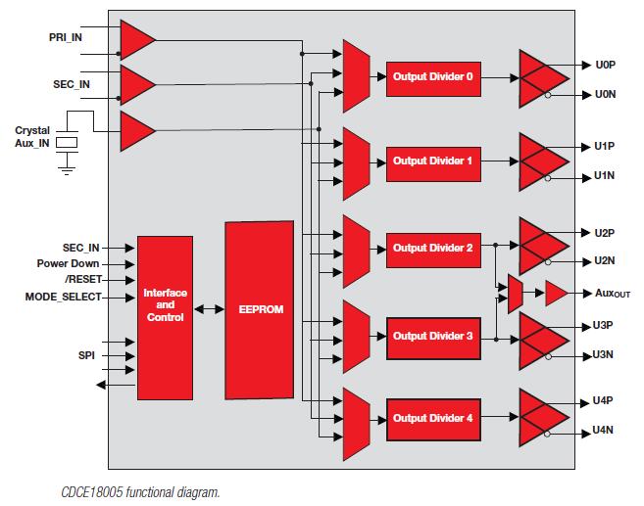
Diagram from CDCE 18005 spec

Slide 23
Software component interfaces
Not as well defined as hardware
Why? Because architecture is the key. There are a few hardware architectures but a huge number of software architectures.
Notice that component marketplaces divide their products into “platform-specific” categories.

Slide 24
A complete interface
The single most frequent mistake with interface definition is to omit error semantics.
AADL has a comprehensive error modeling syntax.
I want to digress into that area for a few slides with the view of what should be behind the interface and then what is made visible.

Slide 25
Error models
A fault is a root cause for an error, e.g. a burned-out transistor in a memory cell in a memory chip.
An error is a persistent undesired or erroneous state or condition in a component, e.g. an incorrect word retrieved from a memory with a bad cell.
A failure occurs when a component is no longer able to satisfy its nominal specification, e.g. an incorrect word retrieved from a faulty memory cannot be corrected by the provided EDAC.

Slide 26
Error models - 2
An error model type may declare Error states, which may be used to model e.g.
• Hazards identified during a hazard analysis
• Failure Modes identified during a FMEA
(There must be a distinguished initial error state.)
Error events, which may be used to model e.g.
• Internal faults
• Internal repairs
(These are made visible to permit external property associations.)
Error propagations, which may be used to model e.g.
• Failure effects

Slide 27
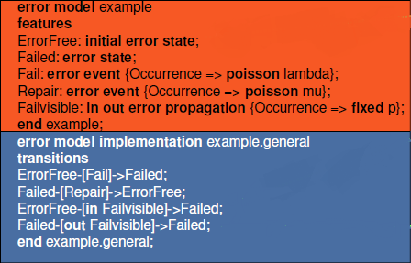
Error models - 3
Error model in AADL
Parallel structure to other AADL elements
Defined separately and then instantiated in a “system”

Slide 28
Dependability
The error models are an integral part of designing dependable systems.
Please read beginning with section 4.3 and through section 5 in this tech report:
  http://www.dtic.mil/cgi-bin/GetTRDoc?AD=ADA472582&Location=U2&doc=GetTRDoc.pdf

Slide 29
AADL Error Annex
annex error {**
Model => My_Models::Example.Notional;
Model_Hierarchy => Error_Free when 2 ormore (S1[Error_Free],
S2[Error_Free],
S3[Error_Free],
S4[Error_Free])
and 1 orless (S1[Fail_Unknown],
S2[Fail_Unknown],
S3[Fail_Unknown],
S4[Fail_Unknown]),
Fail_Unknown when others;
Fail_1.Vote_Transition =>
S2.A_Failure_Detected[Error_Free,Bad_Data]
and S3.A_Failure_Detected[Error_Free,Bad_Data];
Fail_2.Vote_Transition =>
S1.A_Failure_Detected[Error_Free,Bad_Data]
and S3.B_Failure_Detected[Error_Free,Bad_Data];
Fail_3.Vote_Transition =>
S1.B_Failure_Detected[Error_Free,Bad_Data]
and S2.B_Failure_Detected[Error_Free,Bad_Data];
Report => Error_Free;
**};

Slide 30
Error model syntax
In AADL annexes represent additions to the basic standard
annex error model {** -- this opens use of an annex
error model SensorErrorModel – name of model
initial error state – “error” is a modifier for state
out error propagation – an out port for error returns
{Occurrence => poisson 1E-3} – poisson is a statistical distribution defining frequency of occurrence
Full model starts on next slide=>

Slide 31
Error model
package FireAlarmErrorLib
public
annex error model {**
error model SensorErrorModel
features
error free: initial error state;
unavailable, babbling: error state;
smoke detected omission: out error propagation
{Occurrence => fixed 1};
smoke detected commission: out error propagation
{Occurrence => poisson 1E-3};
fail stop, fail babble: error event;
end SensorErrorModel;

Slide 32
Error model - 2
error model implementation SensorErrorModel.Standard
transitions
error free -[fail stop]-> unavailable;
error free -[fail babble]-> babbling;
unavailable -[out smoke detected omission]->unavailable;
babbling -[out smoke detected commission]-> babbling;
end SensorErrorModel.Standard;
. . .
**};
end FireAlarmErrorLib;

Slide 33
Extended example
http://comjnl.oxfordjournals.org/content/early/2010/03/17/comjnl.bxq024.full.pdf+html

Slide 34
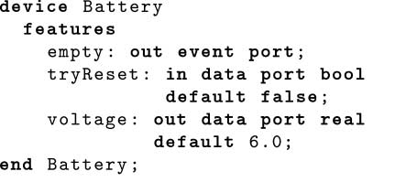
Extended example - 2

Slide 35
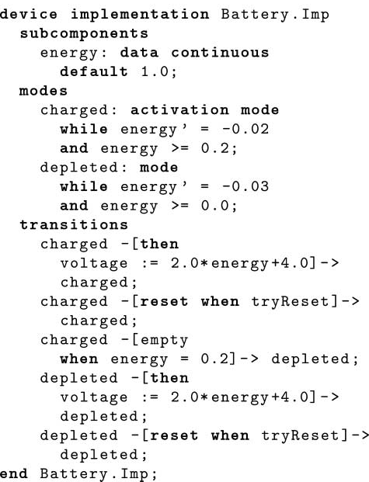
Extended example - 3

Slide 36
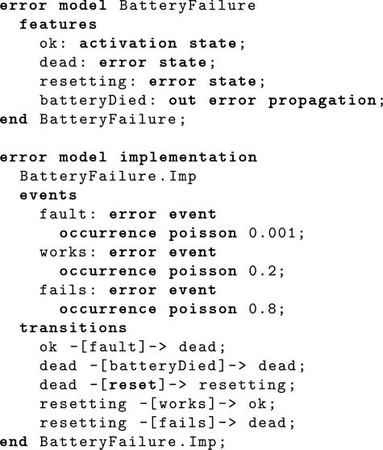
Extended example - 4

Slide 37
AADL and Software Assurance
AADL Practice Framework for Model-Based Analysis
http://sarpresults.ivv.nasa.gov/ViewResearch/21/156.jsp

Slide 38
NASA Analysis Process for AADL Models

Slide 39
Focus
Critical issues – found by independent analyses such as a Quality Attribute Workshop (QAW by the SEI), Fault Tree Analysis (a previous session), and others such as risk analysis.
Analysis Guidelines – developed by NASA, determines which models to build
Outputs Analysis View reports
An analysis viewpoint is characterized by a set of related issues and establishes conventions for developing and documenting analysis views to address those issues.

Slide 40
Build
Analysis View Reports (AVRs) are inputs
Main activity is building new AADL models or revising existing ones
Add the elements needed to support the analyses defined in the AVRs

Slide 41
Analyze
Run the analyses, defined in Focus, on models created in Build.
The OSATE toolkit is the host for these analyses.

Slide 42
Example Analyses
Viewpoint | Analyses (AADL)
Performance Issues: Data Flow Data Consistency Time Partitioning | Transport latency Latency jitter Schedulability Execution Time/Deadline Mode Specific Data rate Instantaneous (peak, averages) over time (integrated)

Slide 43
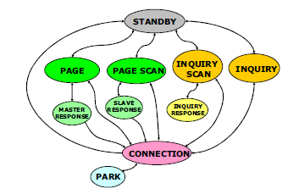
Interface description
Pre/post-conditions on each function
State model that relates the functions
Error model that adds the error behavior
https://developer.bluetooth.org/DevelopmentResources/Pages/Bluetooth-Smart-Optimizations.aspx

Slide 44
Summary
An interface is a specification
The pre/post-conditions and function signature define what is required and what is provided
The state models that are part of the interface definition add constraints to the order in which functions can be used.

Slide 45
Assignment
Select one of the interfaces in our system:
  OBD to cell phone
  Cell phone to cloud
Build a description of the interface using English or AADL

