Slide 1

CPSC 873
John D. McGregor
Session 1
Introduction

Slide 2
Course Checklist
Visit my website https://people.cs.clemson.edu/~johnmc and the course’s site under Current Courses
Read the syllabus

Slide 3
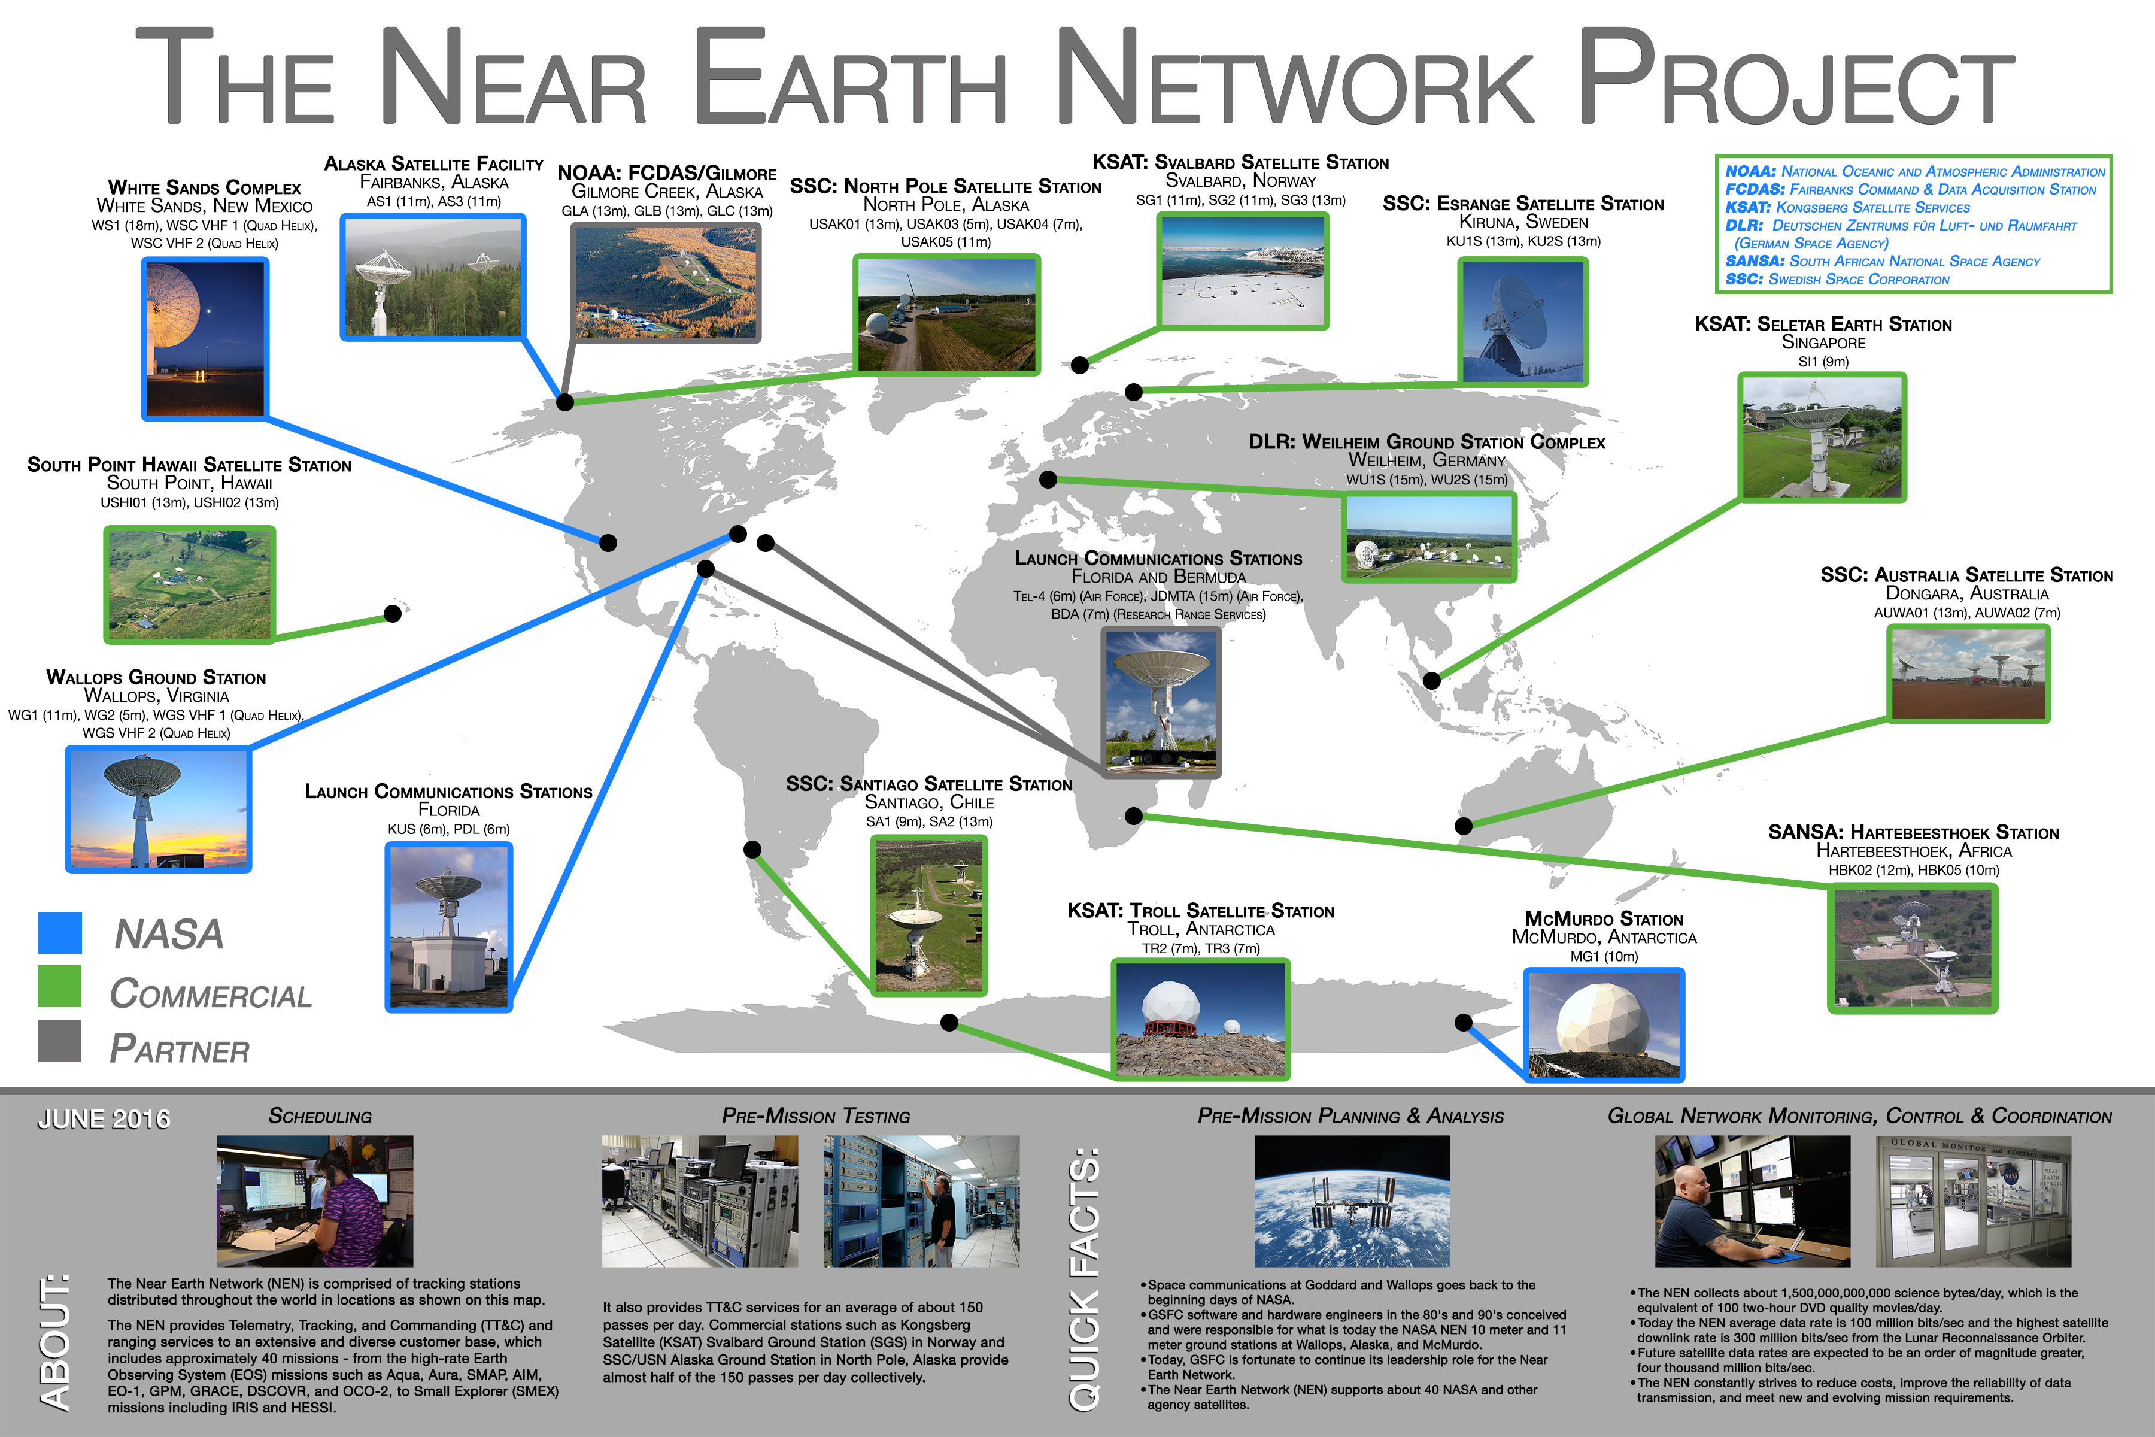
NASA

Slide 4
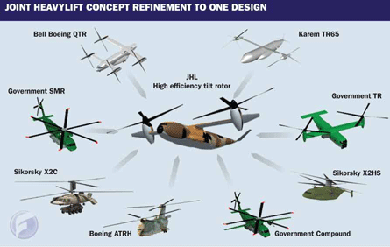
US Army FVL Product Line

Slide 5
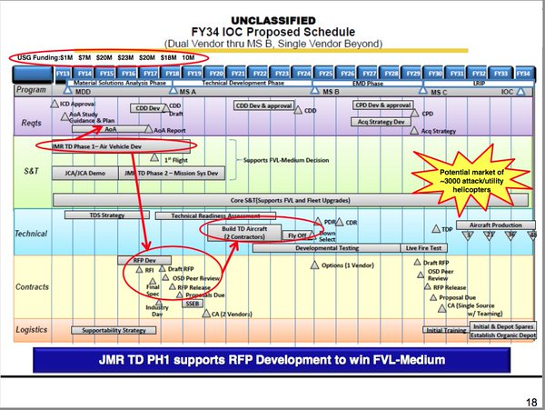
Twenty year plan

Slide 6

What’s the problem? Diverse goals and requirements!
Entertainment
Business
Autonomy

Slide 7
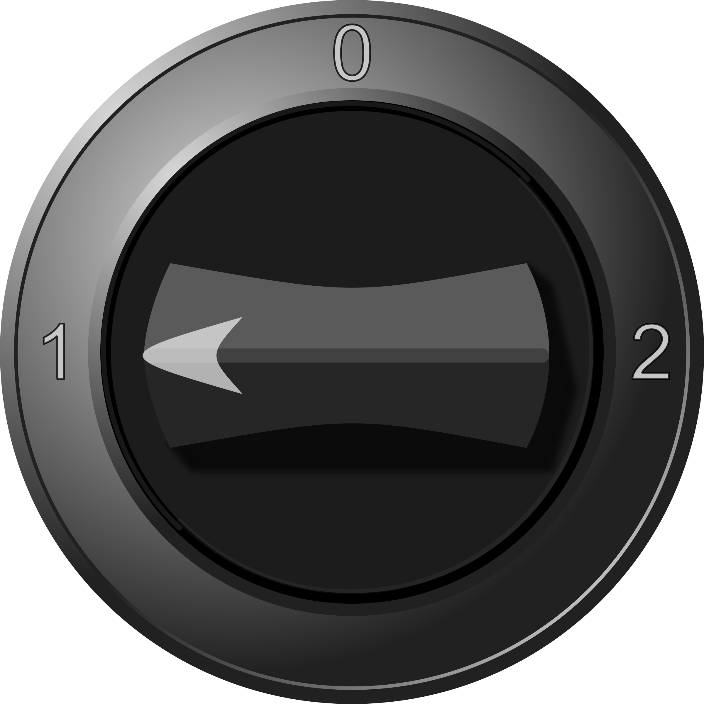
What’s the problem?
Ship and pray
System focus
End to end focus

Slide 8
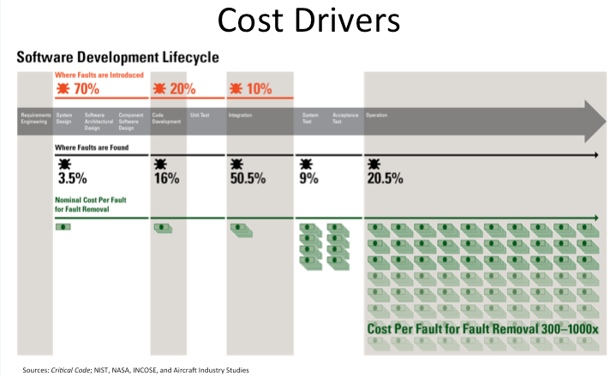
What’s the problem?
Software Interaction Complexity Drives System Cost
Software Development Life Cycle
Where Faults are Introduced
Requirements
Architecture Design
Code
Unit Test
Integration Test
Acceptance Test
Operation
Where Faults are Found
Nominal Cost Per Fault for Fault Removal
Post-unit test software rework cost
50% of total system cost and growing
Software as % of total system cost
1997: 45% → 2010: 66% → 2024: 88%

Slide 9
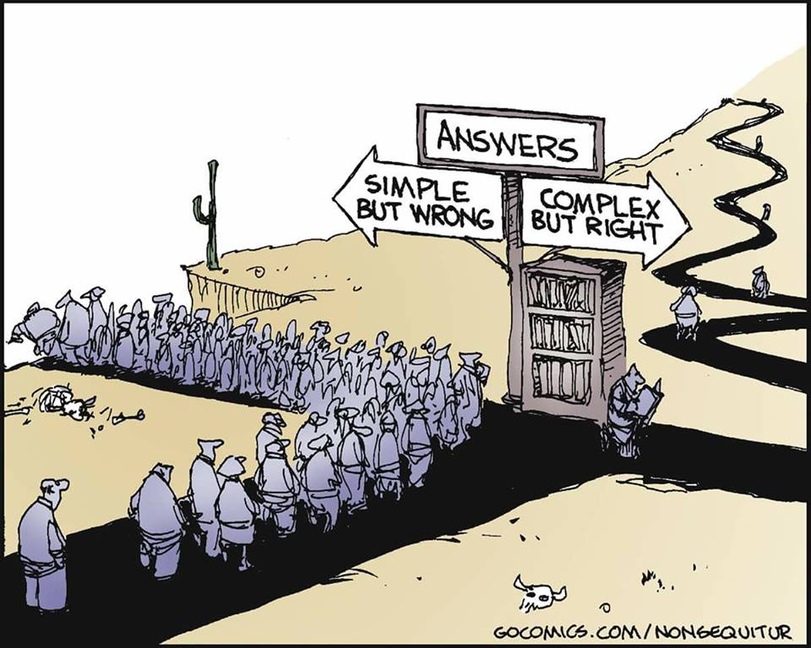
How do you want it?

Slide 10
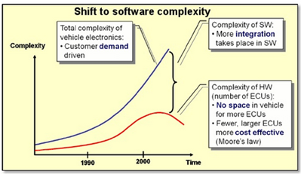
Complexity

Slide 11
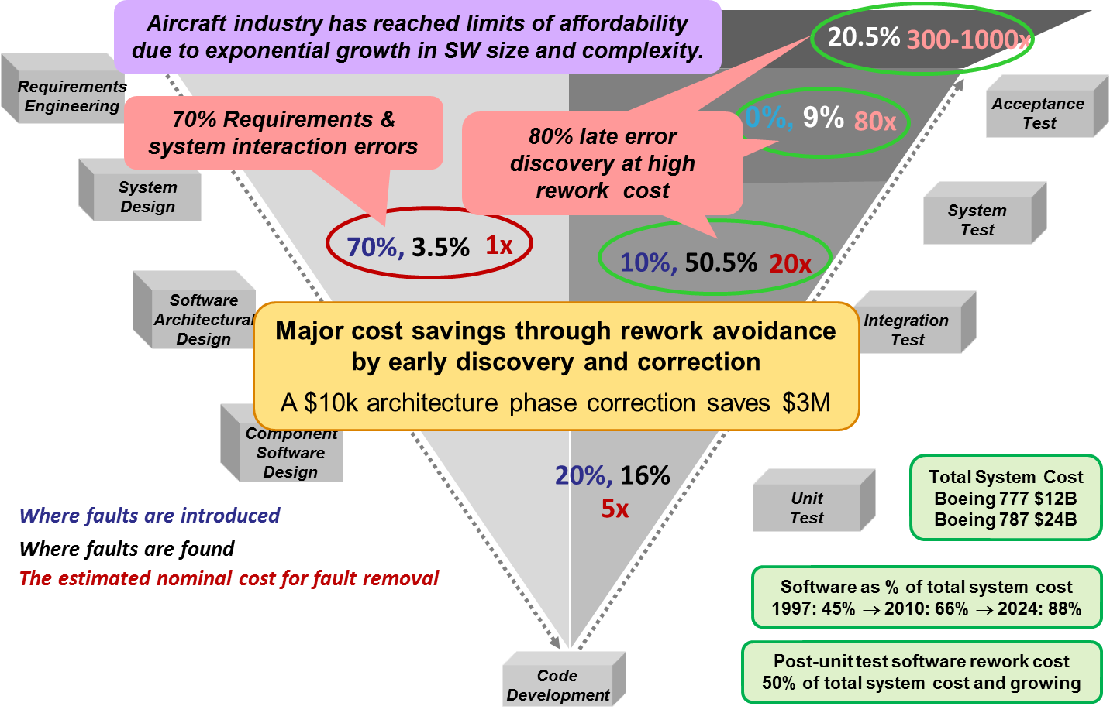
Where do the errors come from?

Slide 12
Recent example – May 2015
A software vulnerability in Boeing's new 787 Dreamliner jet has the potential to cause pilots to lose control of the aircraft, possibly in mid-flight, Federal Aviation Administration officials warned airlines recently.
"This AD was prompted by the determination that a Model 787 airplane that has been powered continuously for 248 days can lose all alternating current (AC) electrical power due to the generator control units (GCUs) simultaneously going into failsafe mode," the memo stated. "This condition is caused by a software counter internal to the GCUs that will overflow after 248 days of continuous power. We are issuing this AD to prevent loss of all AC electrical power, which could result in loss of control of the airplane."

Slide 13
Recent example - continued
The memo doesn't provide additional details about the underlying software bug. Informed speculation suggests it's a signed 32-bit integer overflow that is triggered after 231 centiseconds (i.e. 248.55 days) of continuous operation.
"Have you tried turning it off, and back on again?"
“The airworthiness directive action addresses a condition that only occurred in the lab. Simulated testing determined that this condition is possible in cases where an aeroplane’s power is left on for more than eight continuous months. No airplane in the fleet experienced that condition,” a Boeing spokesman told the Guardian.

Slide 14
Validation and Verification
Verification - Confirmation that selected work products meet their specified requirements.
Validation - Confirmation that an end product or end product component will fulfill its intended purpose when placed in its intended environment.
http://www.faa.gov/about/office_org/headquarters_offices/ang/offices/tc/initiatives/vnv/documents/publications/VVSPT-A2-PDD-014_VnV_Operations_Guide_v2.0.pdf
- read sections 1-3 for next class

Slide 15
Measurement
A measurement is an indication of the size, quantity, amount or dimension of a particular attribute of a product or process. For example the number of errors in a system is a measurement.
A metric is a measurement of the degree that any attribute belongs to a system, product or process. For example the number of errors per person hours would be a metric.
https://www.cs.umd.edu/~basili/publications/technical/T89.pdf
http://www.stsc.hill.af.mil/resources/tech_docs/gsam3/chap13.pdf

Slide 16
Assurance
All inclusive
More management than technical
Helps technical people select V&V activities to perform
And then monitors the performance of these activities.

Slide 17
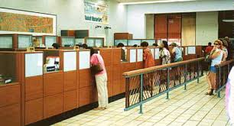

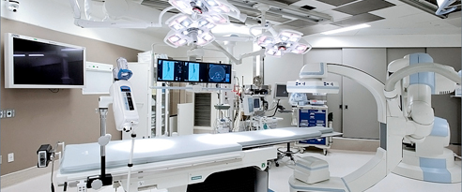
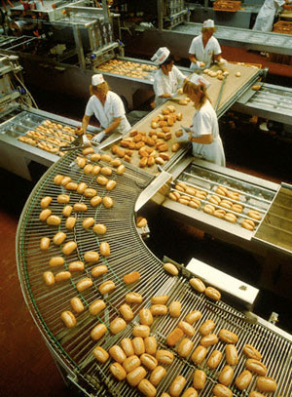
Integrity levels 1-4

Slide 18
What’s the problem? Diverse goals and requirements! Leads to diverse integrity levels.
Entertainment
1
Business
2
Autonomy
4

Slide 19
Life cycle
A piece of software starts as an idea and eventually transitions into production.

Slide 20
Incremental
A portion of the feature set at a time.
http://www.ambysoft.com/downloads/managersIntroToRUP.pdf

Slide 21

Iteration
An iteration, in the context of an Agile project, is a timebox during which development takes place, the duration of which: may vary from project to project, usually between 1 and 4 weeks is in most cases fixed for the duration of a given project

Slide 22
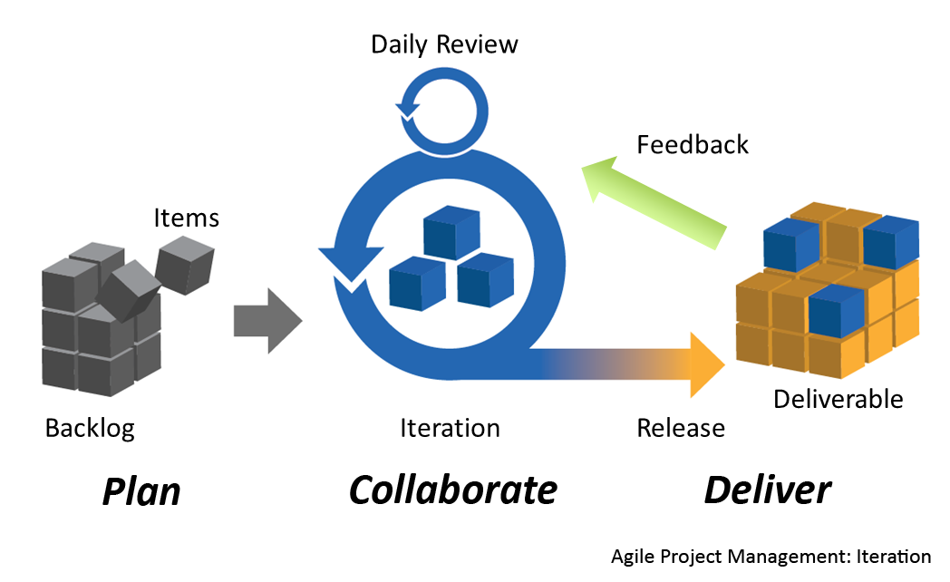
Agile development

Slide 23
DoD 5000
Product development cycle

Slide 24
Early phases

Slide 25
Typical V&V activities
Testing
Reviews
Simulations
Proofs

Slide 26
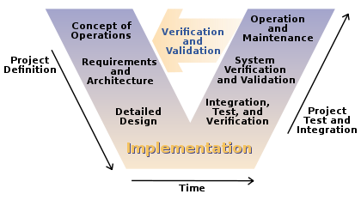
Traditional V Model

Slide 27
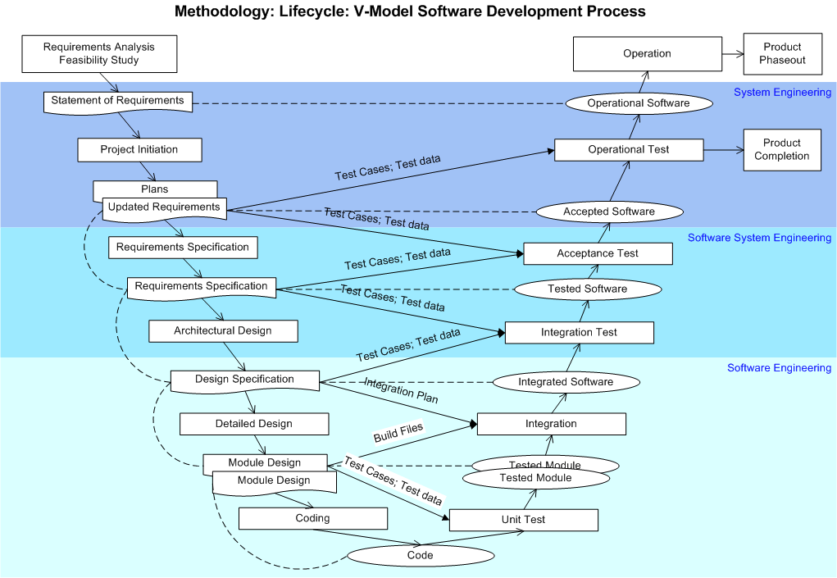
http://myprojects.kostigoff.net/methodology/project_life_cycle/pages/v_model_sw_development.htm

Slide 28
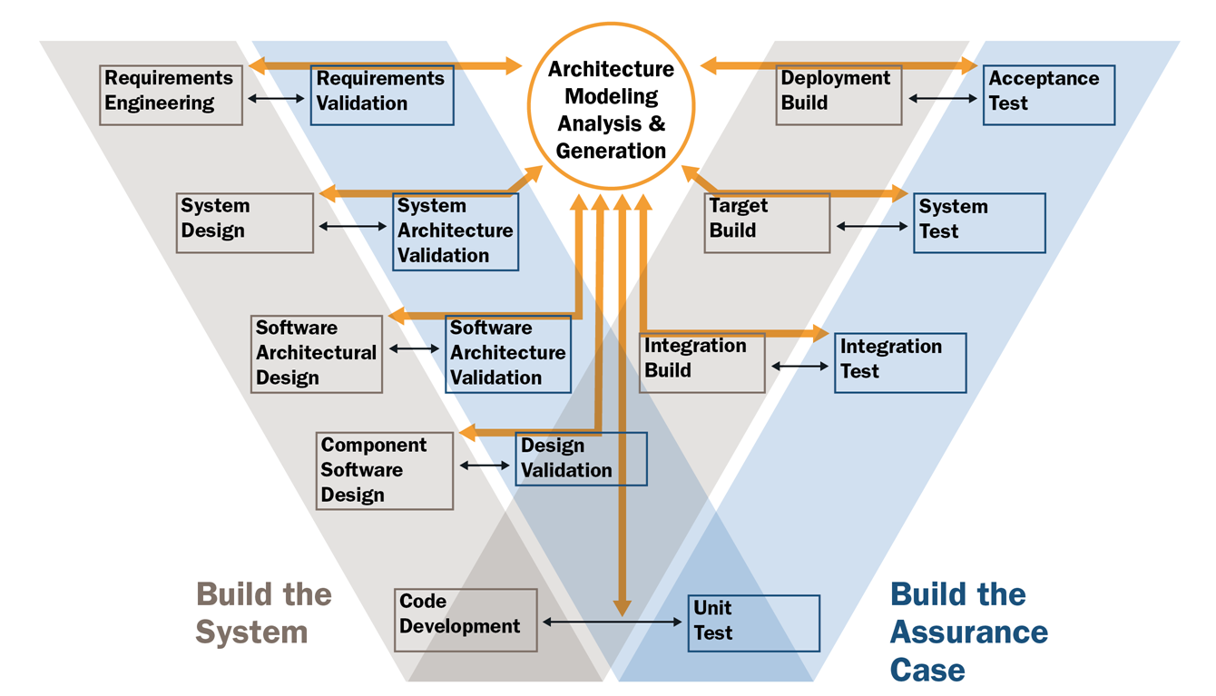
Double V

Slide 29
Uncertainty – Physical vs virtual
Results of computations are seldom exact.
Hardware changes in random ways based on friction, gravity, and other natural forces.
An aircraft tire loses a bit of rubber every time it lands but how much?
Software changes in predictable ways but often it is so complex that our mind cannot make accurate predictions.
Every upgrade adds/replaces/deletes specific lines of code.

Slide 30
Uncertainty – Analog vs Digital
Continuous vs discrete
Even binary representations are not exact for many numbers.
Just how correct do we need to be?

Slide 31
Cyber-physical systems
A blend of analog (continuous) and digital (discrete) functions
Analog brings along even greater uncertainty
Uncertain measures of uncertain things
The Internet of Things makes this more important
M2M – machine to machine systems

Slide 32
Feedback control loop architecture
Controller
model
actuators
sensors
System under
control

Slide 33
Our focus
This semester we will focus on various types of cyber-physical systems
fly-by-wire
Drive-by-wire
Smart appliances
…

Slide 34
Problem/solution
Problem
Solution

Slide 35
Requirement/specification
Problem
Requirements/
Properties
Solution
Specification/
Implementation

Slide 36
Validation and Verification
Problem
Requirements
Solution
Specification
Validation
Verification

Slide 37
Model-based development
Text-based
communication
Diagram-based
communication
Model-based
communication

Slide 38
Tools
Text-based
communication
Meaning is abstracted and assigned to symbols
Diagram-based
communication
Tools “understand” the meaning
Model-based
communication

Slide 39
Roles
Stakeholder – anyone with an interest in the system being developed
User
Client
Affected person
Developer
Designer
Project manager
…

Slide 40
reading
https://www.faa.gov/aircraft/air_cert/design_approvals/air_software/media/AR-08-32.pdf
http://ieeexplore.ieee.org/stamp/stamp.jsp?tp=&arnumber=6204026 – for next Tuesday read down TO section 8.

Slide 41
Install OSATE: osate.org
Play with the tutorial: https://www.youtube.com/watch?v=MjUQZaqaTA4
https://www.youtube.com/watch?v=c-xsWYxSCHY
https://www.youtube.com/watch?v=HemoCKFmBjw

Slide 42
https://www.faa.gov/about/office_org/headquarters_offices/ast/licenses_permits/media/VV_Guide_9-30-03.pdf

Slide 43
Assignment
Pick an incident in which a software system failed in a bad way.
Think about what caused the failure.
What V&V might have been used to locate the weakness before the failure?
Submit a half page summary to johnmc@clemson.edu by 11:59PM Wednesday August 29th.

