Slide 1

CPSC 873
John D. McGregor
Session 10
Misc.

Slide 2
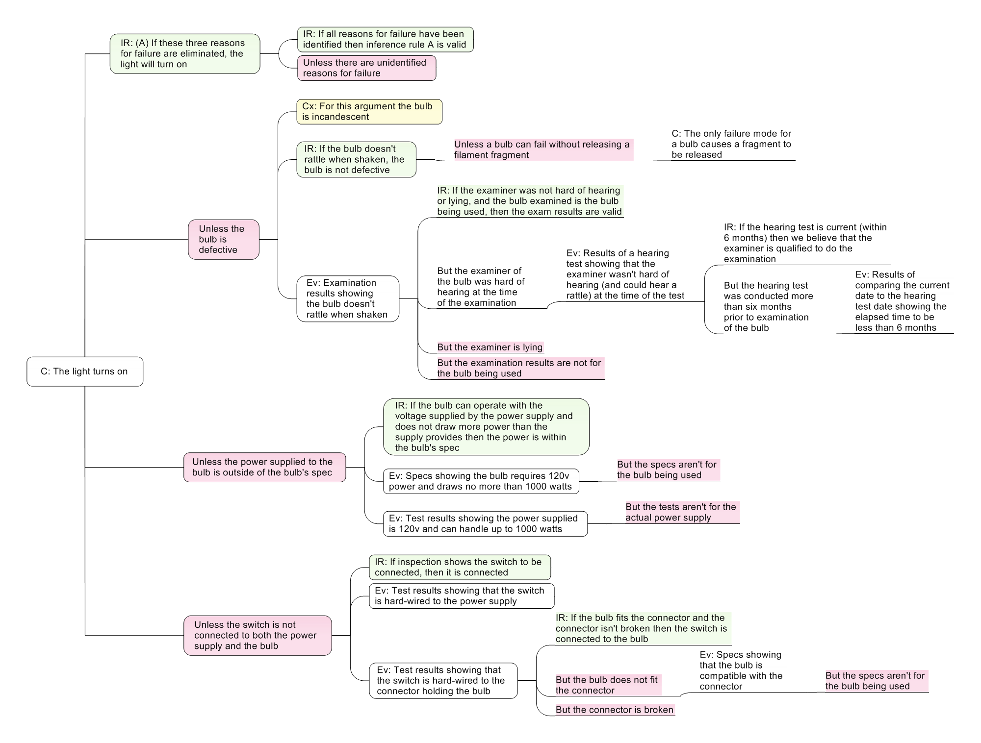

Slide 3
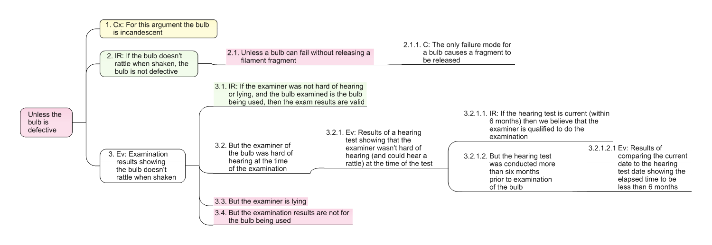

Slide 4
System boundaries and exceptional conditions
Test cases for boundary conditions.

Slide 5
http://www.elysiuminc.com/gpdis/2012/24RockwellCollins-GregPollari-CompositionalVerificationOfArchitecturalModels.pdf
https://www.umsec.umn.edu/sites/www.umsec.umn.edu/files/NFM-springer-proof-72260126.pdf
http://resources.sei.cmu.edu/asset_files/Webinar/2011_018_101_24546.pdf?_ga=1.111431559.2063106740.1442923335

Slide 6
http://resources.sei.cmu.edu/asset_files/ConferencePaper/2013_021_001_88010.pdf
http://resources.sei.cmu.edu/library/asset-view.cfm?assetID=41124

Slide 7
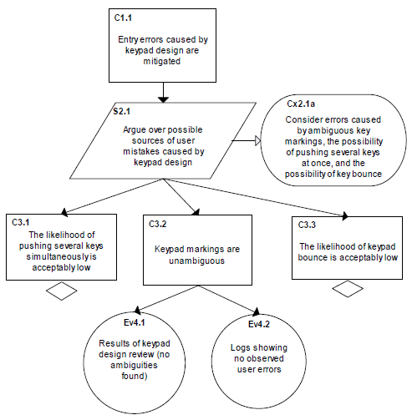

Slide 8
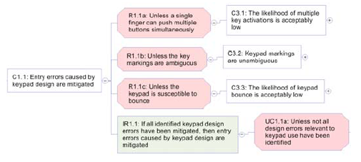

Slide 9
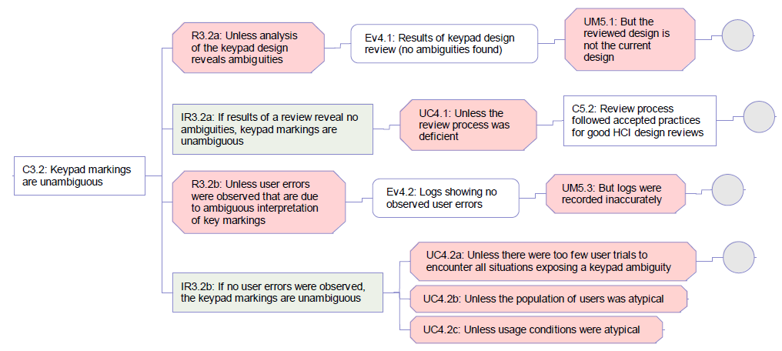
http://resources.sei.cmu.edu/asset_files/TechnicalReport/2012_005_001_28161.pdf

