Slide 1

CPSC 873
John D. McGregor
Session 14
People Issues

Slide 2
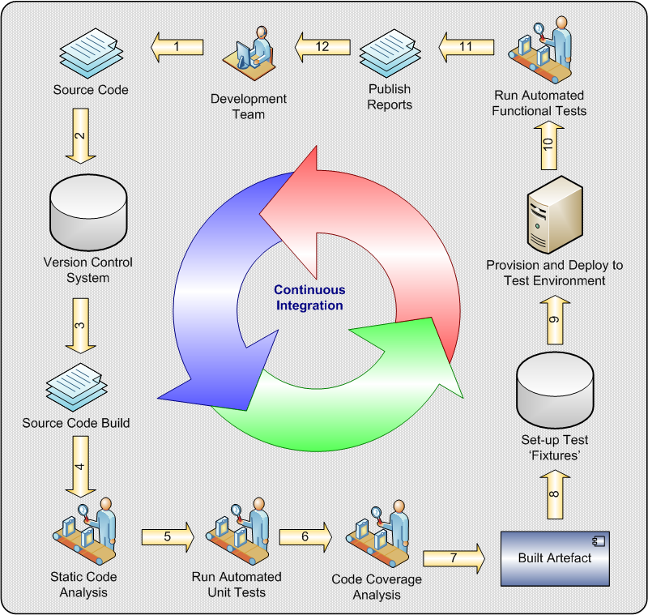

Slide 3
Variation in developer performance
H. Sackman, W.J. Erikson, and E.E. Grant found differences of more than 20 to 1 in the time required by different developers to debug the same problem (“Exploratory Experimental Studies Comparing Online and Offline Programming Performance,” Comm. ACM Jan. 1968)

Slide 4
Warning signs
They cover up their ignorance rather than trying to learn from their teammates.
They are territorial.
They grumble about team decisions and continue to revisit old discussions long after the team has moved on.

Slide 5
Software engineer characteristics
Growth-oriented
Introverted
Autonomous
Need for stability
Need to be sociable
Technically competent
Achievement oriented
Need for variety

Slide 6
Software engineering characteristics
Need for challenge
Need for competent supervisors
Need to make a contribution
Need for feedback
Marketable
Creative
Need for involvement in personal goal setting
Need for geographic stability

Slide 7
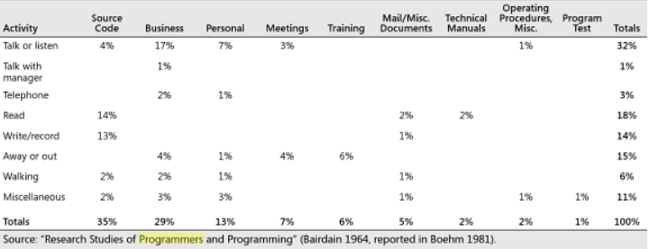
1960s data from AT&T
New Code: 2%
Modifying Existing Code: 20%
Understanding Code: 78%

Slide 8
Some newer numbers
New Code: 2%
Modifying Existing Code: 20%
Understanding Code: 78%

Slide 9
Maslov’s Hierarchy of Needs
Physiological: air, food, water, sex, sleep, excretion, etc.
Safety: health, personal well being, financial and employment stability, security against accidents, etc.
Belonging: love, intimacy, friendship, family, social cohesion, etc.
Esteem: self-esteem, confidence, achievement, respects, etc.
Self actualization

Slide 10
http://www.ted.com/talks/tony_robbins_asks_why_we_do_what_we_do

Slide 11
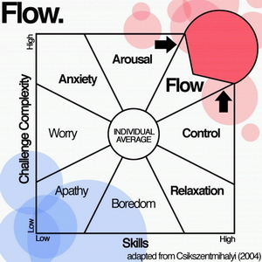
Flow
Flow is an optimal state of intrinsic motivation, where people become totally immersed in what they are doing.
People experiencing flow often forget about physical feelings, passage of time, and their ego fades away.

Slide 12
Motivational Factors
F1- Use of competence in SE
F2 - Power
F3 - Work/life balance
F4 - Career
F5 – Actualization
http://ac.els-cdn.com/S0950584908000827/1-s2.0-S0950584908000827-main.pdf?_tid=4fa03916-737a-11e5-a871-00000aab0f02&acdnat=1444940666_be803322838d94899de9172658a0a1e8

Slide 13
Use of competence in SE
Feedback
Participation in the entire life cycle of a project
Making good use of skills
Problem solving
Exercise creativity
Exercise SE development practices
Team working

Slide 14
Power
Participation in decision making
Autonomy
Empowerment
Making a contribution/task significance
Identification with task

Slide 15
Work/life balance
Working in successful company
Work/life balance

Slide 16
Career
Technical development
Career path
Rewards and financial incentives

Slide 17
Actualization
Experiment
Change
Challenging work

Slide 18
Friction
Friction is any element that slows down your progress
Can come from different sources
Can operate on different time scales
Can be more than simple delays
http://delivery.acm.org/10.1145/1000000/990695/p15-armour.pdf?ip=64.196.95.4&id=990695&acc=AUTHOR-IZED&key=4D4702B0C3E38B35.4D4702B0C3E38B35.4D4702B0C3E38B35.2F44EA6BA188AAC6&CFID=721842984&CFTOKEN=14090242&__acm__=1444942736_6b67defa3ef0baf0d2751cfda5695993

Slide 19
Continuous integration as a mitigation for friction
“I don’t know dude. It works on my machine!”
Slingin’ Code Around
It just flat out takes too long to deploy new versions of the code.
Someone made a mistake in the code deployment to testing.
Are you sure you’ve got the right build?
Continuous Integration Is an Attitude

