Slide 1

CPSC 873
John D. McGregor
Session 15
Test suites and tools

Slide 2
Test case
<pre-conditions, selected inputs, post-conditions>
Every test case is a combination of these 3
What is the single most frequent problem with creating tests?
What is the single most frequent omission in the test process?

Slide 3
Fault model is a source of test cases
Fault model
ATAM
Scenarios
Unit tests
System tests
Interaction
tests

Slide 4
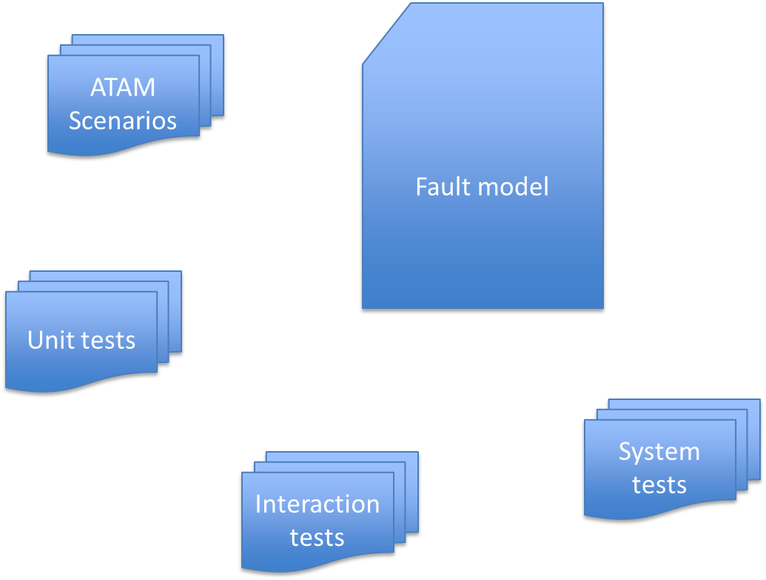
Test cases

Slide 5
Integrated development and testing
Test first programming
Test a little, code a little, test a little, code a little…
Unit testing is testing a piece of code in isolation from the rest of the system
Maybe one developer both tests and develops
Or pair programming
Or tested by an independent test team

Slide 6
Problem with test first
It has a built-in bias
Any misconception the developer has will show up in both the test and the code
Pair programming removes that bias but often has less productivity than 2 independent people
A Buddy System where two developers swap code and test each others works well; it reduces the learning curve without lots of interaction

Slide 7
Somewhat more formal - Bugzilla
How do testers communicate with developers?
https://landfill.bugzilla.org/bugzilla-5.0-branch/

Slide 8
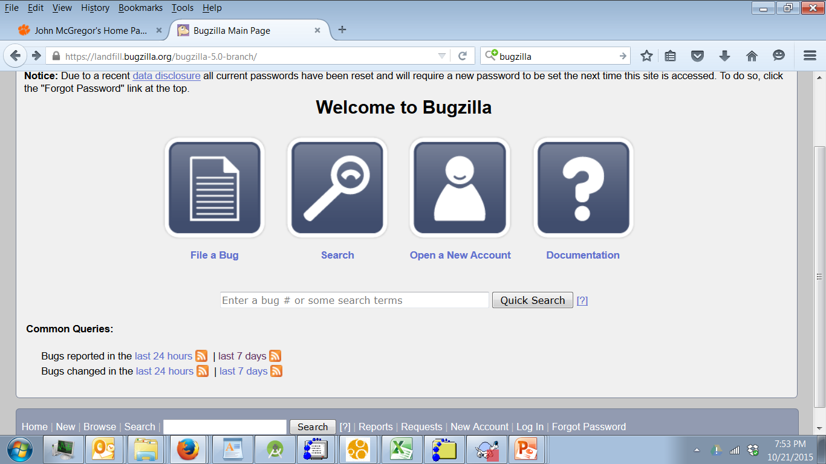

Slide 9
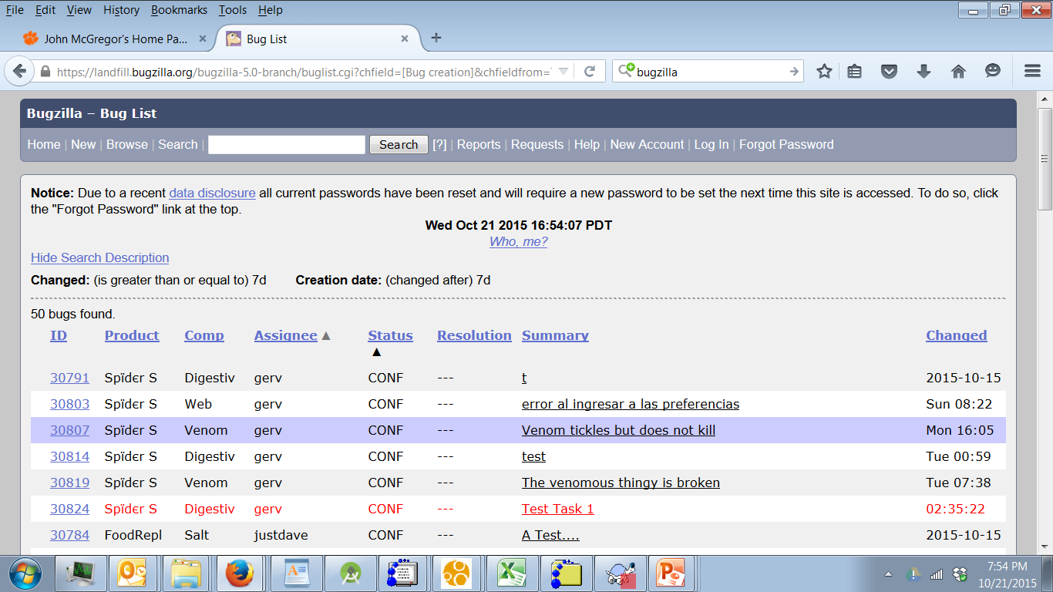

Slide 10
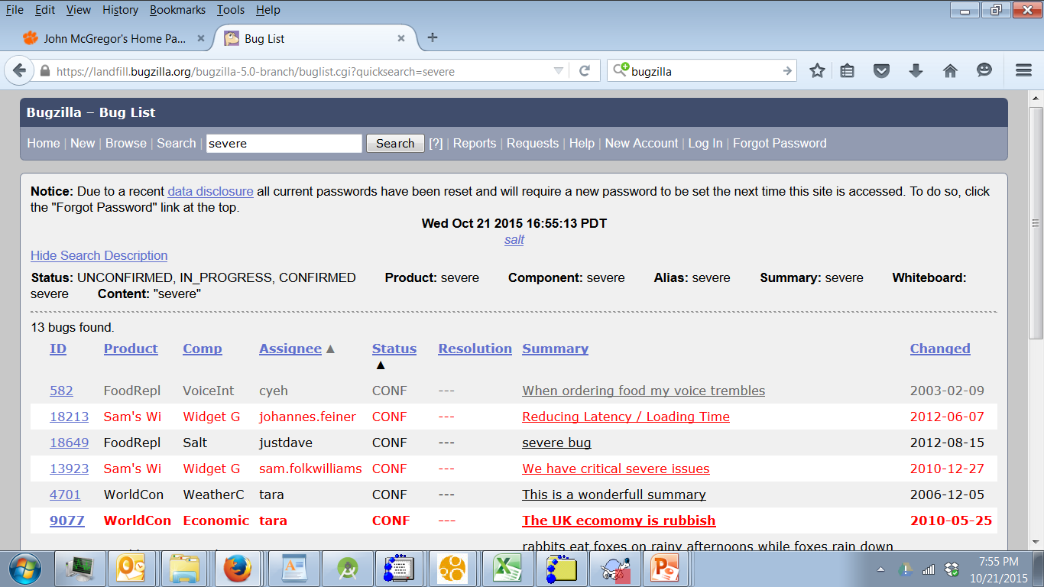

Slide 11
Test reports
TABLE OF CONTENTS
1.0 INTRODUCTION
2.0 OBJECTIVES AND TASKS 2.1 Objectives 2.2 Tasks
3.0 SCOPE
4.0 Testing Strategy 4.1 Alpha Testing (Unit Testing) 4.2 System and Integration Testing 4.3 Performance and Stress Testing 4.4 User Acceptance Testing 4.5 Batch Testing 4.6 Automated Regression Testing 4.7 Beta Testing

Slide 12
Test Report - 2
5.0 Hardware Requirements
6.0 Environment Requirements 6.1 Main Frame 6.2 Workstation
7.0 Test Schedule
8.0 Control Procedures
9.0 Features to Be Tested
10.0 Features Not to Be Tested
11.0 Resources/Roles & Responsibilities
12.0 Schedules
13.0 Significantly Impacted Departments (SIDs)
14.0 Dependencies
15.0 Risks/Assumptions
16.0 Tools
17.0 Approvals

Slide 13
Test execution report
Number of test cases planned for that day
Number of test cases executed – that day
Number of test cases executed overall
Number of defects encountered that day/and their respective states
Number of defect encountered so far/and their respective states
Number of critical defects- still open
Environment downtimes – if any
Showstoppers – if any
Attachment of the test execution sheet / Link to the test management tool where the test cases are placed
Attachment to the bug report/link to the defect/test management tool used for incident management

Slide 14
Test selection
Points in the SDLC
Unit tests
Integration tests
System tests
Regression tests
Acceptance tests
Perspectives
Blackbox
Whitebox

Slide 15
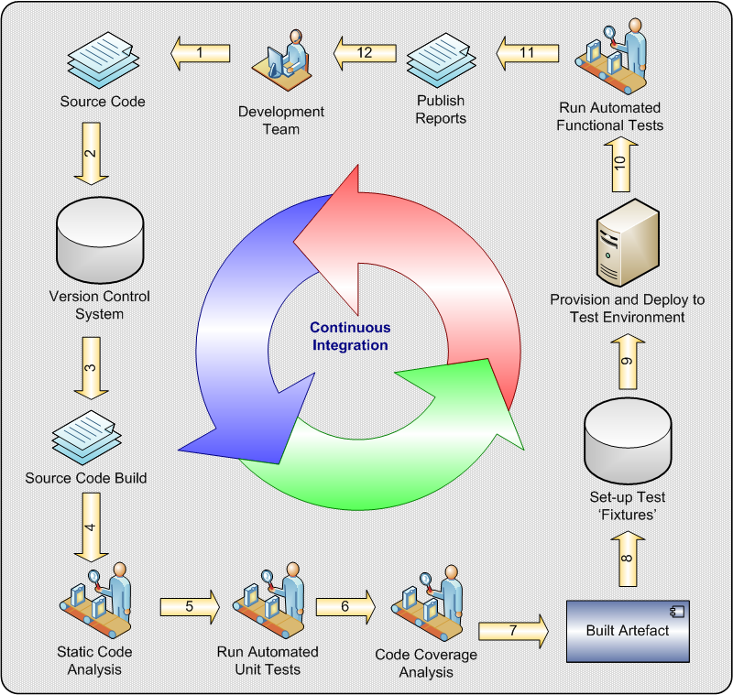

Slide 16
Test characteristics
Correct - what the test case says is the correct answer really is the correct answer
Effective – finds defects
Efficient – use few test cases to find many defects

Slide 17
Unit tests
Isolated from context as much as possible
Use contract as starting point
Include positive/negative tests
If AADL model is available follow flows
Or cover input range and outside boundaries of contracts
It is a matter of design philosophy whether to test outside boundaries

Slide 18
Unit tests
Blackbox coverage levels
Each function
Sample from domain of each parameter
Each non-functional attribute is evaluated
Add values to cover all states that are public
Whitebox coverage levels
Add values that cover all states if private
Select value to deepen coverage
Every line of code

Slide 19
JUnit
http://www.tutorialspoint.com/junit/junit_tutorial.pdf
https://www.tutorialspoint.com/junit/junit_overview.htm

Slide 20
Integration tests
Unit test of integrated units
Each unit does its job
Emergent behavior is what we search for
Flows
Test each flow from one component to another
Sample parameter values
Implicit interactions
Test implicit flows via shared variables
If hardware is involved test any induced interactions

Slide 21
System tests
Up to now we have tested what is there.
From here we test for what should be here
Tests selected using user profiles
User profile assigns a probability of how often each feature is operated

Slide 22
Acceptance tests
Purchasing organization conducts tests of software on which they have an option
Tests are selected based on buyer’s priorities

Slide 23
Emulator testing
When special hardware must be used an emulator may be used for initial testing
http://developer.android.com/tools/help/emulator.html
http://developer.android.com/tools/devices/emulator.html

Slide 24
Visual testing tools
https://en.wikipedia.org/wiki/List_of_GUI_testing_tools
GUIs usually are mostly frameworks plus a bit of custom code.
Using a tester built on the same framework can be very efficient.
The Eclipse RCP test tool
http://www.eclipse.org/rcptt/

