Slide 1

CPSC 873
John D. McGregor
Session 16
Where are we? Where are we going?

Slide 2
Odd error
Doing a copy operation in a pdf file and pasting it in another Office document results in losing any “fi”combinations from the copied text

Slide 3
Software Reliability
http://2014.issre.net/sites/2014.issre.net/files/Tutorial_Williams_Slides.pdf

Slide 4

Many colors of systems
Safety-critical
commercial
games

Slide 5
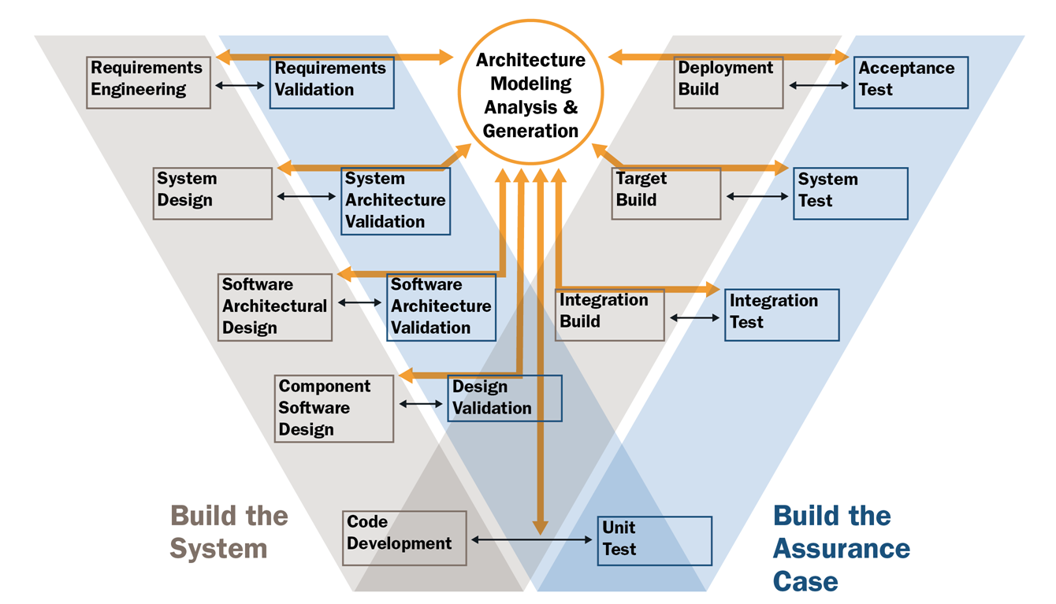
Double V

Slide 6
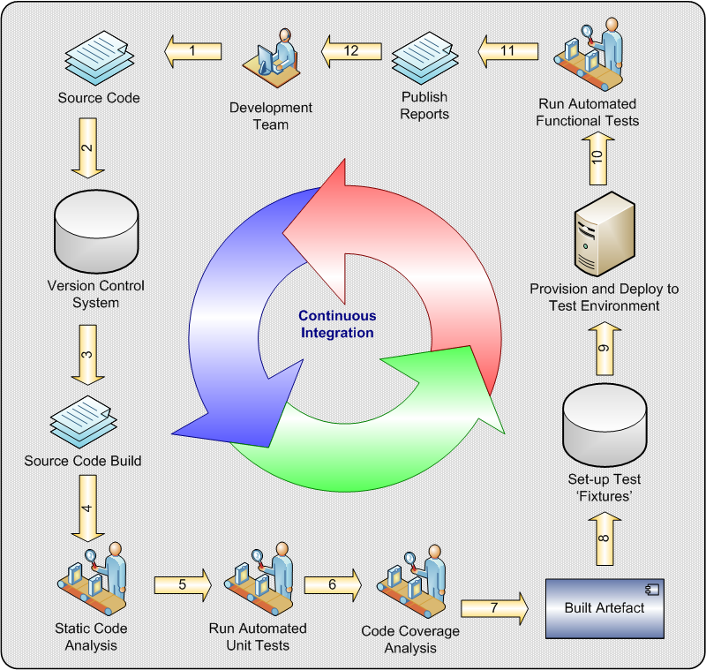

Slide 7
We have come full circle
Now that we have surveyed techniques and you have basic knowledge we will dig deeper into some pieces
We will assume that we are in a large scale organization that produces mission-critical, and sometimes life critical, systems for a wide range of clients

Slide 8
Topics
Software product lines
Safety critical products
Embedded systems
Internet of Things
Dynamically changing products
Highly configurable products
Ecommerce systems

Slide 9
Here’s what you are going to do
Select a topic such as a tool, a technique, a specific context etc. related to an existing implementation from Github or other source
Pick an activity in which you will
Learn something
Create something
Use something
Use existing non-V&V materials such as CVRIA, etc but create artifacts related to V&V
Include references

Slide 10
Project
1 – 2 people
Schedule of weekly milestones; milestones due Oct 31, Nov 7, 14, 21, 28
Propose project including a set of recspec requirements, a work breakdown structure, and a list of deliverables by Oct 24th
Modeling in AADL
Code, if any, in appropriate language
Give a specific context description
5-7 minute video presentation

