Slide 1

CPSC 873
John D. McGregor
Session 2
Preparing for Requirements V & V

Slide 2
Preparing for V & V
As development proceeds, actions must be taken to prepare for and facilitate V & V
What tools are used?
What is written down?
How is it structured?
Where does the information come from?

Slide 3
Distinction
Independent V & V vs. development V & V
Independent V & V is carried out by a group administratively independent from the development team
This ensures that a fresh look is taken
The development team takes a more immediate view

Slide 4
Context
Understand the system boundary
Do not need to know why the boundary is what it is but know the classification rule
Manual control
2 wheeled
Automatic control
4 wheeled
Powered
Licensed
Connected via
wireless
Stand-alone
Non-licensed

Slide 5
Fault/Failure/Error
Fault is a mistake made in the construction of an artifact
Failure is the inability of a system to satisfy its requirements due to a fault
Error is the result of execution in the presence of a failure when trying to execute in the presence of a fault

Slide 6
A good requirement is
Correct
Unambiguous
Complete
Consistent
Prioritized
Verifiable
Modifiable
Traceable

Slide 7
Traceability
Following the life of a requirement – from idea to implementation
How requirements impact each other, and how requirements impact other development lifecycle artifacts (such as designs, tests, tasks, source code, hardware specs, etc.) and vice versa.
The decomposition of requirements – from high level user/customer/market needs to system, sub-system, software or hardware component requirements; and transformation into design specifications and the implementation realization of the requirement.

Slide 8
Types of traces
Satisfaction: a system requirement (or more likely a number of system requirements) ‘satisfies’ a user requirement e.g. system requirement ‘The engine shall have at least 200bhp’ satisfies user requirement ‘The car shall be capable of accelerating from 0-60mph in under 8 seconds’.
Verification: a test case ‘verifies’ that a requirement is satisfied e.g. test case ‘0-60mph acceleration test’ (consisting of a number of test steps) verifies user requirement ‘The car shall be capable of accelerating from 0-60mph in under 8 seconds’.
Dependency (often used where interfaces are concerned): a requirement ‘depends’ on another requirement e.g. requirement ‘the power socket shall take 3 pins’ depends on requirement ‘the plug shall have 3 pins’.

Slide 9
Baselining
A baseline is all about getting to a common agreement between stakeholders. It essentially involves setting the right expectations including responsibilities, risks, assumptions, deliverables and approaches. Once an agreement is reached; it should be put in source control to manage the base line going forward.

Slide 10
Techniques
Simple checks
Traceability, well-written requirements
Prototyping
Functional test design
User manual development
Reviews and inspections
Walkthroughs
Formal inspections
Checklists
Model-Based V&V
First-order logic
Behavioral models

Slide 11
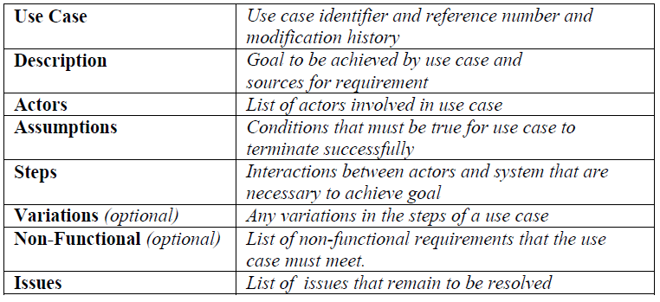
Templates

Slide 12
Notations
Before artifacts are created and verified, their structure and their representation need to be determined.
Resources such as xText allow mini-languages to be defined with grammar based tools so that context sensitive editors can be automatically generated.

Slide 13
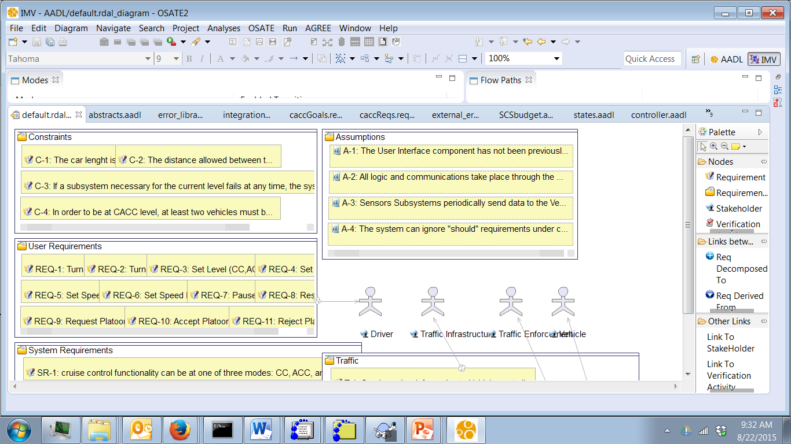
Grouping requirements

Slide 14
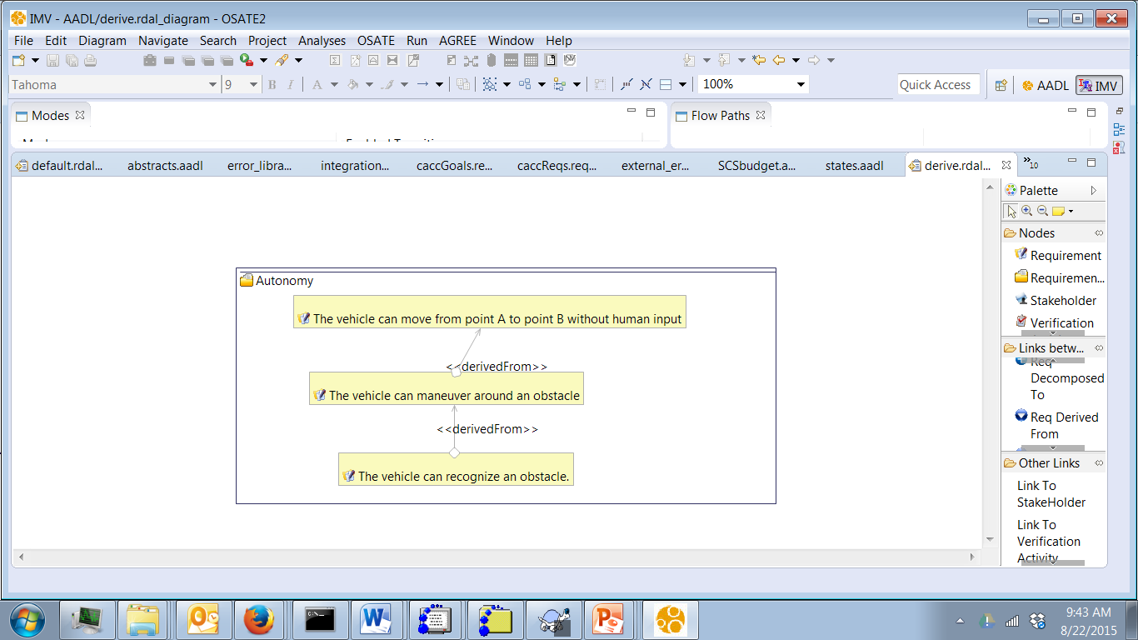
Requirement hierarchy

Slide 15
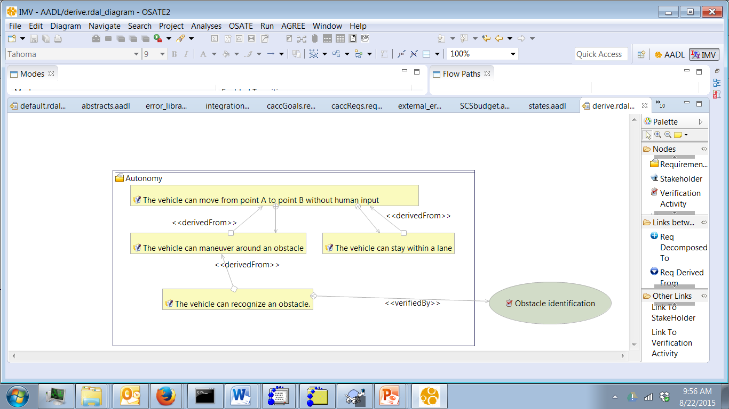
Verification

Slide 16
ReqSpec
system requirements AP : "Requirements for the Autopilot subsystem of the Flight Guidance System"
for Integrator::FGS::AP::prAutoPilot
use constants Globals
[
val AP_ProcessingBudget = 50.0 MIPS
val AP_RAMBudget = 1.6 MByte
val AP_ROMBudget = 16.0 MByte
val AP_FlowPathLatency = 3.0 ms
requirement R1: "Processing Budget" [
description "The processing needs of the AP subsystem
shall not exceed "
UtilizationRatio " percent of "
AP_ProcessingBudget
]
requirement R2_1: "RAM Memory Budget" [
description "The RAM memory needs of the AP subsystem
shall not exceed "
UtilizationRatio " percent of "
AP_RAMBudget
]

Slide 17
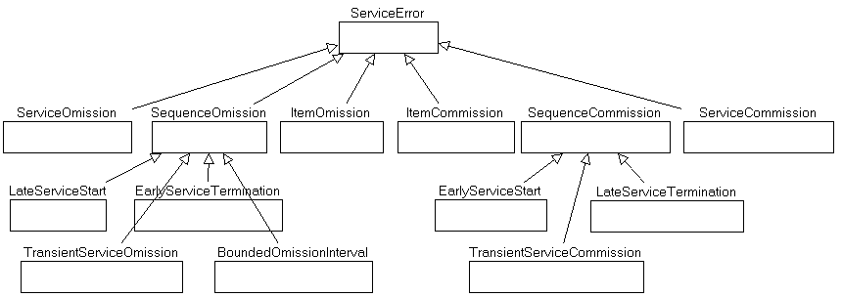
Error ontology - 1

Slide 18
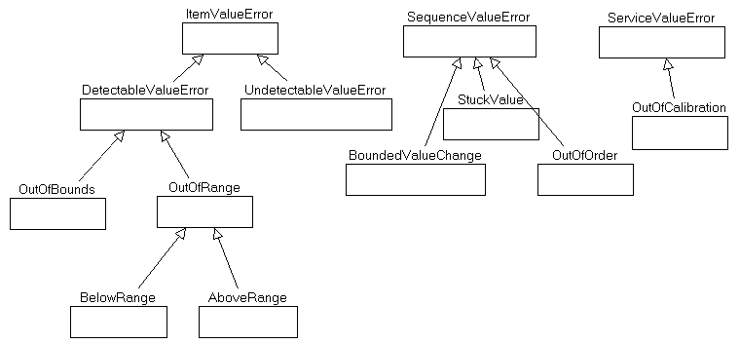
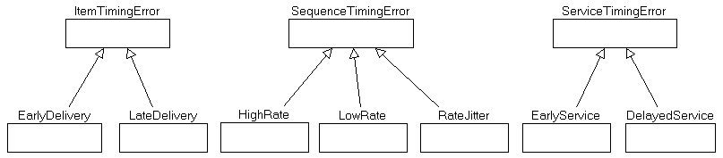
Error ontology - 2

Slide 19
Eclipse/OSATE/ALISA
Download and install OSATE from: http://www.aadl.info/aadl/osate/stable/2.2.2/products/
How to use an update site: https://developers.google.com/web-toolkit/tools/gwtdesigner/installation/updatesite_3.6
http://resources.sei.cmu.edu/asset_files/TechnicalReport/2016_005_001_464378.pdf

Slide 20
AADL
Architecture Analysis and Design Language (AADL)
SAE standard
Precise semantics
Open Source Aadl Tool Environment (OSATE)
http://osate.github.io/
https://github.com/osate
Need java 8 installed

Slide 21
Special languages/annexes
AGREE – model checking
Resolute – model checking
Reqspec – requirements representation
Verify – assurance cases
https://github.com/smaccm/smaccm/blob/master/documentation/agree/AADL%20and%20AGREE.pptx
http://arxiv.org/pdf/1409.4629.pdf

Slide 22
Resources for learning AADL
http://www.sei.cmu.edu/webinars/view_webinar.cfm?webinarid=424907
https://wiki.sei.cmu.edu/aadl/index.php/Editing_a_first_AADL_model
http://www.openaadl.org/
http://www.openaadl.org/post/2013/07/11/aadl-esweek/

Slide 23
Example models
https://github.com/osate
https://github.com/osate/examples/blob/master/ARP4761/simple
https://github.com/osate/examples/blob/master/ARP4761/simple/wbs.aadl

Slide 24
ALISA
https://rawgit.com/osate/alisa-examples/master/Documentation/BasicRequirementSpecificationGuidance.html
https://github.com/osate/alisa-examples
https://wiki.sei.cmu.edu/aadl/index.php/ARP4761_-_Wheel_Brake_System_%28WBS%29_Example

Slide 25
Assignment
Due Sept 5th by 11:59pm
Use the web description of the wheel brake problem to create reqspec requirements
Assign a level of integrity to each main numbered requirement; give a rationale for each value
Think about each requirement and relate it to one of the defect categories. In other words what type of defect is likely to reside in the part of the system covered by the requirement.

