Slide 1

CPSC 873
John D. McGregor
S23
Case Study

Slide 2
Delay Intensive Networking (DTN)
http://ipnsig.org/wp-content/uploads/2015/09/DTN_Tutorial_v3.2.pdf
http://ipnsig.org/wp-content/uploads/2015/09/DTN_Tutorial_v3.2.pdf
http://archive.cone.informatik.uni-freiburg.de/lehre/seminar/adhoc-w09/presentations/delay.tolerant.networks.presentation.pdf
https://slideplayer.com/slide/6633795/

Slide 3
IEEE V&V template
http://pesona.mmu.edu.my/~wruslan/SE2/Readings/detail/Reading-7.pdf

Slide 4
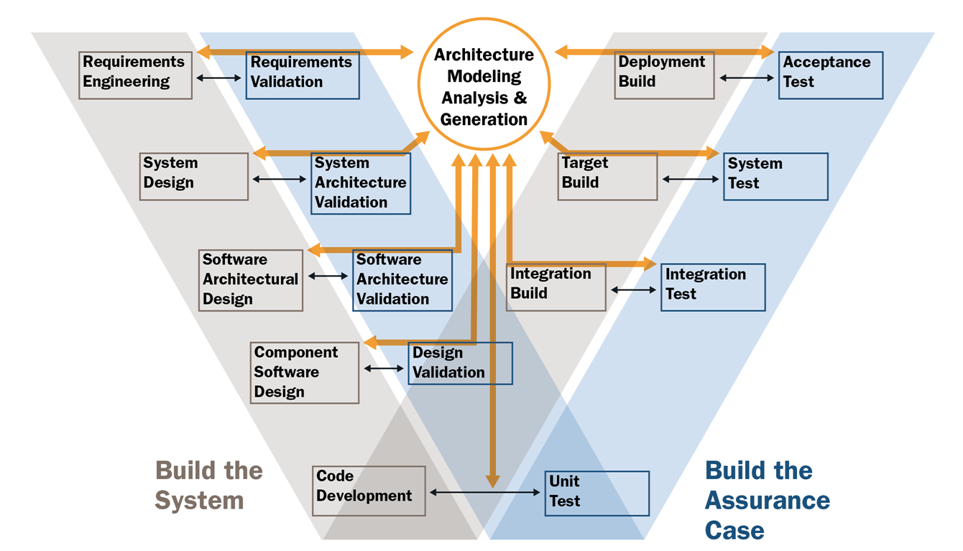

Slide 5
Use Case #1
Actor: system developer
Pre-conditions: Sender may not have access to usual wireless/wi-fi facilities due to damaged equipment during an emergency
Actions: Developer includes a DTN server in the product that can connect to specific network
Post-conditions: The new product can publish information even in the event of catastrophes

Slide 6
Use Case #2
Actor: astronaut
Pre-conditions: launch has occurred; radio networks are available
Actions: The astronaut configures the message request so that speed of delivery is a lower priority that eventual delivery
Post-conditions: The message is sent using the Bundle protocol

Slide 7
Use Case #3
Actor: Eye witness to huge fire
Pre-conditions: conventional networks are so overloaded that messages are lost
Actions: The emergency reporting app uses a DTN server to initiate a message on a DTN enabled network
Post-conditions: A message reaches the emergency dispatch center

Slide 8
Use Case #4
Add one

Slide 9
Requirements V&V
What do we do?

Slide 10
Requirements V&V Tasks
Requirements V&V tasks described in Table 1:
1) Task: Traceability analysis
2) Task: Software requirements evaluation
3) Task: Interface analysis
4) Task: Criticality analysis
5) Task: System V&V test plan generation
6) Task: Acceptance V&V test plan generation
7) Task: Configuration management assessment
8) Task: Hazard analysis
9) Task: Security analysis
10)Task: Risk analysis

Slide 11
Architecture

Slide 12
Android Architecture

Slide 13
Bundle Forwarding

Slide 14
DTN Architecture Constraints

Slide 15
Issues

Slide 16
Design V&V
1)Task: Traceability analysis
2)Task: Software design evaluation
3)Task: Interface analysis
4)Task: Criticality analysis
5)Task: Component V&V test plan generation
6)Task: Integration V&V test plan generation
7)Task: Component V&V test design generation
8) Task: Integration V&V test design generation
9) Task: System V&V test design generation
10) Task: Acceptance V&V test design generation
11) Task: Hazard analysis
12) Task: Security analysis
13) Task: Risk analysis

Slide 17
ATAM for DTN
What is tailored to fit the DTN aspect of the system?

Slide 18
Architecture Verification
What do we do?

Slide 19
Implementation V&V
1)Task: Traceability analysis
2)Task: Source code and source code documentation evaluation
3)Task: Interface analysis
4)Task: Criticality analysis
5)Task: Component V&V test case generation
6)Task: Integration V&V test case generation
7)Task: System V&V test case generation
8) Task: Acceptance V&V test case generation
9) Task: Component V&V test procedure generation
10) Task: Integration V&V test procedure generation
11) Task: System V&V test procedure generation
12) Task: Component V&V test execution
13) Task: Hazard analysis
14) Task: Security analysis
15) Task: Risk analysis

Slide 20
Source Code - Unit Test

Slide 21
Source Code – Interaction Testing

Slide 22
Source Code – System Test
Test that …

Slide 23
Links for Tuesday 11/20
http://pesona.mmu.edu.my/~wruslan/SE2/Readings/detail/Reading-7.pdf
http://www.mys5.org/Proceedings/2016/Day_2/2016-S5-Day2_1430_Sherman.pdf
https://www.owasp.org/images/8/85/OWASP_Top_Ten.ppt
http://ipnsig.org/wp-content/uploads/2015/09/DTN_Tutorial_v3.2.pdf

