Slide 1

CPSC 873
John D. McGregor
Session 3
Requirements V & V

Slide 2
Context
Air pressure
Hydraulic pressure
wow
redundant
velocity
Single point of failure

Slide 3
Software development industry
Software
  Systems software
  Application software
  Middleware and tools
Internet software

Slide 4
Variations on a central theme
Revenue Expectations
  Significant impact on business model – Amazon
  Significant impact on operations – fly-by-wire
Cost
  Custom - 75% or more of total product cost
  Off the shelf – 10% of total cost
Cloud Computing Services
Entertainment Software
Electronic Commerce

Slide 5
Variations on a central theme - 2
Time to deliver
  DevOps
  Continuous engineering
Lifetime
  Must last as long as accompanying product
  Until next upgrade

Slide 6
IEEE Definitions
Mistake – a human action that produces an incorrect result.
Fault [or Defect] – an incorrect step, process, or data definition in a program.
Failure – the inability of a system or component to perform its required function within the specified performance requirement.
Error – the difference between a computed, observed, or measured value or condition and the true, specified, or theoretically correct value or condition.

Slide 7

Context
Upstream source of
information
Target of verification
Impact on downstream

Slide 8
Level of integrity
Usually on a scale from 1 – 4
Measure of how important the element is to health and safety
Value is assigned based on the consequences of the action

Slide 9
Coverage
The portion of the target of verification that is touched by the verification actions
As the level of integrity increases the coverage must increase as well.

Slide 10
Orthogonal defect classification
“types” of defects are categorized into non-overlapping groups
Originated in IBM

Slide 11
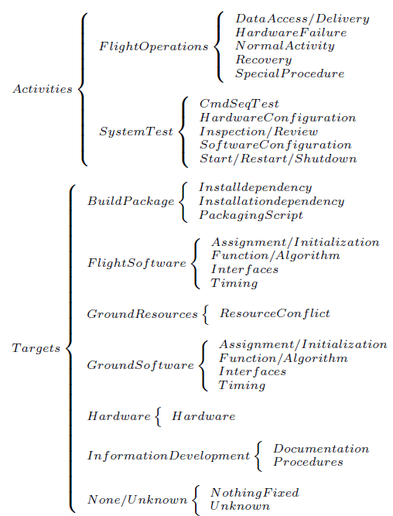
NASA’s ODC

Slide 12
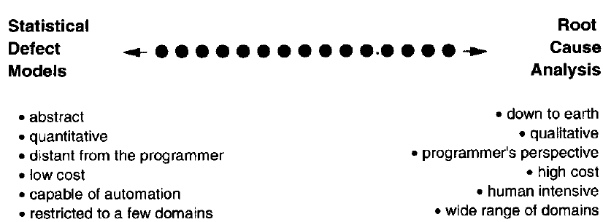

Slide 13
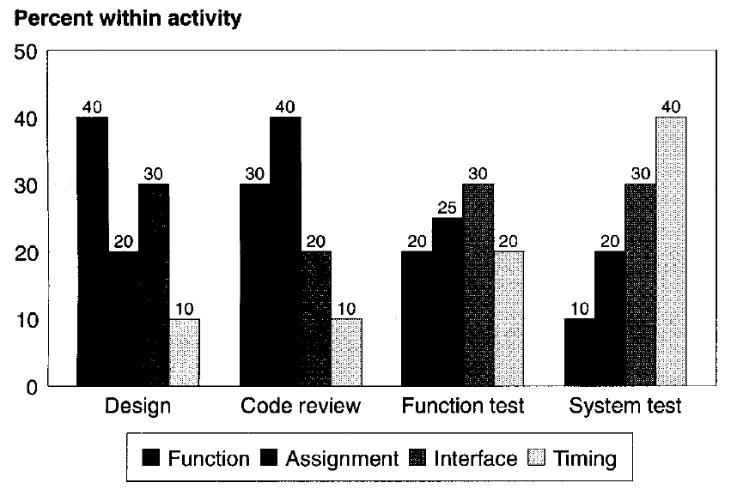

Slide 14
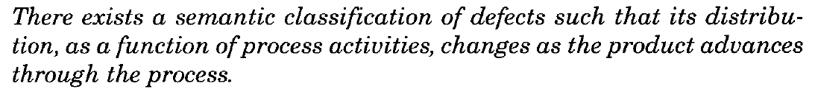
One purpose

Slide 15
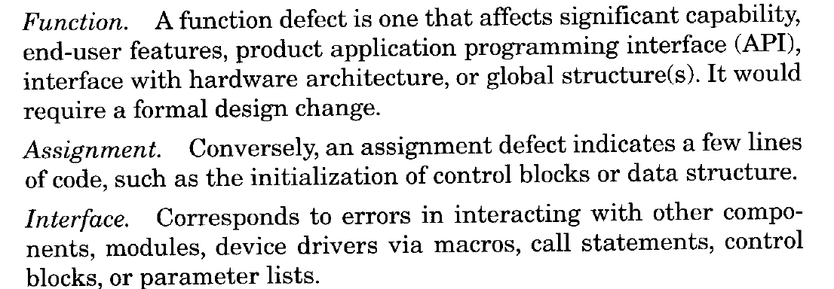
Defect types

Slide 16
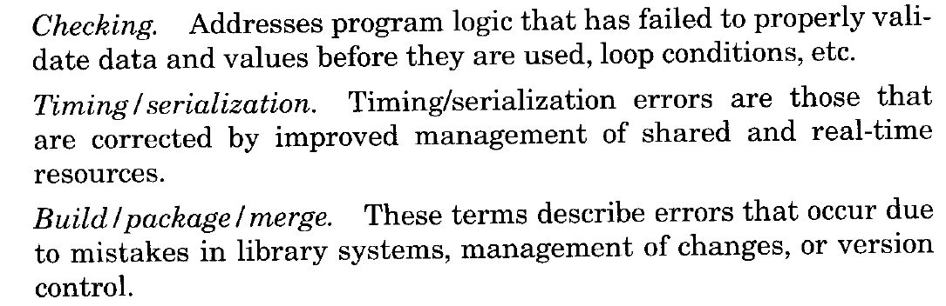
Defect types - 2

Slide 17
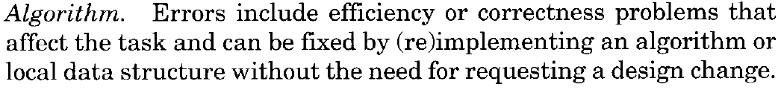
Defect types - 3

Slide 18
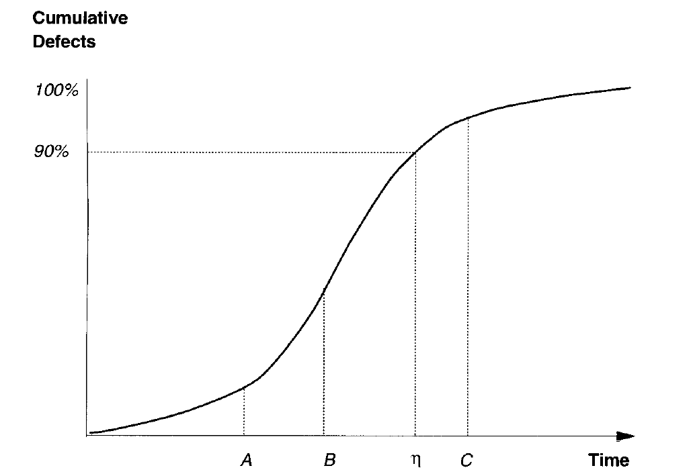
Reliability growth curve

Slide 19
triggers
What causes a fault to become an error and lead to a failure?
Trigger – the idea of what initiated the cascade

Slide 20
Review Triggers
Backward compatibility
Lateral compatibility
Design conformance
Concurrency
Operational semantics
Documentation consistency/completeness
Rare situation

Slide 21
Function test triggers
Test coverage
Test sequencing
Test interaction
Test variation
Simple path coverage
Combination path coverage

Slide 22
System test triggers
Recovery/exception handling
System startup and restart
Workload stress/volume
Hardware configuration and software configuration
Normal mode

Slide 23
http://www.cs.odu.edu/~mln/ltrs-pdfs/NASA-2003-cr212426.pdf
http://citeseerx.ist.psu.edu/viewdoc/download?doi=10.1.1.197.5917&rep=rep1&type=pdf
http://www.cs.cuhk.hk/~lyu/book/reliability/pdf/Chap_9.pdf
http://itech.fgcu.edu/faculty/zalewski/CEN4935/Projects/SampleSRS-AirTrafficControl.html

Slide 24
Get the AADL model
  https://github.com/osate/examples/tree/master/ARP4761
Get the English description of the example
  https://wiki.sei.cmu.edu/aadl/index.php/ARP4761_-_Wheel_Brake_System_%28WBS%29_Example
github
  https://wiki.sei.cmu.edu/aadl/index.php/ARP4761_-_Wheel_Brake_System_(WBS)_Example

