Slide 1

CPSC 873
John D. McGregor
Session 4
Requirements V & V - continued

Slide 2
Goals vs Requirements
Goal: The aircraft will stop smoothly.
Req.: The pressure in the brake shall increase smoothly and monotonically until the commanded amount of pressure is reached.

Slide 3
ReqSpec
system requirements AP : "Requirements for the Autopilot subsystem of the Flight Guidance System"
for Integrator::FGS::AP::prAutoPilot
use constants Globals
[
val AP_ProcessingBudget = 50.0 MIPS
val AP_RAMBudget = 1.6 MByte
val AP_ROMBudget = 16.0 MByte
val AP_FlowPathLatency = 3.0 ms
requirement R1: "Processing Budget" [
description "The processing needs of the AP subsystem
shall not exceed “ UtilizationRatio " percent of AP_ProcessingBudget
]
requirement R2_1: "RAM Memory Budget" [
description "The RAM memory needs of the AP subsystem
shall not exceed “ UtilizationRatio " percent of “ AP_RAMBudget
]

Slide 4
A good requirement is
Correct
Unambiguous
Complete
Consistent
Prioritized
Verifiable
Modifiable
Traceable
Necessary – for validation purposes

Slide 5
A good set of requirements is
Complete
Consistent - internally
Feasible
Implementation independent
Traceable
Conformant

Slide 6
Program of Reviews - government
1 Review process 1.1 Mission Concept Review (MCR)
1.2 System Readiness Review (SRR)
1.3 Mission Definition Review (MDR)
1.4 System Design Review (SDR)
1.5 Preliminary Design Review (PDR)
1.6 Critical Design Review (CDR)
1.7 Production Readiness Review (PRR)
1.8 Test Readiness Review (TRR)
1.9 System Acceptance Review (SAR)
1.10 Operational Readiness Review (ORR)
1.11 Flight Readiness Review (FRR)

Slide 7
Software Requirements Specification (SRS)
The SRS is basically the set up agreement between supplier and the customer tell us about “what are we going to implement in software application.” As per the IEEE standard the characteristics of a great SRS should be Clear, Correct, Complete, Traceable, Modifiable, Verifiable, Ranked for importance and/or stability, Consistent and Unambiguous. http://www.softwaretestingclass.com/guidelines-to-review-software-requirements-specification-srs-document-the-complete-checklist/#sthash.GWzmUObV.dpuf

Slide 8
Reviews
A meeting where requirements are discussed and evaluated
Can be informal or formal depending on the business relationships and purpose
Periodic reviews and acceptance review
Roles
  Moderator – facilitates and keeps process moving
  Recorder – tracks the discussion notes key points
  SME – subject matter experts
  Business people – represent business requirements

Slide 9
Participants
Stakeholders receiving the final product
Stakeholders providing the requirements
  Business
  Technical
Stakeholders supplying materials
Stakeholders developing the product
upstream
producer
downstream

Slide 10
Process
Basically each requirement is read and discussed
Any stakeholder may raise an objection
Discussion is limited to the requirement under review
SMEs give factual information and business people provide business information
A decision process such as voting is used to make decisions

Slide 11
Process - 2
Questions that can not be resolved are listed as issues to be investigated
Change requests are created for decisions that cause changes to the system
A change control board examines and decides whether the change is to be made
The report from a review captures all decisions, some rationales, and any patterns

Slide 12
Review checklists
https://www.google.com/url?sa=t&rct=j&q=&esrc=s&source=web&cd=3&ved=0CCwQFjACahUKEwjp4q2_2tDHAhUKaz4KHRhWDh8&url=http%3A%2F%2Fwww.csis.pace.edu%2F~scharff%2Fcs3892005%2Freqreview.doc&ei=iOniVen-D4rW-QGYrLn4AQ&usg=AFQjCNGv9Su-01rT_vJPC0Zn1WV5AFkdDQ&cad=rja
https://www.google.com/url?sa=t&rct=j&q=&esrc=s&source=web&cd=5&ved=0CDkQFjAEahUKEwjp4q2_2tDHAhUKaz4KHRhWDh8&url=http%3A%2F%2Fwww.uccs.edu%2FDocuments%2Ftboult%2FRequirements%2520Review%2520Checklist.doc&ei=iOniVen-D4rW-QGYrLn4AQ&usg=AFQjCNEDu8pHrpSQ3Dc_fBmnR5aSz2jEzw&cad=rja

Slide 13
Inspection
A more structured review
Uses a checklist – see link later
Fagan, M. “Design and Code Inspections to Reduce Errors in Program Development.” IBM Systems Journal 15, 3 (1976): 182-211. (Please read by next class)

Slide 14
Design Inspection Process
I₁
  Initially designer gives overview
  A reader walks through the design directing the group’s attention
  Group searches for design errors
I₂
  Same as I₁ except no overview

Slide 15
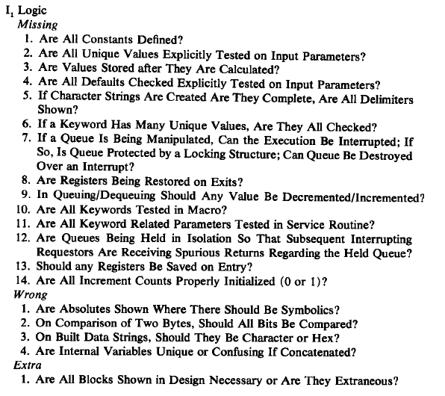
What to look for

Slide 16
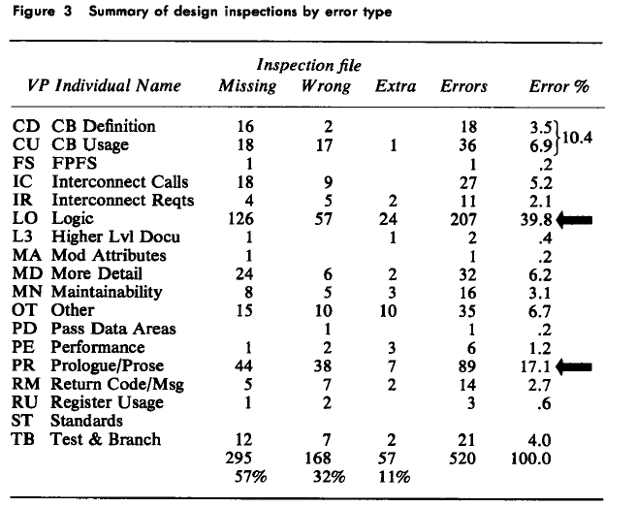
Design Error Types

Slide 17
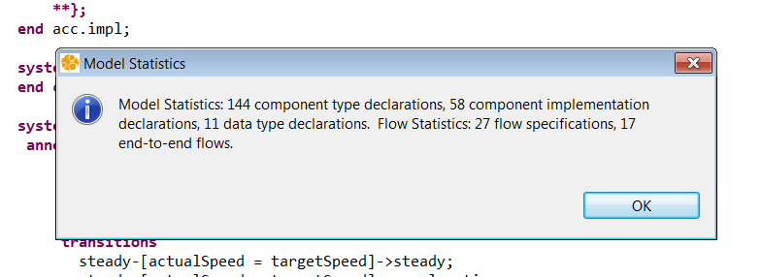
Size of model

Slide 18
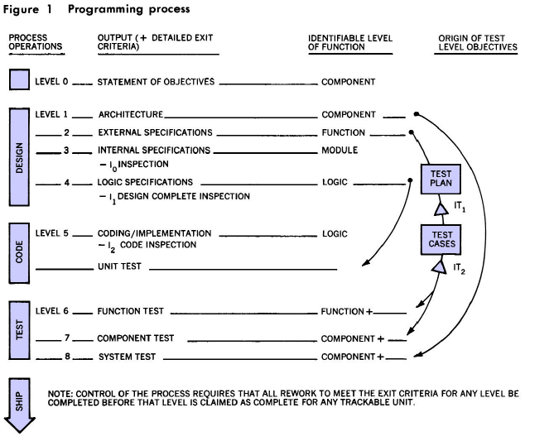
Overview of IBM process in 1990s

Slide 19
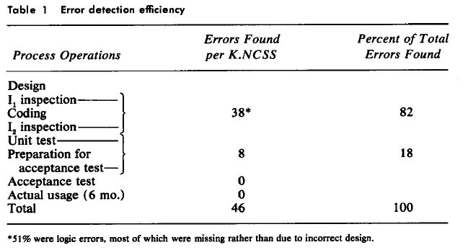
Defect density

Slide 20
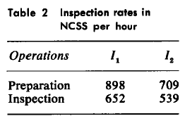
Baseline for throughput
Units/hour
Lines of code
Interface specifications

Slide 21
Fault Model
1.1 Incomplete decomposition
1.2 Omitted requirement
1.3 Improper translation
1.4 Operational environment incompatibility
1.5 Incomplete requirement description
1.6 Infeasible requirement
1.7 Conflicting requirement
1.8 Incorrect assignment of resources
1.9 Conflicting inter-system specification
1.10 Incorrect or missing external constants
1.11 Incorrect or missing description of initial system state
1.12 Over-specification of requirements
1.13 Incorrect input or output descriptions

Slide 22
Link to example checklist
https://www.google.com/url?sa=t&rct=j&q=&esrc=s&source=web&cd=2&cad=rja&uact=8&ved=0CCUQFjABahUKEwia-c7d68vHAhVEoYAKHYWLDpE&url=http%3A%2F%2Fwww.uccs.edu%2FDocuments%2Ftboult%2FRequirements%2520Review%2520Checklist.doc&ei=hFzgVZqnGsTCggSFl7qICQ&usg=AFQjCNEDu8pHrpSQ3Dc_fBmnR5aSz2jEzw

Slide 23
AADL
http://www.slideshare.net/iivanoo/aadl-42305750
http://www.slideshare.net/iivanoo/aadl-42305750?next_slideshow=2

Slide 24
Assignment
Create a requirements review checklist specifically for the wbs example.
What are the priorities for a requirements review for a system of this type?
Submit a pdf by 11:59pm Wednesday Sept 12, 2018

