Slide 1

CPSC 873
John D. McGregor
Session 5
Error Modeling

Slide 2
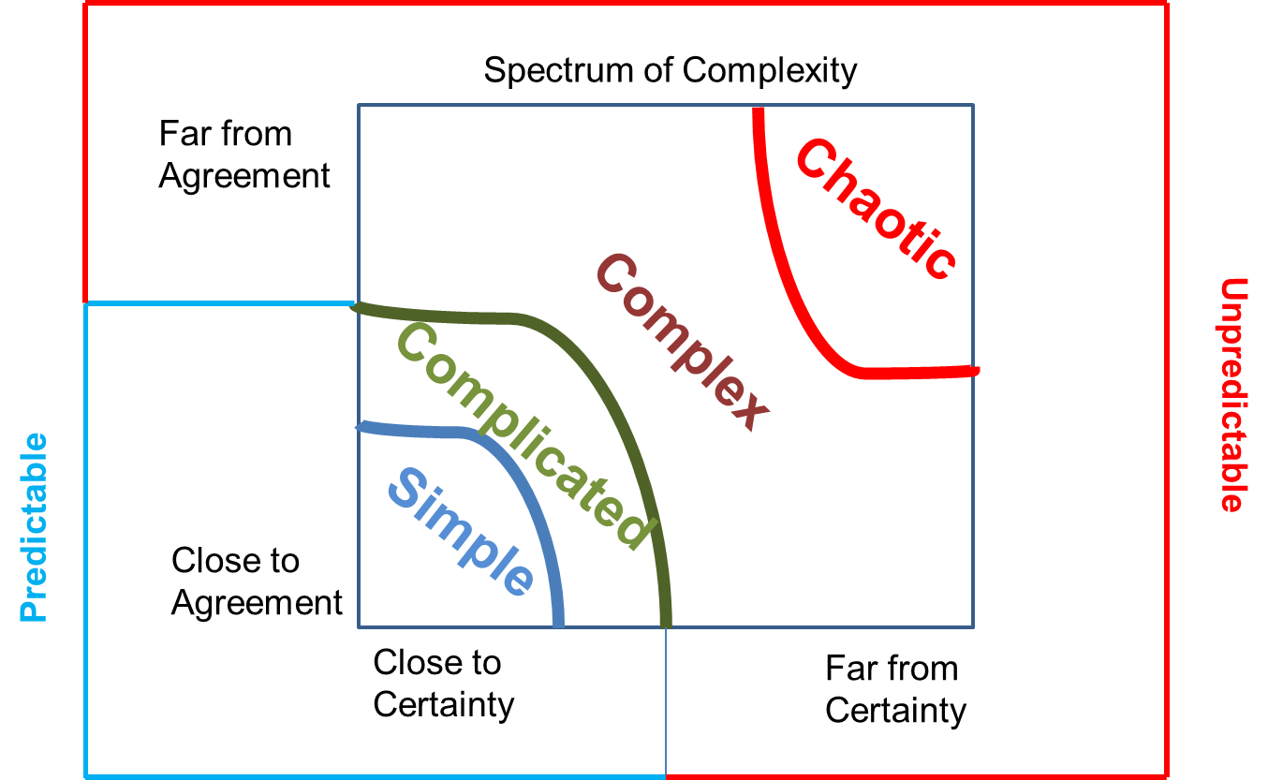
System types
Agnes Meinhard, PhD

Slide 3
A Complex System
Scaling formal verification up to system architectures requires compositional approaches.
Compositional approaches require both logical foundations and engineering support.
Your How is My What: in large-scale systems, requirements vs. design is a often matter of perspective

Slide 4
Properties
Multiplicities
Interdependencies
Diversity

Slide 5
Characteristics
1. Non-linearity This construct means that small actions can stimulate large reactions (otherwise known as the butterfly effect) in which highly improbable, unpredictable and unexpected events have huge impacts.
2. Emergence The appearance of patterns occurs due to the collective behavior What emerges cannot be planned or intended. The whole of the interactions becomes greater than the sum of the separate parts.
3. Dynamical systems change Interactions within, between and among subsystems and parts are volatile, turbulent, and cascade rapidly and unpredictably

Slide 6
Characteristics - 2
4. Adaptation Interacting elements respond and adapt to each other so that what emerges and evolves is a function of ongoing adaptation among both interacting elements and the elements and their environment.
5. Uncertainty Processes and outcomes are unpredictable, uncontrollable and unknowable in advance. There is no clear idea what might happen or how likely possible outcomes are.
6. Co-evolutionary As interacting and adaptive agents self organize, ongoing connections emerge that become co-evolutionary as the agents evolve together (co-evolve) within and as part of the whole system over time.

Slide 7
System verification
SPECIFICATION
SYSTEM DEVELOPMENT
FOUNDRY
INSTANTIATE ARCHITECTURAL PATTERNS
ARCH PATTERN MODELS
ANNOTATE
& VERIFY MODELS
PATTERN & COMP SPEC
LIBRARY
SYSTEM MODELING ENVIRONMENT
SYSTEM MODEL
AUTO
GENERATE
SYSTEM IMPLEMENTATION
COMPONENT MODELS
COMPONENT
LIBRARY
COMPOSITIONAL REASONING & ANALYSIS
Reusable Verification:
Proof of component and pattern requirements (guarantees) and specification of context (assumptions)
Instantiation:
Check structural constraints, Embed assumptions & guarantees in system model
Compositional Verification:
System properties are verified by model checking using component & pattern contracts

Slide 8
Error
slips – when a correct "solution" to a required action has been formulated but a slip is made in its execution.
rule errors - pieces of knowledge of the form "if condition then do action"
knowledge errors - solving, in which the solver has to resort to step-by-step reasoning from first principles
https://cseweb.ucsd.edu/~howden/MyPapers/Error%20Models%20and%20Software%20Certification%20Sept%2027%202011.pdf

Slide 9
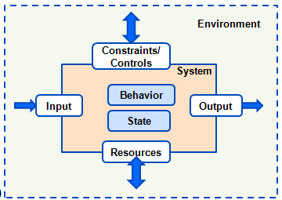
A component/system
Environmental Assumptions
Requirements
Guarantees
Assumptions
Precondition
Postcondition
Invariant
Implementation constraints
Interaction contract: match input assumption with guarantee

Slide 10
Error modeling
A deviation from expected result
Some errors are “implementation dependent and some are not”
It is a feature of an aircraft that it lands on tires (excluding special features)
The tire on a plane may go flat
If the occurrence of an error could result in death or serious injury the requirements are referred to as safety requirements

Slide 11
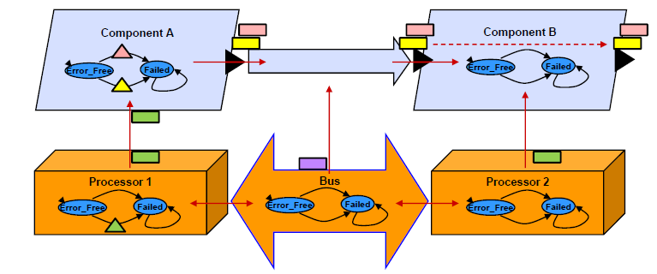
Overview

Slide 12
Top Level
system generic
features
input : requires bus access common::pressure.i;
output : provides bus access common::pressure.i;
annex EMV2 {**
use types error_library;
use behavior error_library::simple;
error propagations
input : in propagation {NoService};
output : out propagation {NoService};
flows
f1 : error path input{NoService} -> output;
end propagations;
**};
end generic;

Slide 13
Separately defined
error types
NoPower : type;
NoService : type;
ValueError: type;
NoValue: type extends ValueError;
PlatformFailure: type;
HardwareFailure: type extends PlatformFailure;
SoftwareFailure: type extends PlatformFailure;
end types;
error behavior ThreeState
states
Operational: initial state;
NonCriticalModeFailure: state;
CriticalModeFailure: state;
end behavior;

Slide 14
AADL EMV2 Error Ontology
https://wiki.sei.cmu.edu/aadl/images/1/13/ErrorModelOverview-Sept222011-phf.pdf
Replication errors
Timing errors
Value errors
Rate errors
Sequence errors
Service errors

Slide 15
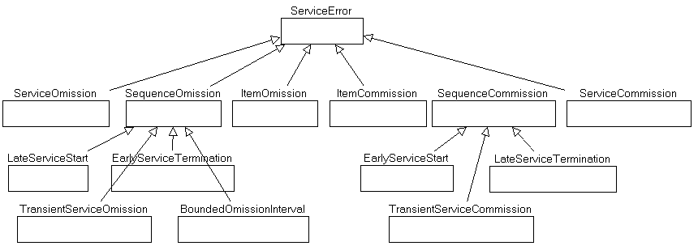

Slide 16
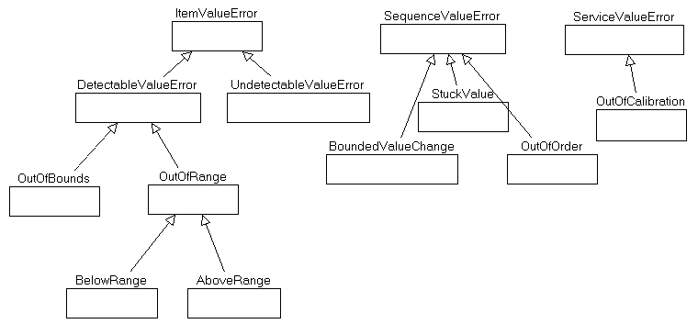
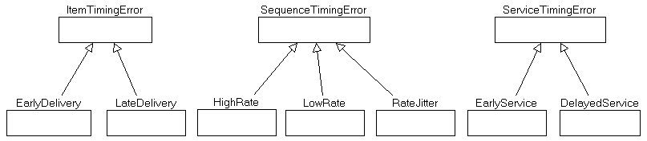

Slide 17
Safety Analysis
http://santoslab.org/pub/mdcf-architect/HazardAnalysis.html

Slide 18
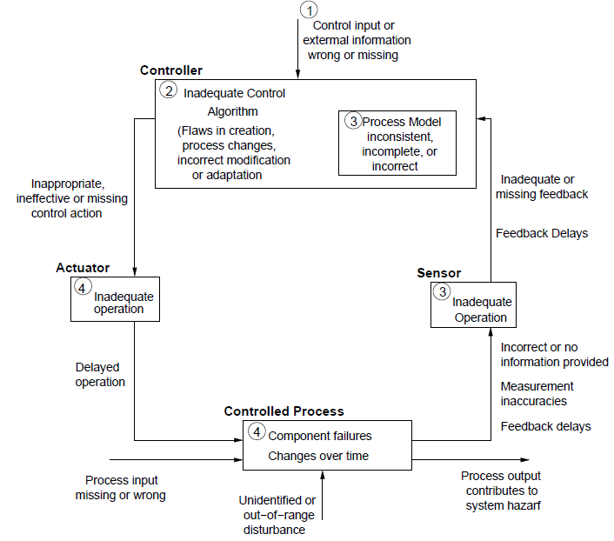
Errors in control systems
Leveson pattern

Slide 19
Here’s what you are going to do.
Read http://repository.cmu.edu/sei/811/
Look at the WBS
Create a fault model for the wbs
Use wbs description to
create error flows using diagrams
Create error flows as part of developing the AADL error annex spec
Write requirements to mitigate the errors and add to your reqspec model..
Add these to your requirements set
Submit by 11:59PM Sept 11th

Slide 20
CDR – model of complete system
Integration – implementation of complete system (eventually)
System – solution to a customer’s problem
What stays the same and what varies from one system to the next?

Slide 21
Conformance testing

Slide 22
Error Modeling

Slide 23
Testing Perspective
Skeptical
Objective
Thorough
Systematic

