Slide 1

CPSC 873
John D. McGregor
Session 6
Preparing for Architecture V & V

Slide 2
So far
Use cases
Requirements
Decomposition
reconsider
Idea
Requirements
Architecture
Implementation
Retire
Scope
review
feedback
Configuration
management
Process/
notations
Infrastructure

Slide 3
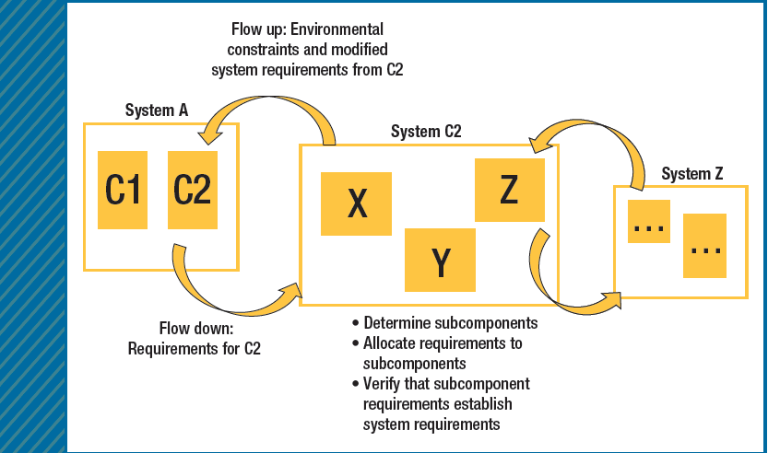
Decomposition

Slide 4
Hazards
In identifying hazards there are two principal considerations: exceptional conditions within architecture elements (characterized using the EMV2 error ontology) and mismatched assumptions (mismatched assumption-guarantee contracts between systems) about their interactions.
We will handle both

Slide 5
Add-in
On the resources page there is download.zip
Unzip it
Copy into your copy of OSATE
Be certain that you copy at the correct level

Slide 6
Capturing requirements
We will use reqspec to capture requirements
And we will use a set of languages to define verification activities
These languages will make the process of V&V more robust and automated.
Given we are building the cruise control for a family of vehicles
We develop requirements first

Slide 7
Goal grammar
Goal ::=
goal Name ( : Title )?
( for TargetElement )?
[
( category ( <ReqCategory> )+ )?
( description Description )?
( ConstantVariable )*
( rationale String )?
( refines ( <Goal> )+ )?
( conflicts with ( <Goal> )+)?
( evolves ( <Goal> )+)?
( dropped )?
( stakeholder ( <Stakeholder> )+ )?
( see document requirement ( <Requirement> )+)?
( see document ( DocReference )+ )?
( issues (String)+ )?
( ChangeUncertainty )?
]
Title ::= String
TargetClassifier ::= <AADL Component Classifier>
TargetElement ::= <ModelElement>
DocReference ::= URI to an element in an external document

Slide 8
Stakeholder goals grammar
StakeholderGoals ::=
stakeholder goals NestedName ( : Title )?
for ( TargetClassifier | all )
( use constants <GlobalConstants>* )?
[
(description Description )?
(see document ( DocReference )+ )?
( ConstantVariable )*
( Goal )+
( issues (String)+ )?
]

Slide 9
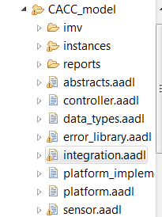

Specific goal
stakeholder goals caccGoals for integration::cacc_rt.devices [
goal g1 : "Safety" [
description "The system shall be safe."
rationale "This is a control system, whose failure affects lives. "
stakeholder cacc.rs
]]

Slide 10
Requirement Grammar
Requirement ::=
requirement Name ( : Title )?
( for TargetElement )?
[
( category ( <ReqCategory> )+ )?
( description Description )?
( Variable )*
( Predicate )?
( rationale String )?
( mitigates ( <Hazard> )+ )?
( refines ( <Requirement> )+)?
( decomposes ( <Requirement> )+)?
( evolves ( <Requirement> )+)?
( dropped )?
(development stakeholder ( <Stakeholder> )+ )?
( see goal ( <Goal> )+)?
( see document goal ( <Goal> )+)?
( see document requirement ( <Requirement> )+)?
( see document ( DocReference )+ )?
( issues (String)+ )?
( ChangeUncertainty )?
]

Slide 11
specific requirement
requirement specification caccreqs
for integration::cacc_rt.devices
[
val MaximumSpeed = 120.0 mph
requirement speed_R1 : "throttle cannot exceed the maximum setting"
[
description this " shall have a maximum reading that is less than or equal to maximum setting"
compute actualSpeed
assert value actualSpeed <= MaximumSpeed
rationale "The system might exceed the maximum safe speed"
mitigates "Invalid data sent by the speedometer"
//category [cc]
see goal caccGoals.g1
]

Slide 12
System Requirements Grammar
SystemRequirements ::=
System requirements NestedName ( : Title )?
for ( TargetClassifier | all )
( use constants <GlobalConstants>* )?
[
( description String )?
(see document ( DocReference )+ )?
( Variable )*
( Requirement )*
( issues (String)+ )?
]

Slide 13
Organization Grammar
Organization::=
organization Name
( Stakeholder )+
Stakeholder ::=
stakeholder Name
[
( full name String )?
( title String )?
( description String )?
( role String )?
( email String )?
( phone String )?
]

Slide 14
Specific organization
organization cacc
stakeholder rs [
full name "Roselane S. Silva"
]
stakeholder jdm [
full name "John D. McGregor"
]

Slide 15
Requirement Categories
RequirementCategories ::=
requirement categories
[
( RequirementCategory )+
]
RequirementCategory ::=
Name ( { <RequirementCategory>+ } )?

Slide 16
Specific categories
selection categories [cc acc cacc]

Slide 17
Variables and Constants
Variable ::= ConstantVariable | ComputedVariable
ConstantVariable ::=
val ( Type )? Name = Value
ComputedVariable ::= computed Name
Type ::= <any type from the Java type system>
constants Name
[ ConstantVariable+ ]

Slide 18
constants
Val string Logger_IP_Address= ” 192.0.2.235”
Computed_Braking_Distance real

Slide 19
Constants
GlobalConstans ::= constants Name
[ ConstantVariable+ ]
Constants Minimum_Separation = 2

Slide 20
Traceability
As we build the requirements model we have traceability in the form of references to the entity constrained by the requirement.
We also have traceability via requirements categories.

Slide 21
Agree model checking
An annex to AADL that allows the specification of guarantees and checks their correctness.
annex agree {**
guarantee ”dummy” : true ;
**};
Inserted into an AADL component specification
We need to replace dummy and true

Slide 22
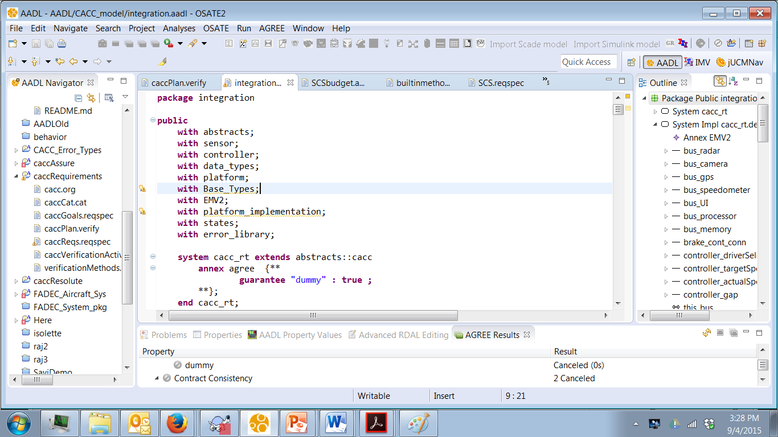
2. Select .impl and
right click and select
all levels
1. insert
3. Read results

Slide 23
Agree example-1
system top_level
features
Input: in data port Base_Types::Integer;
Output: out data port Base_Types::Integer;
annex agree {**
assume "System input range " : Input < 10;
guarantee "System output range" : Output < 50;
**};
end top_level;

Slide 24
Agree example-2
subcomponents
A_sub : system A ;
B_sub : system B ;
C_sub : system C ;
connections
IN_TO_A : port Input -> A_sub.Input
{Communication_Properties::Timing => immediate;};
A_TO_B : port A_sub.Output -> B_sub.Input
{Communication_Properties::Timing => immediate;};
A_TO_C : port A_sub.Output -> C_sub.Input1
{Communication_Properties::Timing => immediate;};
B_TO_C : port B_sub.Output -> C_sub.Input2
{Communication_Properties::Timing => immediate;};
C_TO_Output : port C_sub.Output -> Output
{Communication_Properties::Timing => immediate;};
end top_level.Impl;

Slide 25
Agree example-3
system A
features
Input: in data port Base_Types::Integer;
Output: out data port Base_Types::Integer;
annex agree {**
assume "A input range" : Input < 20;
guarantee "A output range" : Output < 2*Input;
**};
end A ;

Slide 26
Function Hazard Analysis
Function | Failure Condition (hazard description) | Phase | Effect of Failure Condition on Aircraft/Crew | Classification | Reference to supporting material | Verification
Control Thrust | Engine provides no thrust Engine provides too little thrust Engine provides too much thrust Engine is slow to provide commanded thrust (increase or decrease) Engine will not shutdown when commanded Engine cannot be controlled - Loss of Engine Thrust Control (LOTC) | Taxi, Takeoff, Landing, and Flight

Slide 27
Accident | System-Level (operational) Hazards
A-1: Loss of life or serious injury due to aircraft engine A-2: Catastrophic damage to aircraft or other property due to aircraft engine | H0: Ineffective thrust to maintain controlled flight or safe taxi H1: Engine provides no thrust H2: Engine provides too little thrust H3: Engine provides too much thrust H4: Engine is slow to provide thrust (increase or decrease) H5: Engine will not shutdown when commanded H6: Complete Loss of Engine Thrust Control (LOTC)

Slide 28
Hazards | Safety Requirements
H1: Engine provides no thrust | SC1: Thrust must be provided at all times when commanded
H2: Engine provides too little thrust H3: Engine provides too much thrust | SC2: Thrust level must be provided at the commanded level.
H4: Engine is slow to provide commanded thrust | SC3: Engine must provide commanded thrust in xxx seconds.
H5: Engine will not shutdown when commanded | [The relevant safety constraints arising out of this include SC1, SC2, and SC4]
H6: Engine cannot be controlled - Loss of Engine Thrust Control (LOTC) | SC4: Engine must respond to all commands SC4.1: Engine must start when commanded SC4.2: Engine must shutdown when commanded

Slide 29
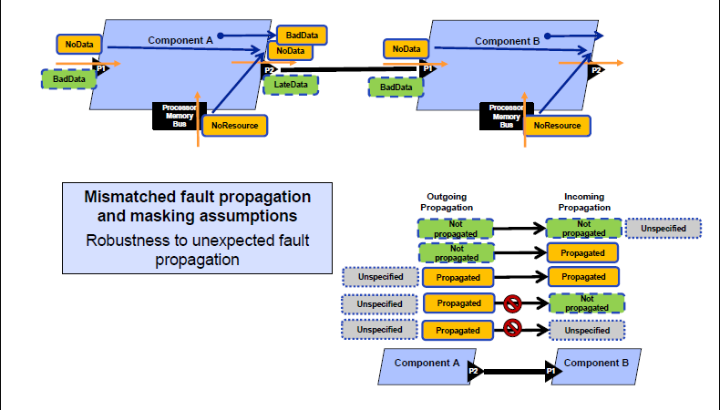
Error handling

Slide 30
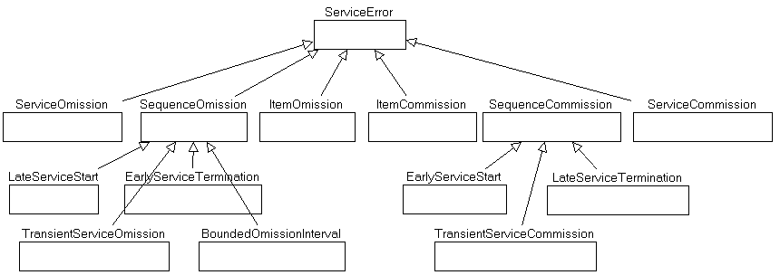

Slide 31
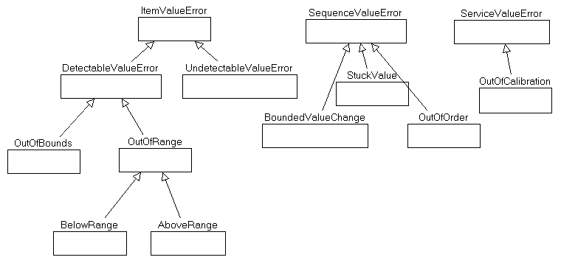
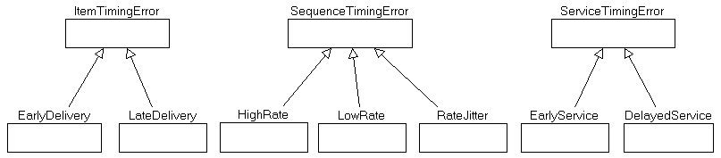

Slide 32
AGREE
http://mys5.org/Proceedings/2014/Day_1_S5_2014/2014-S5-Day1-13_Backes.pdf
Resolute
https://arxiv.org/pdf/1409.4629.pdf

Slide 33
Resolute
Example Resolute models
https://github.com/smaccm/smaccm

Slide 34
Assurance case paper
https://www.umsec.umn.edu/sites/www.umsec.umn.edu/files/Resolute-HILT.pdf

Slide 35
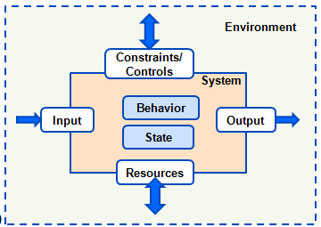
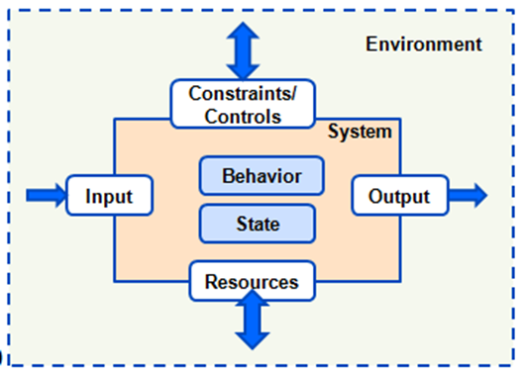

Slide 36
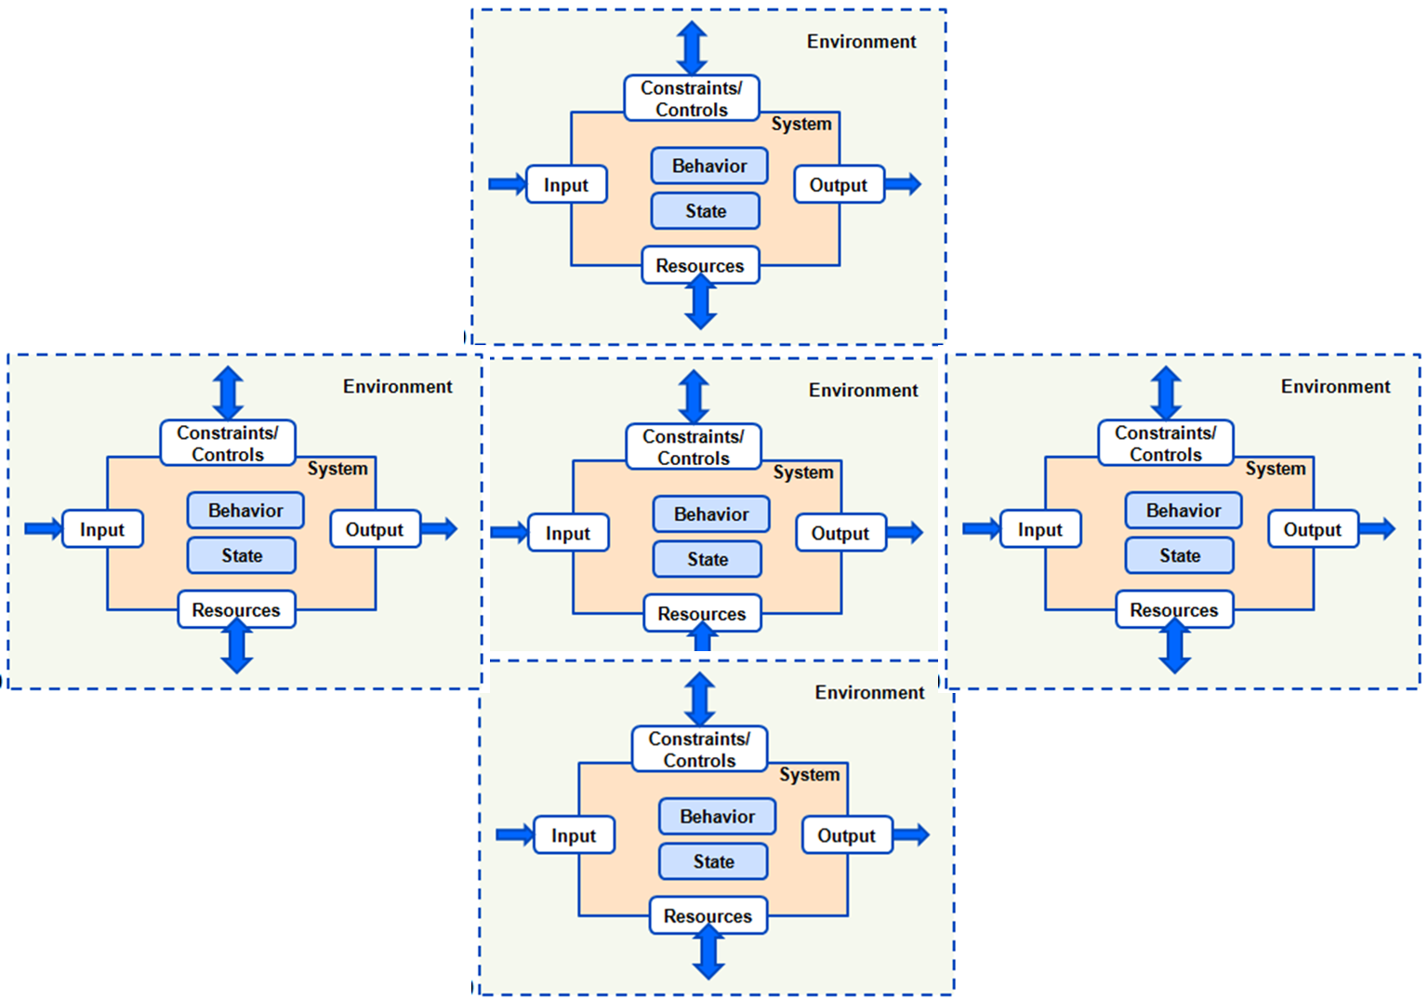

Slide 37
Here’s what you are going to do
Construct an assurance case for the wbs
Use verification methods we have discussed to support specific claims
Use methods that we have not discussed butt about which you are aware, such as testing.
Submit a drawing by Wednesday Sept 20th, 11:59 pm

