Slide 1

CPSC 873
John D. McGregor
Session 6
Preparing for Architecture V & V

Slide 2
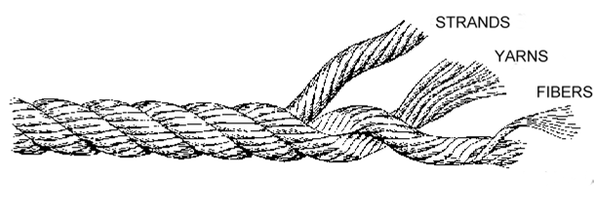
Modern development techniques
verification
architecture
requirements

Slide 3
So far
Use cases
Requirements
Decomposition
reconsider
Idea
Requirements
Architecture
Implementation
Retire
Scope
review
feedback
Configuration
management
Process/
notations
Infrastructure

Slide 4
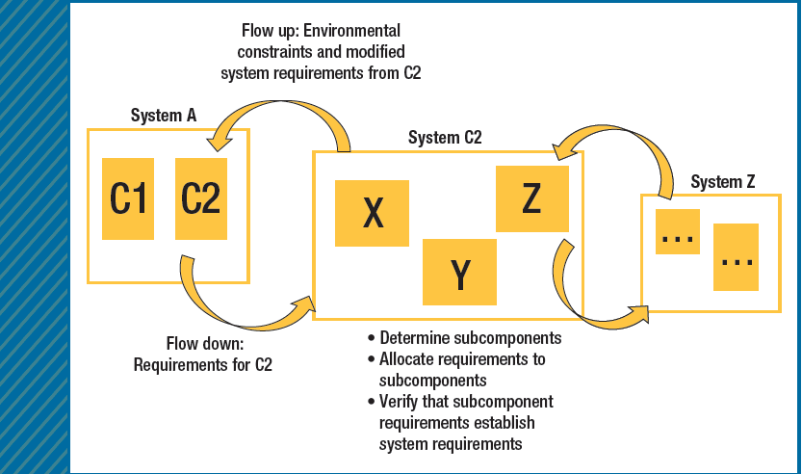
Decomposition

Slide 5
Hazards
In identifying hazards there are two principal considerations: exceptional conditions within architecture elements (characterized using the EMV2 error ontology) and mismatched assumptions (mismatched assumption-guarantee contracts between systems) about their interactions.
We will handle both

Slide 6
Hazard Analysis
http://people.cs.ksu.edu/~scbarrett/pcashutoff-doc/index.html#
http://people.cs.ksu.edu/~scbarrett/pcashutoff-doc/app/shutoff.html
http://santoslab.org/pub/mdcf-architect/HazardAnalysis.html

Slide 7
Traceability
As we build the requirements model we have traceability in the form of references to the entity constrained by the requirement.
We also have traceability via requirements categories.

Slide 8
Agree model checking
An annex to AADL that allows the specification of guarantees and checks their correctness.
annex agree {**
guarantee ”dummy” : true ;
**};
Inserted into an AADL component specification
We need to replace dummy and true

Slide 9
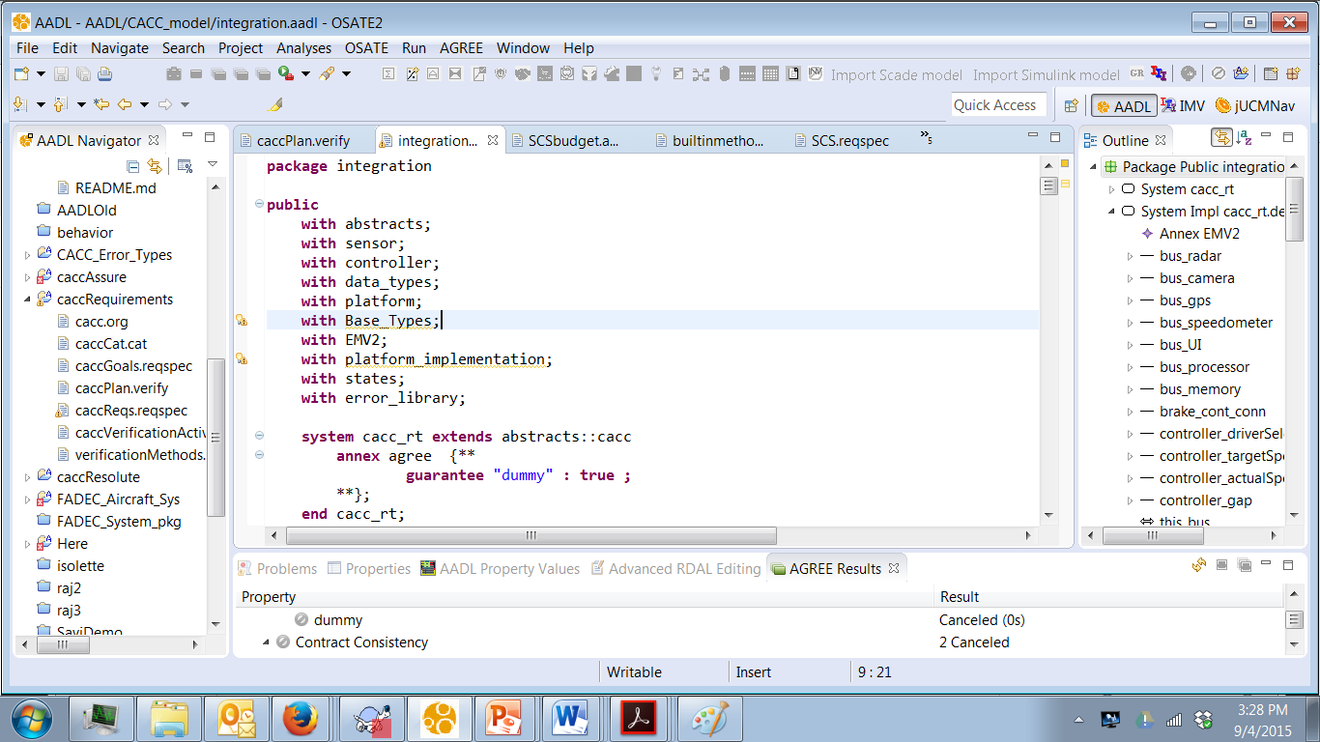
2. Select .impl and
right click and select
all levels
1. insert
3. Read results

Slide 10
Agree example-1
system top_level
features
Input: in data port Base_Types::Integer;
Output: out data port Base_Types::Integer;
annex agree {**
assume "System input range " : Input < 10;
guarantee "System output range" : Output < 50;
**};
end top_level;

Slide 11
Agree example-2
A
B
subcomponents
A_sub : system A ;
B_sub : system B ;
C_sub : system C ;
connections
IN_TO_A : port Input -> A_sub.Input
{Communication_Properties::Timing => immediate;};
A_TO_B : port A_sub.Output -> B_sub.Input
{Communication_Properties::Timing => immediate;};
A_TO_C : port A_sub.Output -> C_sub.Input1
{Communication_Properties::Timing => immediate;};
B_TO_C : port B_sub.Output -> C_sub.Input2
{Communication_Properties::Timing => immediate;};
C_TO_Output : port C_sub.Output -> Output
{Communication_Properties::Timing => immediate;};
end top_level.Impl;
C

Slide 12
Agree example-3
system A
features
Input: in data port Base_Types::Integer;
Output: out data port Base_Types::Integer;
annex agree {**
assume "A input range" : Input < 20;
guarantee "A output range" : Output < 2*Input;
**};
end A ;

Slide 13
In-line agree models
https://github.com/smaccm/smaccm/blob/master/models/Microwave/Microwave_SEng5861.aadl

Slide 14
Function Hazard Analysis
Function | Failure Condition (hazard description) | Phase | Effect of Failure Condition on Aircraft/Crew | Classification | Reference to supporting material | Verification
Control Thrust | Engine provides no thrust Engine provides too little thrust Engine provides too much thrust Engine is slow to provide commanded thrust (increase or decrease) Engine will not shutdown when commanded Engine cannot be controlled - Loss of Engine Thrust Control (LOTC) | Taxi, Takeoff, Landing, and Flight

Slide 15
Accident | System-Level (operational) Hazards
A-1: Loss of life or serious injury due to aircraft engine A-2: Catastrophic damage to aircraft or other property due to aircraft engine | H0: Ineffective thrust to maintain controlled flight or safe taxi H1: Engine provides no thrust H2: Engine provides too little thrust H3: Engine provides too much thrust H4: Engine is slow to provide thrust (increase or decrease) H5: Engine will not shutdown when commanded H6: Complete Loss of Engine Thrust Control (LOTC)

Slide 16
Hazards | Safety Requirements
H1: Engine provides no thrust | SC1: Thrust must be provided at all times when commanded
H2: Engine provides too little thrust H3: Engine provides too much thrust | SC2: Thrust level must be provided at the commanded level.
H4: Engine is slow to provide commanded thrust | SC3: Engine must provide commanded thrust in xxx seconds.
H5: Engine will not shutdown when commanded | [The relevant safety constraints arising out of this include SC1, SC2, and SC4]
H6: Engine cannot be controlled - Loss of Engine Thrust Control (LOTC) | SC4: Engine must respond to all commands SC4.1: Engine must start when commanded SC4.2: Engine must shutdown when commanded

Slide 17
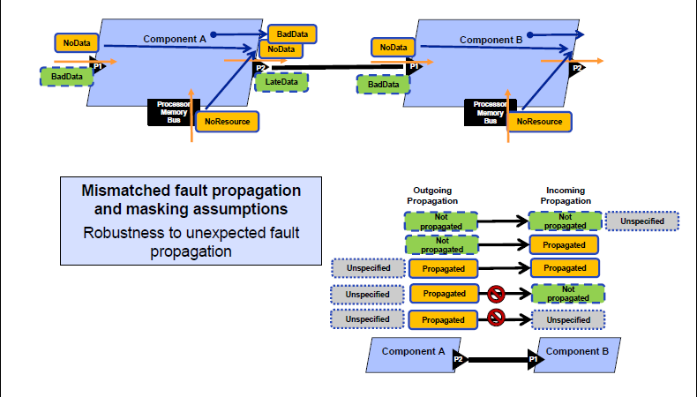
Error handling

Slide 18
Resolute
SumForThread(t: component) : real =
let executions_per_minute : real = (60.0 * 60.0 * 1000.0) / property(t, Period, (60.0 * 60.0 * 1000.0));
let milliwats_per_execution : real = property(t, Power_Properties::PowerBudget, 0.0);
milliwats_per_execution *executions_per_minute

Slide 19
Resolute
Example Resolute models
https://github.com/smaccm/smaccm

Slide 20
PCA Shutoff Valve
http://people.cs.ksu.edu/~scbarrett/pcashutoff-doc/index.html#
http://people.cs.ksu.edu/~scbarrett/pcashutoff-doc/app/shutoff.html

