Slide 1

CPSC 871
John D. McGregor
Module 4 Session 2
More Error Analysis

Slide 2
AADL Annexes
An annex is an addition to the AADL standard but without being an integral part of the standard.
Error, behavior, data modeling, code generation annexes
CMU/SEI-2007-TN-043

Slide 3
Example Error model
error model Example1
features
ErrorFree: initial error state;
Failed: error state;
Fail, Repair: error event;
CorruptedData: out error propagation {Occurrence => fixed 0.8};
end Example1;
error model implementation Example1.basic
transitions
ErrorFree-[Fail]->Failed;
Failed-[out CorruptedData]->Failed;
Failed-[Repair]->ErrorFree;
properties
Occurrence => poisson 1.0e-3 applies to Fault;
Occurrence => poisson 1.0e-4 applies to Repair;
end Example1.basic;

Slide 4
Use of an error model
package My_ErrorModels
public
annex Error_Model {**
error model Example1
…
end Example1;
error model implementation Example1.basic
…
end Example1.basic;
error model Example2
…
end Example2;
error model implementation Example1.basic
…
end Example2.basic;
**};
end My_ErrorModels;

Slide 5
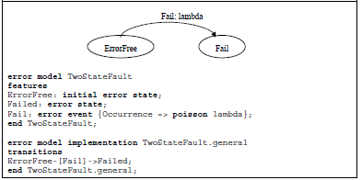
Error model

Slide 6
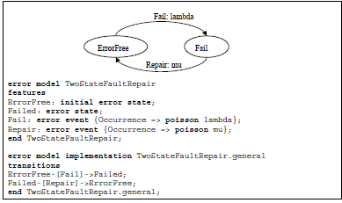
Full error model

Slide 7
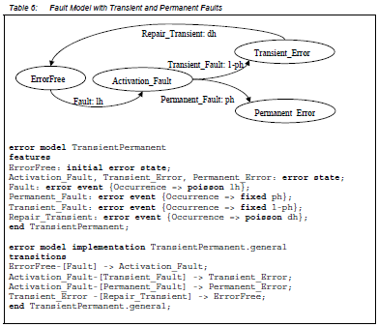

Slide 8
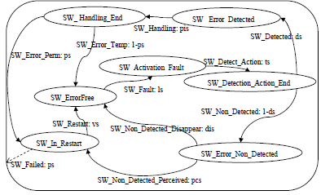
Generic software model

Slide 9
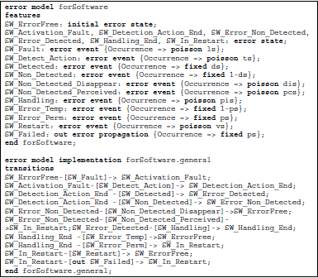
AADL Error Model

Slide 10
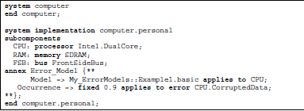
AADL Error Model -2

Slide 11
Building the error model helps you think through what the system’s response should be to every kind of fault.

Slide 12
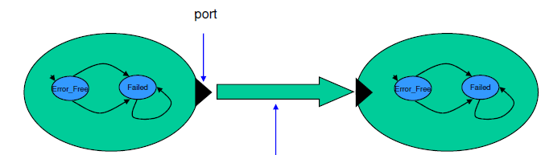
Propagation
Transition: trigger/guard/action
Action: message from one object to another

Slide 13
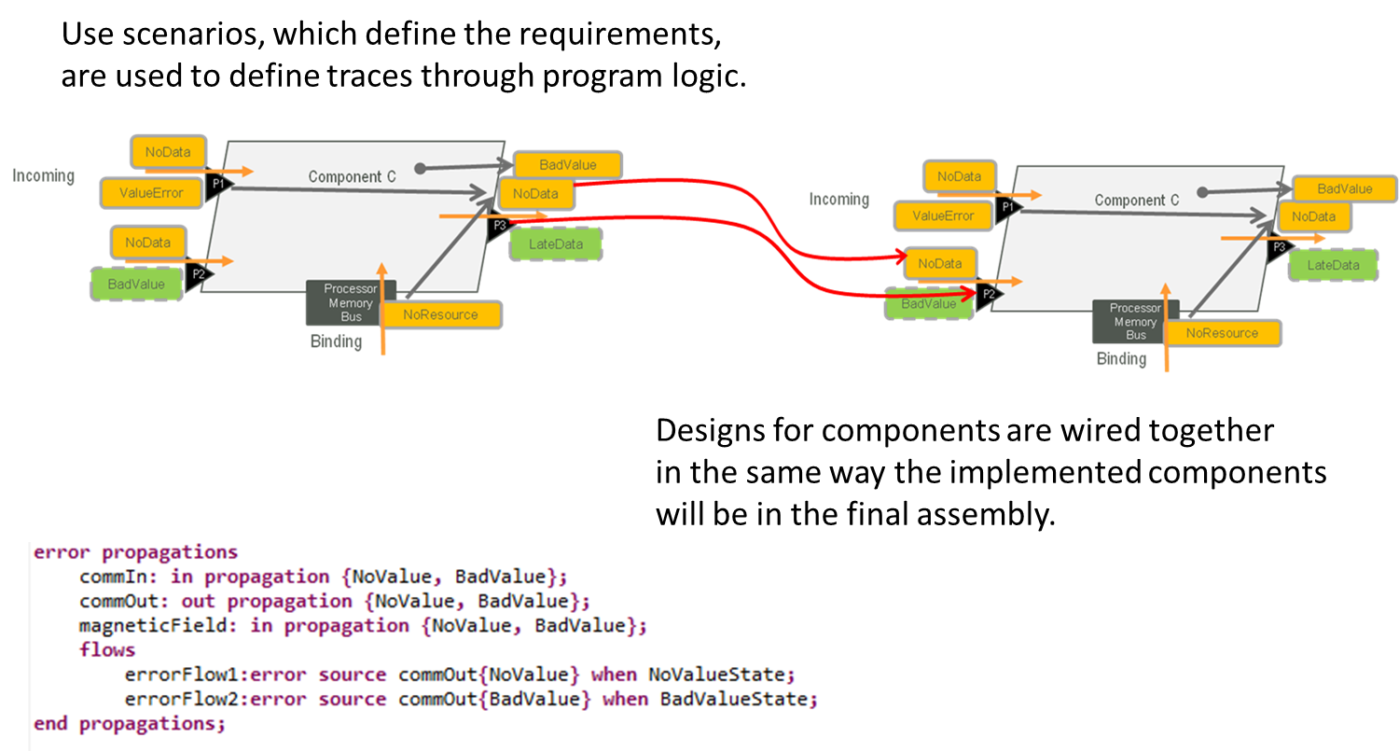
Error propagation

