Slide 1

CPSC 873
John D. McGregor
Session 8
Evaluating Architectures written in AADL

Slide 2
Important elements in an architecture
Clear definitions of components – assume/guarantee
Who is connected to whom - structure
What properties does a component have - definitions
What are the values of those properties – metrics for measuring

Slide 3
Techniques to be used with AADL
Manual Inspection
AGREE queries
Resolute claims
Automated analyses of properties

Slide 4
Test within constraints
assume "seconds_to_cook is greater than or equal to zero" : seconds_to_cook >= 0;
guarantee "The range of the cooking_mode variable shall be [1..3]" : true ;
guarantee "The microwave shall be in cooking mode only when the door is closed." : true;

Slide 5
annex agree {**
eq is_cooking : bool = defs.is_cooking(cooking_mode);
eq is_setup : bool = defs.is_setup(cooking_mode);
eq is_suspended : bool = defs.is_suspended(cooking_mode);
eq is_running : bool = defs.is_running(cooking_mode);
assume "seconds_to_cook is greater than or equal to zero" :
seconds_to_cook >= 0;
guarantee "The range of the cooking_mode variable shall be [1..3]" :
true ;

Slide 6
Check boundary conditions
annex agree {**
guarantee "targetSpeed>=0" : targetSpeed >= 0 ;
guarantee "actualSpeed>=0" : actualSpeed >= 0 ;
guarantee "actualSpeed<=targetSpeed" : actualSpeed <= targetSpeed ;
guarantee "gapLimit>0" : gapLimit > 0 ;
guarantee "gap>0" : gap > 0 ;
guarantee "gap<=gapLimit" : gap<=gapLimit;
**};

Slide 7
Reachability
check_mils_partitions_connections (s : system) <=
** "Check that connected partitions in " s " share the same security level" **
forall (p1 : process) (p2 : process) (c : connection) (vp1 : virtual_processor) (vp2 : virtual_processor) .
(connected (p1, c, p2)) and (processor_bound (p1, vp1)) and (processor_bound (p2, vp2))
=> property (vp1, SEI::SecurityLevel) = property (vp2, SEI::SecurityLevel)

Slide 8
WeightBudget Property exists
AllHaveWeightBudgets(self : component) <= ** "Component " self " shall have a weight budget" **
HasWeightBudget(self) and forall (c: subcomponents(self)). AllHaveWeightBudgets(c)
HasWeightBudget(t : component) : bool =
not(has_property(t,SEI::GrossWeight)) => fail ** t " has no weight" **

Slide 9
Test using java methods
method ElectricalPowerSelfSufficiency: "Verify that a component is electrical power self sufficient" [
Java vmlibrary.AircraftConsistency.electricalPowerSelfSufficiency
description "Verify that a component takes care of its own electrical power."
]

Slide 10
xTend class definition
def boolean electricalPowerSelfSufficiency(ComponentInstance ci) {
val fil = ci.featureInstances
for (fi : fil) {
return fi.getPowerBudget( 0.0) != 0.0 ||
fi.getPowerSupply(0.0) != 0.0
}
}

Slide 11
Safe composition
Ports
  In/out pairs match
Errors
  For each error ontology hierarchy
  Errors in that hierarchy are either
    Handled in ccomponent
    Propagated to component that accepts that type of propagation

Slide 12
State machines
Error model, behavior model, modes
N-way switch cover
http://www.sdn.sap.com/irj/scn/go/portal/prtroot/docs/library/uuid/b025c1e7-86c8-3110-639a-826006483e3e?QuickLink=index&overridelayout=true&59407987644235

Slide 13
ATM

Slide 14
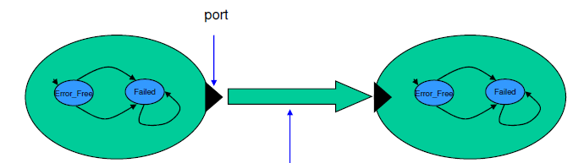
Propagation
Transition: trigger/guard/action
Action: message from one object to another

Slide 15
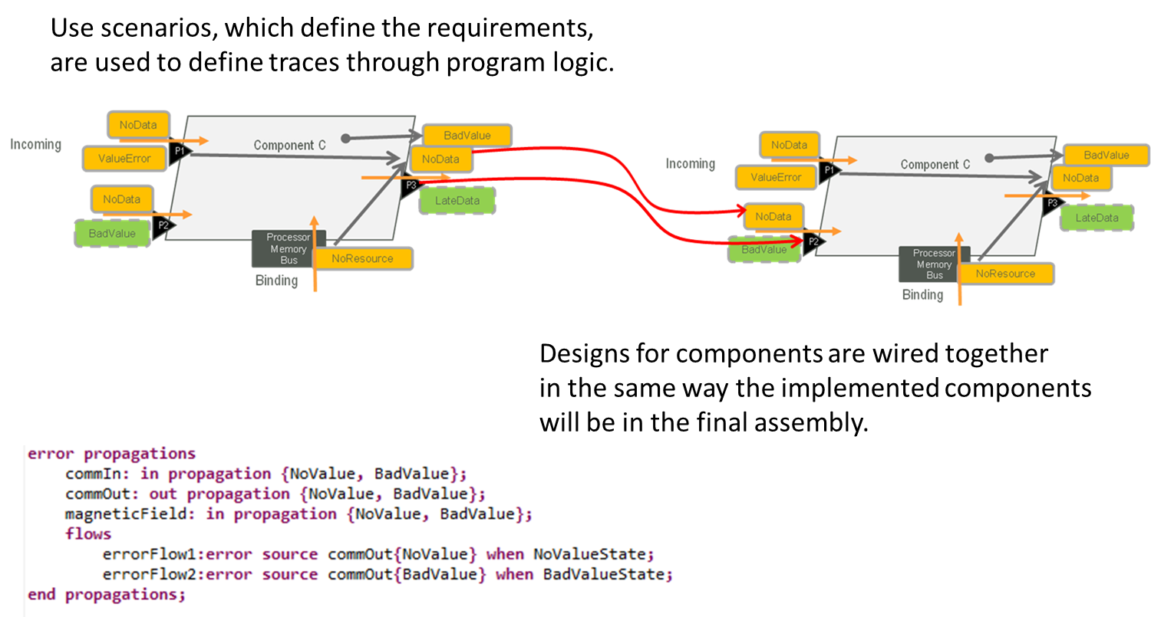
Error propagation

Slide 16
Completely bound system
system DemoSystem
end DemoSystem ;
system implementation DemoSystem.impl
subcomponents
clientProcessor1 : processor platform::DefaultProcessor.impl ;
clientProcess1 : process Client::DefaultClientProcess.impl ;
--clientMemory1 : memory platform::DefaultMemory.impl ;
clientBus1 : bus platform::DefaultBus.impl ;
------
serverProcessor1 : processor platform::DefaultProcessor.impl ;
serverProcess1 : process ServerType::DefaultServerProcess.impl ;
--serverMemory1 : memory platform::DefaultMemory.impl ;
serverBus1 : bus platform::DefaultBus.impl ;
------

Slide 17
Completely bound system
connections
connection1 : port clientProcess1.get -> serverProcess1.put ;
connection2 : port serverProcess1.get -> clientProcess1.put;
connection3 : bus access clientBus1 <-> clientProcessor1.busAcc;
--connection4 : bus access clientBus1 <-> --clientMemory1.busAcc;

Slide 18
Completely bound system
properties
--Actual_Memory_Binding => (reference (clientMemory1 ))
--applies to clientProcess1 ;
Actual_Processor_Binding => (reference (clientProcessor1))
applies to clientProcess1.clientThread ;
------
--Actual_Memory_Binding => (reference (serverMemory1))
--applies to serverProcess1 ;
Actual_Processor_Binding => (reference (serverProcessor1))
applies to serverProcess1.serverThread ;
------

Slide 19
ServerType
package ServerType
public
with types;
subprogram processData
features
inputData: in parameter types::item;
outputData: out parameter types::item;
end processData;
thread interactWithClient
features
receiveRequest: in event data port types::item;
sendToClient:out event data port types::item;
end interactWithClient;
thread implementation interactWithClient.basic
calls C: {
produce : subprogram processData;
};
connections
c1: parameter receiveRequest->produce.inputData;

Slide 20
ServerType - 2
c2: parameter produce.outputData->sendToClient;
properties
Period => 120ms;
Compute_Execution_Time => 30ms .. 40ms;
Dispatch_Protocol => Periodic;
-- annex behavior {**
-- compute(5ms);
-- compute(10ms);
-- compute(15ms);
-- raise(sendToClient);
-- **};
end interactWithClient.basic;
process DefaultServerProcess
features
put: in event data port types::item;
get: out event data port types::item;
end DefaultServerProcess;
process implementation DefaultServerProcess.impl
subcomponents
serverThread : thread ServerType::interactWithClient.basic ;
connections
connection : port put -> serverThread.receiveRequest ;
connection1 : port serverThread.sendToClient -> get;
end DefaultServerProcess.impl ;
end ServerType;

Slide 21
Client-1
package Client
public
with Thread_Properties;
with types;
subprogram produceData
features
inputData: in parameter types::item;
outputData: out parameter types::item;
end produceData;
thread interactWithServer
features
receiveData: in event data port types::item;
requestData:out event data port types::item;
end interactWithServer;
thread implementation interactWithServer.basic
calls C: {
produce : subprogram produceData;
};
connections
c1: parameter receiveData->produce.inputData;

Slide 22
Client - 2
c2: parameter produce.outputData->requestData;
properties
Period => 120ms;
Compute_Execution_Time => 30ms .. 40ms;
Dispatch_Protocol => Periodic;
-- annex behavior {**
-- compute(5ms);
-- compute(10ms);
-- compute(15ms);
-- raise(requestData);
-- **};
end interactWithServer.basic;
process DefaultClientProcess
features
put: in event data port types::item;
get: out event data port types::item;
end DefaultClientProcess ;
process implementation DefaultClientProcess.impl
subcomponents
clientThread : thread Client::interactWithServer.basic ;
connections
connection : port put -> clientThread.receiveData ;
connection1 : port clientThread.requestData -> get;
end DefaultClientProcess.impl ;
end Client;

Slide 23
Types
package types
public
data item
end item;
data implementation item.impl
end item.impl;
end types;

Slide 24
Platform
package platform
public
-- Description of the memory onto which the process is bound
------------------------------------------------------
memory DefaultMemory
features
busAcc: requires bus access DefaultBus.impl;
end DefaultMemory;
memory implementation DefaultMemory.impl
end DefaultMemory.impl;
-- Description of the bus onto which connections are bound
----------------------------------------------------------
bus DefaultBus
end DefaultBus;
bus implementation DefaultBus.impl
end DefaultBus.impl ;
-----------------------------------------------

Slide 25
-- Description of a processor to execute the threads
-------------------------------------------
processor DefaultProcessor
features
busAcc : requires bus access DefaultBus.impl ;
end DefaultProcessor ;
processor implementation DefaultProcessor.impl
subcomponents
mem : memory DefaultMemory.impl ;
properties
Scheduling_Protocol => ( RMS );
end DefaultProcessor.impl ;
end platform;

Slide 26
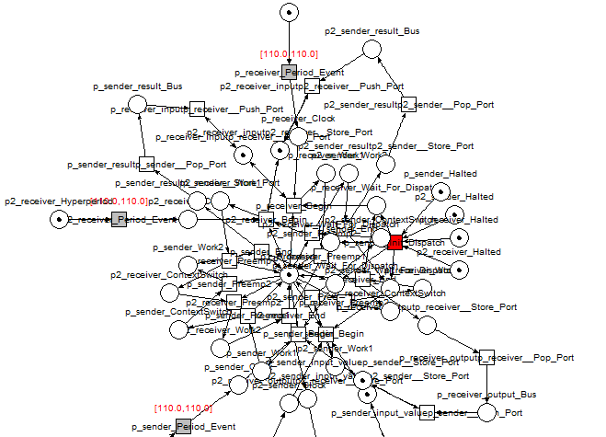
Petri net for client/server

Slide 27
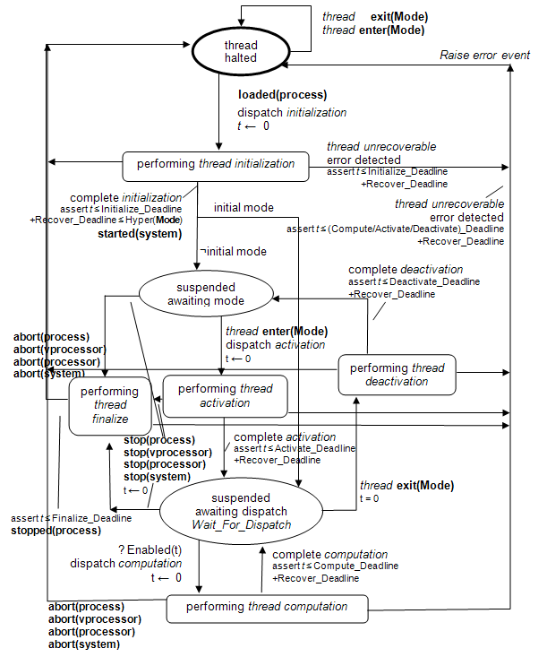

Slide 28
coverage criteria
The values in the program variables determine what state the product instance is in and what structures are accessible
Every end to end flow (nominal or error)
  Covered in every state in which it is “alive”
  Must select test data that exercises each of those states

Slide 29
But …
The model is not what gets delivered
Need to automatically generate the code from the verified models in order to ensure correctness
Ocarina …

