Slide 1

CPSC 372
John D. McGregor
Session 9
Testing Vocabulary

Slide 2
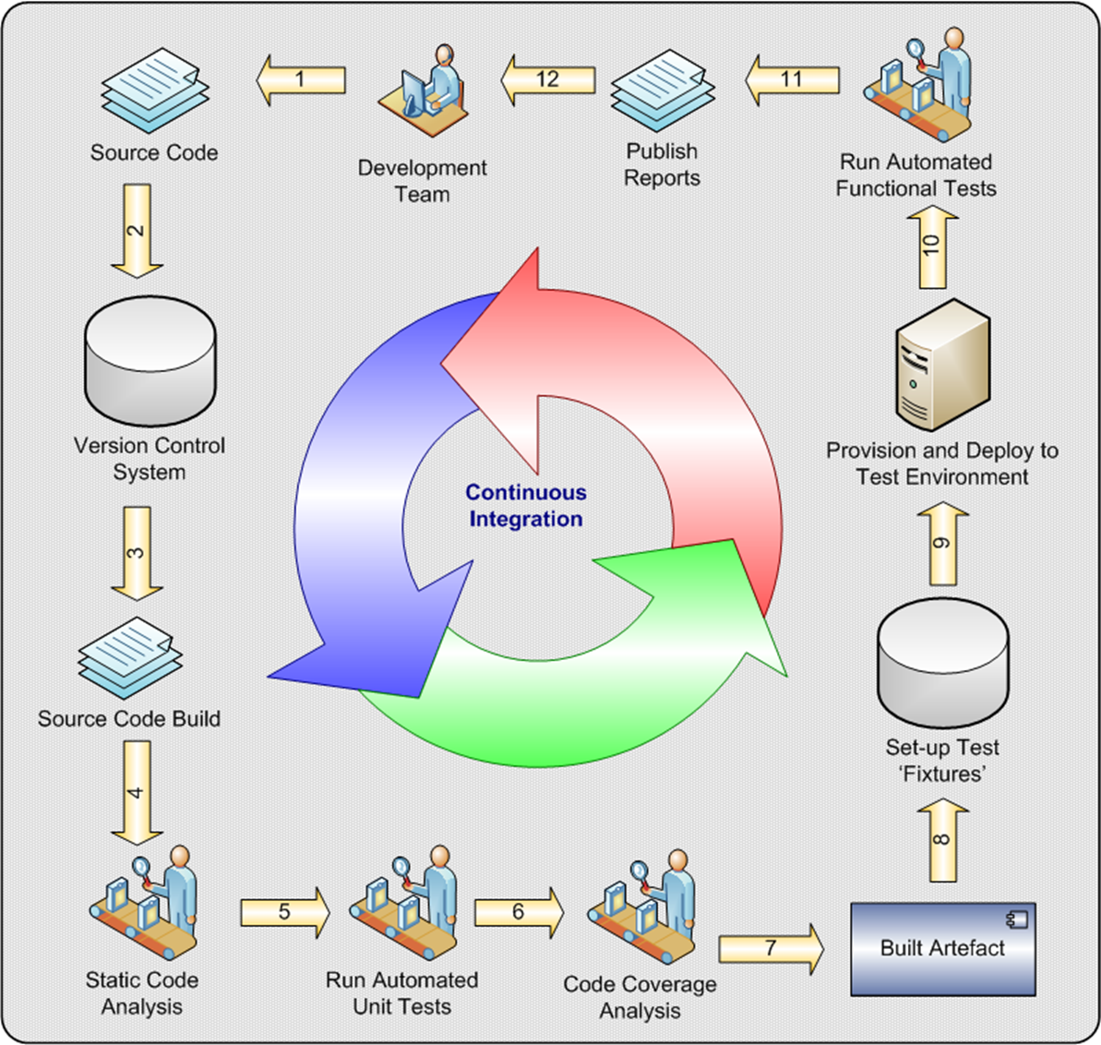

Slide 3
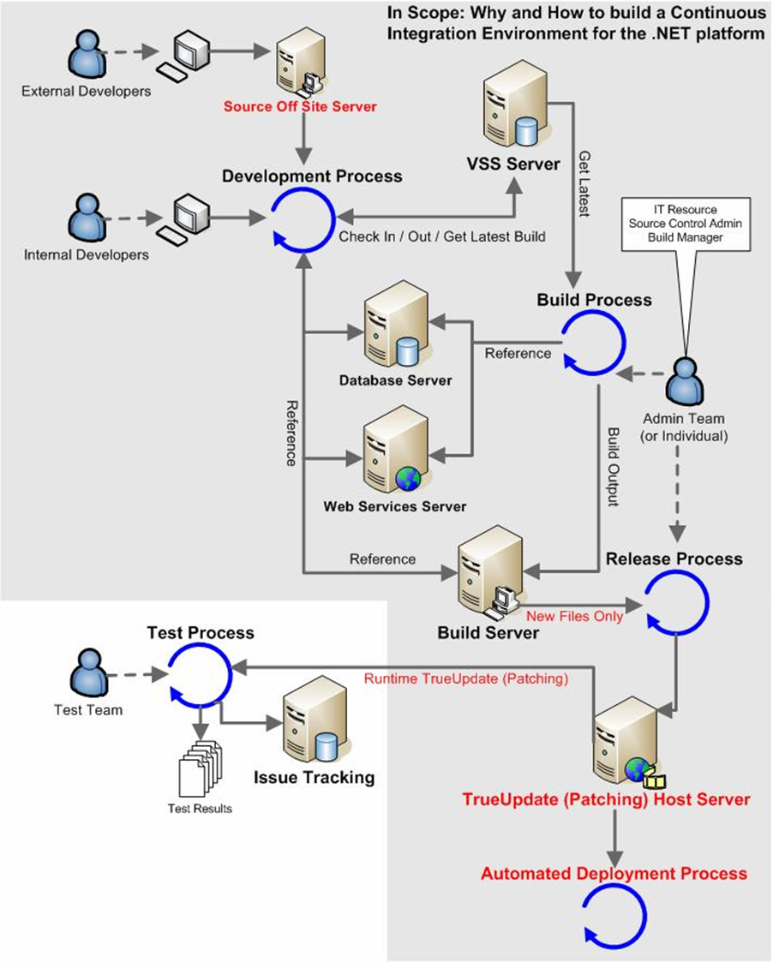

Slide 4
End-to-end quality
Quality can not be tested into a product
Use cases
Review
Requirements
Analysis
models
Guided
Inspection
Analysis
Architectural Design
Architecture
description
ATAM
Guided
Inspection
Design
models
Detailed Design
Unit/Feature
Integration
Implementation
Coding
System
Development
Testing

Slide 5
Test theory
Testing is a search for faults which are manifest as defects in an implementation.
A “successful” test is one that finds a defect and causes an observable failure.
In this unit we will talk a bit about how we guide the search to be the most successful.
Read the following:
  http://www.computer.org/portal/web/swebok/html/contentsch5#ch5

Slide 6
Testability
Part of being successful depends on how easily defects can be found.
Software should be designed to be controllable and observable.
Our testing software must be able to control the software under test to put it in a specific state so the test result can be observed and evaluated.

Slide 7
Fault models
A fault is a defect that can cause a failure.
There may be multiple defects that are all in place because of a single fault.
A fault model is a catalog of the faults that are possible for a given technology.
For example, consider the state machine pattern that structures a system as a set of states and the means of moving from one state to another.

Slide 8
Fault models - 2
An application of that pattern can become faulty if the implementer:
  Type 1: alters the tail state of a transition (a transfer fault);
  Type 2: alters the output of a transition (an output fault);
  Type 3: adds an extra transition; and
  Type 4: adds an extra state.
  Type 5: removes a transition
  Type 6: removes a state
  Type 7: alters guard

Slide 9
Fault models - 3
Any one who tests is using a fault model.
It may be an implicit model or they may write it down and provide to others.
The idea is to capture experience. Where have you been successful finding faults?
For example, people make little mistakes about a numeric value so we usually test for the expected value +/- a small amount.

Slide 10
Test case
Testing a piece of software involves:
  Software that executes the software being tested
  Software being tested
  Software that specifies a particular scenario
In the next session we will consider Junit a software framework that executes tests. In this session we will focus on test cases.
A test case is a triple:
<pre-conditions, input data, expected results>

Slide 11
Black-box Test Case
Here is pseudo-code for a method:
int average(int number, array list_of_numbers){
}
The implementation would go between the {}.
When a tester creates test cases without an implementation it is referred to as specification-based or “black-box” testing.

Slide 12
Black-box Test Case - 2
For
  int average(int number, array list_of_numbers){
A test case would include
pre-conditions – there is no state for an algorithms so no pre-conditions
the number of numbers to be averaged
a list of numbers to be averaged
Consider what could go wrong
  Number might not match the number of numbers
  Number might be entered as a negative
  There might not be any numbers in the list
We also want some tests that will succeed so there should be some test cases in which we expect correct action

Slide 13
Black-box Test Case - 3
Test cases
  <null, 6 (1,2,3,4,5,6), 3.5>
  <null, 3 (10, 20, 30), 20>
  <null, -3 (10, 20, 30), error>
  <null, 4 (10, 20, 30), error)
  <null, 3 (), error)
The first test case fails – any idea why?

Slide 14
White-box Test Case
int average(int number, array list_of_numbers){
sum = 0;
for i=1,number do{
sum = sum + next_number_in_list
}
if (number > 0) return sum/number
}
Structural (or white-box) testing defines test cases based on the structure of the code.

Slide 15
White-box Test Case - 2
Test cases
  <null, 6 (1,2,3,4,5,6), 3.5>
  <null, -3 (10, 20, 30), error>
But these are test cases from the previous set of tests
The test case definition does not look any different whether it is black-box or white-box.

Slide 16
Coverage
We keep defining test cases as long as there are possible faults that have not been directly exercised.
In black-box testing the coverage measures are based on the parameter types and the return type.
In fact the very first test case we defined in the black-box test suite violates the return type for the method average.

Slide 17
Coverage - 2
Specification-based tests help us find out if the software can do all it is supposed to do.
Implementation-based tests help us find out if the software does anything it is not supposed to.
To do a thorough job we need both types of coverage.

Slide 18
Defect Density
Average number of defects per 1 KLOC (1000 lines of code)
For type of domain and development method it is fairly constant
http://www.softrel.com/Current%20defect%20density%20statistics.pdf

Slide 19
A bigger fault model
Actually there is a bigger fault model than we first laid out.
There is an underlying fault model that addresses the “routine” aspects of any program.
For example, the result of calculating an average (using division) may result in a real number but the return is specified as an int (integer).

Slide 20
A bigger fault model - 2
Type mismatches
Incorrect conditions on iteration statements (while, for, do, etc.) or branching statements

Slide 21
Relative fault model
How something is implemented affects what is the fault model we use.
Java, for example, would find the mismatch about return type and computation at compilation time. It is not a testing issue.
Different language tools will find different kinds of defects and eliminate them before testing.
So an abstract fault model has to be filtered by the implementation technology.
Strongly typed languages such as Java and C++ will find more faults earlier than C or other non/loosely typed languages.

Slide 22
Measuring test effectiveness
Compute the coverage achieved from a set of tests
Short-term – which faults in the fault model are being found in the implementation by testing
Long-term – metrics gathered after the fact such as defects not found during testing but found by customers after delivery
Long-term – categories of defects that are being produced in the development process

Slide 23
Timing of tests
Tests are conducted at a number of points in the software development life cycle
Each time a developer finishes an iteration on a unit of software (class, module, component) unit tests are conducted.
The unit tests are based on both the specification and implementation of the unit.

Slide 24
Integration
When two or more pieces of software are joined together, particularly if they were created by two different teams, integration tests are conducted.
These tests are created by focusing on the interactions (method calls) between the two pieces.
Coverage is measured against the set of all possible interactions in the implementation.

Slide 25
System testing
System testing takes a somewhat different perspective – what was the program intended to do?
The test cases for this approach come from the requirements.
Coverage – test cases per requirements
By “system” here I mean the software but system test might also be taken to mean hardware and software if the software runs on specialized hardware.

Slide 26
Testing quality attributes
System test cases must include coverage of non-functional requirements such as latency (how long it takes to accomplish a certain task)
The test harnesses for this and other specific items such as the interactions of the user interface. May require human in the loop testing

Slide 27
Here’s what you are going to do
Go back to your verify activities and determine what level of coverage the proposed tests achieve. Add test acses until you can make some statement about coverage.
Use the informal claim/evidence/uncertainty tree to build the assurance case for the wbs.

