Slide 1

CPSC 873
John D. McGregor
GQM

Slide 2
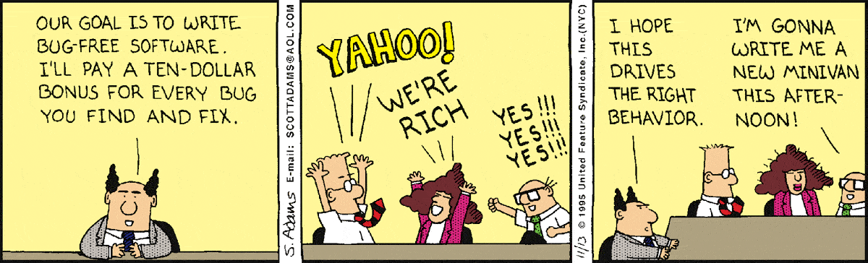
Size
Speed
Money
Reliability and quality
Healthy/smells

Slide 3
attributes
Simple and computable
Empirical and intuitively persuasive
Consistent and objective
Consistent in the use of units and dimensions
Independent of programming language, so directed at models (analysis, design, test, etc.) or structure of program
Effective mechanism for quality feedback

Slide 4
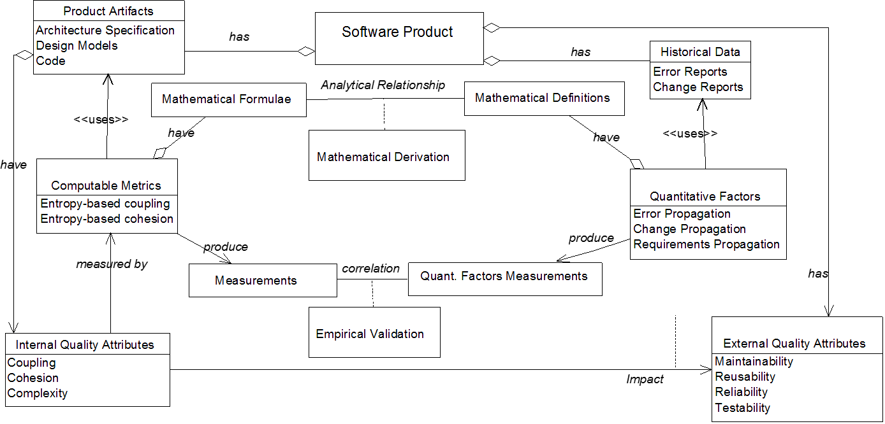
McCall’s model

Slide 5
GQM
We measure to be able to quantify our decisions.
We measure Process and Product
Goal – desired end result
Question – clarification of what we need to know if goal has been achieved
Metric – measurement that answers questions

Slide 6
Defining a Goal
Object – the “thing” being examined
Purpose – why it is being examined
Focus – specific attribute of the object
Viewpoint – from which stakeholder’s perspective
Environment – context within which the examination happens

Slide 7
Example Goal creation
Object – Source code of product under development
Purpose – to decide when fit to ship
Focus – remaining defects
Viewpoint – customer
Environment – upgrade of legacy product for internal use
Goal: Determine whether the source code is of acceptable correctness for our customer to be delighted with the new release.

Slide 8
Questions
More concrete than the goals
Essentially “have we achieved the goals?”
How many defects remain in the code?
How significant are those defects?
How difficult will it be to remove those defects?

Slide 9
Goals again
Are all defects the same?
Should I rank them?
Goal: Determine whether the source code has sufficiently few major defects for our customer to be delighted with the new release.
Questions drive revision of Goals.

Slide 10
Metrics
Data is needed to answer the questions.
Involves the Focus element of the Goal
May be counted – there are 234 writes in this program
May be inferred – It is 95% certain that there are 64 major defects remaining in this code

Slide 11
Attributes of measures
Objective - Counts of things or events
Absolute - Size of something independent of other things
Relative – a comparison between two measures
Explicit - Obtained directly
Derived - Computed from explicit and/or inferred from statistical models
Dynamic – related to time
Static – independent of time

Slide 12
Product vs Process vs Project
What have we got versus how we got it
LOC is a product measure
LOC/day is a process measure
LOC/day/developer is a project measure

Slide 13
Agile metrics
Leadtime—how long it takes you to go from idea to delivered software.
Cycle time—how long it takes you to make a change to your software system and deliver that change into production.
Team velocity—how many “units” of software the team typically completes in an iteration (a.k.a. “sprint”).
Open/close rates—how many production issues are reported and closed within a specific time period.

Slide 14
Production metrics
Mean time between failures (MTBF)
Mean time to recover/repair (MTTR)
Application crash rate—how many times an application fails divided by how many times it was used. This metric is related to MTBF and MTTR.

Slide 15
Metric heuristics
Metrics cannot tell you the story; only the team can do that.
Comparing snowflakes is waste.
You can measure almost anything, but you can't pay attention to everything.
Business success metrics drive software improvements, not the other way round.
Every feature adds value; either measure it or don't do it.
Measure only what matters now.

Slide 16
Standards
Need standard definitions
A line of code is counted as the line or lines between semicolons, where intrinsic semicolons are assumed at both the beginning and the end of the source file. This specifically includes all lines containing program headers, declarations, ex-ecutable and non-executable statements. (NASA)

Slide 17
Halstead’s Textual Complexity Metrics
The four base measurements are
  n1 - number of distinct operators
  n2 - number of distinct operands
  N1 - number of operators
  N2 - total number of operands
Program Length N = N1 + N2
This is Halstead’s definition of the length of a program.

Slide 18
Program Difficulty D = [(n1)/2] (N2/n2)
This is an indication of the difficulty in developing and understanding a program component.
Mental Effort
E = [(n1) (N2) (N1+N2) ln(n1+n2)] / 2(n2)
This is an indication of the effort required to understand and develop a program.

Slide 19
Estimated Number of Errors
B= [E ** (2/3)] / 3000
This is an estimate of the amount of errors resident in a program module.
Most static analysis tools provide the Halstead metrics

Slide 20
McCabe’s cyclomatic complexity
where V(G)=McCabe’s cyclomatic number
E = number of edges in the control graph
N = number of nodes in the control graph
P = number of connected components or subprograms (for calculating V(G) for single components or modules, p = 1)
V(G) = |E| - |N| + p

Slide 21
Kafura and Henry’s complexity
length * (fan-in * fan-out)**2
Where length is the number of lines of code in a program
fan-in is the number of data objects passed into a called procedure plus the number of global data structures from which the procedure retrieves its information
fan-out is the number of data objects received from a called procedure plus the number of global data structures which the procedure updates

Slide 22
Collect and aggragate

Slide 23
Process

Slide 24
References
https://www.cs.umd.edu/~basili/publications/technical/T89.pdf
https://ston.jsc.nasa.gov/collections/trs/_techrep/TM-1994-104799.pdf
http://techbeacon.com/9-metrics-can-make-difference-todays-software-development-teams
http://www.slideshare.net/swatisinghal/software-metrics-5079475

