Slide 1
Testability

Slide 2
Quality
“Totality of features of a software product that bears on its ability to satisfy given needs.” [Source: IEEE-STD-729]
“Composite characteristics of software that determine the degree to which the software in use will meet the expectations of the customer.” [Source: IEEE-STD-729]

Slide 3
http://search.proquest.com/docview/215836114?pq-origsite=gscholar
www.idi.ntnu.no/emner/tdt4242/foiler/3-2-Testability.ppt
http://paris.utdallas.edu/qrs16/docs/Keynote-Jeff-Voas-slides.pdf
http://www.rti.org/sites/default/files/resources/software_testing.pdf
http://citeseerx.ist.psu.edu/viewdoc/download?doi=10.1.1.85.391&rep=rep1&type=pdf

Slide 4
Testability
According to ISO 9126, testability is defined as:
The capability of the software product to enable modified software to be validated.
IEEE Dictionary of Standard Terminology
“(1) the degree to which a system or component facilitates the establishment of test criteria and the performance of tests to determine whether those criteria have been met; and (2) the degree to which a requirement is stated in terms that permit establishment of test criteria and performance of tests to determine whether the criteria have been met”

Slide 5
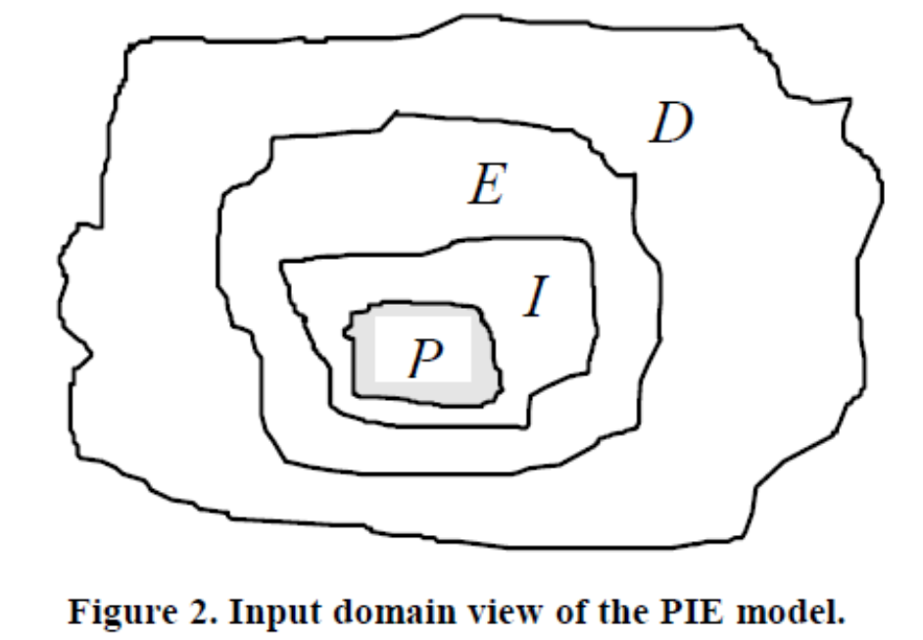
PIE
Propagation
Infection
Execution

Slide 6
2 concerns
How easy is it to test the implementation?
How test-friendly is the requirement?
3 ways to examine
T – Tests. Input / output. Involves the computer system and peripherals.
E – Experiments. Input / output but involves also the users.
I – Inspections. Evaluation based on documents.

Slide 7
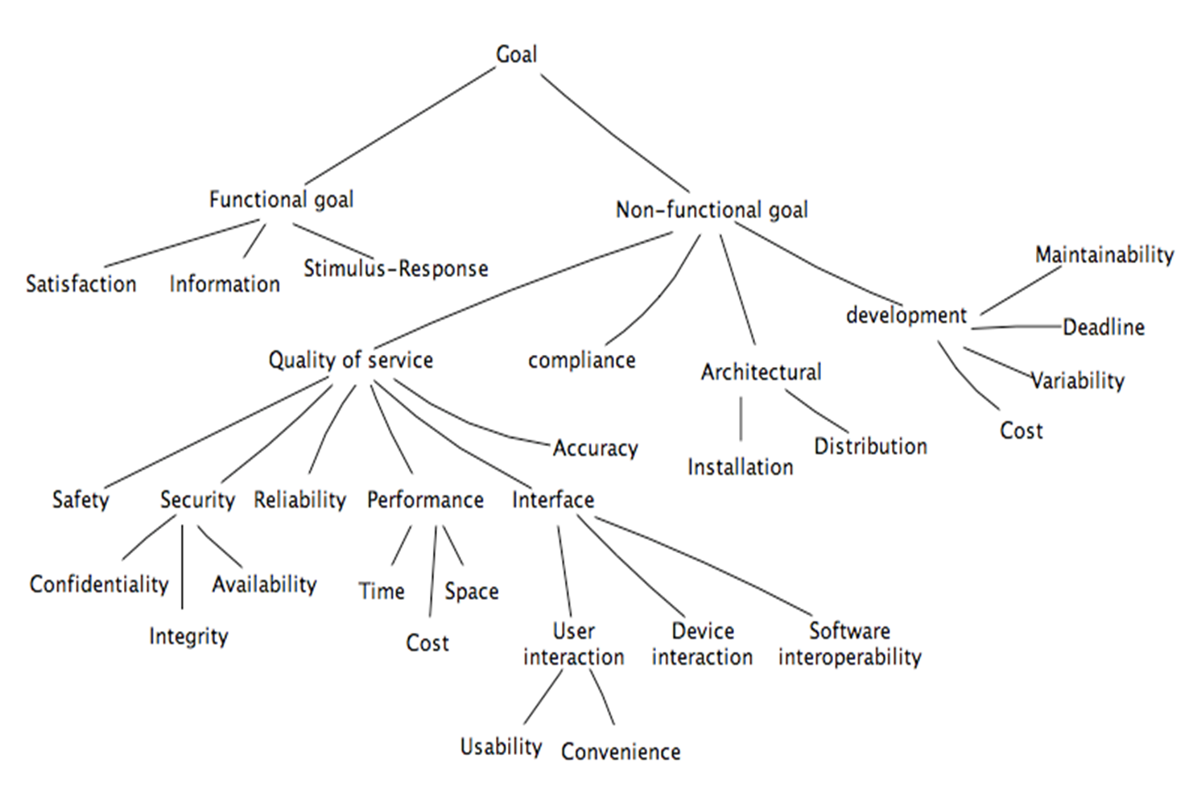

Slide 8
In order to be testable, a requirement needs to be stated in a precise way. For some requirements this is in place right from the start:
When the ACC system is turned on, the “Active” light on the dashboard shall be turned on.
In other cases we need to change a requirement to get a testable version.
The system shall be easy to use.

Slide 9
Requirement: Reverse thrust may only be used, when the airplane is landed.
The important questions are
“How do you define landed?”
Who should you ask – e.g. pilots, airplane construction engineers, or airplane designers?

Slide 10
First and foremost:
The customer needs to know what he wants and why he wants it. In some cases it is easier to test if the user actually has achieved his goal than to test that the system implements the requirement.
Unfortunately, the “why”-part is usually not stated as part of a requirement.

Slide 11
Each requirement needs to be
Relevant, i.e. pertinent to the system’s purpose and at the right level of restrictiveness.
Feasible, i.e. possible to realize. If it is difficult to implement, is might also be difficult to test.
Traceable, i.e. it must be possible to relate it to one or more
Software components
Process steps

Slide 12
Automatic door opener – what is missing?
If the door is closed and a person is detected then send signal Open_Door. If no person is detected after 10 sec., send signal Close_Door.

Slide 13
Words and phrases that include:
as appropriate
if practical
as required
to the extent necessary / practical.
Their meaning
is subject to interpretation
make the requirement optional
Phrases like "at a minimum" only ensure the minimum, while "shall be considered" only requires the contractor to think about it.

Slide 14
Words and phrases that include:
as appropriate
if practical
as required
to the extent necessary / practical.
Their meaning
is subject to interpretation
make the requirement optional
Phrases like "at a minimum" only ensure the minimum, while "shall be considered" only requires the contractor to think about it.

Slide 15
Observability
A software component is observable “if distinct outputs are generated from distinct inputs”
Progress of the test execution? This is important for tests that do not produce output – e.g. the requirement is only concerned with an internal state change or update of a database.
Results of the test? Important for tests where the output is dependent on an internal state or database content.

Slide 16
Controllable
A software component is controllable “if, given any desired output value, an extra input exists which ‘forces’ the component output to that value”

Slide 17
Test Restartability
This is mostly a question of check points in the code. How easy is it to
Stop the test temporarily
Study current state and output
Start the test again from
The point where it was stopped
Start

Slide 18
Given a function Q = f(t)
Domain The domain of f is the set of all possible input values, t, which yield an output
Range The range of f is the corresponding set of output values Q

Slide 19
Domain
The domain is the set of all possible inputs into the function { 1, 2, 3, … }
The nature of some functions may mean restricting certain values as inputs

Slide 20
Range
{ 9, 14, -4, 6, … }
The range would be all the possible resulting outputs
The nature of a function may restrict the possible output values

Slide 21
Definition
Given a function Q = f(t)
Domain The domain of f is the set of all possible input values, t, which yield an output
Range The range of f is the corresponding set of output values Q

Slide 23
PIE

Slide 24
Estimation
Execution probability is estimated for some given input distribution by determining the proportion of cases that execute the location of interest.
Infection probability is estimated by introducing mutations of the location and determining the proportion of input cases that give rise to a different state from the non-mutated location.
Propagation probability is estimated by determining the proportion of cases for which perturbed data states at the location propagate and give rise to faulty results.

Slide 25
Fault size
the syntactic size of a fault as “the number of statements or tokens that need to be changed to get a correct program”.
the semantic size of a fault as “the relative size of the subdomain of D for which the output mapping is incorrect”

Slide 26
DRR
where |D| is the cardinality of the domain of the specification and |R| is the cardinality of the range.

Slide 27
Design for testability
Binder [6] talks about six major factors that result in testability in the development process. The factors are:
characteristics of the design documentation,
characteristics of the implementation,
built-in test capabilities,
presence of a test suite,
presence of test tools and the software development
process capability/maturity.

Slide 28
DRR
The closer to 1 the DRR is the more testable the function
The domain range ratio DRR of a

Slide 29
http://search.proquest.com/docview/215836114?pq-origsite=gscholar
Write a half page summary of the content nd half a page of critique of the idea, not the presentation
Submit as ususal Oct 17th by 11:59PM

Slide 30
Fewer tests means more escapes: Suppose our tests have 1:100 odds of finding a bug and there are 1,000 latent bugs in our system. We need to run at least 100,000 tests to find these bugs. But suppose we run only 50,000 tests and release; we’ll probably ship with about 500 latent bugs.
Testability determines the limit to which the risk of costly or dangerous bugs can be reduced to an acceptable level.
That is, poor testability means you’ll probably ship/release a system with more nasty bugs than is prudent.

Slide 31
About 130 individual factors that contribute to testability according to Binder. The effect of all this can be measured with two ratios:
Efficiency: average tests per unit of effort. Or, much testing can we get done with the time, technology, and people on hand?
Effectiveness: average probability of killing a bug per unit of effort.

Slide 32
Modules with low testability
Faults are harder to find
Coverage criteria hould vary
Stopping criteria

