Slide 1

Cloud architectures
John D. McGregor
johnmc@clemson.edu

Slide 2
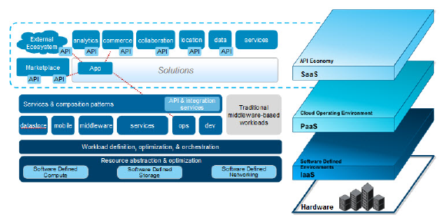

Slide 3
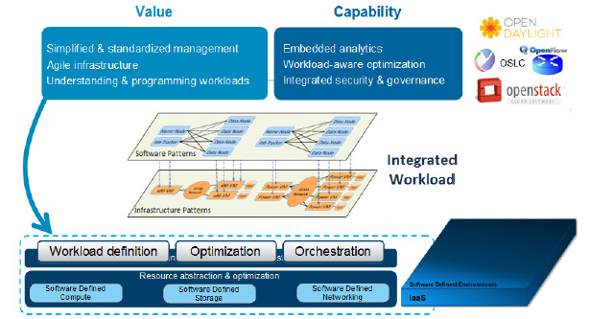

Slide 4
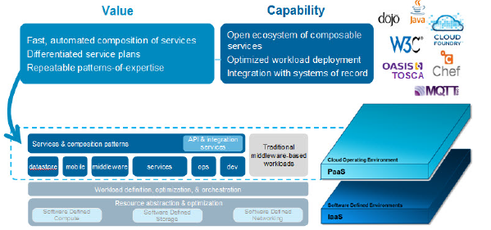

Slide 5
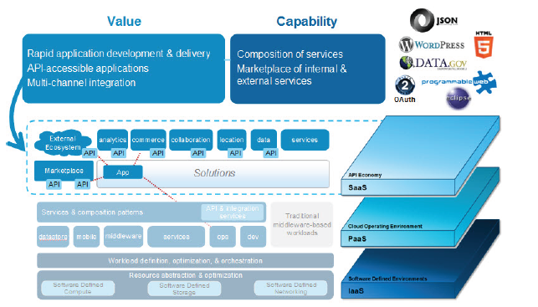

Slide 7
Amazon web architecture

Slide 8
MQTT
MQTT is a machine-to-machine (M2M)/"Internet of Things" connectivity protocol.
MQTT-SN is designed to be as close as possible to MQTT, but is adapted to the peculiarities of a wireless communication environment such as low bandwidth, high link failures, short message length, etc

Slide 9
Types of nodes

Slide 10
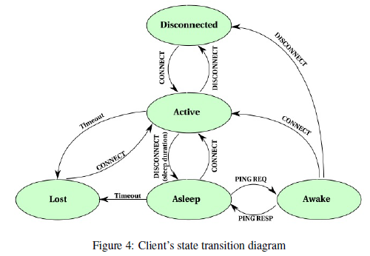
State machine for client

Slide 11
http://www.ibm.com/developerworks/cloud/library/cl-open-architecture/cl-open-architecture-pdf.pdf
http://www.oracle.com/technetwork/articles/cloudcomp/jimerson-ha-arch-cloud-1669855.html
http://mqtt.org/

