Slide 1

CpSc 875
John D. McGregor
C11 - Documentation

Slide 2
2 sources
Clements et al. – book that describes an approach called Views and Beyond
IEEE 1471 adopted standard
Results in a two volume set of documentation. See the reference at the end of the slides to the pedagogical product line and follow the link to see an example two volume set.

Slide 3
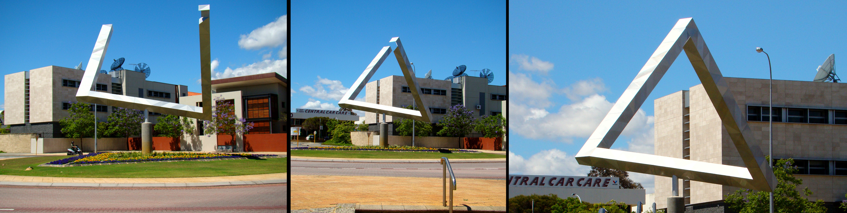
Views and Viewpoints

Slide 4
Viewpoint
Presents the information in the architecture from a certain perspective
That is, it emphasizes certain aspects of the architecture over other aspects
Example, the specification viewpoint shows the spec without showing the implementations available

Slide 5
Viewpoint
define the types of elements, the relations among them, the significant properties they exhibit, and the constraints they obey for views conforming to this viewpoint.
The basic structures in an architecture are one source of viewpoints
Module viewpoint – Shows an individual module and information about that module

Slide 6
View
Applies a viewpoint to the architecture for a specific stakeholder
Every stakeholder should have at least one view that speaks to their concerns
The view should put the information into context but not confuse the reader with extraneous material

Slide 7
View
For example, a user interface designer would want a view that shows each module used in the interface from the viewpoint of that module’s definition.

Slide 8
View
Name of view
View description
Primary presentation
List of view packets
Element catalog
Context diagram
Variability mechanisms
Architecture background

Slide 9
View Packet
Primary Presentation
Element Catalog
Properties of the elements
Relations and their properties
Element interfaces
Element behavior
Context Diagram
Variation Guide
Architecture Background
Rationale. Analysis results. Assumptions.
Other Information
Related View Packets

Slide 10
Example
Module Decomposition View
In this section, we describe the basic structure of an AGM game. Game variations are addressed by substitution, parameterization, and specialization. Game-specific behaviors are provided by game-specific implementations of the interfaces in this document.
Module Decomposition View Packet 1: Game
The previous figure shows the Game component as the representation for the generic product. The following figure shows that component's interface as the top-level interface of the system (defined in the GameBoard Interface section) and the other major interfaces that are at the first level of decomposition within the GameInterface (defined later in this document).

Slide 11
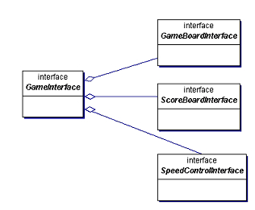
Primary presentation

Slide 12
Element Catalog Elements and their properties. The following table displays element details.
Relations and their properties. The primary relation is composition. Game is
responsible for creating, managing, and killing the elements it composes.
Elements and Responsibilities for Model Decomposition View Packet 1: Game
Element | Responsibilities
GameBoard interface | This container component holds all the elements needed for the game.
ScoreBoard interface | This interface keeps and presents the score as the game specifies. It is defined in the ScoreBoard Interface section.
SpeedControl interface | This interface controls how often a tick is issued to the GameBoard. It is defined in the SpeedControl Interface section.

Slide 13
Relations and their properties. The primary relation is composition. Game is responsible for creating, managing, and killing the elements it composes.
Element interfaces. Game interface is the program's GUI. It provides the user with Game start, stop, pause, and save behaviors. The other interfaces are documented as follows:
GameBoard
SpeedControl
ScoreBoard
Element behavior. The behavior is the game that is displayed to the user.
Context Diagram Game is the top level of the product and the top-level context.
Variation Guide Game and ScoreBoard will each be replaced by a game-specific implementation as described in the Module Generalization View section.

Slide 14
Variation Guide Game and ScoreBoard will each be replaced by a game-specific implementation as described in the Module Generalization View section.
Architecture Background Game encapsulates game-specific behavior. It arranges the GameBoard, keeps score, and determines the won/lost status based on its rules. The composed elements are mostly generic and can be reused and rearranged to implement other games.
Other Information No other information applies.
Related View Packets
Module Generalization View Packet 1: Game
ScoreBoard Interface

Slide 15
Next steps
Read http://www.sei.cmu.edu/library/abstracts/reports/05tn017.cfm
Select the “download the template” link on:
http://www.sei.cmu.edu/architecture/tools/viewsandbeyond/
Here is example documentation for the pedagogical product line architecture: http://www.sei.cmu.edu/productlines/ppl/arch_docs.html
Fill in the template for your architecture

