Slide 1
Security And Architecture
CpSc 8750
Wanda Moses
February 16, 2017

Slide 2
IT Security Architecture
The design artifacts that describe how the security controls (= security countermeasures) are positioned, and how they relate to the overall IT Architecture. These controls serve the purpose to maintain the system’s quality attributes, among them confidentiality, integrity, availability, accountability and assurance. (http://www.opensecurityarchitecture.org/cms/definitions/it-security-architecture)

Slide 3
Microsoft Definition
Security is the capability of a system to prevent malicious or accidental actions outside of the designed usage, and to prevent disclosure or loss of information. A secure system aims to protect assets and prevent unauthorized modification of information.

Slide 4
Security Architecture
Security architecture is a unified security design that addresses the necessities and potential risks involved in a certain scenario or environment. It also specifies when and where to apply security controls. The design process is generally reproducible. (https://www.techopedia.com/definition/72/security-architecture)

Slide 5
Key Attributes of Security Architecture
Relationships and Dependencies
Between components within a system and how the depend on each other
Benefits
Standardization - makes it affordable. Security architecture is cost-effective due to the re-use of controls described in the architecture.
Form
Generally includes a catalog of conventional controls, relationship diagrams, principles, etc…
Drivers
Security controls are determined based on four factors:
Risk management
Benchmarking and good practice
Financial
Legal and regulatory

Slide 6
Security Architecture Process - Key Phases
Architecture Risk Assessment
Evaluates vital business assets, and the chances and effects of vulnerabilities and security threats
Security Architecture and Design
Security services, which facilitate business risk exposure objectives
Implementation
Security services and processes are implemented, operated and controlled. Assurance services are designed to ensure that the security policy and standards, security architecture decisions, and risk management are mirrored in the real runtime implementation
Operations and Monitoring
Daily management of processes, such as threat and vulnerability management. Here, measures are taken to supervise and handle the operational state in addition to the depth and breadth of the systems security.

Slide 7
What does Security Framework mean?
A security framework, in cloud computing, is a defined approach that intends to make computing free from security risks and privacy threats. With the introduction of cloud drives, the confidentiality, authentication and integrity of personal data have been challenged. Cloud accounts should be able to easily access data while, at the same time, security is safeguarded. One of the striking usability features of this framework is the single-sign-on (SSO)-based authentication, which allows users to maintain only one authentication credential for accessing different applications, even with different cloud service providers. (https://www.techopedia.com/definition/30605/security-framework-cloud-computing)

Slide 8
Software security
Software security is a complex multidimensional problem, touching coding, design, operation, and policy
Secure coding – Can be expensive
Security Frameworks - encapsulate best practices in design and coding
(Slides 8 – 20: Approaching Security from an “Architecture First:” Perspective, Software Engineering Institute, Carnegie Mellon University )

Slide 9
An Architectural Approach
An architectural approach to software security relies on three related fundamental design concepts:
Tactics
Techniques that an architect can employ to achieve required quality attributes in a system.
Realizing them in code involves lots of interpretation.
Patterns
There are a number of well-established security pattern catalogs.
They help to structure a design, but they are difficult to correctly implement, maintain, and combine.
Frameworks
A reusable software element that provides generic functionality addressing recurring concerns across a broad range of applications.
There are security frameworks for many languages and technology stacks.
They increase productivity, but often have a steep learning curve and "lock-in".

Slide 10
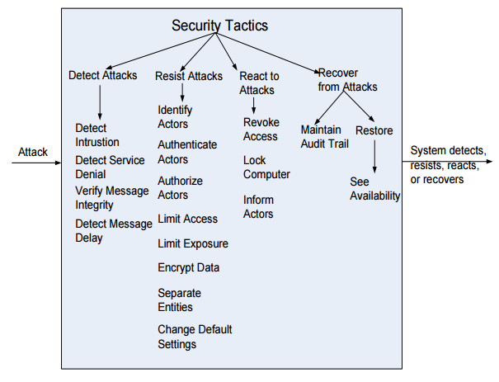
Security Tactics

Slide 11
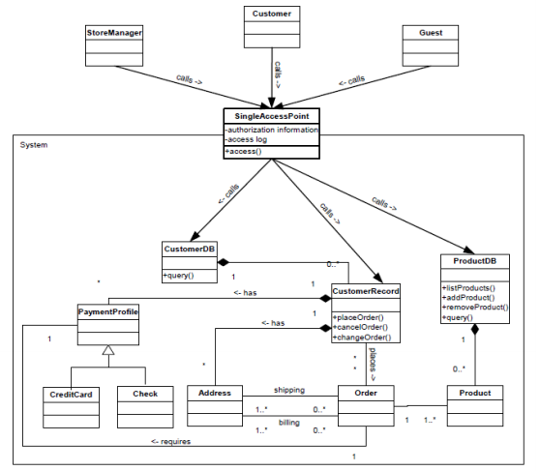
Security Patterns

Slide 12
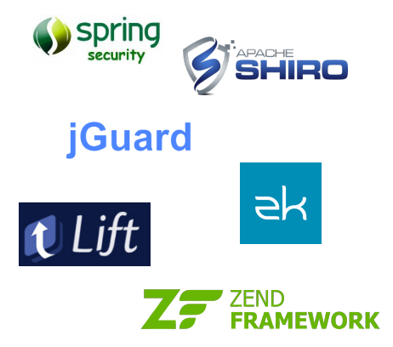
Security Frameworks

Slide 13
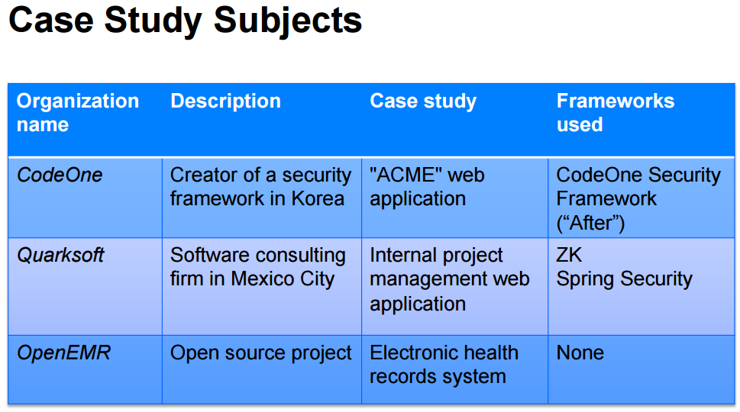

Slide 14
Case Study Protocol
Interview the architect regarding the approach to security, the size of the system, and the effort expended on security.
Scan the system to identify its vulnerabilities using AppScan from IBM.
Goal: explore tradeoff space between costs and benefits (effectiveness) of different approaches to security, and determine if there are optimal project strategies employing the approaches.

Slide 15
Case studies represent three different security approaches, in terms of their architectural support for security (degree of adoption of frameworks):
Full adoption: security framework used throughout the lifetime of the software, e.g. Quarksoft.
Partial adoption: security framework is introduced in the middle of the lifetime, e.g. ACME “After”.
No adoption: no use of any third-party security framework, e.g. OpenEMR, ACME “Before”.

Slide 16
Interview Questions
What were your primary drivers (quality attributes for the system) and how important is security among them?
With respect to security, what are the approaches that you have taken to address this quality attribute?
How do you reason about tradeoffs?
How did you ensure that your programmers conform to the security approaches? (policies, inspections, etc.)
What percentage of project effort do you estimate goes into security without the use of a security framework?
If using a security framework, what percentage of effort does this take?
Other comments

Slide 17
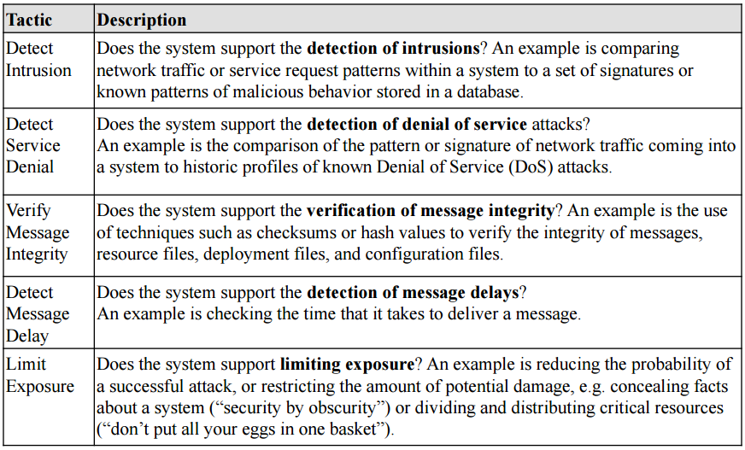
Example Questions

Slide 18
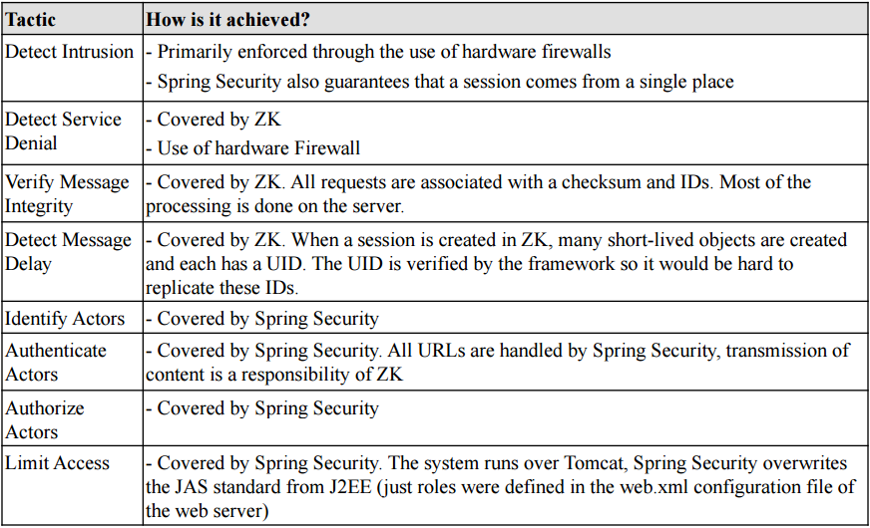
Example Answers

Slide 19
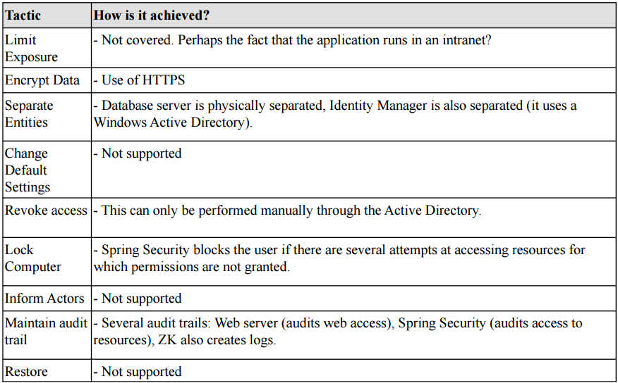
Example Answers Cont’d

Slide 20
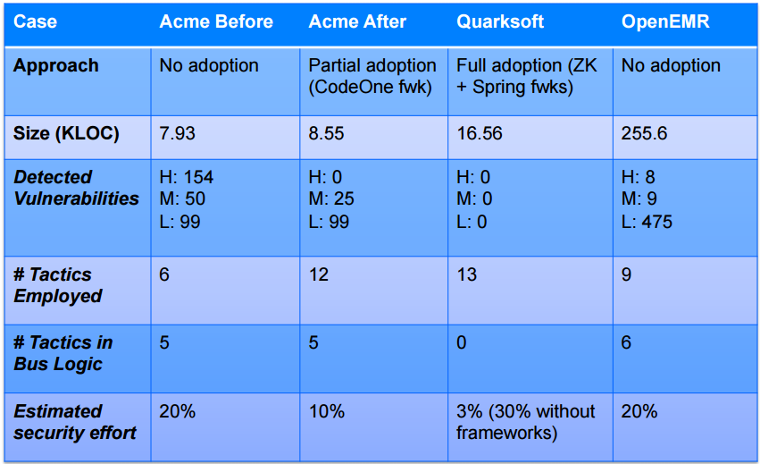
Case Study Results

Slide 21
The Internet Architecture Board (IAB) begins RFC 7452,33 “Architectural Considerations in Smart Object Networking’’
The term "Internet of Things" (IoT) denotes a trend where a large number of embedded devices employ communication services offered by the Internet protocols. Many of these devices, often called "smart objects,’’ are not directly operated by humans, but exist as components in buildings or vehicles, or are spread out in the environment. (https://www.internetsociety.org/sites/default/files/ISOC-IoT-Overview-20151014_0.pdf)

Slide 22
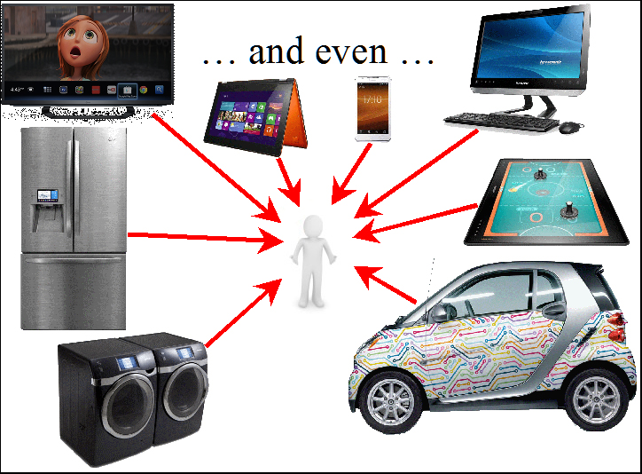
Residential IoT

Slide 23
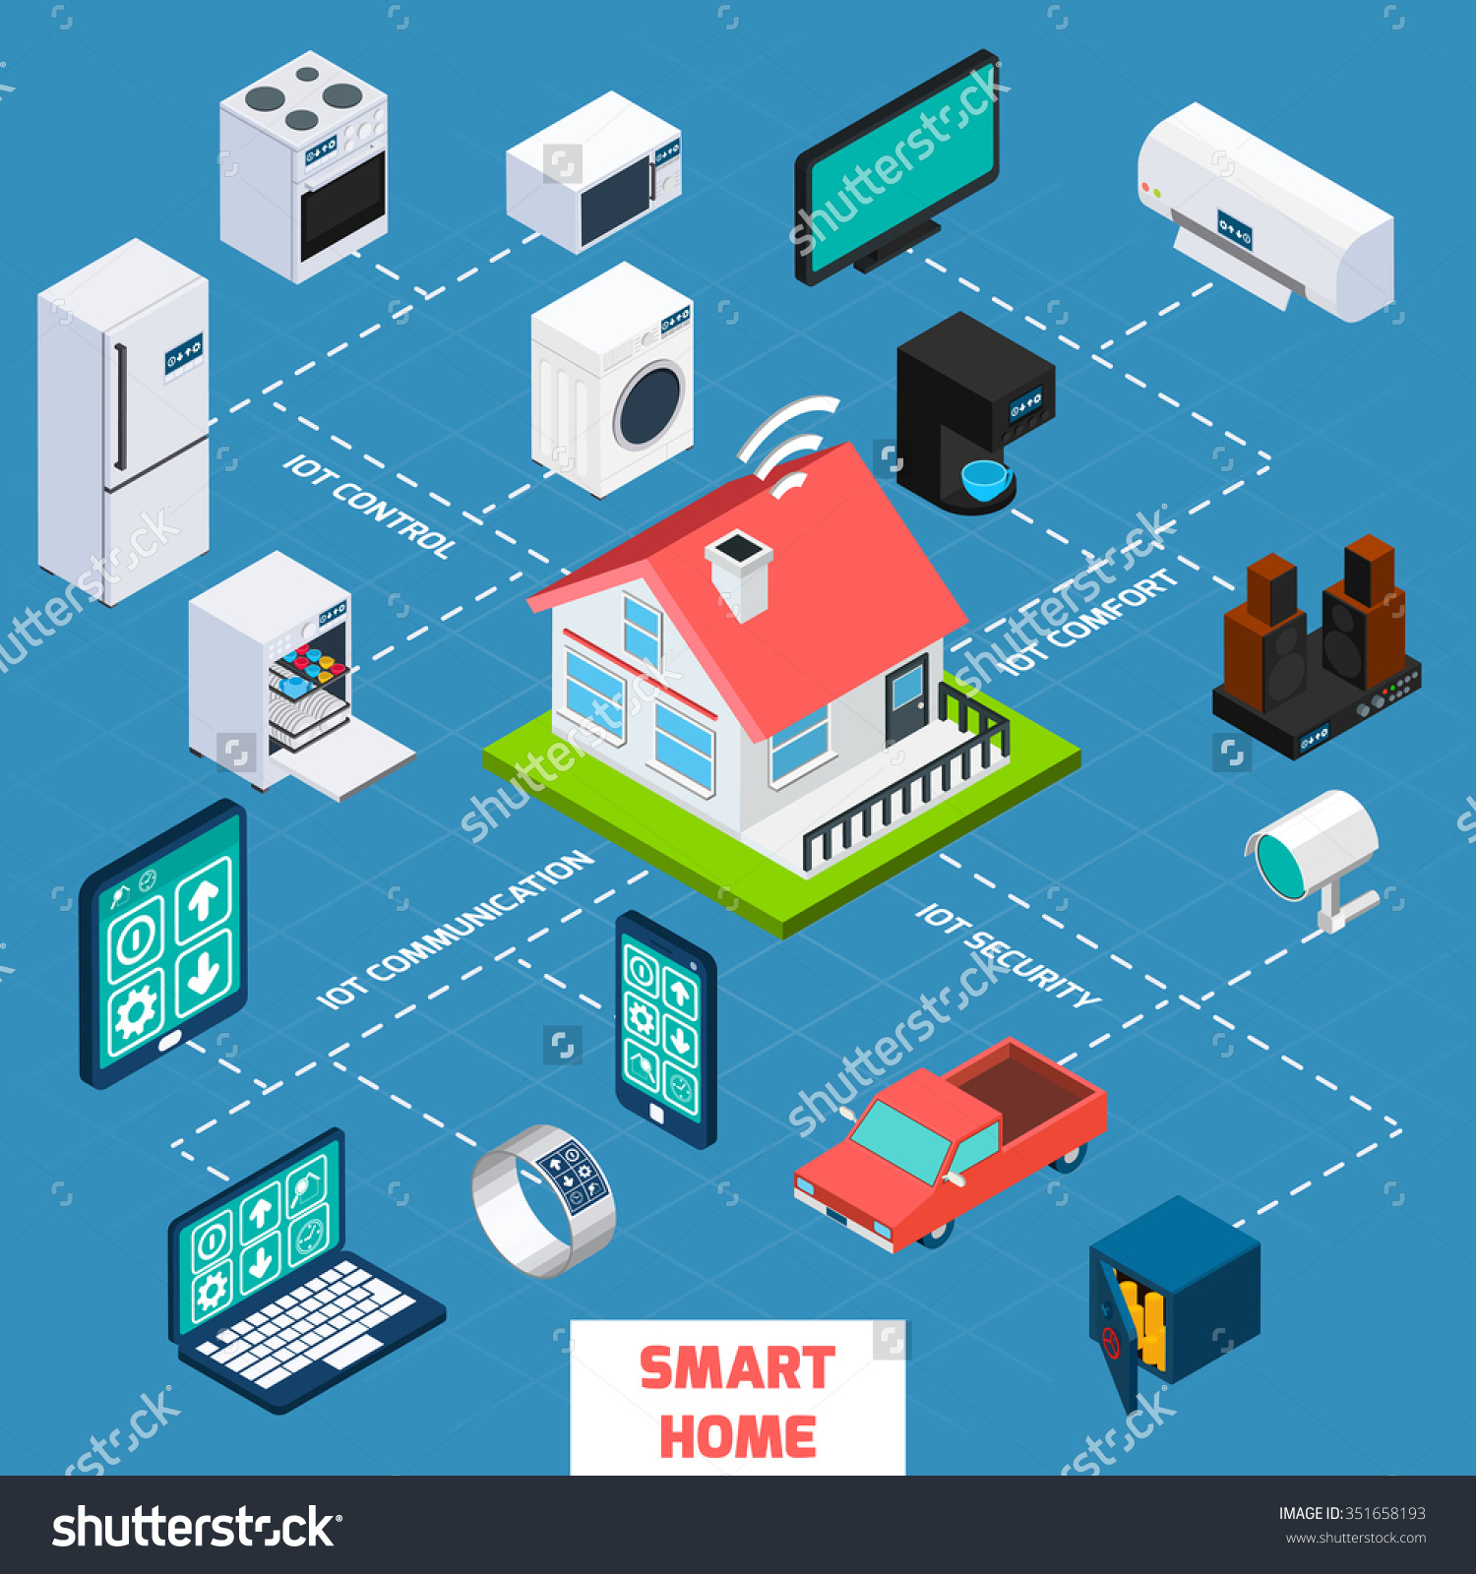
Security of Residential IoT

Slide 24
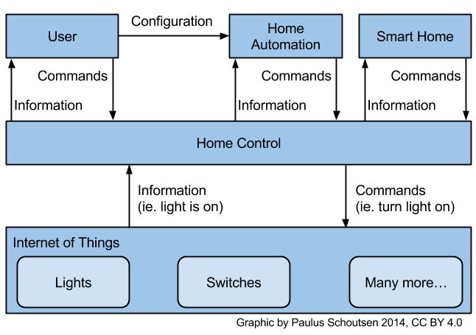
Residential IoT Architecture

Slide 25
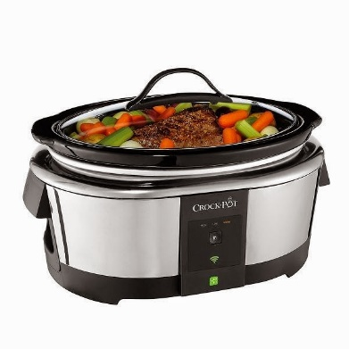
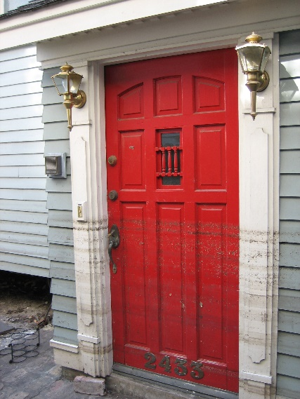
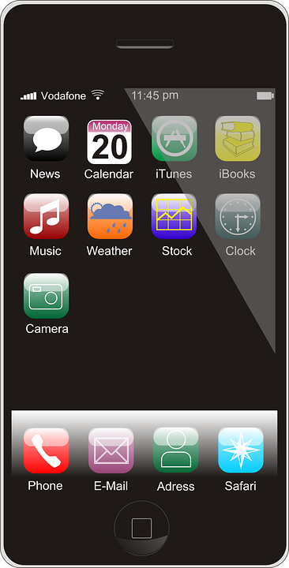
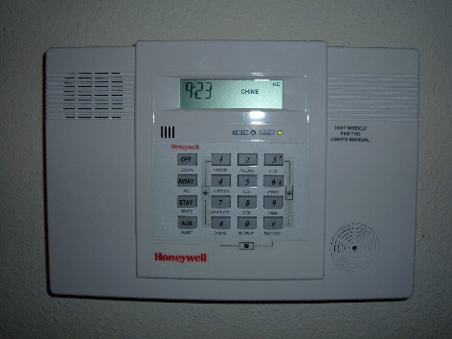
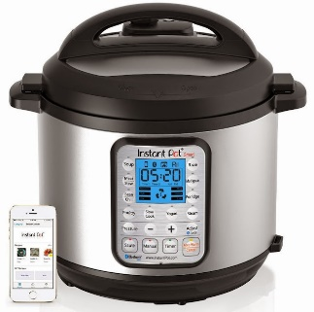
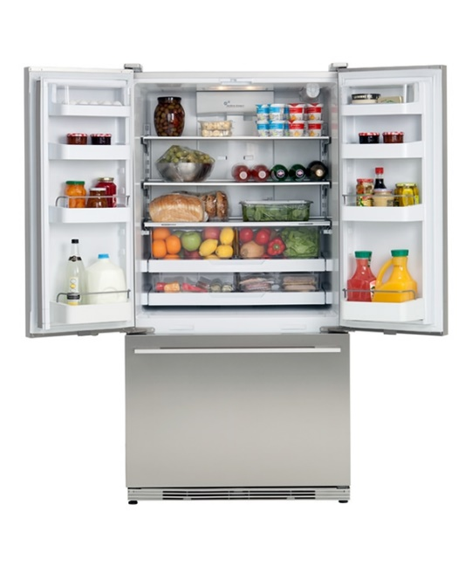
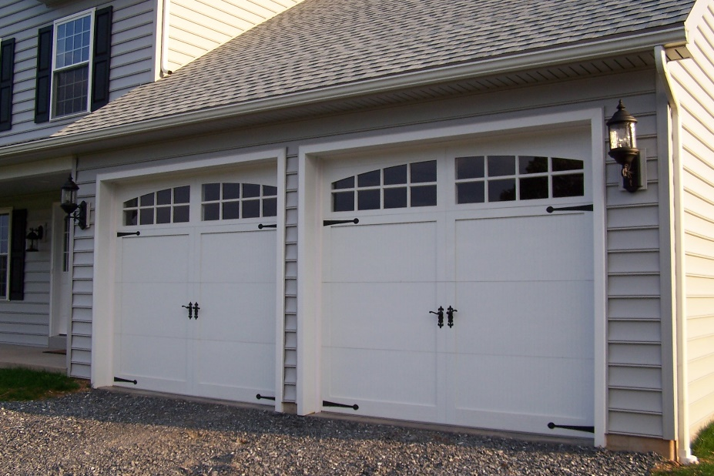
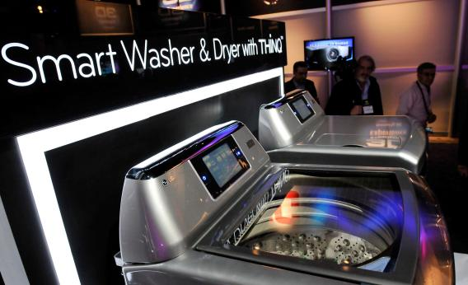
Devices for an AADL Residential IoT Security Model

Slide 26




