Slide 1

CPSC 875
John D. McGregor
Security

Slide 2
Non-architecture of the day
Toyota’s unintended acceleration problem
Many problems but architecturally:
Single points of failure
Inadequate separation
http://www.edn.com/design/automotive/4423428/2/Toyota-s-killer-firmware--Bad-design-and-its-consequences

Slide 3
Toyota-1
Mirroring (where key data is written to redundant variables) was not always done. This gains extra significance in light of …
Stack overflow. Toyota claimed only 41% of the allocated stack space was being used. Barr's investigation showed that 94% was closer to the truth. On top of that, stack-killing, MISRA-C rule-violating recursion was found in the code, and the CPU doesn't incorporate memory protection to guard against stack overflow.
Two key items were not mirrored: The RTOS' critical internal data structures; and—the most important bytes of all, the final result of all this firmware—the TargetThrottleAngle global variable.
Although Toyota had performed a stack analysis, Barr concluded the automaker had completely botched it. Toyota missed some of the calls made via pointer, missed stack usage by library and assembly functions (about 350 in total), and missed RTOS use during task switching. They also failed to perform run-time stack monitoring.

Slide 4
Toyota-2
Toyota's ETCS used a version of OSEK, which is an automotive standard RTOS API. For some reason, though, the CPU vendor-supplied version was not certified compliant.
Unintentional RTOS task shutdown was heavily investigated as a potential source of the UA. As single bits in memory control each task, corruption due to HW or SW faults will suspend needed tasks or start unwanted ones. Vehicle tests confirmed that one particular dead task would result in loss of throttle control, and that the driver might have to fully remove their foot from the brake during an unintended acceleration event before being able to end the unwanted acceleration.
A litany of other faults were found in the code, including buffer overflow, unsafe casting, and race conditions between tasks.

Slide 5
Toyota-3
The Camry ETCS code was found to have 11,000 global variables. Barr described the code as “spaghetti.” Using the Cyclomatic Complexity metric, 67 functions were rated untestable (meaning they scored more than 50). The throttle angle function scored more than 100 (unmaintainable).
Toyota loosely followed the widely adopted MISRA-C coding rules but Barr’s group found 80,000 rule violations. Toyota's own internal standards make use of only 11 MISRA-C rules, and five of those were violated in the actual code. MISRA-C:1998, in effect when the code was originally written, has 93 required and 34 advisory rules. Toyota nailed six of them.
Barr also discovered inadequate and untracked peer code reviews and the absence of any bug-tracking system at Toyota.
NASA, which was involved in an earlier investigation, discussed in its report the five fail-safe modes implemented in the ETCS. They comprise three limp-home modes, RPM limiting, and finally, engine shutdown. All fail-safes are handled by the same task. What if that task dies or malfunctions?

Slide 6
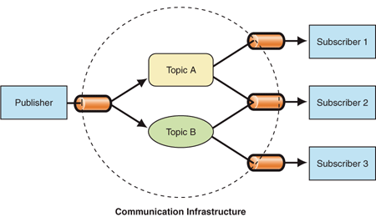
Architecture of the day – Pub/Sub
Loose coupling
Scalability

Slide 7
Pub/Sub fault
one common mistake is a mismatch between the execution frequency of the publisher and subscriber, such as when the publisher sends data faster than the subscriber can handle it. Our validation tool analyzes the application of such a pattern and checks for timing mismatch, ensuring that the subscriber has enough time and resources to receive and handle all incoming data.

Slide 8
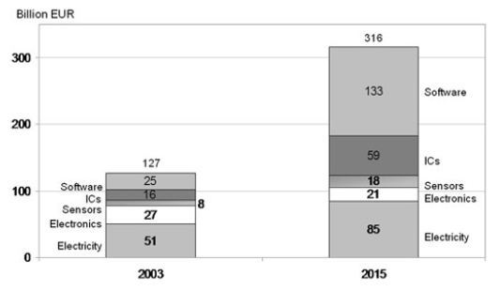
Mark volume for automotive software
http://link.springer.com/article/10.1007/s00450-010-0136-y

Slide 9
Attack surface
What is exposed to external access?
Key fob
OnStar etc.
OBD – adapter adds bluetooth
Wireless networks and features such as bluetooth
Communication via wireless charger

Slide 10
50 – 80% of all security risks are due to design and implementation defects
Most can only be found by analysis rather than code review because no single line of code shows threat

Slide 11
Traceability
First, trace requirements to product components so that changes to requirements can be focused and no unnecessary changes are made by accident
Second, use the traceability features to develop test cases and ensure coverage
Third, use the traceability features to review periodically

Slide 12
Analyses
Use engineering judgment to examine design
Remember that you almost never find what’s not there
Use checklists both generic and project specific

Slide 13
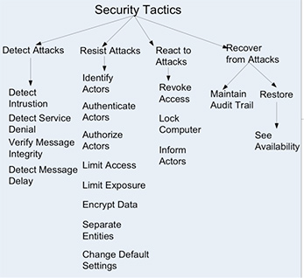
Security Tactics

Slide 14
Microsoft’s STRIDE analysis
spoofing,
tampering,
repudiation,
information disclosure,
denial of service, and
elevation of privilege

Slide 15
Do it yourself
For your domain what are the types of attacks most likely to occur?
Failure Modes and Effects Analysis (FMEA) conducted on the system

Slide 16
Flows
Expected sequences
Nominal flows
Error Flows
Plan for both

Slide 17
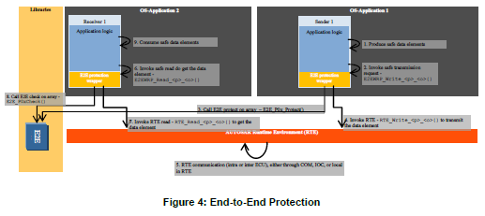
End to End protection

Slide 18
Automotive security
http://www.autosar.org/download/R4.1/AUTOSAR_TR_SafetyConceptStatusReport.pdf

Slide 19
Reflective design
Monitor program flow to determine that only valid sequences are being executed
Does not necessarily use reflection as an implementation
A separate process can be fed sequence information

Slide 20
Error/Fault ontology
What can happen with sensors?
No data
Bias - Incorrect data off by the same amount all the time
Drift – gets further off the true value with time
Frozen – data never changes
Loss of accuracy – error amount varies over/under
No calibration – returns a different value than true but with a changing bias

Slide 21
Fault Ontology
What can happen with actuators?
Lock in place - unchanging
Float – actuator moves but hardware does not
Hardover – when actuated moves to one extreme or the other – totally open/closed
Loss of effectiveness – amount of actuator movement is not reflected in movement of the hardware

Slide 22
Redundancy
Able to switch from one component to another
But first must be able to detect that there is a failure
Then isolate so that only take the action necessary

Slide 23
Detection/Isolation
Create boundaries around components to contain bad behavior
Build in test “circuits”
Command an actuator and then use an independent means to verify that it is in that position
Use intelligent agents
Have intermediate requirements against which actual behavior can be checked
Use separate address spaces or cores

Slide 24
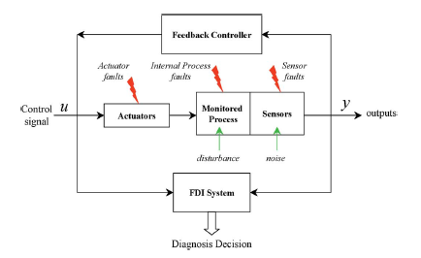
Agent-based architecture

Slide 25
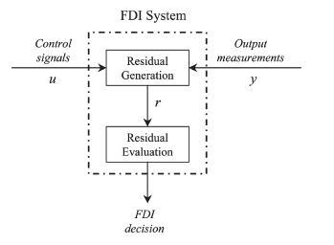
Measuring differences

Slide 26
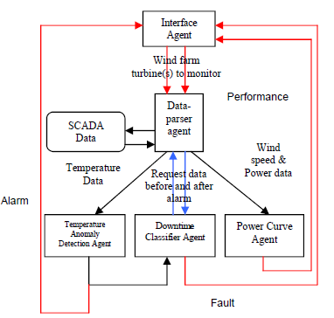
Agent-based architecture

Slide 27
Here’s what you are going to do…
https://wiki.sei.cmu.edu/aadl/index.php/Good_Software_Architecture_Practices_with_AADL
There are three main topics: consumer/producer, use of shared data, and variable scope
For your architecture identify at least one occurrence of each of these three
Describe how you would use the information given at the web site to shape your architecture
Update your AADL model to reflect this information
Due Feb 25 by 6am.

