Slide 1

CpSc 8750
John D. McGregor
Class 1
Overview

Slide 2
Syllabus
Important consideration – this course meets at 8am 2 days a week – can you manage that?
We will use original sources on architecture but you might want “AADL In Practice: Become an expert in software architecture modeling and analysis Kindle Edition by Julien Delange (Author). Get the Kindle reader app and buy the book for 4.99
Note the dates in the syllabus
Questions?

Slide 3
Course Threads
Designing the architecture
  A process
  Techniques
Communicating the architecture
  Notations
  Content
Optimizing business value using
the architecture

Slide 4
You probably didn’t know when you registered that
This is really several courses in one:
  Design
  Business strategy
  Organizational theory
  Economics
  Psychology
  Computer science

Slide 5
Tools
OSATE – an Eclipse-based IDE for AADL
https://osate-build.sei.cmu.edu/download/osate/stable/latest/products/
Have OSATE installed and running by next class
AADL tutorial information
  http://www.openaadl.org/post/2013/07/11/aadl-esweek/ (keep looking there are copies of the slides)
There are numerous resources on github including one we will use in class located at:
https://github.com/osate/alisa-examples - a set of AADL projects

Slide 6
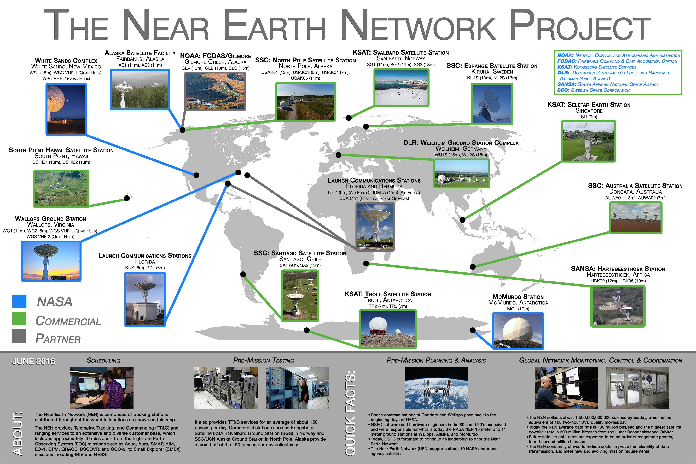
NASA

Slide 7
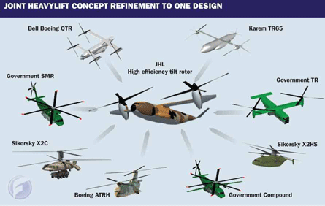
US Army FVL Product Line

Slide 8
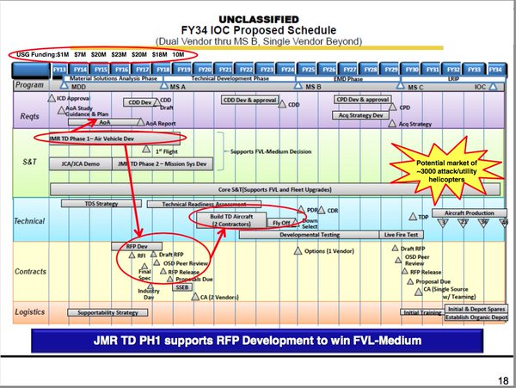
Twenty year plan

Slide 9
Architecture of physical buildings
https://www.wbdg.org/design-disciplines/architecture
The architect as the Master Builder

Slide 10
Definition of software architecture
The software architecture of a program or computing system is the structure or structures of the system, which comprise software elements, the externally visible properties of those elements, and the relationships among them.
Software Architecture in Practice (2nd edition), Bass, Clements, Kazman; Addison-Wesley 2003

Slide 11
Why??
Every system has an architecture
Not every system needs a formally constructed architecture
A formally created/studied architecture is needed when there are certain system characteristics that are critical to correct operation and/or that are hard to achieve.
“Register xx must be read every 40 nanoseconds.”

Slide 12
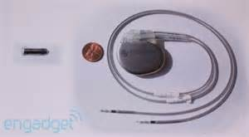
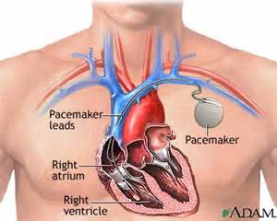
Embedded, real time system
A pacemaker artificially stimulates a heart that is beating incorrectly.

Slide 13
Pacemaker
http://www.cardiacengineering.com/pacemakers-wallace.pdf
http://clusterlabs.org/doc/en-US/Pacemaker/1.0/html/Pacemaker_Explained/s-intro-architecture.html
http://sqrl.mcmaster.ca/_SQRLDocuments/PACEMAKER.pdf
http://wiki.di.uminho.pt/twiki/pub/Education/MFES0910/ProjectoIntegrado/BSC1-Presentation.pdf

Slide 14
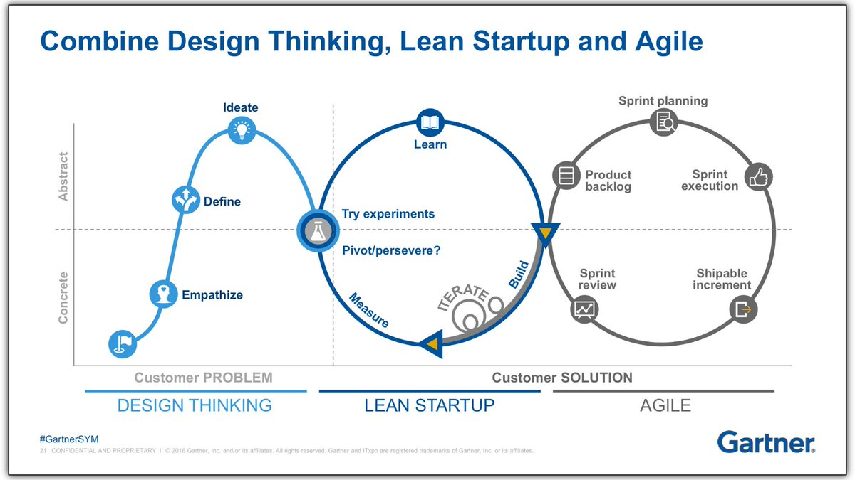
Process Context
https://medium.com/xplor8/design-thinking-lean-startup-and-agile-what-is-the-difference-1eed3594b121?fbclid=IwAR03EQfh7jXZxxqlryMhkVvI_zEXPjunum1EoYSNxIQVG30gOi8hZuKsLo0

Slide 15
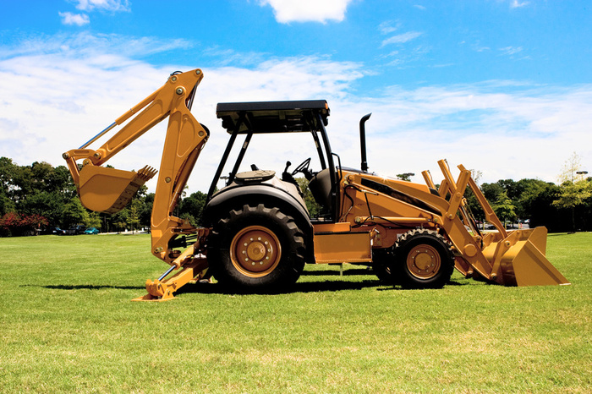
Starting the process
Don’t just start digging the foundation
Few “green field” projects, mostly brown field
Have some domain experience and architectural background

Slide 16
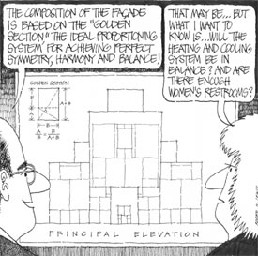
Competing Concerns

Slide 17
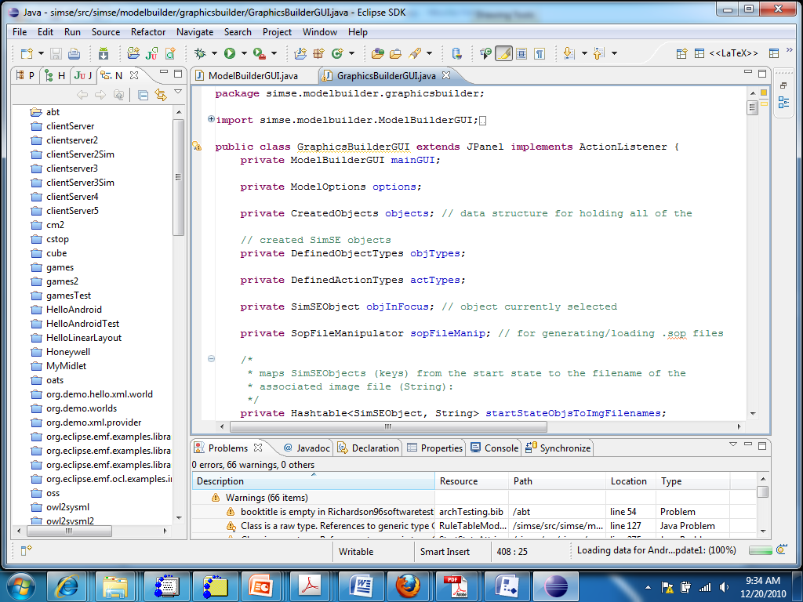
The Eclipse architecture

Slide 18
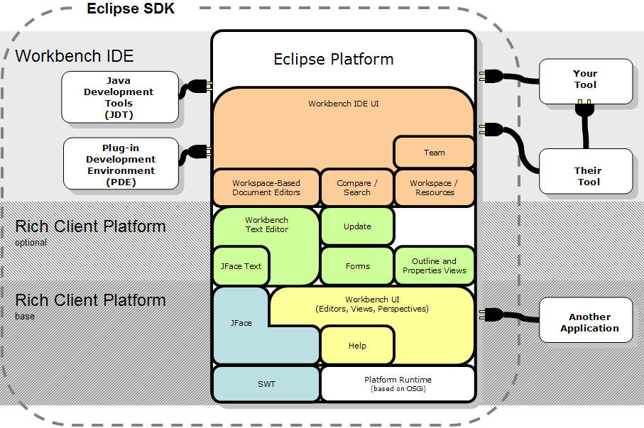
Eclipse architecture cartoon

Slide 19
Pieces
Modules, subsystems, …
These are pieces of a system and entities with which the architect works.
Determining what a particular module does is the job of the architect
How a particular module does its assigned job is a detailed design issue not an architecture issue
Architectural issues cross module boundaries

Slide 20
Orchestration/choreography
The architect creates pieces for certain reasons
And connects certain pieces to achieve specific objectives.
The architect orchestrates the interactions of the pieces of the system but leaves the details to the engineers.

Slide 21
System/software
A system is the complete package needed to solve a problem. It will usually include:
  Hardware – stand-alone computer; an electronic controller embedded in an assembly such as a brake assembly; an integrated multi-function device such as a cell-phone
  Software – an operating system or an end-user application
  May include people such as the users and other stakeholders

Slide 22
Classes of systems
System
System of systems
Cyber-physical system
Complex adaptive systems
Ultra-large scale system

Slide 23
xxxx architecture
Software architecture
System architecture
Reference architecture
Enterprise architecture

Slide 24
Dimensions
Dynamic adaptive
  Pre-configured vs sensing the current environment
Safety
  Controls heart rate in real time
Longevity
  Web site vs embedded control
Human interaction
  Candy crush vs autonomous vehicle

Slide 25
Stakeholders
A stakeholder is any person with an interest in the system.
We will listen harder to some stakeholders than others.
In our techniques often we will explicitly give stakeholders differing numbers of votes based on their priority.
The architect is a diplomat but also a dictator.

Slide 26
Business Goals
The goals of the business must be reflected in the architecture of its software-intensive products.
Business strategy is used to set the business goals and influence the architecture.
Do you want to dominate the market? Become part of a community? Be the center of that community?

Slide 27
Porter’s 5 Forces Strategy Development Technique
Potential Entrants
Suppliers
Competitors
Buyers
Substitutes

Slide 28
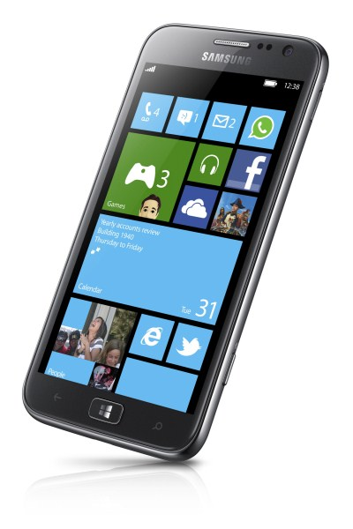
Strategy/architecture
Today many products are designed to work with other products. For example, the patient’s pacemaker might work with certain smart phones.
Our strategy is to
  establish an ecosystem of companies that work together.
  expand our market by accommodating a variety of technologies.
  ride the crest of the wave of change in cyber-physical systems
Our architecture will be a domain-specific architecture that emphasizes
  light weight, small footprint hardware
  flexibility, and
  easily modified software.

Slide 29
Strategy/organization
Architecture team
Product team
System qualities
Strategic direction
System deadlines
Tactical decisions

Slide 30
Platform
This term has many meanings.
Some people see it as
  an operating system, or
  an operating system and processor instruction set, but
  it may be a software platform.
Essentially a “platform” is a dividing line below/ beyond which product builders have no control.
A product may be intended for many platforms but each will have some unique characteristics.

Slide 31
Platform - 2
Microsoft windows/Intel-compatible processor is considered a platform
The software architect for an application, which will execute on the platform, has to understand the characteristics of the platform.
In organizations that manufacture platforms, the software architect may be part of an architecture team that covers both hardware and software.

Slide 32
Ecosystem
A platform is often the basis for an ecosystem.
An ecosystem is a group of systems or companies that enhance or degrade each other.
For example, there may be several accounting packages all within the same ecosystem.
A company may deploy their products in multiple ecosystems with different sets of features, e.g. the Exchange mail server.

Slide 33
Ecosystem - 2
An ecosystem encompasses a wide range of types of companies and every member of the ecosystem is a stakeholder (although with varying levels of influence).
The ecosystem can control directions of the marketplace if it is sufficiently large and influential
http://advice.cio.com/thomas_wailgum/11248/apples_ipad_ecosystem_suppliers_and_developers_hard_at_work

Slide 34
Requirements
This is not a course on requirements but they are a necessary input into the architecting process
We will use a two phase approach that starts with use cases followed by reqspec, a language in ALISA.
A use case is a description of an actual “use” of the system to be developed.
An actor is the source of the stimulus from outside the system.
The use is a set of stimulus/response pairs.
There are relationships between uses: extends, generalizes, includes.

Slide 35
Functional requirements
These are the things that the system must be able to do:
  Example: The pacemaker issues a measured voltage to the leads attached to the heart.
  Typically 80% of project problems are related to the requirements

Slide 36
Non-functional requirements
“How” a function is carried out
  How fast must it be carried out
  How reliably
A quality attribute is a characteristic or property of a piece of software
A non-functional requirement is a constraint on the value of a quality attribute for the system under design
“The addition of a new feature must be done in 5 days or less” – non-functional requirement on the modifiability quality attribute
“The velocity of the vehicle must be reduced to zero within X seconds” – stopability quality attribute
A quality attribute is sometimes termed an “ility”

Slide 37
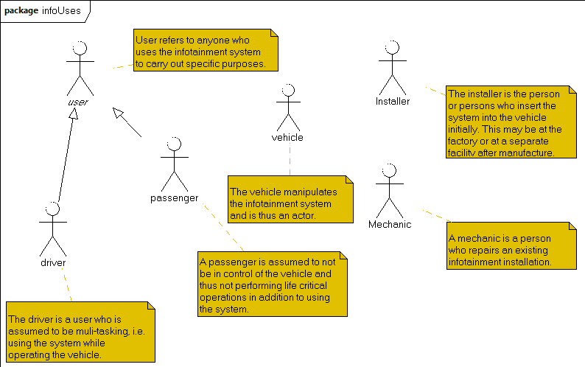
Use case diagram
Actor is a stimulus from outside the system
Actors are a subset of stakeholders

Slide 38
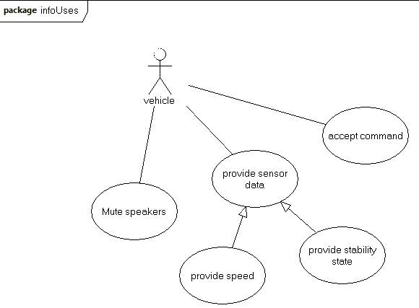
Use case diagram - 2
Use case is a single use of the system triggered by an actor.
Association relates an actor to a use
Extension relates a use to a use by adding on.
Generalization relates a use to a use by resolving abstractions.
Reference: www-edlab.cs.umass.edu/cs520/OMG-Tutorials/Tut2BehaviorModeling.ppt

Slide 39
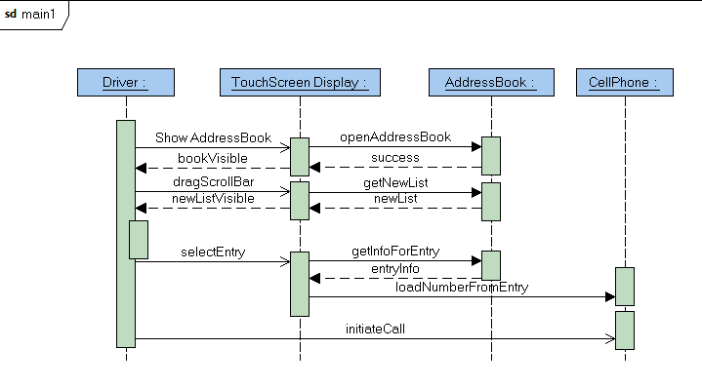
Sequence Diagram
Shows the sequence of interactions.
Each “life line” – the vertical line – is the life of an object – an instance of a class.
Closed arrows are synchronous and open arrows are asynchronous messages.

Slide 40
Specification/Interface
A specification defines the public methods (functions) that a module provides.
An interface defines the interaction of two or more modules through provided and required methods.
An architecture defines modules, their specifications, and interfaces and determines which modules should be associated in the interface.

Slide 41
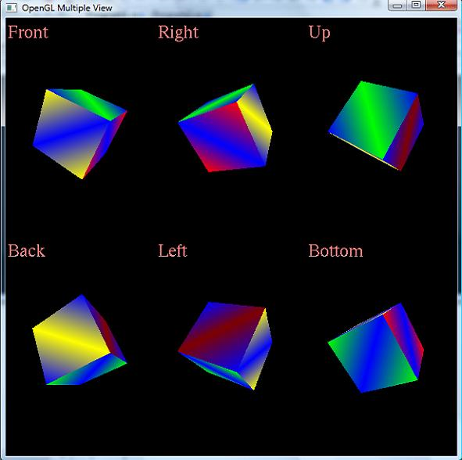
Viewpoints
Different ways of looking at the same thing.

Slide 42
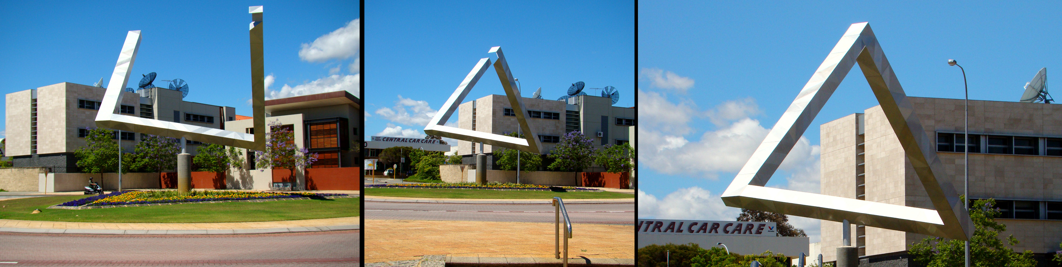
One entity, 3 viewpoints

Slide 43
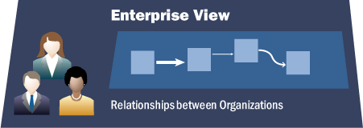
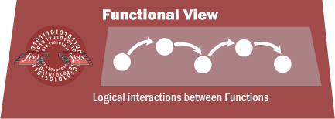
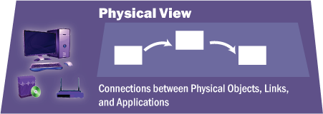
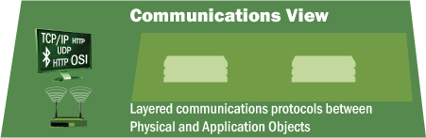
Multiple views
CVRIA views

Slide 44
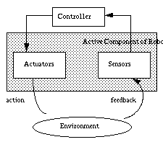
1st architecture - Control/Feedback Loop
This is an abstract description.

Slide 45
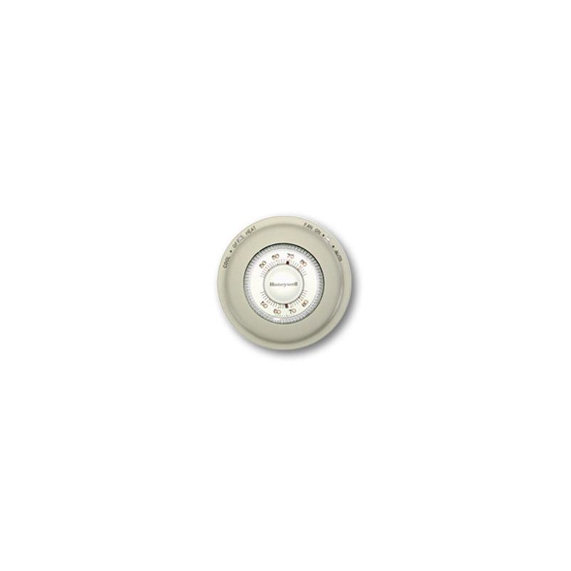
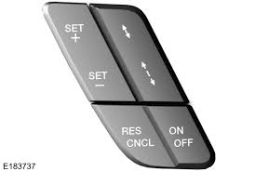
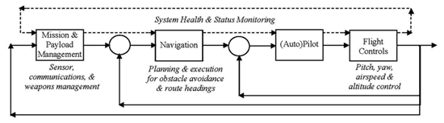
Applying the pattern
This is an application of the abstract description..
thermostat
Cruise control
Autonomous navigation

Slide 46
Reading – original sources
Creating
  http://www.sei.cmu.edu/reports/06tr023.pdf
  http://www.sei.cmu.edu/reports/07tr005.pdf
Communicating
  http://www.sei.cmu.edu/architecture/tools/viewsandbeyond/index.cfm
  http://www.sei.cmu.edu/reports/05tn017.pdf

Slide 47
Action list for next class
Install and test the required software
Read the first reference and scan the rest for the running example
Read the first tech report on the previous slide
Get enough sleep to last the entire semester

