Slide 1

CPSC 875
John D. McGregor
C10 – Error architecture

Slide 2
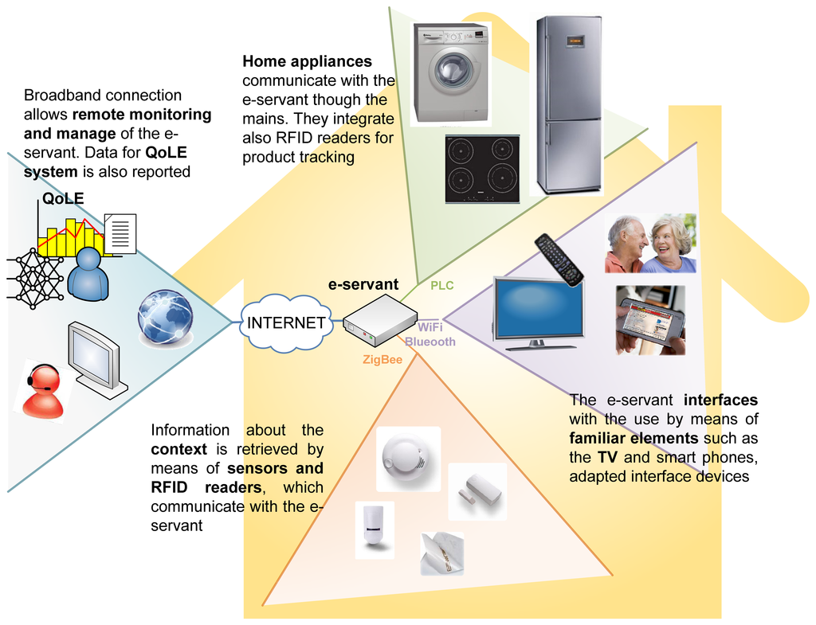
Smart Home architecture

Slide 3
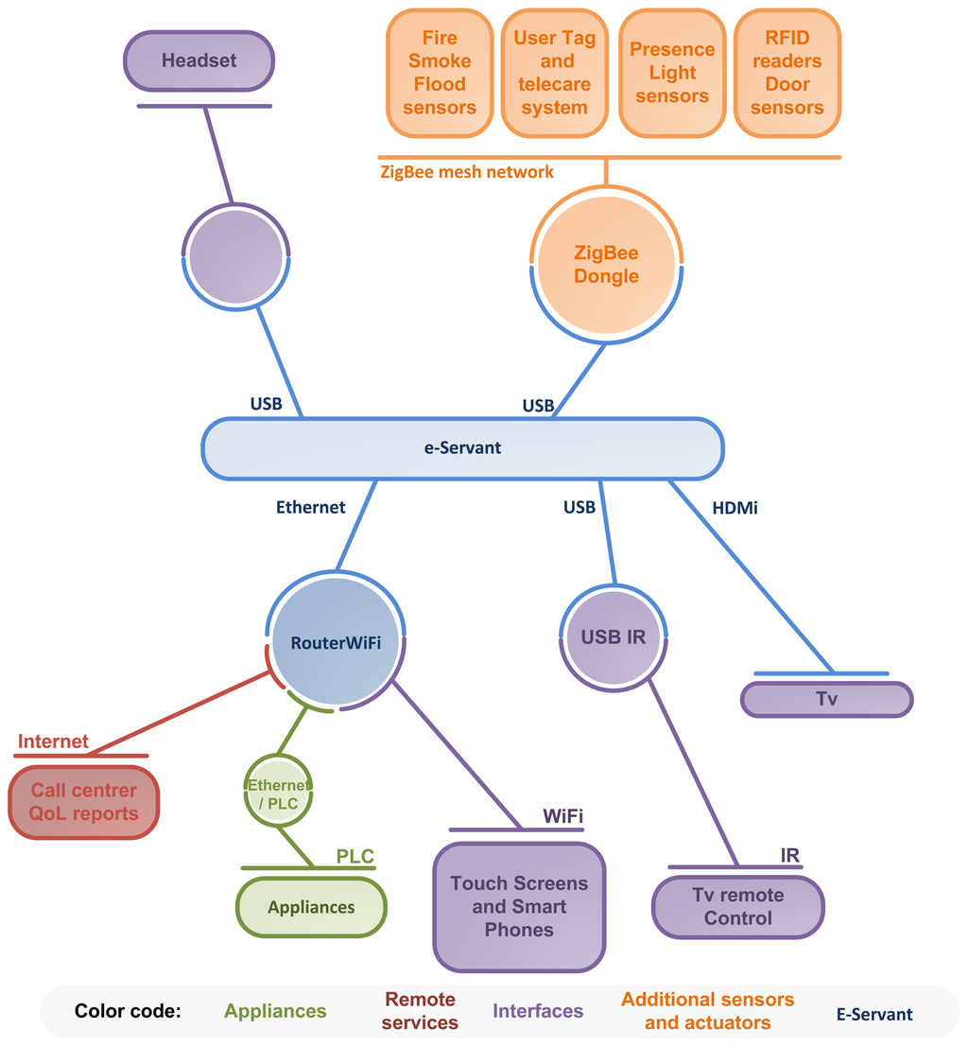
Communication diagram for context interaction in the Smart Kitchen.

Slide 4
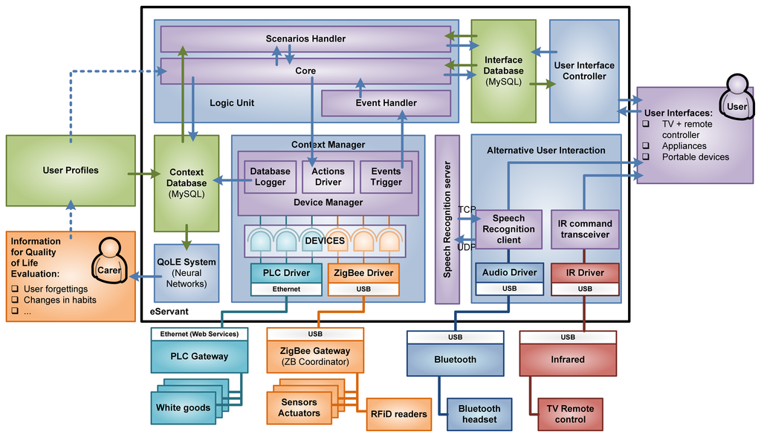
E-servant architecture

Slide 5
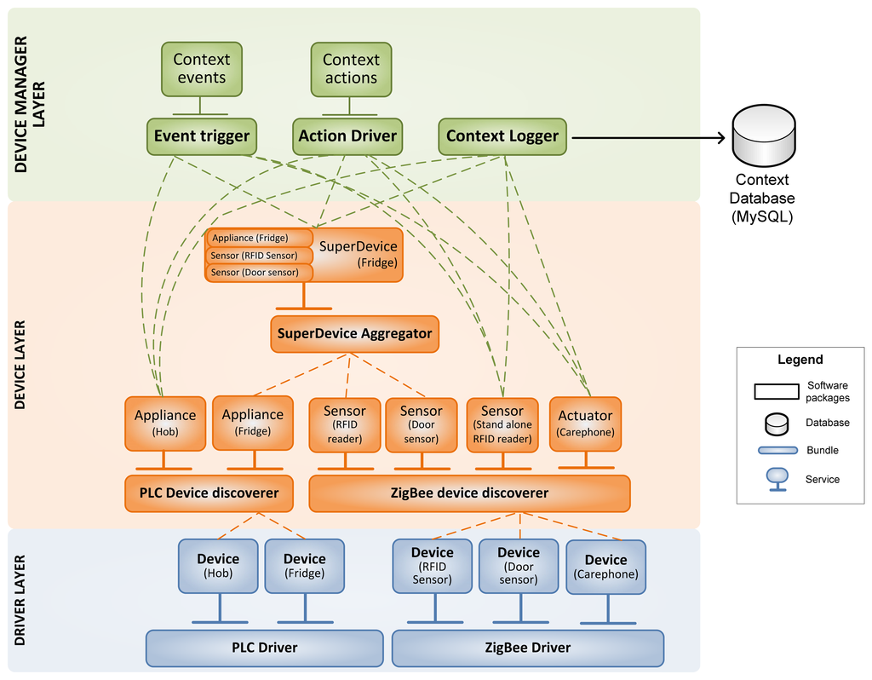
Context manager

Slide 6
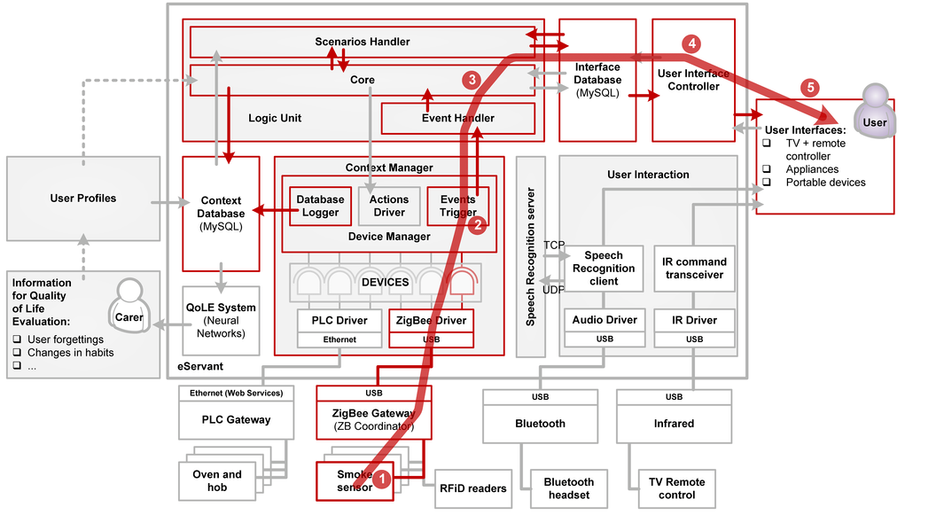
Use case

Slide 7
To illustrate the interaction of the various blocks of the architecture, consider the use case drawn in Figure 7, in the event of smoke detection. The ZigBee smoke sensor (1) warns to the CM (2) that there is smoke in the kitchen. LU (3) is notified and decides to launch a user-scenario to warn to the user. UIC (4) commands the interfaces (5) in order to warn the user about the situation. After a timeout, the interfaces (6) notify to the UIC (7) that the user does not interact with them and the LU (3) decides to turn off the PLC hob and the oven (10) through the CM (9).

Slide 8
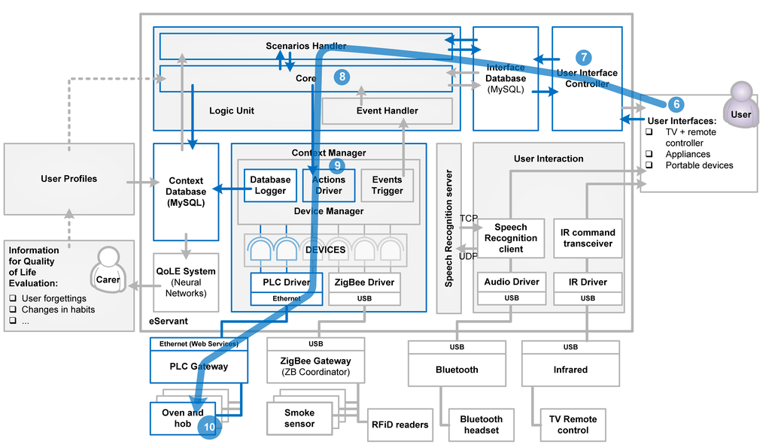

Slide 9
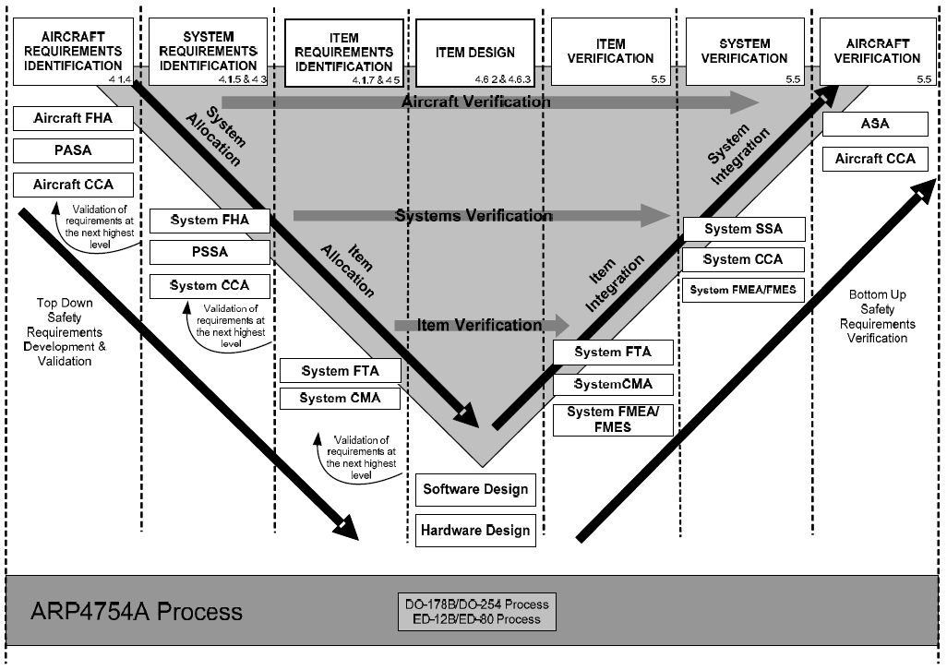
Architecture and process

Slide 10
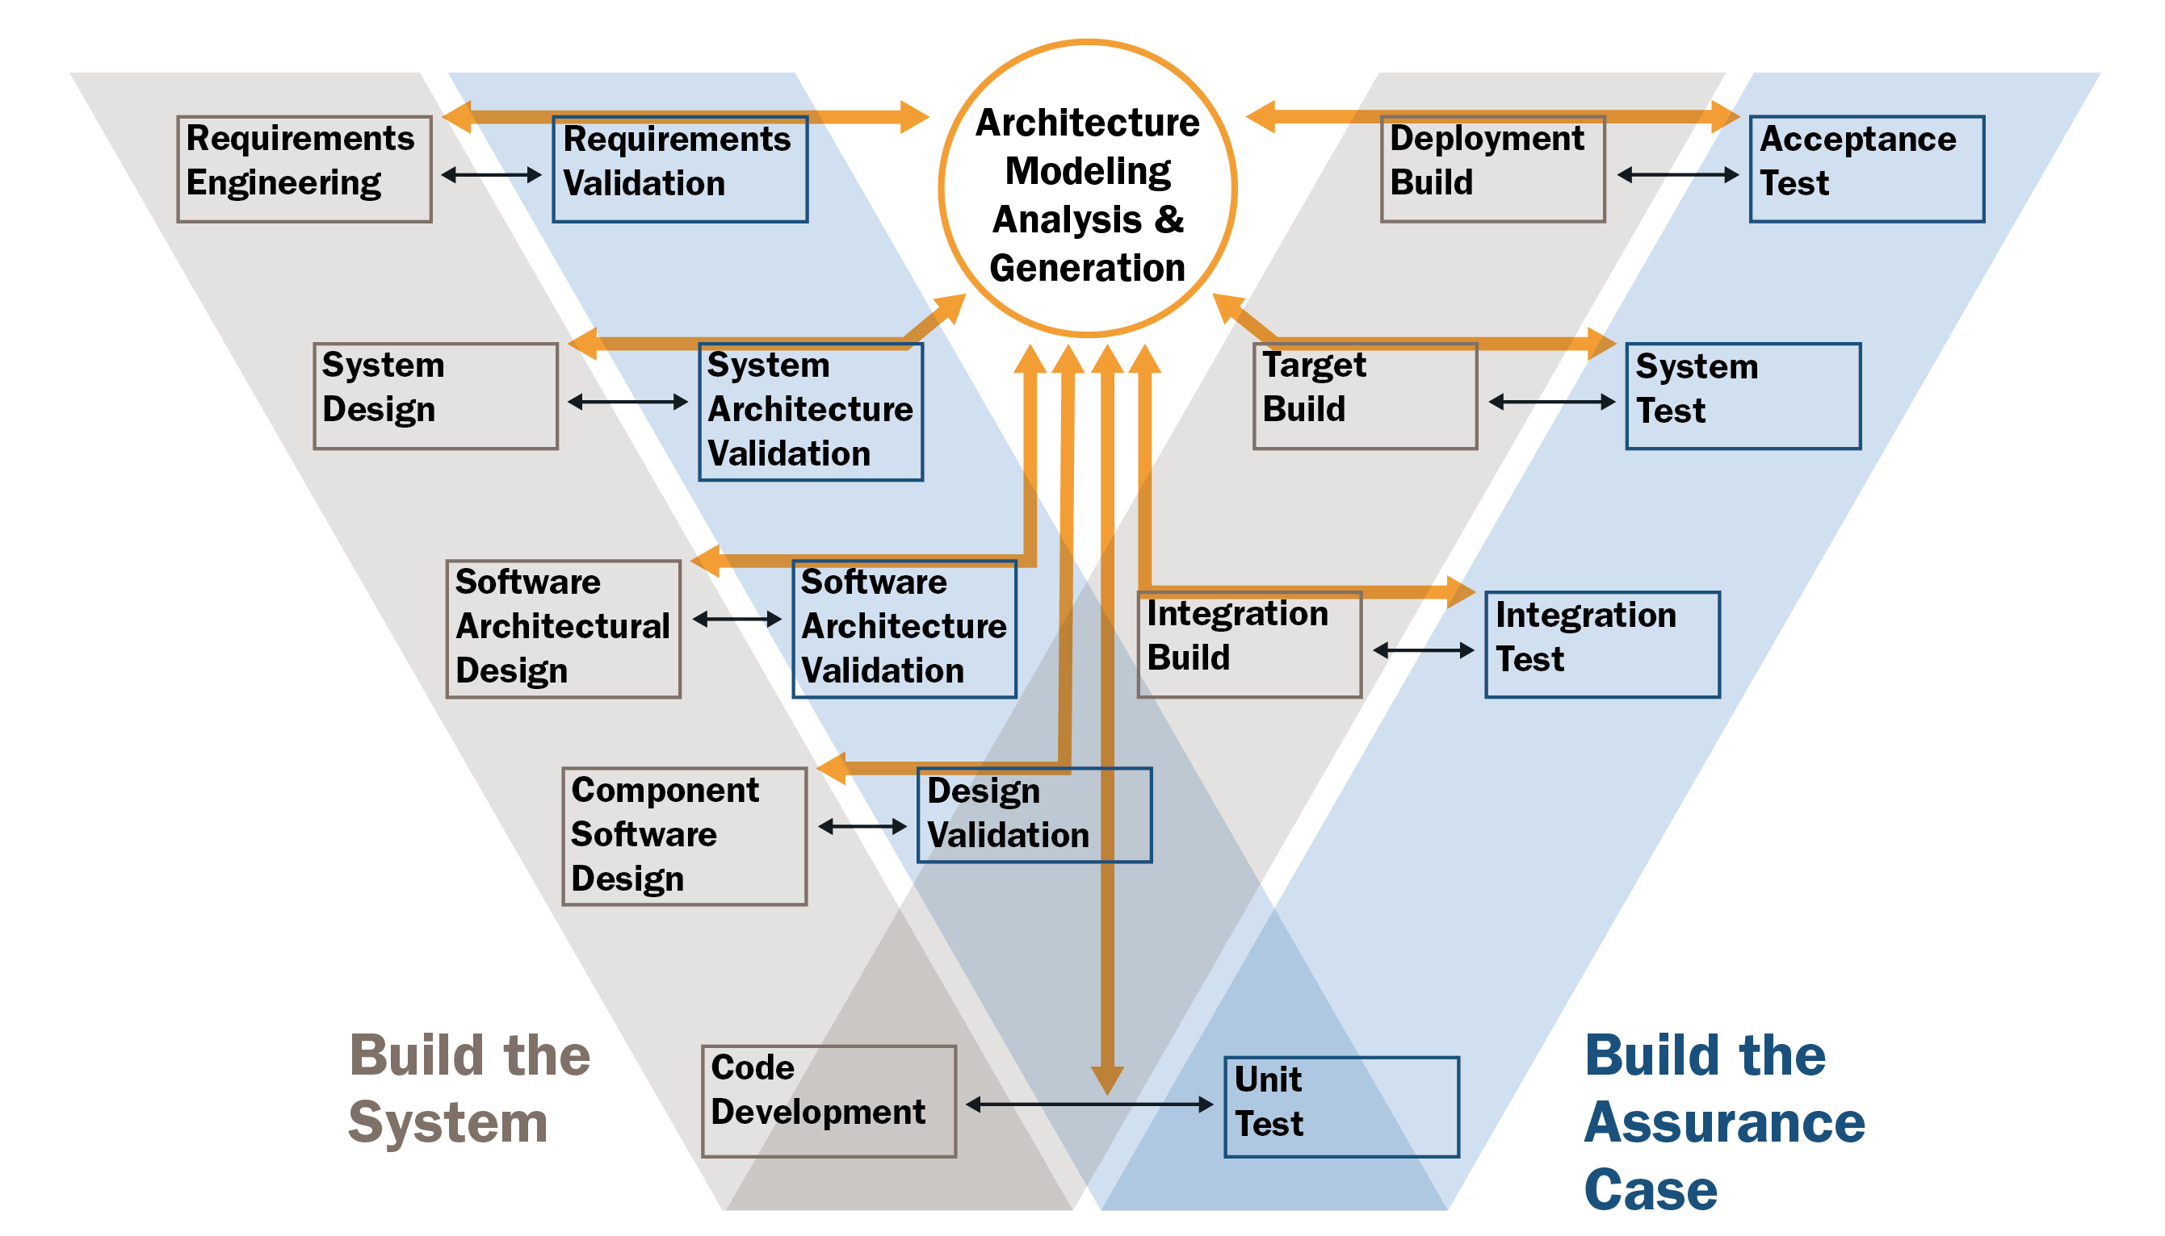
Architecture and process - 2

Slide 11
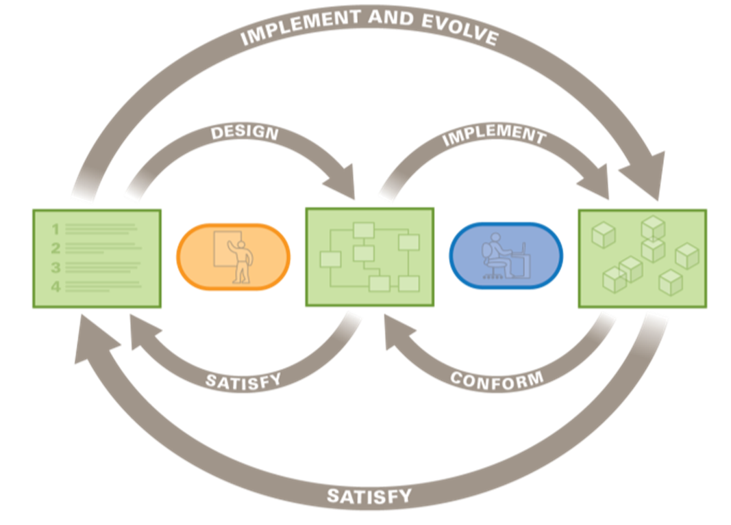
Architecture and process - 3

Slide 12
Iterations within iterations-4
ReqSpec
AADL
Verify

Slide 13
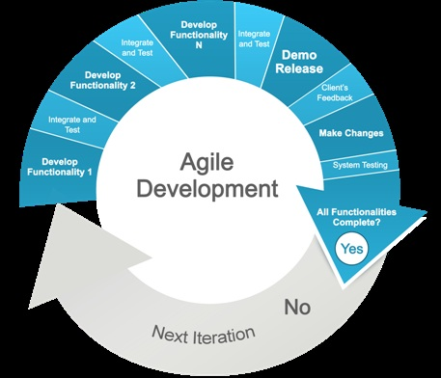
Architecture and process - 5
ADD
TSP (Team software process)
Using an agile process
Qualities determined
up front
Architecture developed
just in time

Slide 14
What can go wrong?
Error vs uncertainty
Uncertainty in every measurement
Object being measured expands/contracts with temperature
Represent 1/3 as a decimal
Eyeball a measurement using a ruler
Use the error ontology to give ideas of what can go wrong
Pacemaker – shocks too early, too late, …

Slide 15
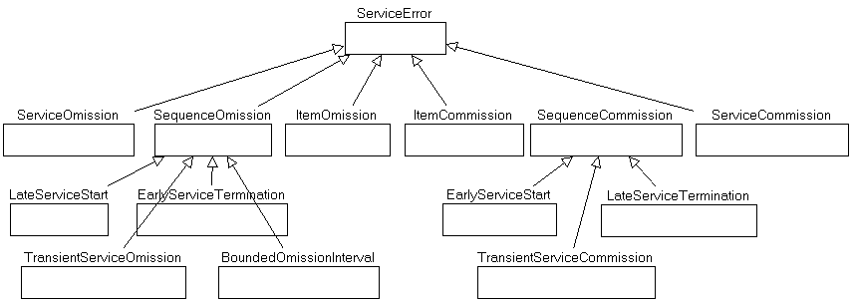
Error ontology-1

Slide 16
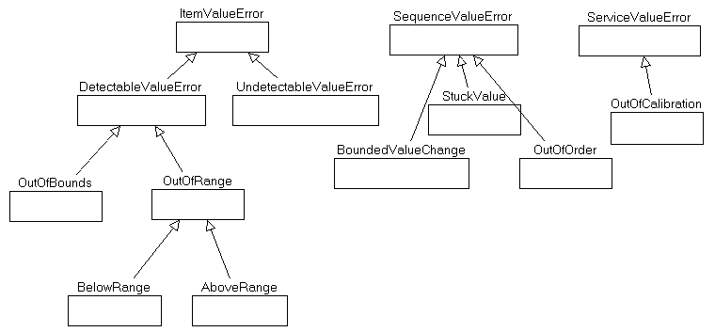
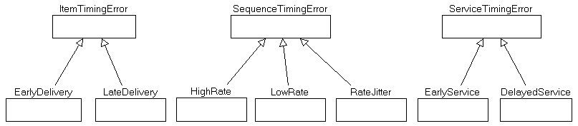
Error ontology-2

Slide 17
Mitigation
For hardware, redundancy is the primary mitigation for faults
Want more reliability add copies
For software, functional redundancy is workable but the implementations must be developed independently and this sharply increases cost
Develop specific traces of error logic
Usually the project has constraints on MTTR…

Slide 18
I/O Errors
Each input field is appropriately constrained
Numeric data directly from a user may need to be alpha and then converted
Accept/reject input as close to the actual input field as possible
Use standard libraries that check availability and readiness of devices to avoid livelock

Slide 19
Error Logging
Every component should log errors before they are handled or propagated
Reflection can be used to provide access to each component
Log sufficient information to locate and fix the defect

Slide 20
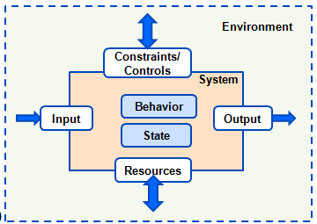
Error propagation
Execution of a fault results in an error
The error value may be returned as a result
OR it might be passed as a parameter to a subcomponent
OR it might be handled

Slide 21
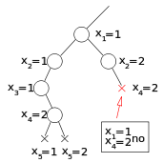

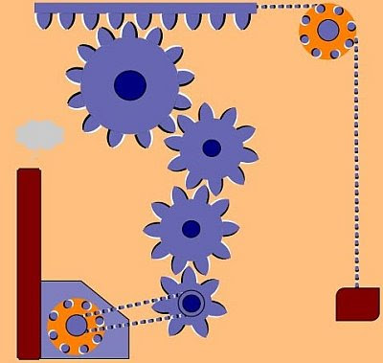
Context
http://www.docsity.com/en/oscillating-output-components-and-techniques-for-digital-systems-solved-quiz/286006/

Slide 22
Something goes wrong. What is the architecture for that part of the logic?
Nominal
Error

Slide 23
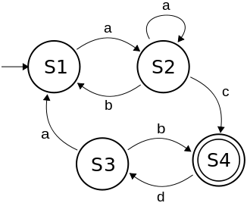
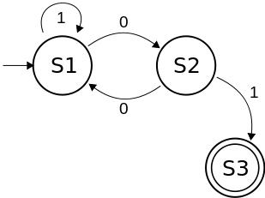
Maybe go to a reduced feature set.
Nominal
Error

Slide 24
Exception handling
Backs up the call chain
Looks for an error handler

Slide 25
Things to do:
Reduced feature set – don’t allow operations that could corrupt vital features
Replace bad value with estimate
Provide an escape route if they cannot make a valid selection.
Clean up before progressing or backtracking
Recurse only if you have a solid base case
http://architectingusability.com/2012/06/05/designing-error-handling-for-maximum
-usability-in-your-application/

Slide 26
Nominal behavior
annex behavior_annex {**
states
off:initial state;
on:state;
on_not_engaged: state;
on_engaged: state;
on_engaged_steady: state;
on_engaged_slowing: state;
on_engaged_accelerating: state;
transitions
off->[]->on;
on-[]->off;
on-[]->on_not_engaged;
on_not_engaged-[]->on_engaged;
on_engaged-[]->on_not_engaged;
on_not_engaged-[]->on;
on_engaged-[]->on_engaged_steady;
on_engaged_steady-[]->on_engaged_slowing;
on_engaged_steady-[]->on_engaged_accelerating;
on_engaged_accelerating-[]->on_engaged_steady;
on_engaged_slowing-[]->on_engaged_steady;
**};

Slide 27
Component Error behavior
annex EMV2 {**
use types error_library;
use behavior error_library::stateMachine;
error propagations
logger_out: out propagation {BadValue, LateValue};
sensor_data_in : in propagation {NoValue, BadValue};
sensor_data_out : out propagation {NoValue, BadValue,LateValue};
flows
ef0 : error source logger_out{BadValue, LateValue};
ef1 : error source sensor_data_out{LateValue};
ef2 : error path sensor_data_in{NoValue, BadValue}->sensor_data_out{LateValue};
end propagations;
component error behavior
events
BadRead : error event;
RecoverEvent: recover event;
transitions
t0 : Operational -[sensor_data_in{NoValue, BadValue}]-> Failed;
t1 : Operational -[BadRead]-> Failed;
t2 : Failed -[RecoverEvent]-> Operational;
end component;
**};

Slide 28
Composite error
annex EMV2 {**
use types error_library;
use behavior error_library::stateMachine;
composite error behavior
states
[radar_handler.Failed and camera_handler.Failed and gps_handler.Failed and speedometer_handler.Failed]-> Failed;
[radar_handler.Failed and camera_handler.Failed]-> Failed;
[radar_handler.Failed or camera_handler.Failed]-> Operational;
[radar_handler.Operational and camera_handler.Operational and gps_handler.Operational and speedometer_handler.Operational]-> Operational;
end composite;
**};

Slide 29
Refinement hierarchy

Slide 30
Refinement hierarchy - inputs and outputs may be changed through refinement so constraints have to be propagated

Slide 31
Active mode

Slide 32
Degraded mode

Slide 33
As errors propagate up the call chain the message should change to be meaningful to the new audience
2
1
3

Slide 34
As an error is propagated a return value be certain the value is within the input constraints

Slide 35
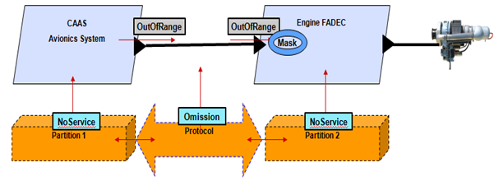

Slide 36
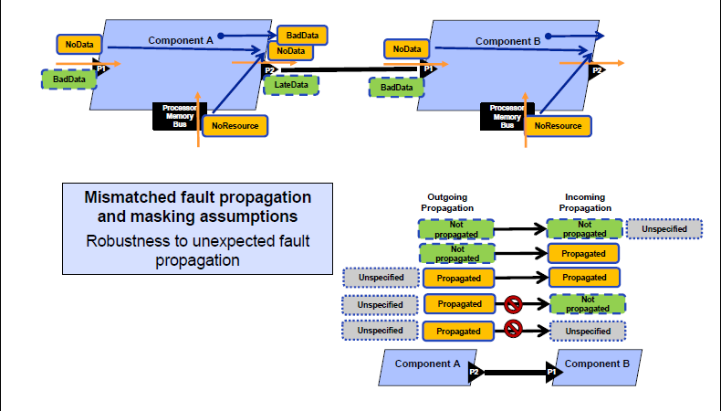

Slide 37
