Slide 1

CPSC 875
John D. McGregor
C10 – Design decisions

Slide 2
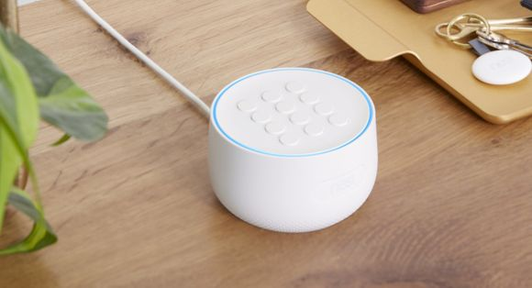
The latest “news”
"I suppose it depends upon your outlook on if you are happy or creeped out that your security system secretly had an undocumented microphone capable of doing the listening all along," https://www.usatoday.com/story/tech/talkingtech/2019/02/20/google-nest-secure-microphone/2925026002/

Slide 3
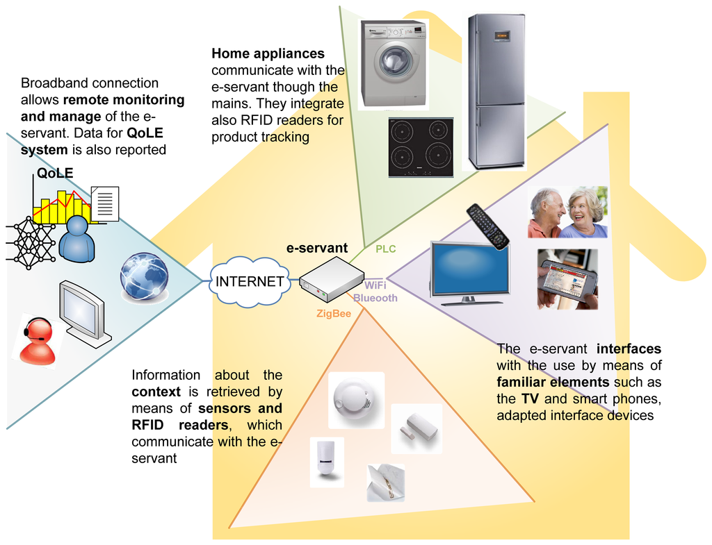
Smart Home architecture

Slide 4
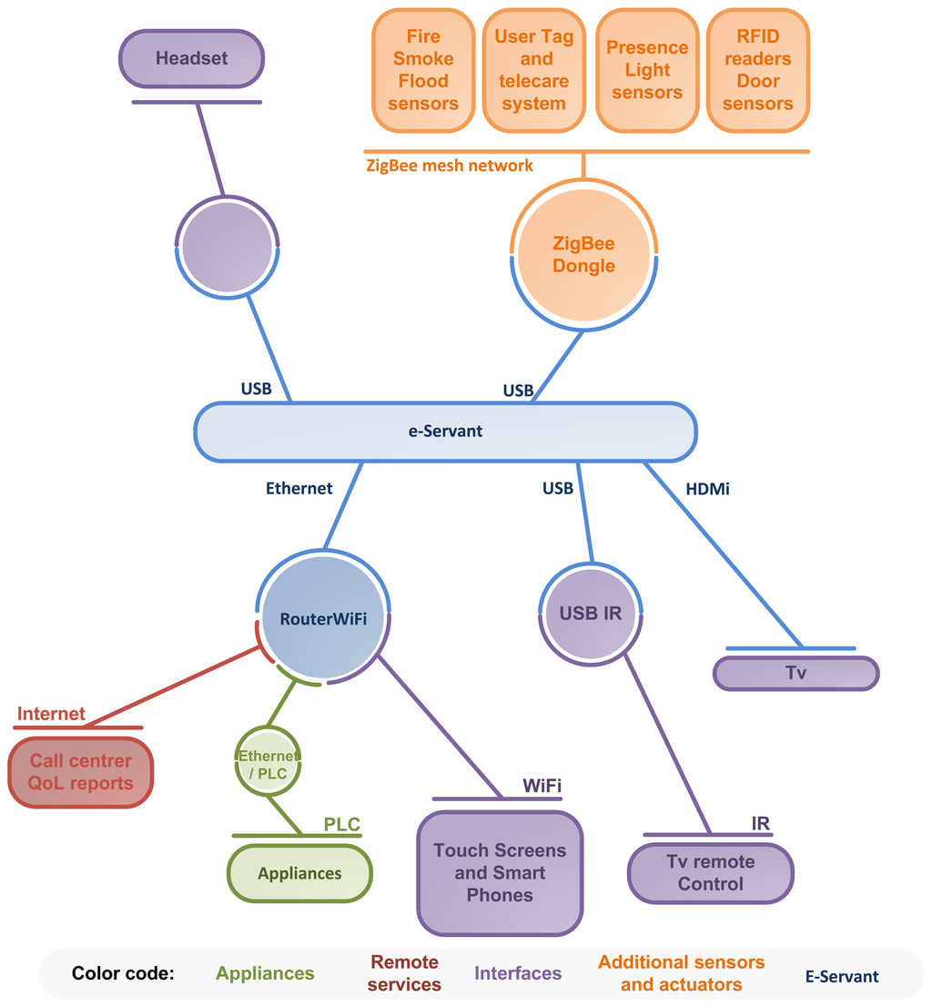
Communication diagram for context interaction in the Smart Kitchen.

Slide 5
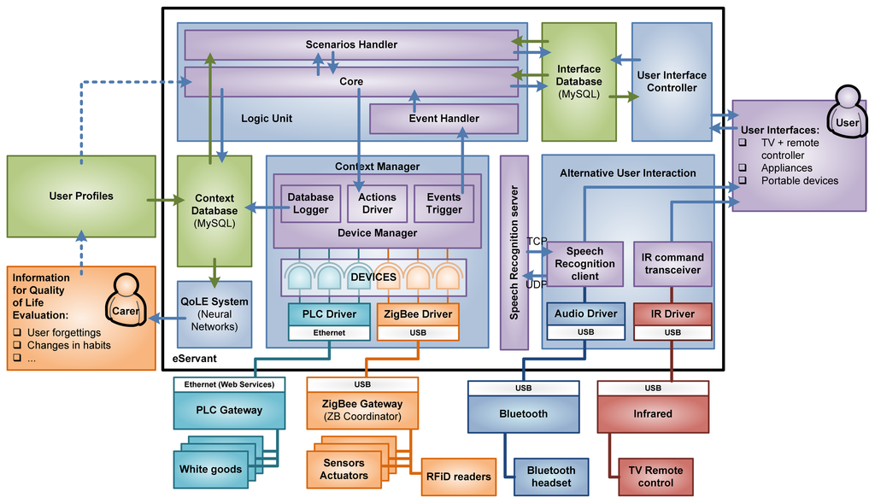
E-servant architecture

Slide 6
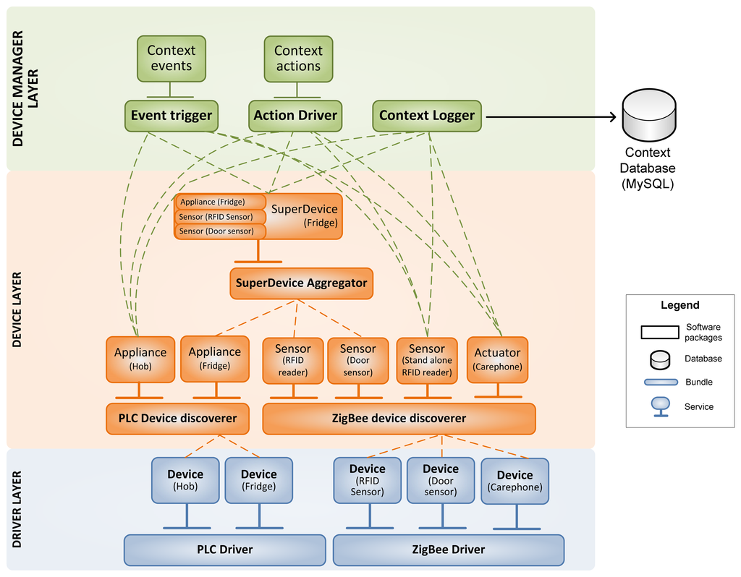
Context manager

Slide 7
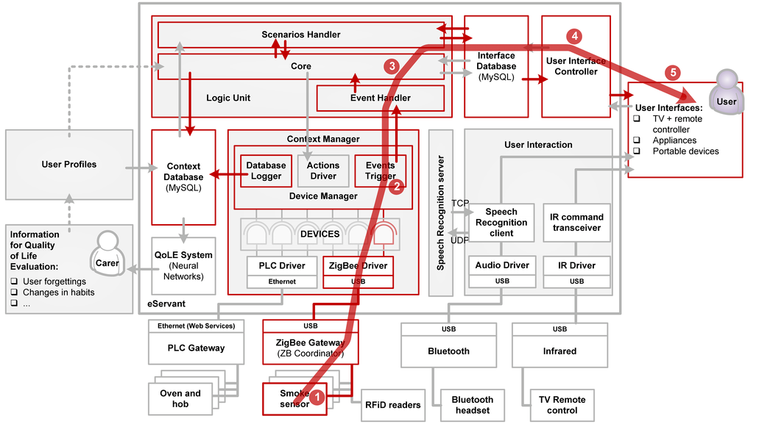
Use case

Slide 8
To illustrate the interaction of the various blocks of the architecture, consider the use case drawn in Figure 7, in the event of smoke detection. The ZigBee smoke sensor (1) warns to the CM (2) that there is smoke in the kitchen. LU (3) is notified and decides to launch a user-scenario to warn to the user. UIC (4) commands the interfaces (5) in order to warn the user about the situation. After a timeout, the interfaces (6) notify to the UIC (7) that the user does not interact with them and the LU (3) decides to turn off the PLC hob and the oven (10) through the CM (9).

Slide 9
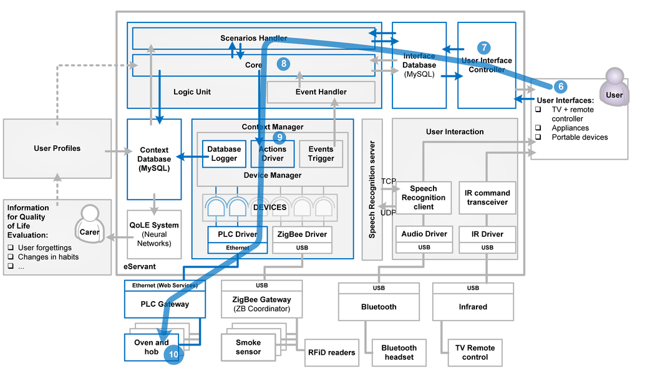

Slide 10
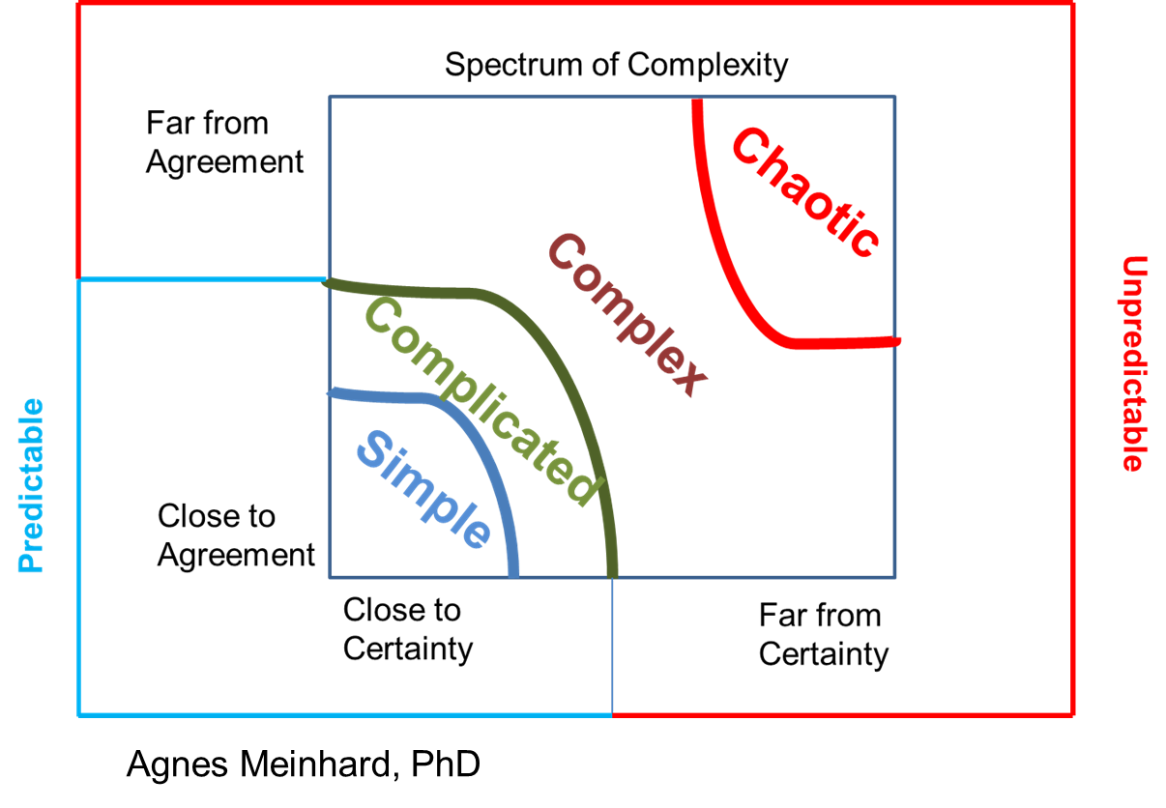
Complex vs Complicated

Slide 11
Design decisions
Which tactic should be applied?
Utility tree
Design Structure Matrix (DSM)
The goal is to maximize the value of each desired quality
This is confounded by trade-offs

Slide 12
Trade-offs
Some times increasing the value of one attribute decreases the value of another
Decomposing a module improves modularity but almost always increases latency

Slide 13
Decomposition
Each port has overhead. Stack frames are created, parameters are loaded into frame, and frames destructed when finished.
Decomposition increases the number of ports.
This increase depends on chosen technologies

Slide 14
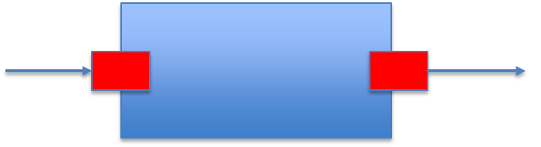
Substitution
The new module may be more complex
Have a different latency or reliability
“Compatible” means more than compatible data types

Slide 15
Rationale
A justification for an architecture design decision
Quantitative/qualitative
Quantitative – definitive, measured
Qualitative – expert opinion, back of envelope estimates
Units – based on the domain
Languages like reqspec directly support this

Slide 16
Assigned readings
Read:
http://hbswk.hbs.edu/item/5699.html At the bottom of the page there is a place to download “Full Working Paper Text”
http://www.sei.cmu.edu/reports/07tn043.pdf

Slide 17
Structuring AADL models into packages and projects
Separate major architecture elements into separate AADL packages and each package into a separate file.
A package lists all the other packages referenced.
Separate major model divisions into separate OSATE projects. The AADL compiler will look into every open AADL project to find definitions.

Slide 18
QAW
Today in class each team will make presentations to another team
Include in your report the names of those participating in the session
Include the presentations about business and architecture as described in the SEI tech report
Include the QA scenarios
Include the utility tree

Slide 19
What do you have so far …
A reference architecture for some portion of your system
A set of requirements tied to portions of the reference architecture
QAW business and technical presentations, scenarios, and utility tree
…

Slide 20
Here’s what you are going to do
Develop a first cut application architecture by refining the reference architecture
Retain the reference architecture model but start the application architecture in a separate file that “uses” the reference architecture file
Include property definitions for the top priority quality attribute. If necessary revise your reqspec to support the properties.
Version your files.

