Slide 1

CpSc 875
John D. McGregor
C11 – Modules and Flows

Slide 2
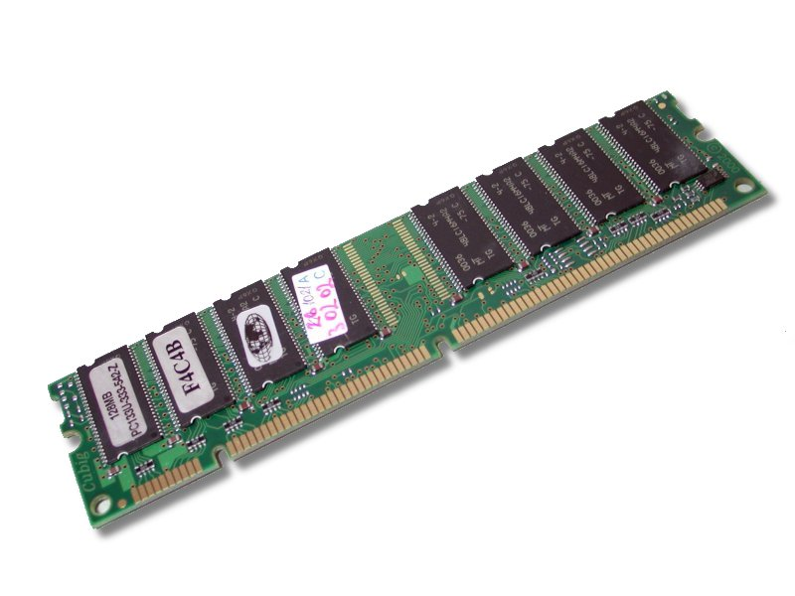
Subprograms in AADL
A subprogram is a set of instructions
When compiled the subprogram is referenced by the entry point
When the subprogram is called it is instantiated by appropriate registers
and the entry point in program memory.
The logic of the subprogram is modeled by the Behavior Annex
process
thread
subprogram
ip
registers
memory
instructions

Slide 3
Analyses
Create an instance of the system
Click on the instance in the AADL Navigator
Right click on Analyses and then on the analysis you wish to run
Select that analysis and check the reports folder under the Instances folder

Slide 4
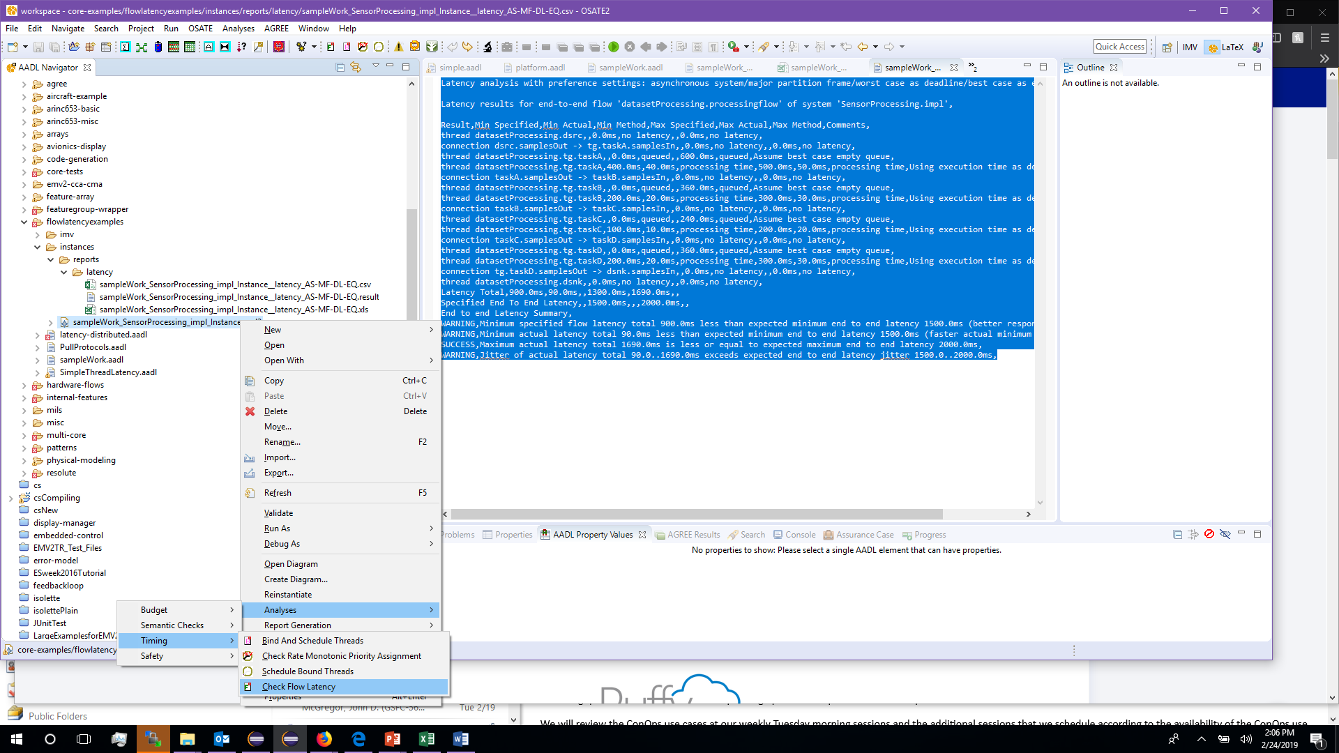

Slide 5
Structures
We characterized an architecture as a graph
Modules are the nodes in the graph
A module encapsulates a concept
Each module has responsibilities related to the concept
Therefore, one criteria for defining modules is identifying the boundaries of concepts

Slide 6
Flows
A flow is a path through a module from one input port to an output port or a sink
Our job is to identify all of the flows that are necessary to satisfy all of the requirements for that module
At the module level we don’t care about the internal structure only from input to output
It is an estimate

Slide 7
Flows-2
Each segment of a flow takes a finite amount of time
Experience helps in estimation of latency
Each source, sink, and flow path has a latency value
As a module is decomposed we make estimates of the latency of each part adding up to the original estimate for the total

Slide 8
Connections
Work gets done by data flowing from module to module through the graph
A connection is a flow from an output port of one module to an input port of another module
Latency on a connection is due largely to
Technologies used
Amount of data to be transferred

Slide 9
Connections - 2
Security, as a property, is viewed as whether info from one module should be seen in the connected module
In AADL Security has a value of

Slide 10
OSATE Latency Analysis – 1
Latency analysis with preference settings: asynchronous system/major partition frame/worst case as deadline/best case as empty queue
Latency results for end-to-end flow 'datasetProcessing.processingflow' of system 'SensorProcessing.impl',
Result,Min Specified,Min Actual,Min Method,Max Specified,Max Actual,Max Method,Comments,
thread datasetProcessing.dsrc,,0.0ms,no latency,,0.0ms,no latency,
connection dsrc.samplesOut -> tg.taskA.samplesIn,,0.0ms,no latency,,0.0ms,no latency,
thread datasetProcessing.tg.taskA,,0.0ms,queued,,600.0ms,queued,Assume best case empty queue,
thread datasetProcessing.tg.taskA,400.0ms,40.0ms,processing time,500.0ms,50.0ms,processing time,Using execution time as deadline was not set,
connection taskA.samplesOut -> taskB.samplesIn,,0.0ms,no latency,,0.0ms,no latency,
thread datasetProcessing.tg.taskB,,0.0ms,queued,,360.0ms,queued,Assume best case empty queue,
thread datasetProcessing.tg.taskB,200.0ms,20.0ms,processing time,300.0ms,30.0ms,processing time,Using execution time as deadline was not set,
connection taskB.samplesOut -> taskC.samplesIn,,0.0ms,no latency,,0.0ms,no latency,
thread datasetProcessing.tg.taskC,,0.0ms,queued,,240.0ms,queued,Assume best case empty queue,

Slide 11
OSATE Latency - 2
thread datasetProcessing.tg.taskC,100.0ms,10.0ms,processing time,200.0ms,20.0ms,processing time,Using execution time as deadline was not set,
connection taskC.samplesOut -> taskD.samplesIn,,0.0ms,no latency,,0.0ms,no latency,
thread datasetProcessing.tg.taskD,,0.0ms,queued,,360.0ms,queued,Assume best case empty queue,
thread datasetProcessing.tg.taskD,200.0ms,20.0ms,processing time,300.0ms,30.0ms,processing time,Using execution time as deadline was not set,
connection tg.taskD.samplesOut -> dsnk.samplesIn,,0.0ms,no latency,,0.0ms,no latency,
thread datasetProcessing.dsnk,,0.0ms,no latency,,0.0ms,no latency,
Latency Total,900.0ms,90.0ms,,1300.0ms,1690.0ms,,
Specified End To End Latency,,1500.0ms,,,2000.0ms,,
End to end Latency Summary,
WARNING,Minimum specified flow latency total 900.0ms less than expected minimum end to end latency 1500.0ms (better response time),
WARNING,Minimum actual latency total 90.0ms less than expected minimum end to end latency 1500.0ms (faster actual minimum response time),
SUCCESS,Maximum actual latency total 1690.0ms is less or equal to expected maximum end to end latency 2000.0ms,
WARNING,Jitter of actual latency total 90.0..1690.0ms exceeds expected end to end latency jitter 1500.0..2000.0ms,

Slide 12
Behavior annex
Subprogram start_read
features
debug: in parameter Behavior::boolean;
End start_read;
Subprogram implementation start_read.i
calls
{
p1: subprogram std::print;
};
annex behavior_specification
{**
states s0 : initial state;
s1 : return state;
transitions
s0 -[ on debug ]-> s1 { std::print!; };
s0 -[ on not debug ]-> s1 {};
**};
End start_read;

Slide 13
thread
thread ctrl
features
r_s_d_acc: requires subprogram access scale_data.sensor;
v_acc: requires subprogram access verify.basic;
end ctrl;
thread implementation ctrl.basic
calls
basic_calls:{
verify_locals: subprogram v_acc;
scale_remote: subprogram r_s_d_acc;
}
end ctrl.basic;
process ctrl_process
features
r_s_d_acc: requires subprogram access scale_data.sensor;
end ctrl_process

Slide 14
Remote calls to subprograms
“Actual_subprogram_call” is used to provide one call with remote access to
the actual subprogram in the other process
system
process
process
thread
thread
registers
registers
memory
instructions
memory
instructions

Slide 15
Stock trading system
http://www.turingfinance.com/algorithmic-trading-system-architecture-post/#prettyPhoto[slides]/7/

Slide 16
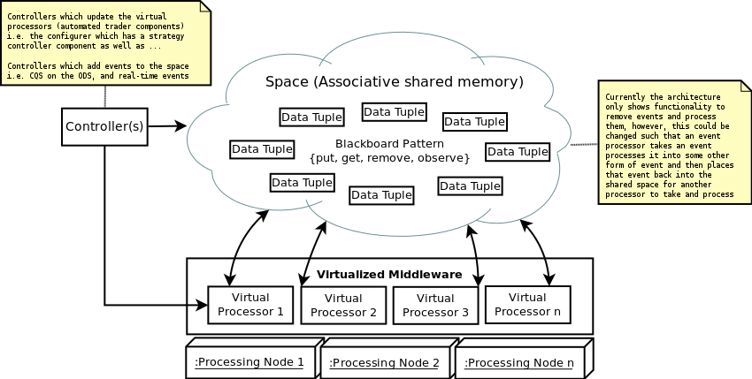
Play Previous
1/13
Next
Close

Slide 17
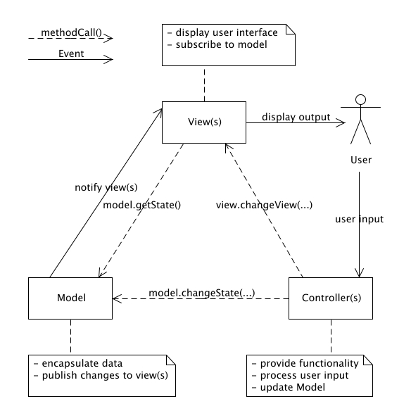
Play Previous
2/13
Next
Close

Slide 18
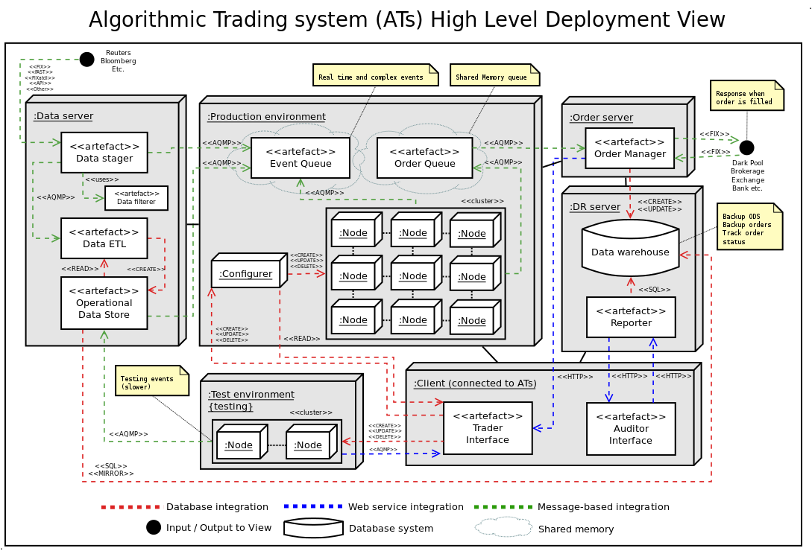
Play Previous
3/13
Next
Close

Slide 19
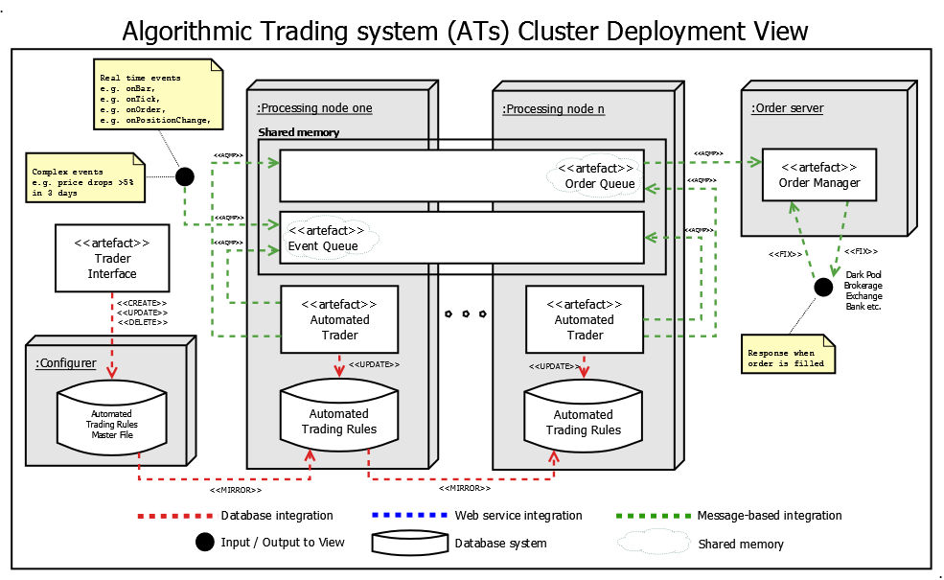
Play Previous
4/13
Next
Close

Slide 20
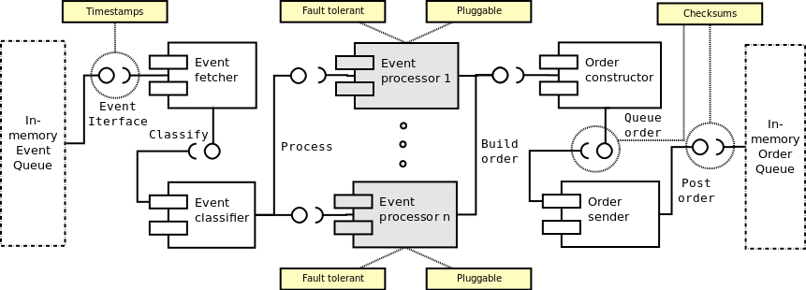

Slide 21
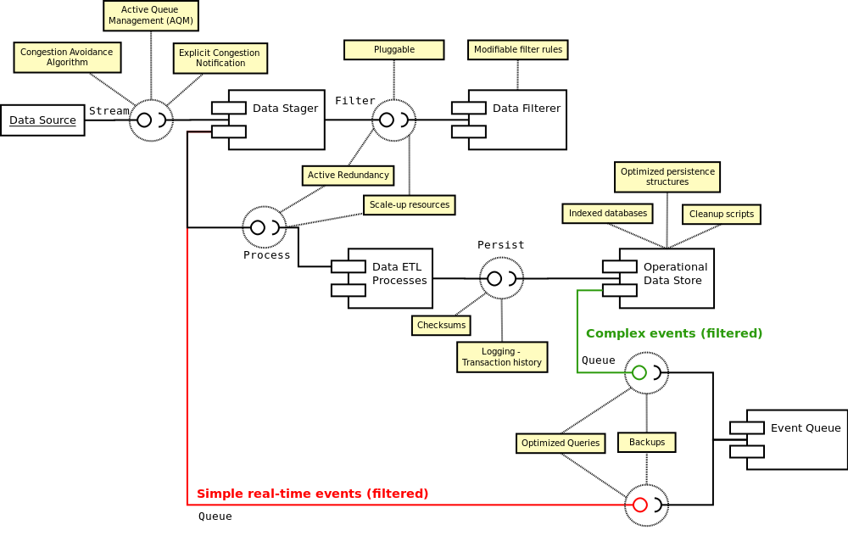

Slide 22
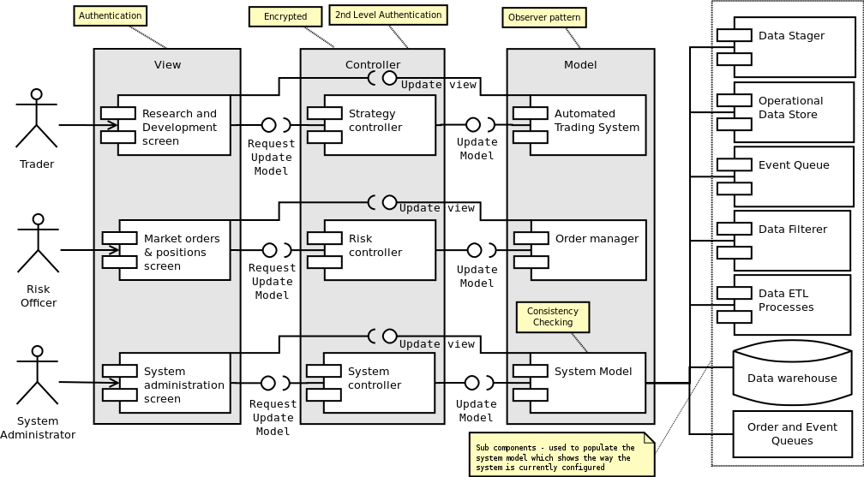

Slide 23
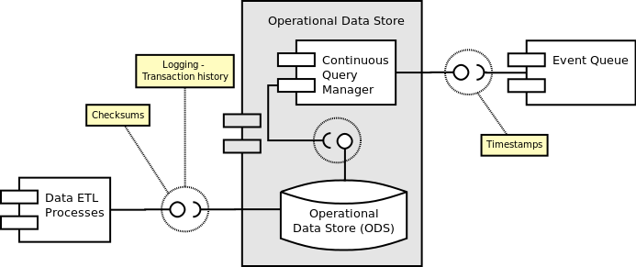

Slide 24
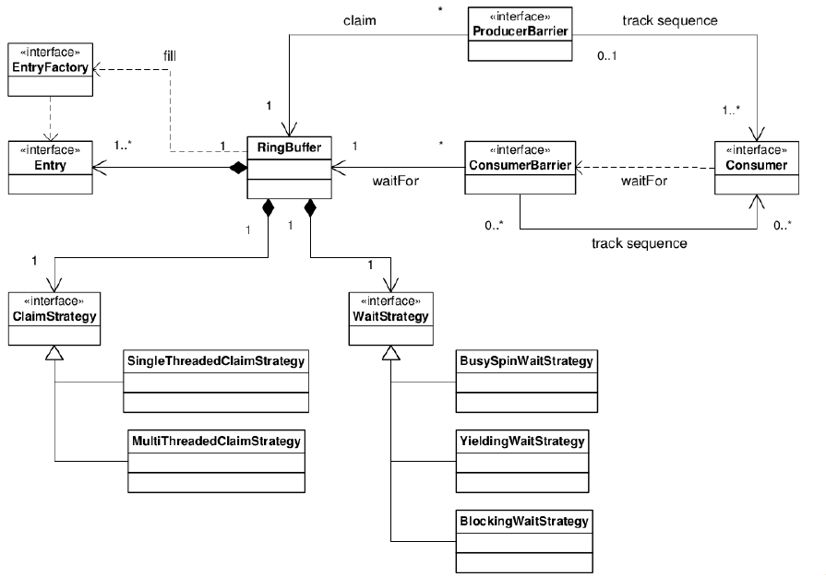

Slide 25
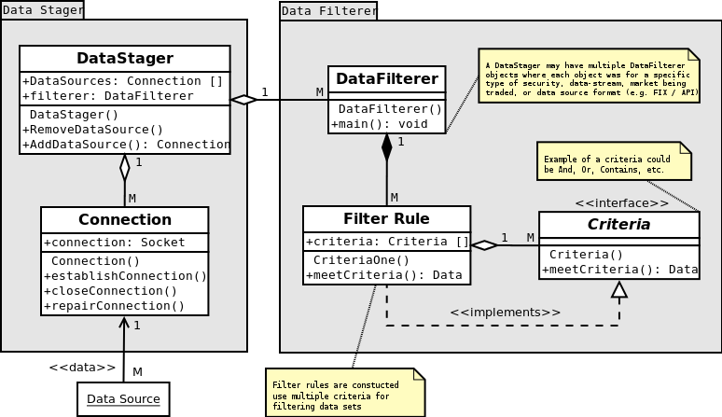

Slide 26
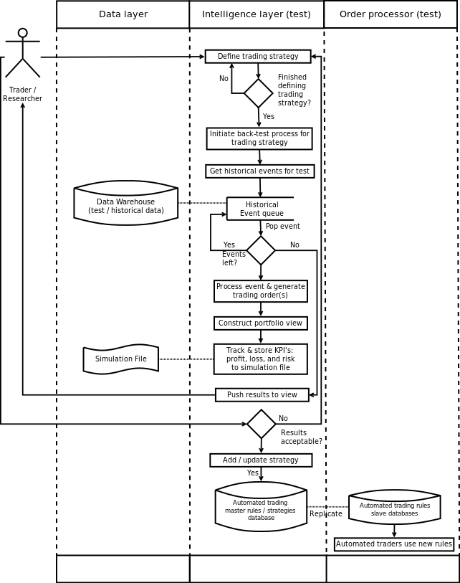

Slide 27
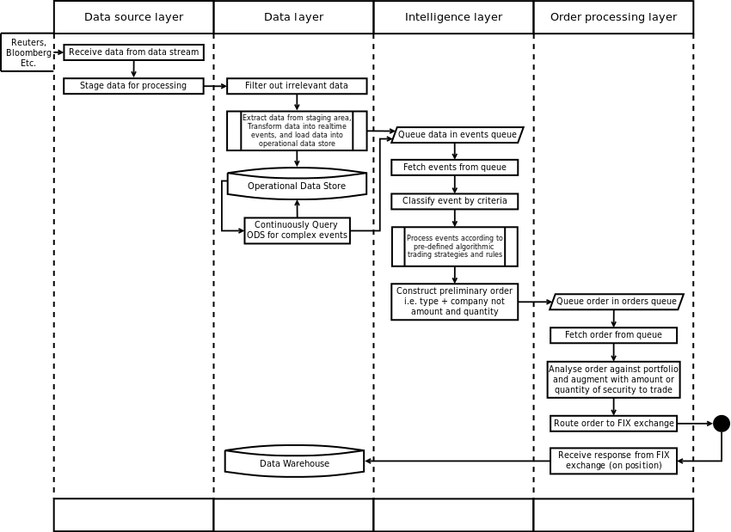

Slide 28
Event data ports
AADL distinguishes between three port categories. Event data ports are ports through which data is sent and received. The arrival of data at the destination may trigger a dispatch or a mode switch. The data may be queued if the destination component is busy. Event data ports effectively represent message ports.

Slide 29
Data ports
Data ports are event data ports with a queue size of one in which the newest arrival is kept. By default arrival of data at data ports does not trigger a dispatch. Data ports effectively represent unqueued ports that communicate state information, such as signal streams that are sampled and processed in control loops.

Slide 30
Event ports
Event ports are event data ports with empty message content. Event ports effectively represent discrete events in the physical environment, such as a button push, in the computing platform, such as a clock interrupt, or a logical discrete event, such as an alarm.

Slide 31
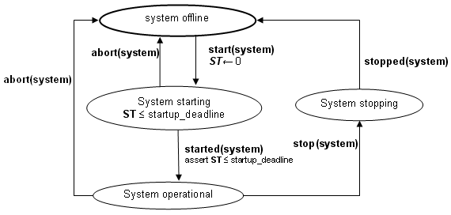
System startup and system shutdown states

Slide 32
2 sources
Clements et al. – book that describes an approach called Views and Beyond
IEEE 1471 adopted standard
Results in a two volume set of documentation. See the reference at the end of the slides to the pedagogical product line and follow the link to see an example two volume set.

Slide 33

Views and Viewpoints

Slide 34
Viewpoint
Presents the information in the architecture from a certain perspective
That is, it emphasizes certain aspects of the architecture over other aspects
Example, the specification viewpoint shows the spec without showing the implementations available

Slide 35
Viewpoint
define the types of elements, the relations among them, the significant properties they exhibit, and the constraints they obey for views conforming to this viewpoint.
The basic structures in an architecture are one source of viewpoints
Module viewpoint – Shows an individual module and information about that module

Slide 36
View
Applies a viewpoint to the architecture for a specific stakeholder
Every stakeholder should have at least one view that speaks to their concerns
The view should put the information into context but not confuse the reader with extraneous material

Slide 37
View
For example, a user interface designer would want a view that shows each module used in the interface from the viewpoint of that module’s definition.

Slide 38
View
Name of view
View description
Primary presentation
List of view packets
Element catalog
Context diagram
Variability mechanisms
Architecture background

Slide 39
View Packet
Primary Presentation
Element Catalog
Properties of the elements
Relations and their properties
Element interfaces
Element behavior
Context Diagram
Variation Guide
Architecture Background
Rationale. Analysis results. Assumptions.
Other Information
Related View Packets

Slide 40
Example
Module Decomposition View
In this section, we describe the basic structure of an AGM game. Game variations are addressed by substitution, parameterization, and specialization. Game-specific behaviors are provided by game-specific implementations of the interfaces in this document.
Module Decomposition View Packet 1: Game
The previous figure shows the Game component as the representation for the generic product. The following figure shows that component's interface as the top-level interface of the system (defined in the GameBoard Interface section) and the other major interfaces that are at the first level of decomposition within the GameInterface (defined later in this document).

Slide 41
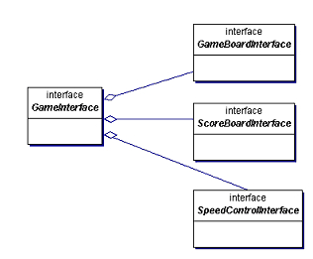
Primary presentation

Slide 42
Element Catalog Elements and their properties. The following table displays element details.
Relations and their properties. The primary relation is composition. Game is
responsible for creating, managing, and killing the elements it composes.
Elements and Responsibilities for Model Decomposition View Packet 1: Game
Element | Responsibilities
GameBoard interface | This container component holds all the elements needed for the game.
ScoreBoard interface | This interface keeps and presents the score as the game specifies. It is defined in the ScoreBoard Interface section.
SpeedControl interface | This interface controls how often a tick is issued to the GameBoard. It is defined in the SpeedControl Interface section.

Slide 43
Relations and their properties. The primary relation is composition. Game is responsible for creating, managing, and killing the elements it composes.
Element interfaces. Game interface is the program's GUI. It provides the user with Game start, stop, pause, and save behaviors. The other interfaces are documented as follows:
GameBoard
SpeedControl
ScoreBoard
Element behavior. The behavior is the game that is displayed to the user.
Context Diagram Game is the top level of the product and the top-level context.
Variation Guide Game and ScoreBoard will each be replaced by a game-specific implementation as described in the Module Generalization View section.

Slide 44
Variation Guide Game and ScoreBoard will each be replaced by a game-specific implementation as described in the Module Generalization View section.
Architecture Background Game encapsulates game-specific behavior. It arranges the GameBoard, keeps score, and determines the won/lost status based on its rules. The composed elements are mostly generic and can be reused and rearranged to implement other games.
Other Information No other information applies.
Related View Packets
Module Generalization View Packet 1: Game
ScoreBoard Interface

Slide 45
Next steps
Read http://www.sei.cmu.edu/library/abstracts/reports/05tn017.cfm
Select the “download the template” link on:
http://www.sei.cmu.edu/architecture/tools/viewsandbeyond/
Create a first edition of documentation for your architecture.
Here is example documentation for the pedagogical product line architecture: http://www.sei.cmu.edu/productlines/ppl/arch_docs.html

