Slide 1

CpSc 875
John D. McGregor
C 12 – Security/ATAM

Slide 2
Microkernel pattern http://viralpatel.net/blogs/microkernel-architecture-pattern-apply-software-systems/

Slide 3
Attack surface of a product
https://www.owasp.org/index.php/Attack_Surface_Analysis_Cheat_Sheet
http://reports-archive.adm.cs.cmu.edu/anon/isr2011/CMU-ISR-11-121.pdf

Slide 4
Attack Surface Metric
Damage-Effort Ratio (DER)
An attacker will choose the target that can cause the most damage for the least effort
The access rights determine how hard it is to access the elements that will be compromised
M₁
M₂
A
D
B
E
C
F

Slide 5
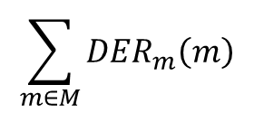
ChannelConnectors
Connector Type ChannelT = {
Property channelAccessRights : int;
Property channelProtocol : int;
}
Larger protocol values indicate larger chunks of data that can be passed making it easier to move programs
protocols
------------------
access rights
$$\sum_{m∈M}{{DER}_{m}\left(m\right)}$$

Slide 6

Port Type EntryExitPointT = {
Property entryExitPointPrivileges : int;
Property entryExitPointAccessRights : int;
}
Level of privileges determines the damage that can be done
Privileges
-------------------
Access rights
$$\sum_{c∈C}{{DER}_{c}\left(c\right)}$$

Slide 7
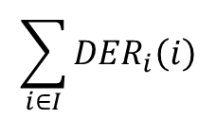
Component Type DataItemT = {
Property dataItemType : int;
Property dataItemAccessRights : int;
}
The less restrictive the data types are the easier it is for attackers to enter.
Data types
------------------
Access rights
$$\sum_{i∈I}{{DER}_{i}\left(i\right)}$$

Slide 8
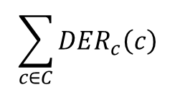
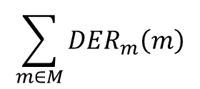
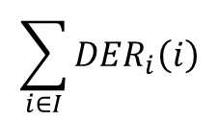
Complete Attack Surface
$$\sum_{m∈M}{{DER}_{m}\left(m\right)}$$
$$\sum_{c∈C}{{DER}_{c}\left(c\right)}$$
$$\sum_{i∈I}{{DER}_{i}\left(i\right)}$$
A transform is evaluated to determine its effect on the attack surface
Would using a feature group reduce the port vulnerability?
Would using a record to group data fields together make an attack easier/

Slide 9
Sanitize Data at Entry/Exit Points
this transformation requires the architect to insert a component between an entry/exit point and the environment
Ports that previously served as entry/exit points should be moved to the sanitizer
have their privileges reduced by an order of magnitude to reflect the sanitizing function

Slide 10
Favor
Restricted Channels
Limiting the type of data transmitted over a channel can reduce the attack surface of the system by lessening the advantage gained by exploiting that channel
The protocol value should be lowered to reflect the more restrictive nature of the new protocol

Slide 11
Move Data Items to the Interior
Moving data items to the interior of a system shifts untrusted data items away from the system’s perimeter
Data items that cannot be moved to the interior of the system should be evaluated to determine if they are necessary and be eliminated if they are not

Slide 12
Design to a Single Point of Access
Introduction of a gatekeeper component to serve as a unified point of access
Combining entry/exit points that share the same privileges and access rights reduces the number of entry/exit points by reducing the number of externally-facing interfaces in the system.

Slide 13
Attack surface properties in AADL
property set securityProperties is
Channel_Protocol : aadlinteger applies to (connection);
Channel_AccessRights: aadlinteger applies to (connection);
entryExitPointPrivileges: aadlinteger applies to (port);
entryExitPointAccessRights:aadlinteger applies to (port);
dataItemType:aadlinteger applies to (data);
dataItemAccessRights:aadlinteger applies to (data);
end securityProperties;

Slide 14
Architecture adds value
Value is a synonym for desirableness
If the value of something increases it is because it has become more desirable for some reason
A “value chain” represents a sequence of stages, each of which makes the “thing”, for which this is the value chain, more desirable.
The value chain for a software product is the series of activities that craft a solution.

Slide 15
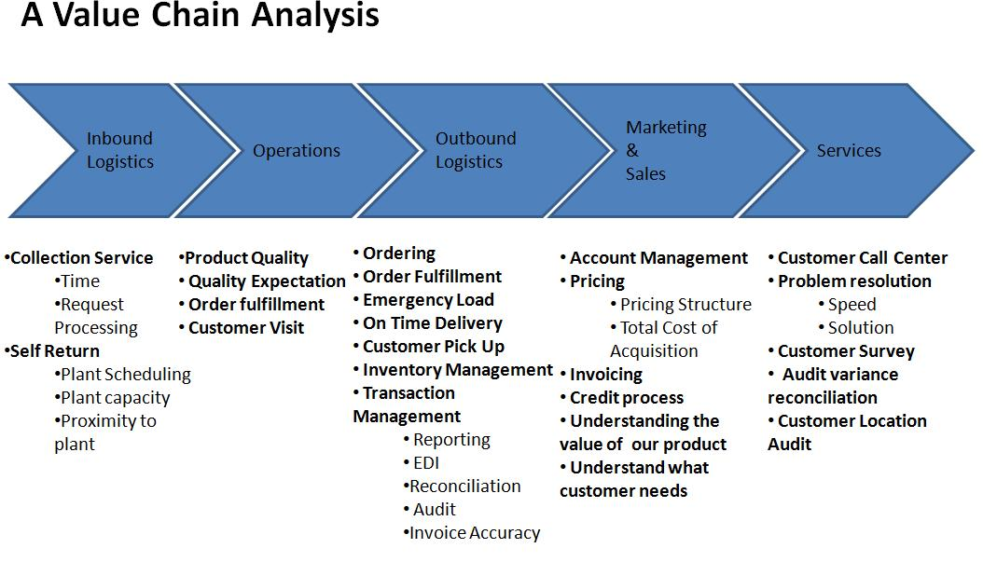
Porter’s Value Chain

Slide 16
Adding value
How does architecture add value? (How does it make the product more desirable?)
  Increased probability that customers like the product
  Increased probability of highly reliable operation
  Increased probability that the product will have the qualities desired
  Increased predictability of implementation

Slide 17
Adding value - 2
Even architecture evaluation adds value
It removes defects making the architecture more desirable as a basis for building a product
Question: How do we measure these increases in value?

Slide 18
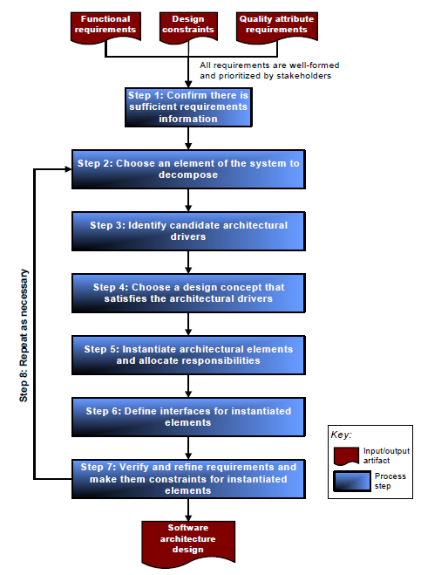
Where are we?

Slide 19
Architecture TradeOff Analysis Method (ATAM)
The purpose of the ATAM is to assess the consequences of architectural decisions in light of quality attribute requirements.
http://www.sei.cmu.edu/reports/00tr004.pdf

Slide 20
Conceptual Flow of ATAM
Business
Drivers
Quality
Attributes
Scenarios
Analysis
Software
Architecture
Architectural
Approaches
Architectural
Decisions
Tradeoffs
impacts
Sensitivity Points
distilled
into
Non-Risks
Risk Themes
Risks

Slide 21
Phase 0
  Partnership and preparation
Phase 1
  Evaluation
Phase 2
  Evaluation continued
Phase 3
  Follow-up

Slide 22
Phase 0
Logistics are agreed to
  Meeting dates
  Who must attend
  Team membership
Agenda is agreed to
Collect initial information

Slide 23
Overview of Phase 1
Step 1
  Present the ATAM
Step 2
  Present business drivers
Step 3
  Present architecture
Step 4
  Identify architectural approaches
Step 5
  Generate quality attribute utility tree
Step 6
  Analyse architectural approaches

Slide 24
Step 1 – Present the ATAM Process
The ATAM evaluators set expectations
Give an outline of the steps
Normal meeting management activities

Slide 25
Step 2 - Present Business Drivers
Describe
  The system’s most important functions
  Any relevant technical, managerial, economic, or political constraints
  The business goals and context as they relate to the project
  The major stakeholders
  The architectural drivers (the major quality attribute goals)

Slide 26
Step 3 - Present Architecture
Driving architectural requirements, measurable quantities associated with these, standards/models/approaches for meeting these
Important architectural information
  Context diagram
  Module or layer view
  Component and connector view
  Deployment view

Slide 27
Present Architecture - 2
Architectural approaches, patterns, tactics employed, what quality attributes they address and how they address those attributes
Use of COTS and their integration
Most important use case scenarios
Most important change scenarios
Issues/risk w.r.t. meeting the diving requirements

Slide 28
Step 4: identify architectural approaches
Catalog the evident patterns and approaches
  Based on step 3
  Serves as the basis for later analysis

Slide 29
Quality Attribute Scenario
Stimulus
Stimulus source
Environment
Artifact
Response
Response measure

Slide 30
Quality Attribute Scenario
Stimulus – the hand control is moved to make a 2 inch long, 1 inch deep incision
Stimulus source – doctor
Environment – patient and robot have been aligned
Artifact – image in the viewfinder
Response – the view is updates with no flicker
Response measure – the doctor experiences no difficulty seeing the incision as it is made

Slide 31
Step 5: Generate quality attribute utility tree
Utility tree
  Present the quality attribute goals in detail
Quality attribute goals are
  Identified, prioritized, refined
  Expressed as scenarios
Utility is an expression of the overall goodness of the system
  Quality attributes form the second level being components of utility

Slide 32
Step 5: Generate quality attribute utility tree con’t
Scenarios are prioritized
  Depending on how important they are and
  Depending on how difficult it will be for the architecture to satisfy a scenario

Slide 33
Step 5 – Lets draw the tree
(H,M)
Repair in 3 days
Maintenance
(M,L)
Modifiability
Replace function
In 2 days
Extensibility
Utility

Slide 34
Step 6: Analyze architectural approaches
Examine the highest ranked scenarios
The goal is for the evaluation team to be convinced that the approach is appropriate for meeting the attribute-specific requirements
Scenario walkthroughs
Identify and record a set of sensitivity points and tradeoff points, risks and non-risks
  Sensitivity and tradeoff points are candidate risks

Slide 35
Phase 2
Step 7
  Brainstorm and prioritize scenarios
Step 8
  Analyze architectural approaches
Step 9
  Present results

Slide 36
Step 7: Brainstorm and prioritise scenarios
Utility tree shows architects view on the quality attributes
Here the focus is on the other stakeholders view on the quality attributes and scenarios based on these
  Which are the mot meaningful and important scenarios w.r.t. users etc.

Slide 37
Step 8: Analyse architectural approaches
Highest ranked scenarios from step 7 are presented to the architect
  Explain how relevant architectural decisions contribute to realising each one

Slide 38
Step 9: Present results
Outputs:
  The architectural approaches documented
  The set of scenarios and their prioritization from the brainstorming
  The utility tree
  The risks discovered
  The non-risks documented
  The sensitivity points and tradeoff points found

Slide 39
Conceptual Flow of ATAM
Business
Drivers
Quality
Attributes
Scenarios
Analysis
Software
Architecture
Architectural
Approaches
Architectural
Decisions
Tradeoffs
impacts
Sensitivity Points
distilled
into
Non-Risks
Risk Themes
Risks

Slide 40
ATAM with AADL
Tradeoffs made more crisp because we have better data
Sensitivity points can be explored by “jiggling” quality attribute values and observing the degree of change
Risks can be more correctly quantified using the results of safety and risk analyses

